Slide 1

CS4305 · LECTURE 4 · AI TOOLS
LISP and Expert System Shells
The list-processing language of AI, and ready-made expert systems

Slide 2
Recap and Today's Plan
Today we will learn
Last lecture
1
What LISP is and why AI used it
Prolog: facts, rules, queries
Matching and backtracking
Prolog as an expert system
2
Lists and prefix notation
3
Functions, conditions, recursion
4
What an expert system shell is
5
Real shells: CLIPS and others
CS4305 Artificial Intelligence | Lecture 4
2

Slide 3





What is LISP?
LISP = LISt Processing. Created by John McCarthy in 1958 — the same person who named "Artificial Intelligence". It was the main AI language for about 30 years.
Very old, still alive
Everything is a list
Family of dialects
Gave us new ideas
The second-oldest high-level language still used (after FORTRAN).
Both data and programs are written as lists in brackets.
Common Lisp, Scheme, Clojure. The Emacs editor also uses LISP.
Garbage collection, if-then-else and the interactive prompt (REPL) came from LISP.
CS4305 Artificial Intelligence | Lecture 4
3

Slide 4
Everything is an Atom or a List
Together they are called S-expressions (symbolic expressions)
ATOM
LIST
a single thing
things inside brackets
42
3.14
(1 2 3)
(apple mango)
ahmed
"hello"
(+ 2 3)
(a (b c) d)
CS4305 Artificial Intelligence | Lecture 4
4

Slide 5
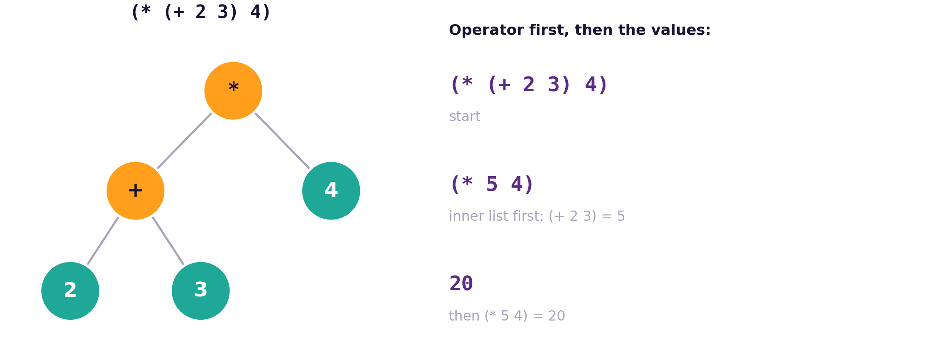

Prefix Notation: The Operator Comes First
Maths | LISP
2 + 3 | (+ 2 3)
(2 + 3) × 4 | (* (+ 2 3) 4)
10 − 4 − 1 | (- 10 4 1)
largest of 7, 21, 3 | (max 7 21 3)
Rule: ( operator value value ... ). LISP always works out the innermost brackets first — just like BODMAS.
CS4305 Artificial Intelligence | Lecture 4
5

Slide 6
The Quote ' : Data or Program?
Without quote: RUN it
With quote: keep it as DATA
(+ 1 2)
→ 3
'(+ 1 2)
→ (+ 1 2)
Why it matters for AI: a program is just a list, so an AI program can build a new list (a new program) and then run it. This is called "code is data".
(defparameter expr '(+ 10 20 30)) ; store a program as data
(car expr) → + ; look inside it
(eval expr) → 60 ; now run it
CS4305 Artificial Intelligence | Lecture 4
6

Slide 7
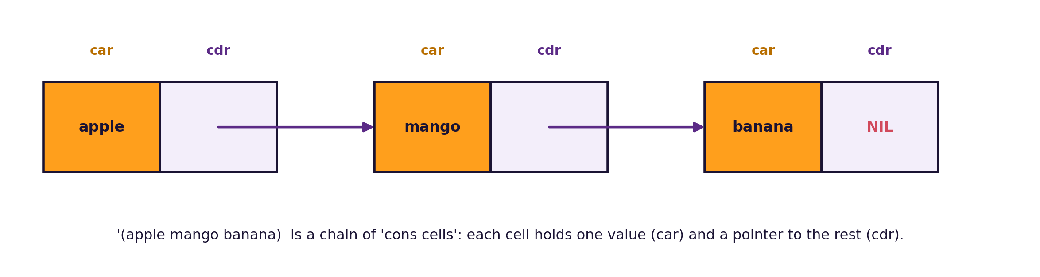
Working with Lists: car, cdr, cons
Function | Meaning | Example | Result
car | first element | (car '(apple mango banana)) | APPLE
cdr | everything except the first | (cdr '(apple mango banana)) | (MANGO BANANA)
cons | add to the front | (cons 'orange '(apple mango)) | (ORANGE APPLE MANGO)
list | make a list | (list 1 2 3) | (1 2 3)
CS4305 Artificial Intelligence | Lecture 4
7

Slide 8
Defining Your Own Functions
(defun
square
(x)
(* x x))
(square 7)
→ 49
keyword
name
inputs
body (the answer)
Two inputs
Variables
(defun average (a b)
(/ (+ a b) 2))
(average 70 90) → 80
(defparameter marks 78)
(setq marks 85) ; change it
marks → 85
CS4305 Artificial Intelligence | Lecture 4
8

Slide 9

Making Decisions: if and cond
if: two choices
cond: many choices
(defun pass-or-fail (marks)
(if (>= marks 50)
"Pass"
"Fail"))
(pass-or-fail 45) → "Fail"
(defun grade (marks)
(cond ((>= marks 85) 'A)
((>= marks 70) 'B)
((>= marks 50) 'C)
(t 'F)))
(grade 78) → B
(if test then else) picks one of two. cond checks tests from top to bottom and stops at the first true one; t means "otherwise".
CS4305 Artificial Intelligence | Lecture 4
9

Slide 10
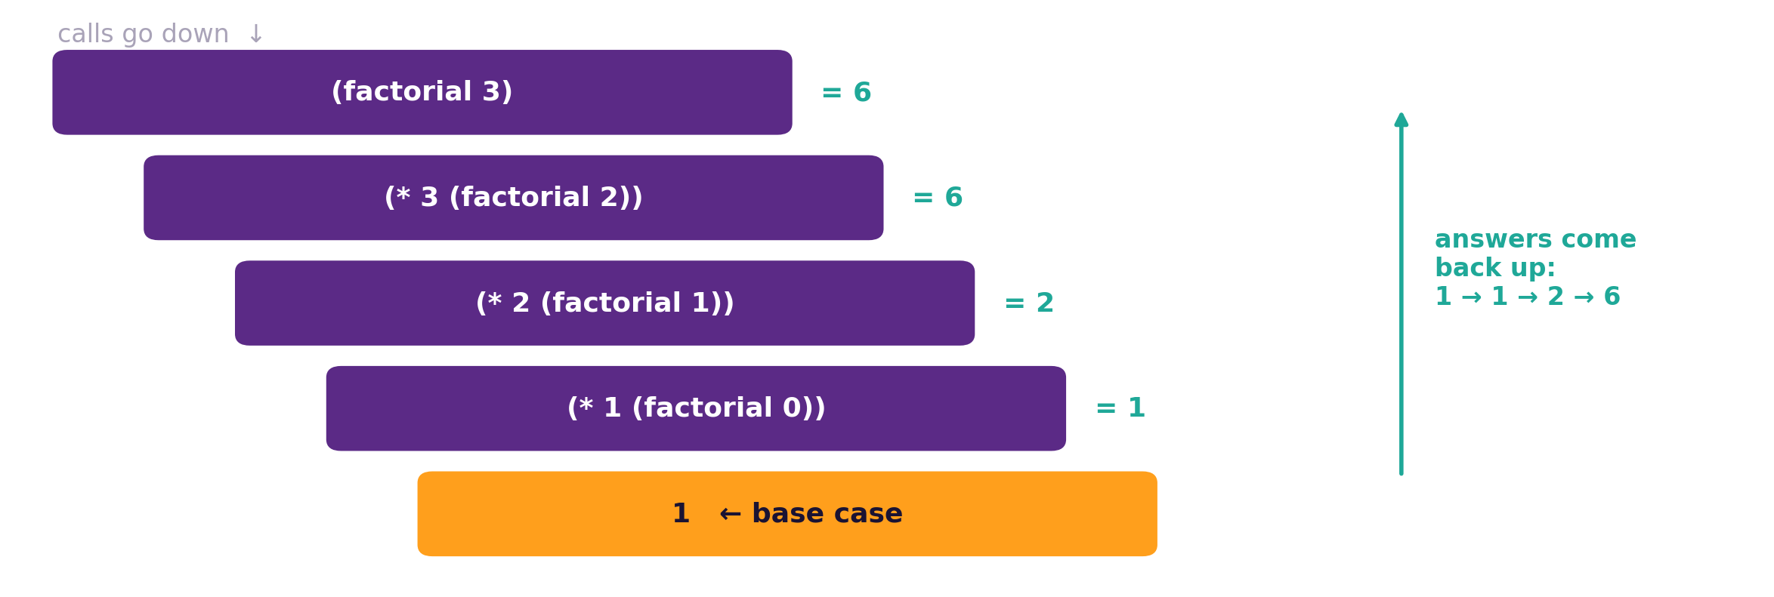
Recursion in LISP
(defun factorial (n)
(if (= n 0)
1
(* n (factorial (- n 1)))))
(factorial 5) → 120
(defun my-length (lst)
(if (null lst) 0
(+ 1 (my-length (cdr lst)))))
Base case stops the recursion. Recursive case makes the problem smaller.
CS4305 Artificial Intelligence | Lecture 4
10

Slide 11


Why Was LISP the Language of AI?
Symbols, not just numbers
Lists are natural
AI works with ideas like (bird can fly). LISP handles symbols easily.
Sentences, rules, trees and plans can all be written as lists.
Code is data
Interactive
Programs can create and change other programs — useful for learning systems.
Type an expression, see the answer immediately (REPL). Great for experiments.
CS4305 Artificial Intelligence | Lecture 4
11

Slide 12
LISP vs Prolog vs Python
 | LISP | Prolog | Python
Style | Functional (functions & lists) | Logic (facts & rules) | Mostly imperative (steps)
Main idea | Everything is a list | Ask questions, get answers | Easy to read, huge libraries
Search built in? | No | Yes (backtracking) | No
Popular for | Classic AI, symbolic reasoning | Expert systems, language rules | Modern AI, machine learning
Example | (+ 2 3) | X is 2 + 3. | x = 2 + 3
CS4305 Artificial Intelligence | Lecture 4
12

Slide 13

PART 2
Expert System Shells
How to build an expert system without writing the engine yourself

Slide 14
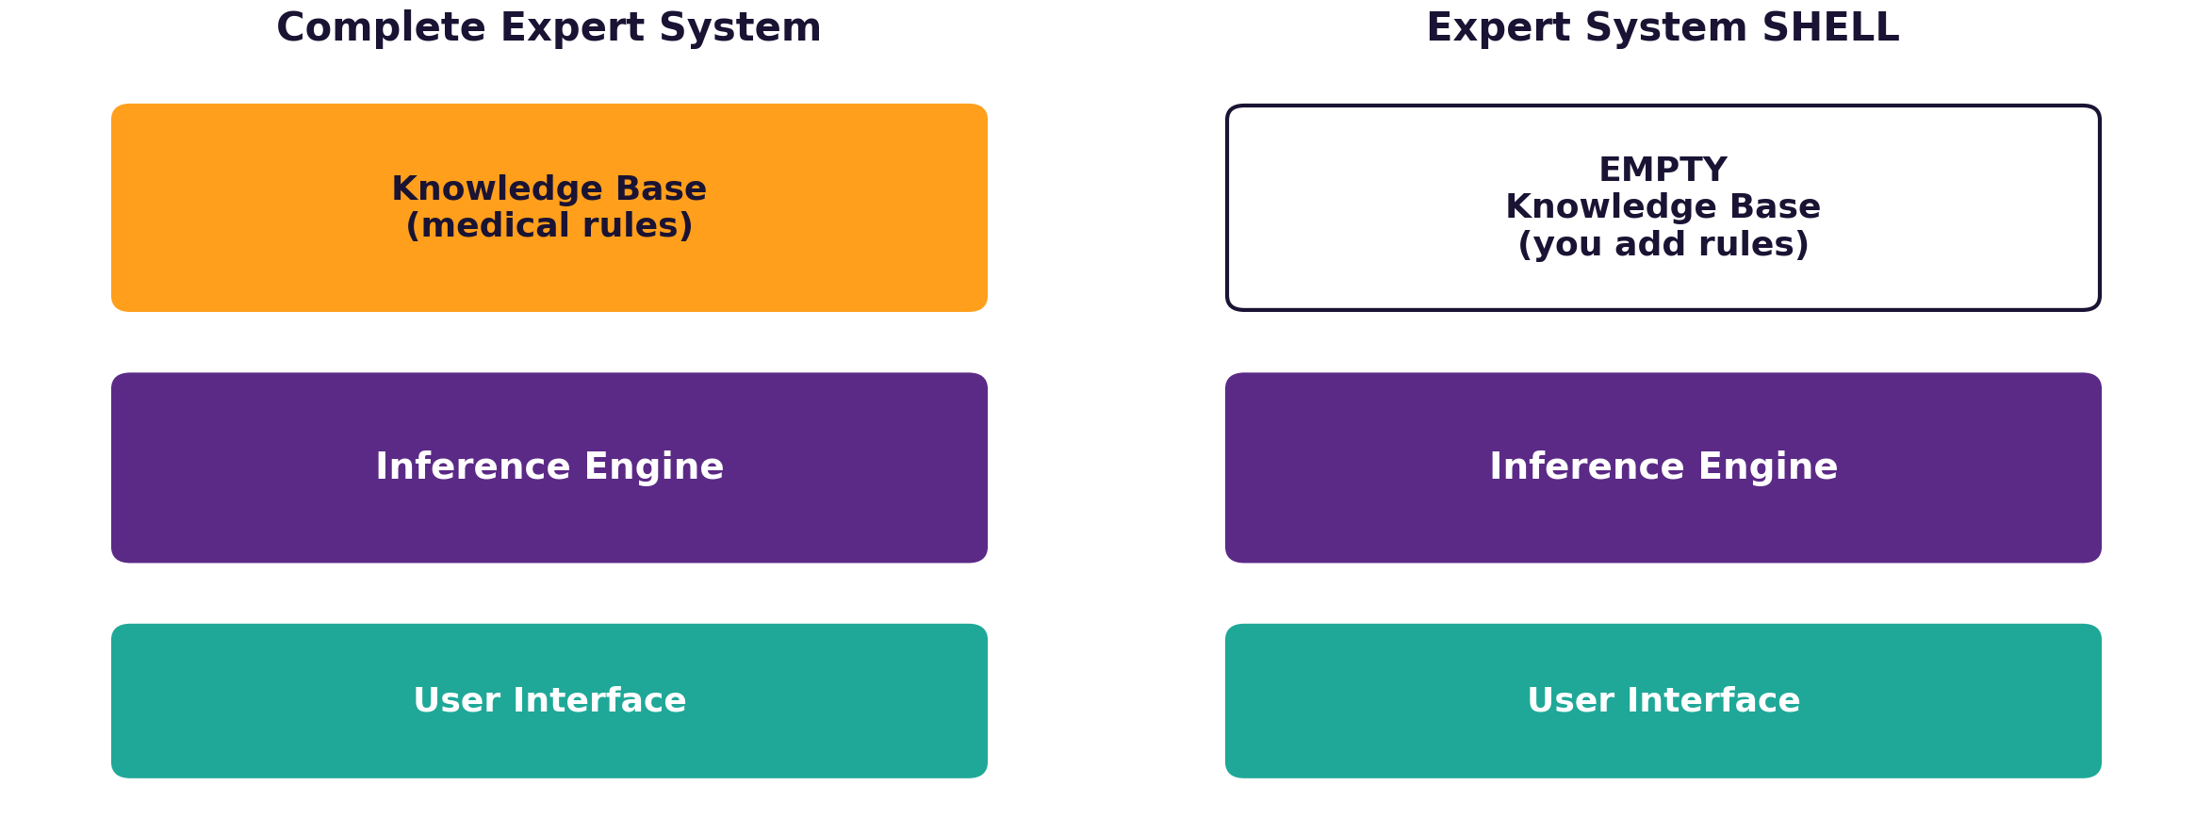


What is an Expert System Shell?
Shell = an expert system with an EMPTY knowledge base. The inference engine and user interface are already built. You only add the rules.
Analogy: a shell is like an empty exam paper template — the format is ready, the teacher only adds the questions.
Expert System = Knowledge Base + Inference Engine + User Interface
CS4305 Artificial Intelligence | Lecture 4
14

Slide 15


Why Use a Shell?
Faster to build
Experts can add rules
Easy to update
One shell, many uses
No need to program the reasoning engine again for every project.
Doctors or engineers write IF-THEN rules, not complex code.
Change a rule without touching the engine.
The same shell can hold medical, car-repair or loan rules.
History: after MYCIN (medical expert system, 1970s) was built, its doctors' rules were removed. The empty engine that remained was called EMYCIN ("Empty MYCIN") — one of the first shells.
CS4305 Artificial Intelligence | Lecture 4
15

Slide 16
Well-Known Expert System Shells
Shell | Made by / year | Notes
EMYCIN | Stanford, 1970s | MYCIN with the medical knowledge removed
CLIPS | NASA, 1985 | Free, fast, still used; we use it in Lab 4 (clipspy)
Jess | Sandia National Labs, 1995 | CLIPS-like shell written in Java
Drools | Red Hat (open source) | Business rules in banking and insurance
e2gLite | eXpertise2Go | Simple shell for building web expert systems
CS4305 Artificial Intelligence | Lecture 4
16

Slide 17

A Rule in CLIPS
CLIPS
Part | Meaning
defrule dengue | start a rule called dengue
(symptom fever) ... | IF these facts are all true
=> | THEN
(assert ...) | add a new fact to memory
(defrule dengue
(symptom fever)
(symptom joint_pain)
(symptom rash)
=>
(assert (diagnosis dengue)))
When we add the facts fever, joint_pain, rash, the CLIPS engine fires this rule automatically and concludes diagnosis dengue.
CS4305 Artificial Intelligence | Lecture 4
17

Slide 18


Building an Expert System with a Shell
1. Choose a small problem
2. Interview the expert
3. Write IF-THEN rules
4. Load rules in the shell
5. Test and improve
Knowledge engineer
Domain expert
Testing
The person who talks to the expert and turns their knowledge into rules.
The doctor, mechanic or teacher who knows the subject.
Try real cases. If an answer is wrong, fix or add a rule.
CS4305 Artificial Intelligence | Lecture 4
18

Slide 19


Practical: Colab Lab 4
Open CS4305_Lab04_LISP_and_Shells.ipynb in Google Colab
Prefix notation
car, cdr, cons
Functions & recursion
Run LISP (SBCL) inside Colab
Play with lists
defun, if, cond, factorial
Code is data
Mini shell in Python
CLIPS
eval and a tiny knowledge base
One engine, two experts
A real NASA shell with rules
In the notebook: each part starts with a 📊 picture that explains the idea, then the 💻 code, then 📝 lab tasks at the end.
CS4305 Artificial Intelligence | Lecture 4
19

Slide 20
Summary
LISP (1958, McCarthy) = LISt Processing; everything is an atom or a list.
Prefix notation: (operator values...), innermost brackets first.
car = first, cdr = rest, cons = add to front; the quote ' keeps a list as data.
defun, if, cond and recursion are the main tools for writing LISP programs.
Shell = expert system with an empty knowledge base; experts only add rules.
Examples: EMYCIN, CLIPS (NASA), Jess, Drools.
CS4305 Artificial Intelligence | Lecture 4
20

Slide 21
Review Questions
What does LISP stand for? Who created it and when?
Differentiate between an atom and a list with two examples of each.
Convert to LISP: (a) (8 − 3) × 2 (b) average of 4, 6 and 8.
Find the result: (car (cdr '(red green blue))) and (cons 'a '(b c)).
Write a LISP function (is-even n) using if.
Why was LISP popular for AI? Give three reasons.
What is an expert system shell? How is it different from a complete expert system?
Write one CLIPS rule for 'if the engine won't start and the lights are dim, the battery is weak'.
CS4305 Artificial Intelligence | Lecture 4
21

Slide 22

NEXT LECTURE
Problem Solving as Search
States, actions, goals — and how a computer explores them

