Slide 1

CS4305 · LECTURE 5 · TECHNIQUES: SEARCHING
Problem Solving as Search
States, actions, goals — and how a computer explores them

Slide 2
Recap and Today's Plan
Today we will learn
Last lecture
1
How an agent solves a problem
Prolog and LISP: classic AI tools
Expert system shells
Prolog finds answers by searching
2
The 5 parts of a problem
3
Examples: route, 8-puzzle, water jug
4
From state space to search tree
5
How to judge a search algorithm
CS4305 Artificial Intelligence | Lecture 5
2

Slide 3

You Already Solve Problems by Searching
Example: you are in Peshawar and must reach Multan. You think about the roads you could take, compare them, choose a route, and then drive.
A problem-solving agent does the same 4 steps:
1. Set the GOAL
"reach Multan"
2. Describe the PROBLEM
states & actions
3. SEARCH
find a sequence of actions
4. EXECUTE
follow the plan
Search = trying out different sequences of actions (in the computer's memory) to find one that reaches the goal.
CS4305 Artificial Intelligence | Lecture 5
3

Slide 4






The 5 Parts of Every Search Problem
1. Initial state
2. Actions
3. Result (transition)
Where we start.
e.g. in Peshawar
What we can do in a state.
e.g. drive to a neighbouring city
Where an action takes us.
e.g. drive to Kohat → now in Kohat
4. Goal test
5. Path cost
Solution
Have we reached the goal?
e.g. are we in Multan?
How expensive a path is.
e.g. total kilometres
A sequence of actions from the initial state to a goal. The cheapest one is the optimal solution.
CS4305 Artificial Intelligence | Lecture 5
4

Slide 5
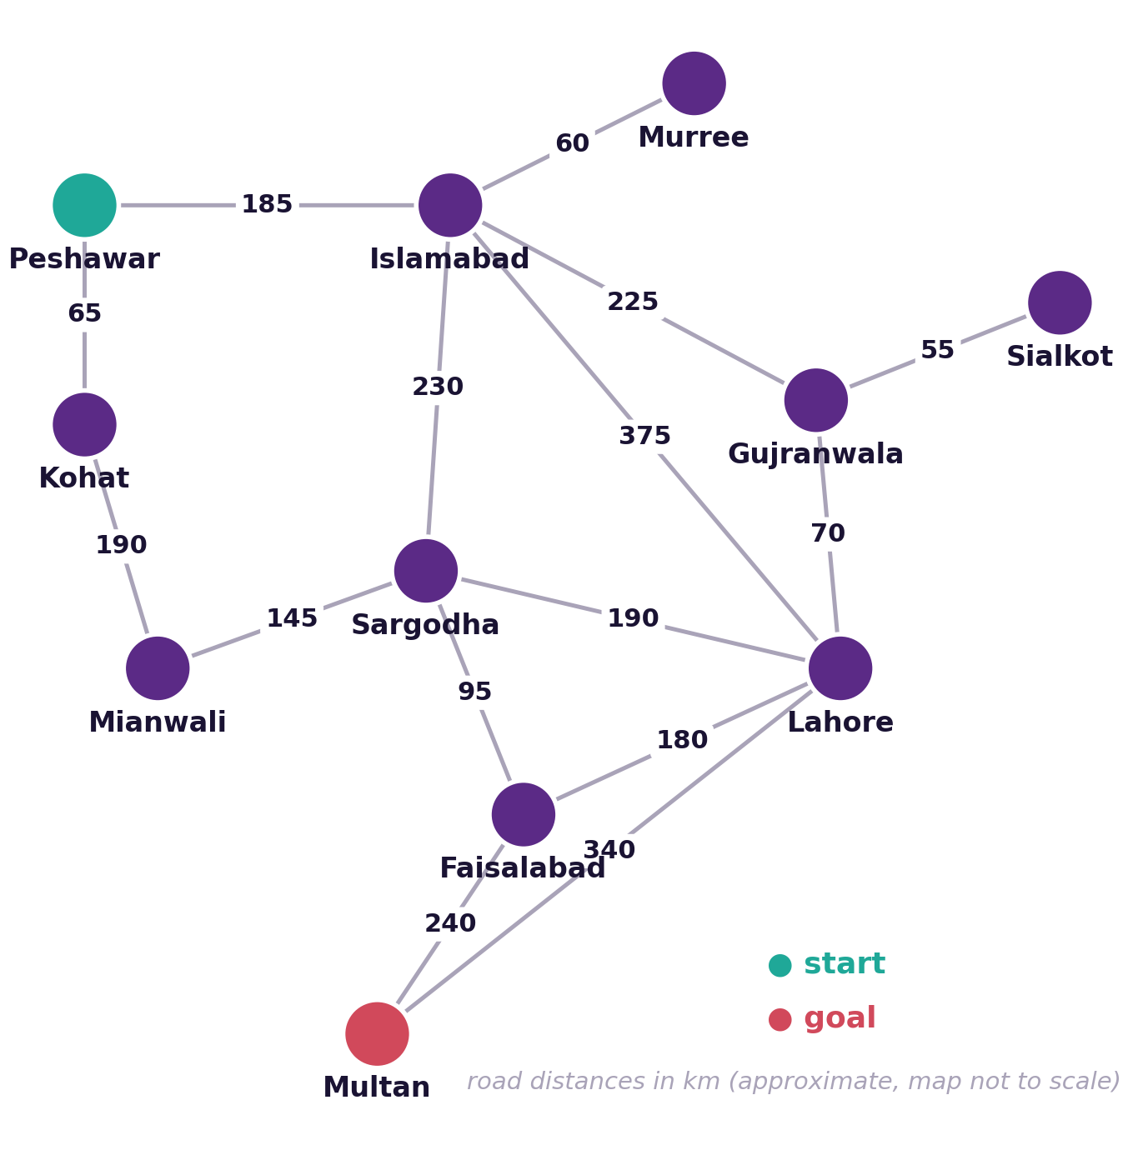

Example 1: Route Finding
Part | Route problem
Initial state | Peshawar
Actions | take a road to a neighbour
Result | arrive in that city
Goal test | city = Multan?
Path cost | sum of road km
Three possible routes cost 900, 750 and 735 km. Which is optimal?
CS4305 Artificial Intelligence | Lecture 5
5

Slide 6

The State Space
State space = all the states you can reach from the initial state, and the actions that connect them. We draw it as a graph: circles = states, lines = actions.
Word | Meaning | In the route problem
State | one situation of the world | being in Lahore
State space | all reachable states | all 11 cities
Path | a sequence of states | Peshawar → Islamabad → Lahore
Solution | a path that reaches the goal | any path ending in Multan
Optimal solution | the solution with lowest cost | the 735 km route
CS4305 Artificial Intelligence | Lecture 5
6

Slide 7
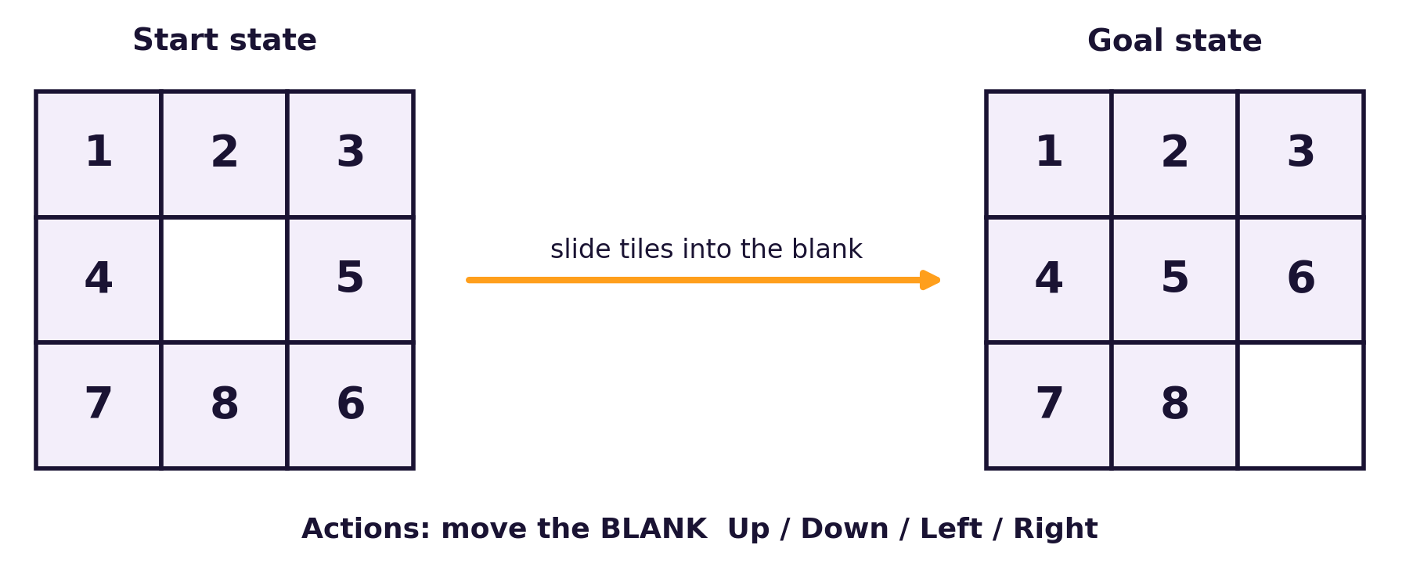


Example 2: The 8-Puzzle
Part | 8-puzzle
State | position of the 8 tiles
Actions | move blank Up / Down / Left / Right
Goal test | matches the goal picture?
Path cost | 1 per move
9! = 362,880 arrangements
Bigger versions
Half of them can be reached from any start state.
15-puzzle: about 10 trillion states — too many to try one by one.
CS4305 Artificial Intelligence | Lecture 5
7

Slide 8

Example 3: The Water Jug Problem
You have a 4-litre jug and a 3-litre jug with no markings, and a tap. How can you get exactly 2 litres in the 4-litre jug?
State (x, y): x = litres in 4L jug, y = litres in 3L jug. Start: (0, 0) Goal: (2, any)
# | Rule (action) | Before | After
1 | Fill the 4L jug | (x, y), x < 4 | (4, y)
2 | Fill the 3L jug | (x, y), y < 3 | (x, 3)
3 | Empty the 4L jug | (x, y), x > 0 | (0, y)
4 | Empty the 3L jug | (x, y), y > 0 | (x, 0)
5 | Pour 3L into 4L until 4L is full or 3L is empty | (x, y), y > 0 | (min(4, x+y), leftover)
6 | Pour 4L into 3L until 3L is full or 4L is empty | (x, y), x > 0 | (leftover, min(3, x+y))
CS4305 Artificial Intelligence | Lecture 5
8

Slide 9
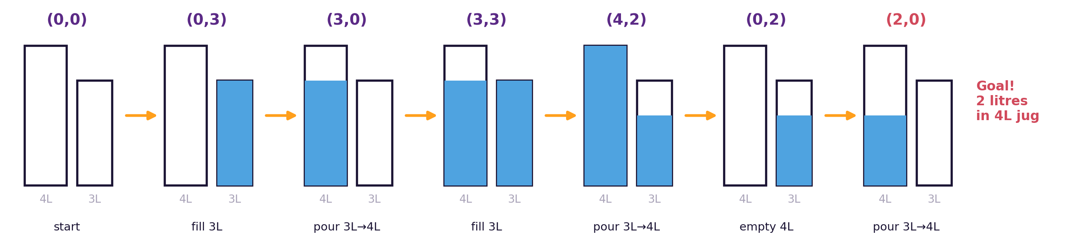

Water Jug: One Solution (6 steps)
Each picture is one state. Each arrow is one action.
Only 14 states can be reached. The computer can try them systematically — that is search. Lab 5 finds this solution automatically.
CS4305 Artificial Intelligence | Lecture 5
9

Slide 10

Toy Problems vs Real-World Problems
Toy problems
Real-world problems
Small and exact — perfect for learning and comparing algorithms.
Large and messy — people actually care about the answer.
8-puzzle and 15-puzzle
Water jug problem
8-queens (place 8 queens safely)
Vacuum-cleaner world
Missionaries and cannibals
Route finding (Google Maps)
University timetabling
Robot navigation
Airline travel planning
Designing computer chips (VLSI layout)
CS4305 Artificial Intelligence | Lecture 5
10

Slide 11
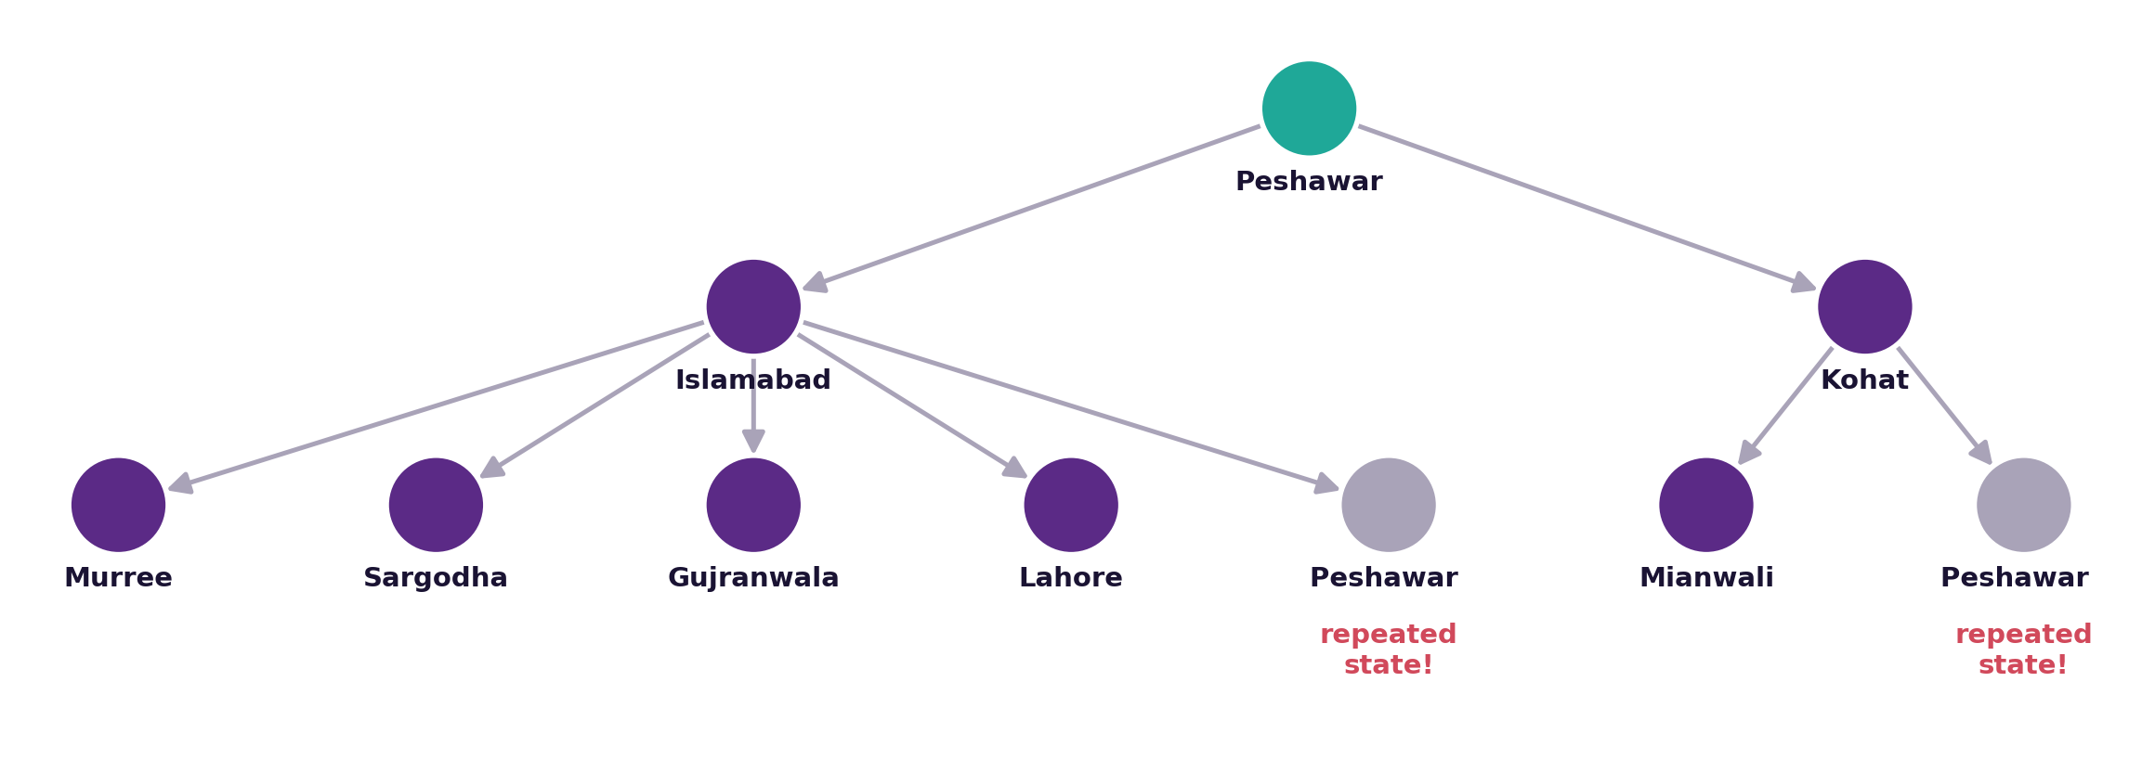


From State Space to Search Tree
Expanding
Repeated states
Creating the children of a node by applying every action.
Grey nodes: going back to Peshawar wastes time. Keep an explored list.
CS4305 Artificial Intelligence | Lecture 5
11

Slide 12
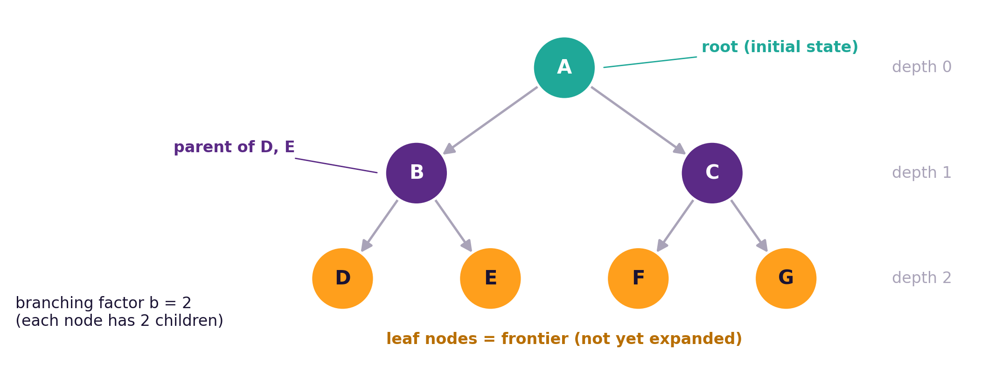
Search Tree Vocabulary
Term | Meaning
Root | the initial state
Frontier (open list) | nodes waiting to be expanded
Explored (closed list) | nodes already expanded
Depth | number of steps from the root
b | branching factor: children per node
d | depth of the shallowest goal
CS4305 Artificial Intelligence | Lecture 5
12

Slide 13
The General Search Algorithm
Put the initial state in the FRONTIER
The key question
Which node do we take out of the frontier next?
That single choice is the ONLY difference between BFS, DFS, UCS, Greedy and A*.
Frontier empty?
yes
FAIL: no solution
loop
Take one node out of the frontier
EXPAND it: add its children to the frontier
no
Is it the goal?
yes
SUCCESS: return the path
CS4305 Artificial Intelligence | Lecture 5
13

Slide 14


How Do We Judge a Search Algorithm?
Completeness
Optimality
Time complexity
Space complexity
If a solution exists, is it guaranteed to find one?
Does it find the cheapest (best) solution?
How long does it take? (number of nodes generated)
How much memory does it need? (nodes stored at once)
Symbol | b | d | m
Meaning | branching factor (children per node) | depth of the shallowest goal | maximum depth of the tree
CS4305 Artificial Intelligence | Lecture 5
14

Slide 15
Why We Need Clever Search: The Explosion
A tree with b = 10 has 10^d nodes at depth d
Depth d | Nodes (b = 10) | Time at 1 million nodes/second
2 | 100 | 0.0001 seconds
4 | 10,000 | 0.01 seconds
6 | 1,000,000 | 1 second
8 | 100,000,000 | under 2 minutes
10 | 10,000,000,000 | about 3 hours
12 | 1,000,000,000,000 | about 12 days
Lesson: trying everything becomes impossible very quickly. Good algorithms decide cleverly which nodes to explore first.
Next two lectures: blind search (no hints) and knowledge-directed search (uses hints called heuristics).
CS4305 Artificial Intelligence | Lecture 5
15

Slide 16

Practical: Colab Lab 5
Open CS4305_Lab05_Problem_Solving_as_Search.ipynb in Google Colab
Road map in Python
The 5 parts
Growing a tree
Cities and roads as a dictionary
Actions, result, goal test, path cost
See it explode and repeat states
Water jug
8-puzzle
Lab tasks
Rules, state space and a solution
States, moves and solving
Add cities, new goals, new problems
In the notebook: each part starts with a 📊 picture that explains the idea, then the 💻 code, then 📝 lab tasks at the end.
CS4305 Artificial Intelligence | Lecture 5
16

Slide 17
Summary
Problem-solving agent: goal → problem → search → execute.
5 parts: initial state, actions, result, goal test, path cost.
State space = all reachable states; a solution is a path to a goal; optimal = cheapest.
Examples: route finding, 8-puzzle, water jug (toy) and timetabling, robots (real).
Search tree: root, frontier (open list), explored (closed list), depth, b and d.
Judge algorithms by completeness, optimality, time and space.
CS4305 Artificial Intelligence | Lecture 5
17

Slide 18
Review Questions
List the 4 steps of a problem-solving agent.
Write the 5 parts of the problem for the 8-puzzle.
Solve the water jug problem by hand and show each state (x, y).
Differentiate between state space and search tree.
Define frontier, explored list, branching factor and depth.
Explain completeness, optimality, time and space complexity.
Give two toy problems and two real-world search problems.
CS4305 Artificial Intelligence | Lecture 5
18

Slide 19

NEXT LECTURE
Blind (Uninformed) Search
BFS · DFS · Uniform-Cost · Depth-Limited · Iterative Deepening · Bidirectional

