Slide 1

CS4305 · LECTURE 6 · TECHNIQUES: SEARCHING
Blind (Uninformed) Search
Searching when you have no idea where the goal is

Slide 2
Recap and Today's Plan
Today we will learn
Last lecture
1
What "blind" search means
The 5 parts of a problem
State space and search tree
Frontier and explored list
Completeness, optimality, time, space
2
Breadth-First Search (BFS)
3
Depth-First Search (DFS)
4
Uniform-Cost Search (UCS)
5
Depth-limited, iterative deepening, bidirectional
CS4305 Artificial Intelligence | Lecture 6
2

Slide 3


What Does "Blind" Mean?
Blind (uninformed) search knows only the problem definition: the actions and how to recognise the goal. It has NO hint about which direction is closer to the goal.
Analogy: lost keys in a dark house
Six blind strategies
Breadth-First (BFS)
Depth-First (DFS)
Uniform-Cost (UCS)
Depth-Limited (DLS)
Iterative Deepening (IDDFS)
Bidirectional
You can't see where the keys are.
Plan A: check every room on the ground floor, then every room upstairs (that is BFS).
Plan B: go into one room, search every cupboard deeply, then move to the next (that is DFS).
Both will find the keys — they only differ in the ORDER of searching.
CS4305 Artificial Intelligence | Lecture 6
3

Slide 4
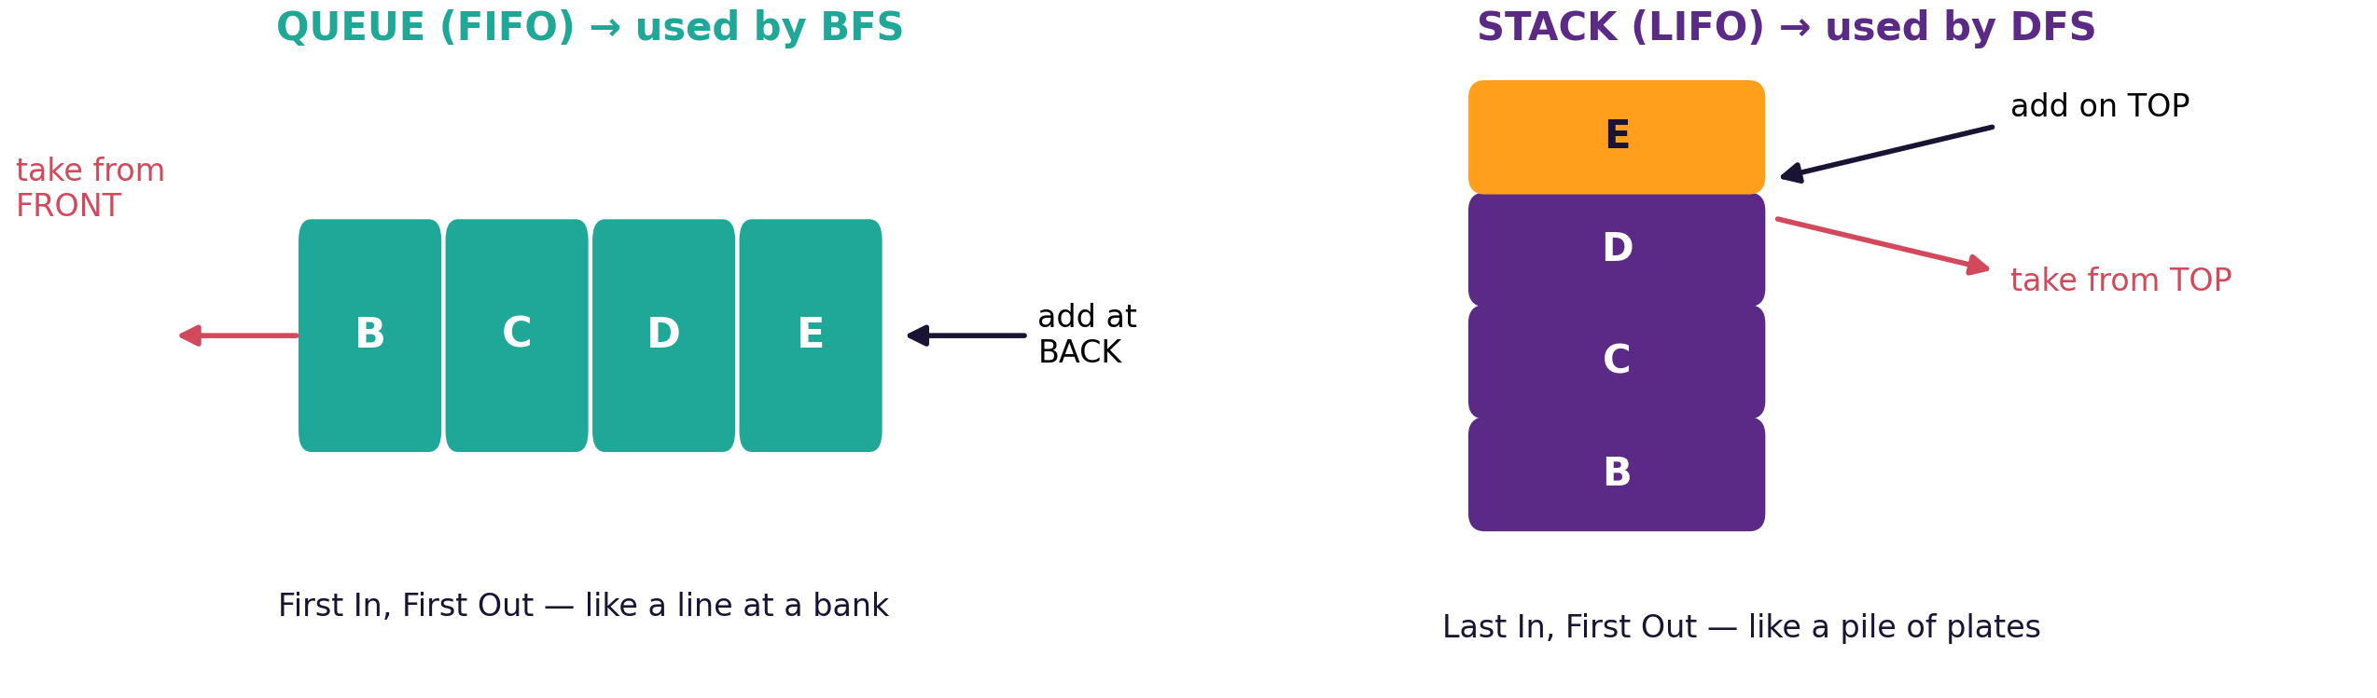
The One Difference: Which Node Comes Out Next?
The frontier is a list of nodes waiting to be expanded
Algorithm | BFS | DFS | UCS
Frontier type | Queue (FIFO) | Stack (LIFO) | Priority queue (cheapest first)
CS4305 Artificial Intelligence | Lecture 6
4

Slide 5
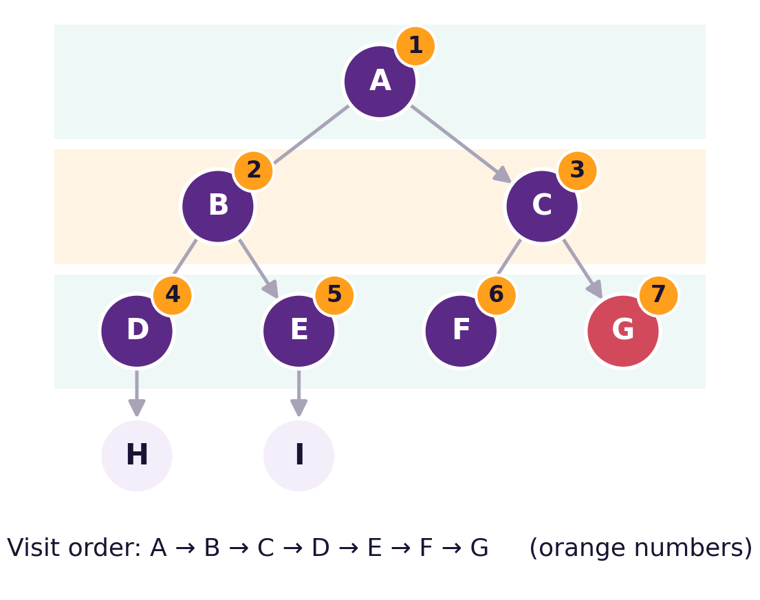


Our Example Tree
Start at A. Goal = G. We will run every algorithm on this same tree.
The orange numbers show the order in which BFS visits the nodes. Before looking, try to guess the DFS order yourself!
Tip: in all examples we check for the goal when a node is taken OUT of the frontier.
CS4305 Artificial Intelligence | Lecture 6
5

Slide 6

Breadth-First Search (BFS)
Idea: expand ALL nodes at depth 1, then ALL at depth 2, and so on — like ripples spreading in water. Uses a QUEUE: the oldest node is expanded first.
Step | Take out | Queue after adding children
1 | A | B, C
2 | B | C, D, E
3 | C | D, E, F, G
4 | D | E, F, G, H
5 | E | F, G, H, I
6 | F | G, H, I
7 | G ✓ goal | path: A → C → G
Python idea
queue = [start]
while queue:
node = queue.pop(0) # FRONT
if node == goal: done
queue += children(node) # BACK
New children always join at the BACK of the queue.
CS4305 Artificial Intelligence | Lecture 6
6

Slide 7





BFS: Good and Bad Points
Complete: YES
Optimal: YES*
Time: O(b^d)
Space: O(b^d)
It will always find a solution if one exists (finite b).
Finds the path with the FEWEST steps. *Best only if every step costs the same.
It looks at every node up to the goal depth.
Must remember the whole level — its biggest problem.
On our map: BFS found Peshawar → Islamabad → Lahore → Multan: only 3 roads, but 900 km. Fewest steps is not the same as fewest kilometres!
CS4305 Artificial Intelligence | Lecture 6
7

Slide 8
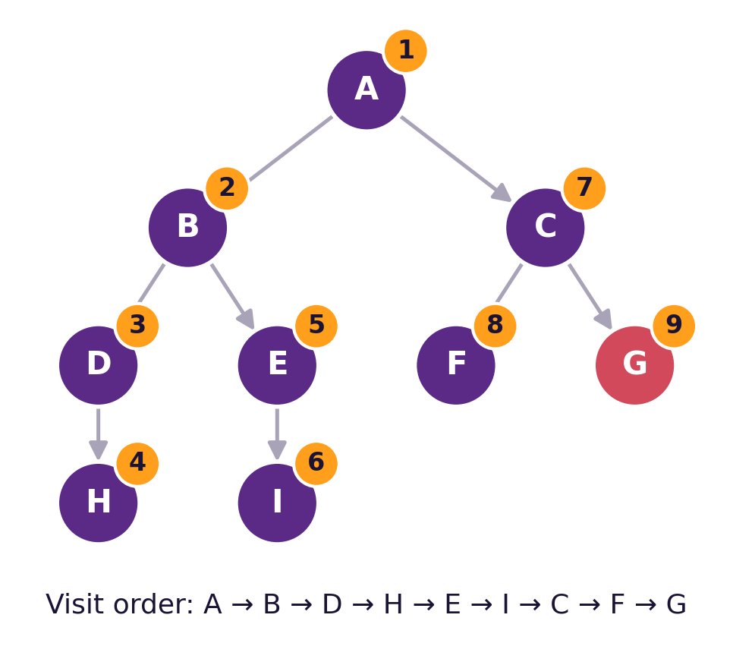

Depth-First Search (DFS)
Step | Take out | Stack (top on right)
1 | A | C, B
2 | B | C, E, D
3 | D | C, E, H
4 | H | C, E
5 | E | C, I
6 | I | C
7 | C | G, F
8 | F | G
9 | G ✓ | path: A → C → G
Idea: go as DEEP as possible first; when stuck, back up. Uses a STACK: the newest node is expanded first.
CS4305 Artificial Intelligence | Lecture 6
8

Slide 9

DFS: Good and Bad Points
Complete: NO
Optimal: NO
Time: O(b^m)
Space: O(b·m)
Can go down an endless path or loop forever (safe only in finite graphs with an explored list).
Returns the first solution it meets, which may be long.
m = maximum depth; can be much worse than BFS.
Only remembers one path plus siblings — its big advantage!
On our map: DFS found a 1,030 km route — a valid path, but the worst of the three algorithms.
CS4305 Artificial Intelligence | Lecture 6
9

Slide 10
BFS vs DFS at a Glance
 | BFS | DFS
Order | level by level | deepest first
Data structure | Queue (FIFO) | Stack (LIFO)
Finds shortest (fewest steps) path? | Yes | No
Memory needed | High: O(b^d) | Low: O(b·m)
Danger | runs out of memory | gets lost in deep or infinite paths
Good when | goal is near the start | many solutions exist and memory is small
CS4305 Artificial Intelligence | Lecture 6
10

Slide 11
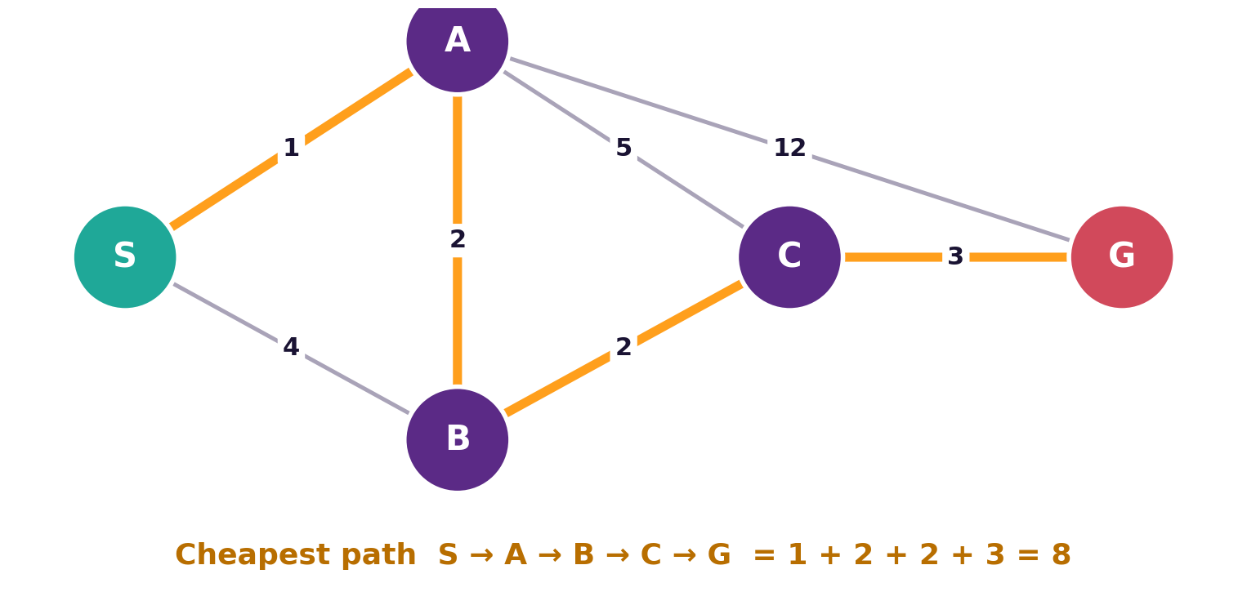

Uniform-Cost Search (UCS)
Step | Take out (cost) | Frontier, cheapest first
1 | S (0) | A 1, B 4
2 | A (1) | B 3, B 4, C 6, G 13
3 | B (3) | C 5, C 6, G 13
4 | C (5) | G 8, G 13
5 | G (8) ✓ | S → A → B → C → G
Idea: roads have different lengths, so always expand the path with the LOWEST total cost so far — g(n). Uses a priority queue.
Complete: yes · Optimal: YES (always the cheapest path) · Same as BFS when every step costs 1.
CS4305 Artificial Intelligence | Lecture 6
11

Slide 12
Depth-Limited Search (DLS)
Idea: DFS with a rule: "never go deeper than limit L". Nodes at depth L are treated as if they have no children.
Fixes DFS's problem
New problem
Choosing L
It can never get lost in an endless path.
If L is smaller than the goal depth d, it fails. If L is too big, it wastes time.
Use knowledge: a map with 11 cities needs at most 10 roads, so L = 10 is safe.
Complete: only if L ≥ d · Optimal: no · Time: O(b^L) · Space: O(b·L)
CS4305 Artificial Intelligence | Lecture 6
12

Slide 13
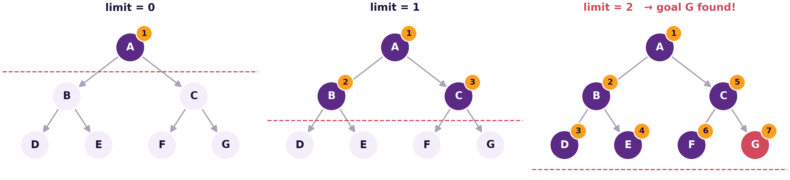
Iterative Deepening Search (IDDFS)
Best of both
Isn't it wasteful?
Often the best blind choice
Little memory like DFS, finds the shallowest goal like BFS.
Top levels are repeated, but most nodes are in the bottom level: only about 11% extra work (b = 10).
When the search space is big and the goal depth is unknown.
CS4305 Artificial Intelligence | Lecture 6
13

Slide 14
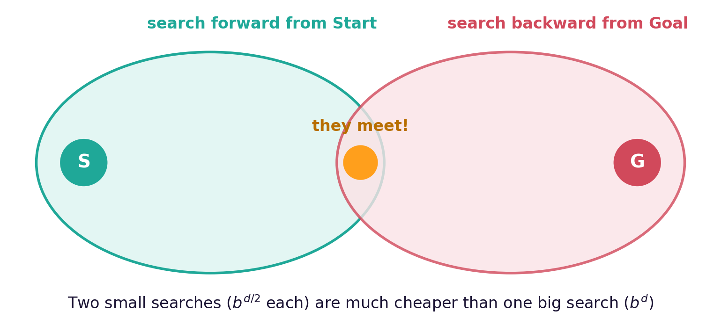

Bidirectional Search
Idea: search forward from the start AND backward from the goal at the same time. Stop when the two searches meet.
Why faster: b = 10, d = 6: one search ≈ 1,000,000 nodes; two half searches ≈ 2 × 1,000 = 2,000 nodes!
Catch: we must know the goal state exactly and be able to move backwards (fine for maps, hard for chess).
CS4305 Artificial Intelligence | Lecture 6
14

Slide 15
Comparing All Six Blind Searches
Algorithm | Complete? | Optimal? | Time | Space
BFS | Yes | Yes (equal step costs) | O(b^d) | O(b^d)
Uniform-Cost | Yes | Yes | ≈ O(b^d) | ≈ O(b^d)
DFS | No | No | O(b^m) | O(b·m)
Depth-Limited | No (only if L ≥ d) | No | O(b^L) | O(b·L)
Iterative Deepening | Yes | Yes (equal step costs) | O(b^d) | O(b·d)
Bidirectional | Yes | Yes (equal step costs) | O(b^(d/2)) | O(b^(d/2))
b = branching factor, d = depth of the shallowest goal, m = maximum depth, L = depth limit
CS4305 Artificial Intelligence | Lecture 6
15

Slide 16
Which Blind Search Should I Use?
Equal step costs, enough memory
Steps have different costs
Huge space, goal depth unknown
→ BFS
→ Uniform-Cost Search
→ Iterative Deepening
Very little memory, any answer is fine
Start and goal both known
We have a hint about the goal
→ DFS (with a depth limit)
→ Bidirectional
→ Heuristic search (next lecture!)
CS4305 Artificial Intelligence | Lecture 6
16

Slide 17


Practical: Colab Lab 6
Open CS4305_Lab06_Blind_Search.ipynb in Google Colab
BFS step by step
DFS step by step
DLS and IDDFS
Watch the queue change
Watch the stack change
Limits 0, 1, 2 ...
Uniform-Cost
Compare
Draw the routes
Cheapest route on the map
Roads, km and steps for each
See all three paths on the map
In the notebook: each part starts with a 📊 picture that explains the idea, then the 💻 code, then 📝 lab tasks at the end.
CS4305 Artificial Intelligence | Lecture 6
17

Slide 18
Summary
Blind search has no hint about the goal; algorithms differ only in which node they expand next.
BFS uses a queue: complete, fewest steps, but needs lots of memory.
DFS uses a stack: little memory, but not complete and not optimal.
UCS expands the cheapest path first: optimal when step costs differ.
DLS adds a depth limit; IDDFS repeats DLS with growing limits — often the best blind choice.
Bidirectional searches from both ends and meets in the middle.
CS4305 Artificial Intelligence | Lecture 6
18

Slide 19
Review Questions
What is the difference between blind and informed search?
Draw a tree of depth 3 and write the BFS and DFS visit orders.
Why does BFS use a queue and DFS use a stack?
Why is DFS not complete? How does depth-limited search fix this?
Trace UCS on the S-A-B-C-G graph and show the frontier at each step.
Explain iterative deepening. Why is the repeated work not a big problem?
Make a table comparing BFS, DFS, UCS and IDDFS on completeness, optimality, time and space.
CS4305 Artificial Intelligence | Lecture 6
19

Slide 20

NEXT LECTURE
Knowledge-Directed (Heuristic) Search
Greedy best-first · A* · Hill climbing · Minimax

