Slide 1

CS4305 · LECTURE 7 · TECHNIQUES: SEARCHING
Knowledge-Directed (Heuristic) Search
Using a smart guess to reach the goal faster

Slide 2
Recap and Today's Plan
Today we will learn
Last lecture
1
What a heuristic is
BFS, DFS, Uniform-Cost
Depth-limited and iterative deepening
Blind search wastes time exploring everywhere
2
Greedy Best-First Search
3
A* Search and admissible heuristics
4
Hill Climbing and its problems
5
A first look at game search (Minimax)
CS4305 Artificial Intelligence | Lecture 7
2

Slide 3


Blind vs Informed: An Everyday Example
Without a hint (blind)
With a hint (informed)
You are new in a city and looking for a famous mosque. You walk down every street one by one until you find it.
You can see the tall minaret above the buildings. You choose the streets that go towards it. You arrive much faster.
The minaret is a HEURISTIC: extra knowledge that tells you roughly how close you are to the goal.
CS4305 Artificial Intelligence | Lecture 7
3

Slide 4





What is a Heuristic?
Heuristic h(n) = an estimate of the cost from node n to the goal. It is a smart guess, not the exact answer. At the goal, h = 0.
Route finding
8-puzzle (h1)
8-puzzle (h2)
Chess
Straight-line distance to the destination ("as the crow flies").
Number of tiles in the wrong place.
Manhattan distance: total up/down + left/right steps each tile needs.
Material count: value of my pieces minus value of opponent's pieces.
Where does the knowledge come from? From understanding the problem — this is why it is called knowledge-directed search.
CS4305 Artificial Intelligence | Lecture 7
4

Slide 5
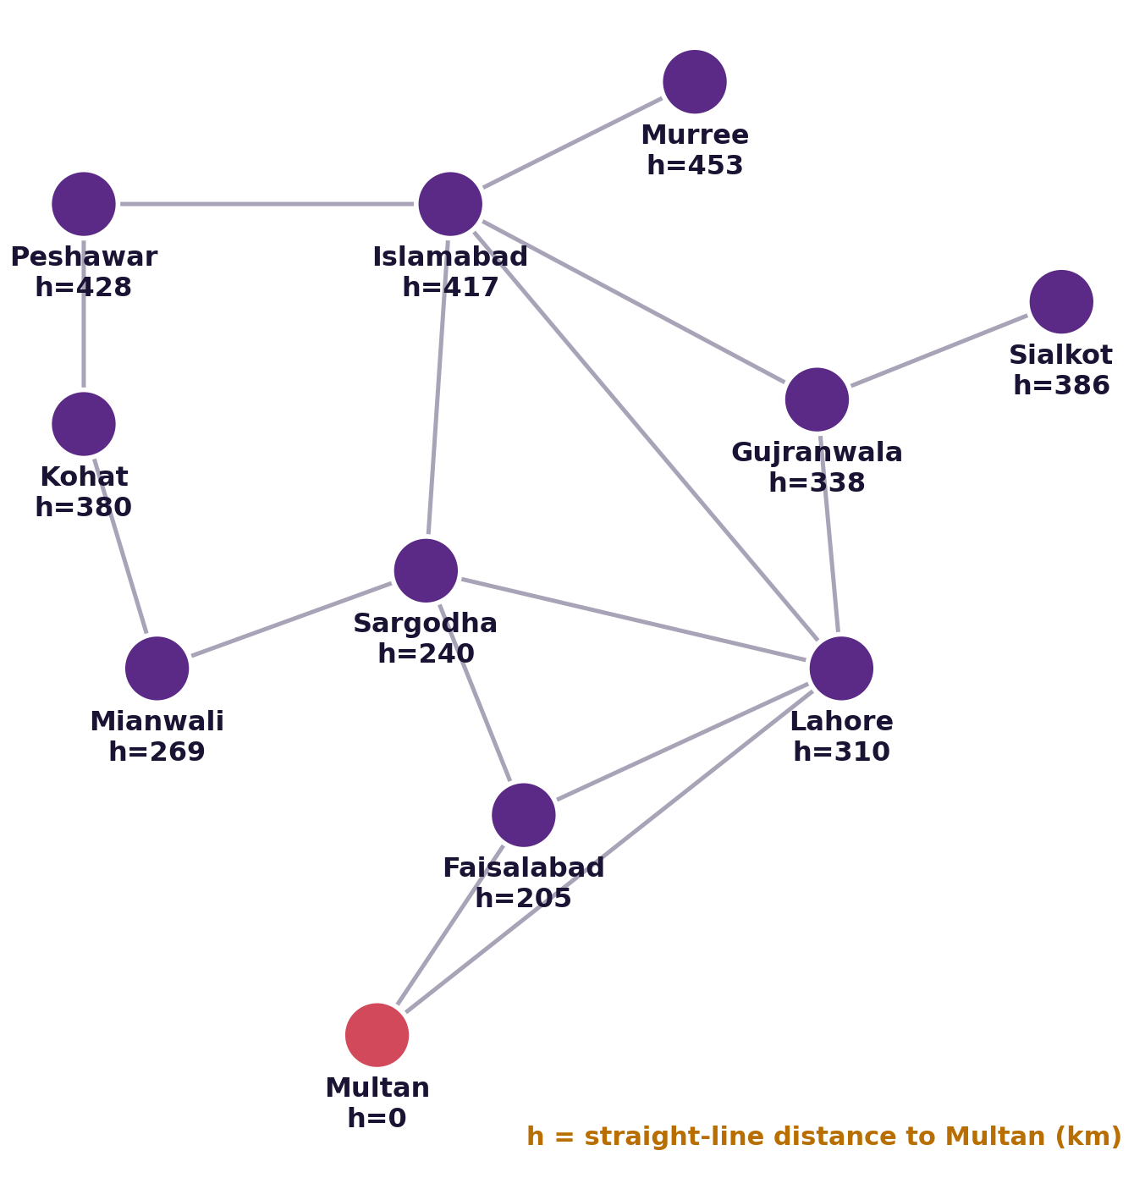

Heuristic Example: Straight-Line Distance to Multan
From Kohat, the straight-line distance to Multan is 380 km. The real road distance is longer, but 380 tells us Kohat is "closer" than Islamabad (417).
Important: a road can never be shorter than a straight line, so this h never overestimates. Remember this for A*!
CS4305 Artificial Intelligence | Lecture 7
5

Slide 6
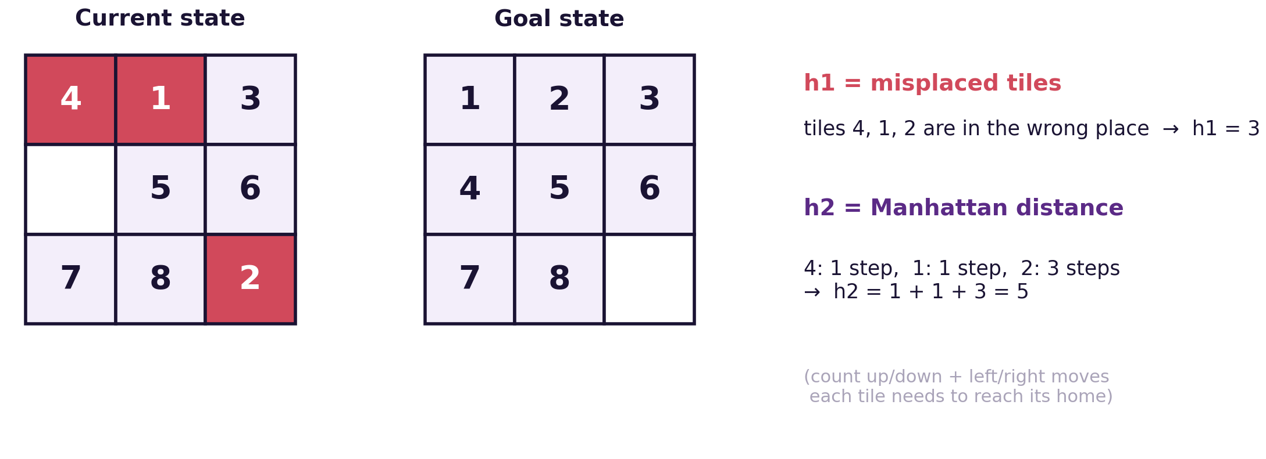

Heuristic Example: The 8-Puzzle
h1 says "at least 3 moves", h2 says "at least 5 moves". The true answer is 13 moves. h2 is closer to the truth, so it is a better heuristic.
CS4305 Artificial Intelligence | Lecture 7
6

Slide 7
Best-First Search: Expand the Most Promising Node
Every node gets a score f(n). The node with the SMALLEST f is expanded next.
Uniform-Cost
Greedy
A*
f(n) = g(n)
f(n) = h(n)
f(n) = g(n) + h(n)
cost so far only
estimate to goal only
cost so far + estimate
(blind — Lecture 6)
fast, not always best
fast AND best
g(n) = real cost from the start to n h(n) = estimated cost from n to the goal
CS4305 Artificial Intelligence | Lecture 7
7

Slide 8



Greedy Best-First Search: f(n) = h(n)
Idea: always go to the node that LOOKS closest to the goal. Like always walking towards the minaret, even if that street is a dead end or very long.
Step | Take out | h | Frontier (smallest h first)
1 | S | 6 | B (h=3), A (h=5)
2 | B | 3 | C (h=2), A (h=5)
3 | C | 2 | G (h=0), A (h=5)
4 | G ✓ | 0 | path S → B → C → G
Fast
Only 4 steps.
Not optimal
Cost 4 + 2 + 3 = 9, but a path of cost 8 exists!
Greedy is also not complete: it can get stuck going back and forth between two nodes.
CS4305 Artificial Intelligence | Lecture 7
8

Slide 9

A* Search: f(n) = g(n) + h(n)
f(n)
=
g(n)
+
h(n)
estimated total trip cost through n
distance already travelled (known)
estimated distance still to go (guess)
Analogy: choosing a bus route. You add the time already spent (g) to the expected time left (h), and pick the route with the smallest total. You don't ignore the past like Greedy, and you don't ignore the future like UCS.
A* is the most famous search algorithm in AI — used in games, robots and map apps.
CS4305 Artificial Intelligence | Lecture 7
9

Slide 10
A* Step by Step (same graph, goal = G)
Step | Take out | g | h | f = g + h | Frontier after expanding (f values)
1 | S | 0 | 6 | 6 | A 6, B 7
2 | A | 1 | 5 | 6 | B 6 (cheaper via A), C 8, G 13
3 | B | 3 | 3 | 6 | C 7 (cheaper via B), G 13
4 | C | 5 | 2 | 7 | G 8 (cheaper via C)
5 | G ✓ | 8 | 0 | 8 | path S → A → B → C → G
A* found the path with cost 8 — the true best. When a cheaper way to reach a node appears (B, C, G), A* uses the cheaper one.
CS4305 Artificial Intelligence | Lecture 7
10

Slide 11
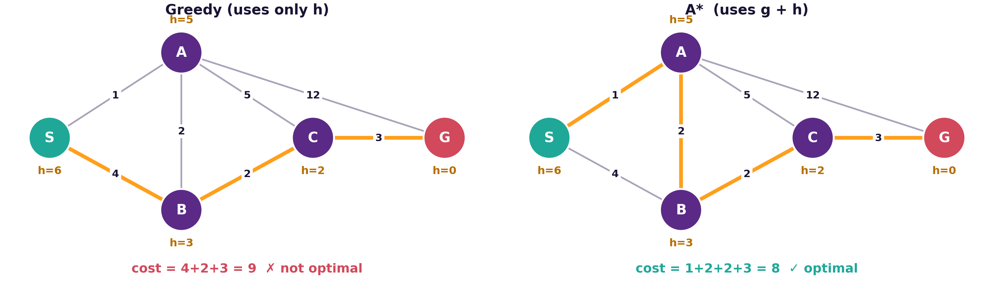
Greedy vs A* on the Same Graph
Orange numbers under each node are the h values
Greedy trusted the guess h(B) = 3 and ignored that S → B already costs 4.
CS4305 Artificial Intelligence | Lecture 7
11

Slide 12
When is A* Guaranteed to Find the Best Path?
Admissible heuristic: h(n) NEVER overestimates the real cost to the goal. It is always optimistic: h(n) ≤ true cost.
Heuristic | Admissible? | Why
Straight-line distance | Yes | No road is shorter than a straight line
Misplaced tiles (h1) | Yes | Each wrong tile needs at least 1 move
Manhattan distance (h2) | Yes | Each tile needs at least that many moves
h(A) = 10 in our graph | No ✗ | Real cost from A to G is only 7 → A* gives cost 9
Rule: if h is admissible, A* is optimal. And if h1 ≤ h2 (both admissible), h2 is better — it guides the search more.
CS4305 Artificial Intelligence | Lecture 7
12

Slide 13

A Better Heuristic = Much Less Work
Solving the same 8-puzzle (13 moves) with A*
All three find the same 13-move solution. With Manhattan distance, A* looks at about 24 times fewer states.
Harder puzzle (31 moves): h1 expands about 144,000 states, h2 only about 21,000.
CS4305 Artificial Intelligence | Lecture 7
13

Slide 14
UCS vs Greedy vs A*
 | Uniform-Cost | Greedy Best-First | A*
Uses | g(n) | h(n) | g(n) + h(n)
Complete? | Yes | No | Yes
Optimal? | Yes | No | Yes (admissible h)
Speed | slow (explores in all directions) | usually very fast | fast (explores towards the goal)
Main weakness | ignores where the goal is | ignores cost already paid | can use a lot of memory
CS4305 Artificial Intelligence | Lecture 7
14

Slide 15
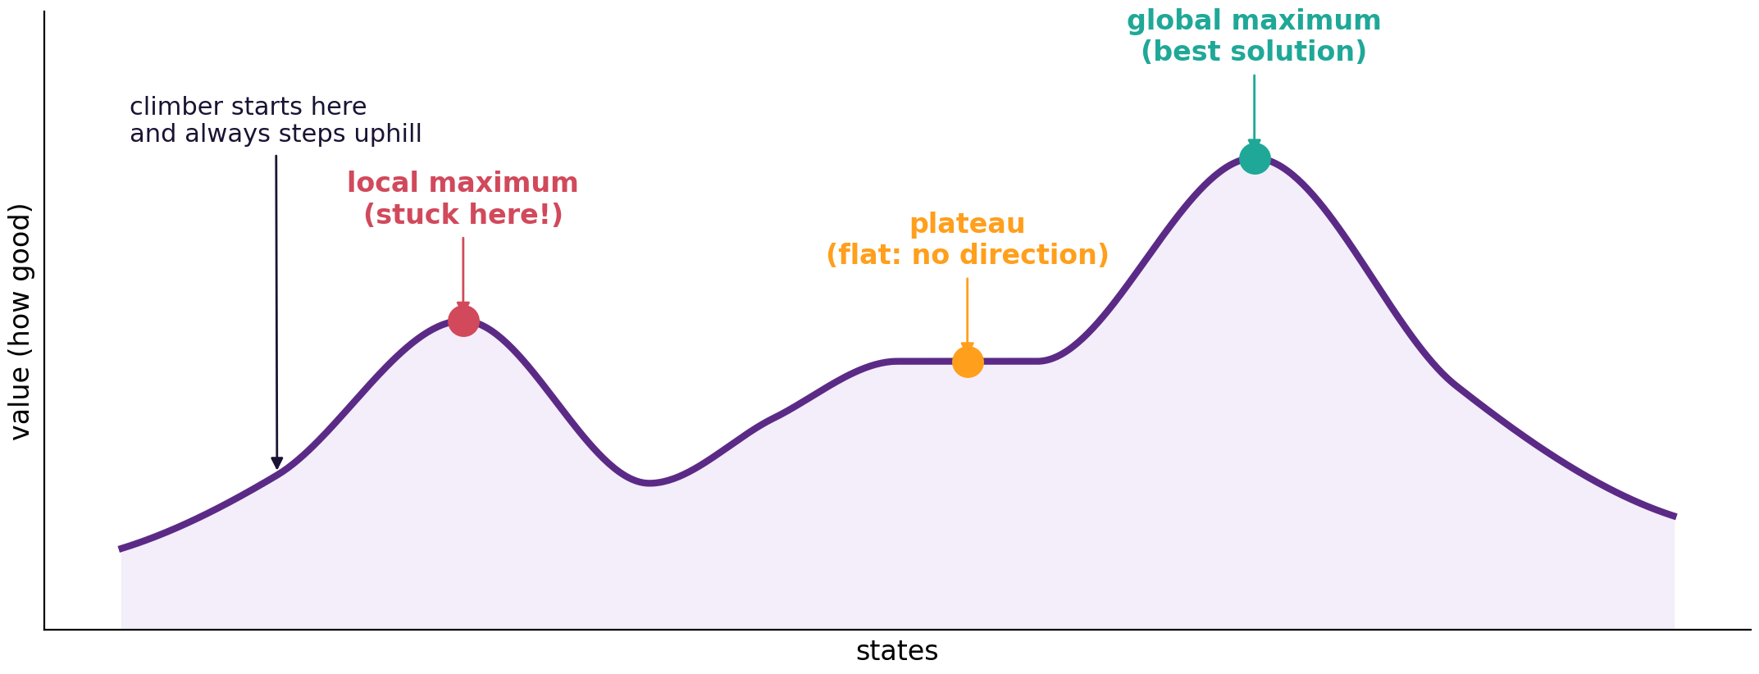

Hill Climbing: Always Step Uphill
Analogy: climbing a mountain in thick fog. You can only see the ground next to you, so you always take the step that goes up.
current = start
loop:
best = best neighbour of current
if best is not higher: STOP
current = best
Keeps only ONE state in memory — very fast and light. But it does not remember a path and never goes back.
CS4305 Artificial Intelligence | Lecture 7
15

Slide 16






Hill Climbing: Problems and Fixes
Local maximum
Plateau
Ridge
A small hill: every neighbour is lower, but it is not the highest peak. The climber stops too early.
Flat ground: all neighbours have the same value, so there is no direction to go.
A narrow slope: going uphill needs a diagonal step that single moves can't make.
Fixes
Random restart
Sideways moves
Simulated annealing
Climb again from many random starting points; keep the best.
Allow a few flat moves to cross a plateau.
Sometimes allow a downhill step (often at first, rarely later) to escape small hills.
CS4305 Artificial Intelligence | Lecture 7
16

Slide 17
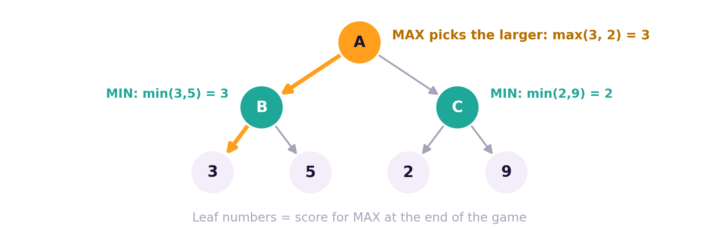
Game Search: Minimax
Two players: MAX (you) wants a high score, MIN (the opponent) wants a low score. Minimax assumes both play their best.
Work from the bottom up.
At MIN levels take the smallest value.
At MAX levels take the largest value.
Here MAX chooses B and is sure to get at least 3.
Used in tic-tac-toe and chess. Alpha-beta pruning makes it faster by skipping branches that cannot change the decision.
CS4305 Artificial Intelligence | Lecture 7
17

Slide 18



Heuristic Search in Real Life
Map and ride apps
Video games
Robots and drones
Route planning uses A*-style search with distance heuristics.
Characters find paths around walls using A*.
Plan safe paths through rooms and warehouses.
Chess engines
Scheduling
Puzzle solvers
Minimax with heuristic board evaluation.
Timetables and deliveries use hill climbing and related methods.
Rubik's cube and 15-puzzle solvers use A* variants.
CS4305 Artificial Intelligence | Lecture 7
18

Slide 19
Practical: Colab Lab 7
Open CS4305_Lab07_Heuristic_Search.ipynb in Google Colab
Greedy vs A*
A* on the map
8-puzzle
See Greedy fail and A* succeed
Fewer cities than UCS, same route
h1 vs h2: count the work
Hill climbing
Random restarts
Minimax
Getting stuck on a local maximum
Escape and find the top
Solve a tiny game tree
In the notebook: each part starts with a 📊 picture that explains the idea, then the 💻 code, then 📝 lab tasks at the end.
CS4305 Artificial Intelligence | Lecture 7
19

Slide 20
Summary
Heuristic h(n): an estimate of the cost from n to the goal (straight-line distance, Manhattan distance).
Greedy: f = h. Fast, but not optimal and not complete.
A*: f = g + h. Complete and optimal when h is admissible (never overestimates).
Better heuristics (closer to the true cost) make A* expand far fewer nodes.
Hill climbing: always step uphill; can get stuck on local maxima, plateaus and ridges.
Minimax: MAX takes the largest, MIN the smallest value, from the leaves up.
CS4305 Artificial Intelligence | Lecture 7
20

Slide 21
Review Questions
What is a heuristic? Give two examples of heuristic functions.
Compute h1 and h2 for an 8-puzzle state given by your teacher.
Differentiate between Greedy Best-First Search and A* with an example.
Trace A* on a small graph and show g, h and f at each step.
What is an admissible heuristic? Why does it make A* optimal?
Explain local maximum, plateau and ridge. How does random restart help?
Apply minimax to a two-level game tree with leaves 4, 8, 1, 6.
CS4305 Artificial Intelligence | Lecture 7
21

Slide 22

NEXT LECTURE
Knowledge Representation I: Logic
Propositional logic · Predicate logic · Inference

