Slide 1

CS4305 · LECTURE 8 · KNOWLEDGE REPRESENTATION
Knowledge Representation I: Logic
Writing knowledge so exactly that a computer can reason with it

Slide 2
Recap and Today's Plan
Today we will learn
Last lecture
1
What knowledge representation is
Search: blind and heuristic
A*, hill climbing, minimax
Search needs knowledge to be smart
2
Propositional logic and truth tables
3
Proving things: inference rules
4
Predicate logic: ∀ and ∃
5
From English to logic
CS4305 Artificial Intelligence | Lecture 8
2

Slide 3

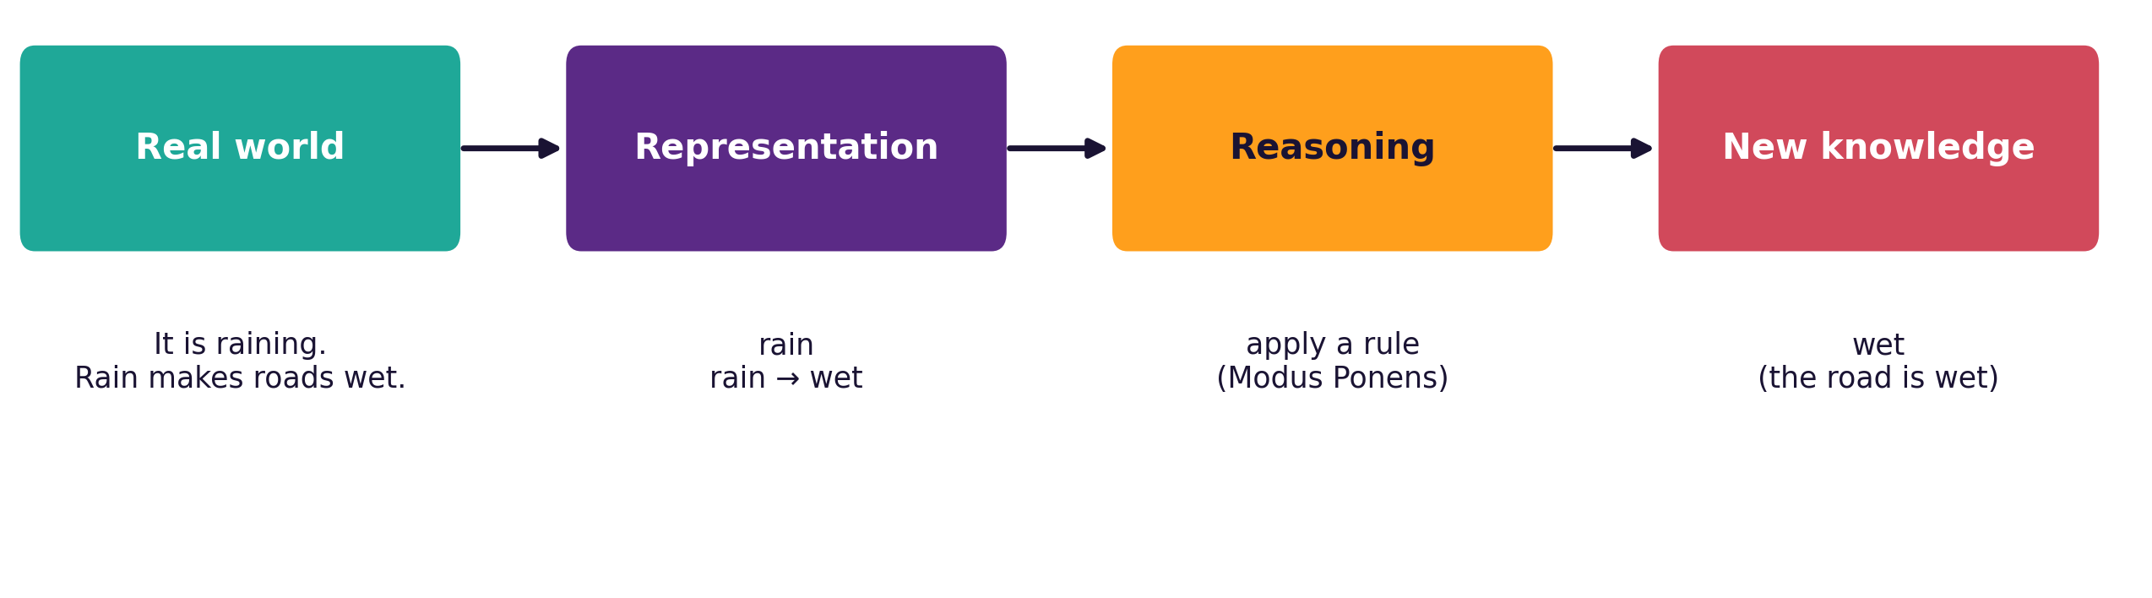

What is Knowledge Representation (KR)?
Knowledge Representation = storing facts about the world in a form a computer can use to reason and answer questions.
Analogy: a recipe book. The same knowledge can be written as text, a table or a picture — but the cook needs it in a form they can follow. KR is choosing that form for the computer.
CS4305 Artificial Intelligence | Lecture 8
3

Slide 4




The KR Methods in This Course
Logic (today)
Rules (Lecture 9)
Semantic networks (Lecture 10)
Frames & scripts (Lecture 10)
Exact true/false sentences.
bird(tweety)
IF-THEN knowledge.
IF bird THEN can fly
A graph of concepts.
tweety → is-a → bird
Forms with slots; stories of usual events.
A good representation is:
correct (no mistakes) · complete enough for the job · easy for people to read and change · efficient for the computer to reason with
CS4305 Artificial Intelligence | Lecture 8
4

Slide 5

Propositional Logic: Propositions
Proposition = a statement that is either TRUE or FALSE. We give it a short name like P or Rain.
Sentence | Proposition? | Why
"Islamabad is the capital of Pakistan." | Yes ✓ | it is true
"2 + 2 = 5" | Yes ✓ | it is false (but still true-or-false)
"Close the door." | No ✗ | a command is not true or false
"How are you?" | No ✗ | a question is not true or false
"x > 10" | No ✗ | depends on x (predicate logic handles this)
CS4305 Artificial Intelligence | Lecture 8
5

Slide 6
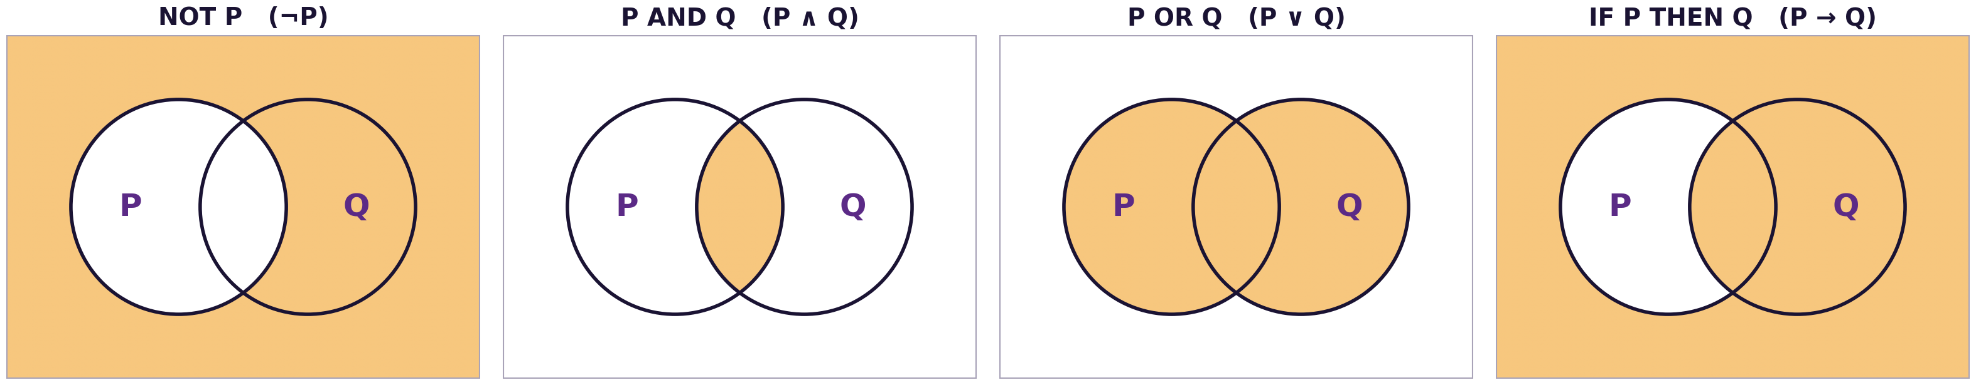
Connectives: Joining Propositions
Symbol | Name | Read as | Example (R = it rains, C = it is cold)
¬P | NOT | not P | ¬R : it is not raining
P ∧ Q | AND | P and Q | R ∧ C : it is raining and cold
P ∨ Q | OR | P or Q (or both) | R ∨ C : it is raining or cold
P → Q | IMPLIES | if P then Q | R → C : if it rains then it is cold
P ↔ Q | IFF | P if and only if Q | R ↔ C : rain exactly when cold
CS4305 Artificial Intelligence | Lecture 8
6

Slide 7


Truth Tables
P | Q | ¬P | P ∧ Q | P ∨ Q | P → Q | P ↔ Q
T | T | F | T | T | T | T
T | F | F | F | T | F | F
F | T | T | F | T | T | F
F | F | T | F | F | T | T
A truth table lists every possible combination. n propositions → 2ⁿ rows (2 → 4 rows, 3 → 8 rows).
AND is true only when both are true. OR is false only when both are false.
CS4305 Artificial Intelligence | Lecture 8
7

Slide 8

The Tricky One: IF-THEN
Think of it as a PROMISE: "IF you get 90% (P), THEN you get a prize (Q)"
You got 90%? (P) | Got a prize? (Q) | Was the promise kept? | P → Q
Yes | Yes | kept ✓ | T
Yes | No | BROKEN ✗ | F
No | Yes | kept ✓ (a bonus is allowed) | T
No | No | kept ✓ (no promise was made) | T
Remember: P → Q is FALSE in only one case — when P is true and Q is false.
CS4305 Artificial Intelligence | Lecture 8
8

Slide 9

Tautology, Contradiction and Equivalence
Tautology
Contradiction
Equivalent
Always TRUE, in every row.
P ∨ ¬P ("it rains or it does not")
Always FALSE, in every row.
P ∧ ¬P ("it rains and it does not")
Same truth table.
We write ≡
Useful equivalence | In words
¬(P ∧ Q) ≡ ¬P ∨ ¬Q | De Morgan: "not both" = "at least one is not"
¬(P ∨ Q) ≡ ¬P ∧ ¬Q | De Morgan: "neither" = "not this and not that"
P → Q ≡ ¬P ∨ Q | IF-THEN written with OR (used in resolution)
P → Q ≡ ¬Q → ¬P | contrapositive: if not Q then not P
CS4305 Artificial Intelligence | Lecture 8
9

Slide 10
From English to Propositional Logic
Let E = exam tomorrow, S = I study tonight, P = I pass, F = I feel tired
English | Logic
If there is an exam tomorrow, I study tonight. | E → S
I pass only if I study. | P → S
I study and I feel tired. | S ∧ F
I don't study, or I pass. | ¬S ∨ P
I pass if and only if I study. | P ↔ S
It is not true that I am tired and I pass. | ¬(F ∧ P)
Class activity: translate "If it is Friday and there is no rain, we play cricket."
CS4305 Artificial Intelligence | Lecture 8
10

Slide 11
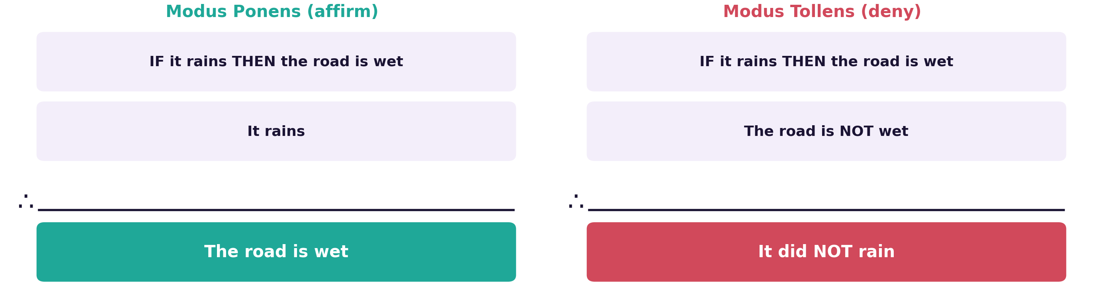
Inference: Drawing New Conclusions
Rule | If you know | You can conclude
Modus Ponens | P → Q and P | Q
Modus Tollens | P → Q and ¬Q | ¬P
And-elimination | P ∧ Q | P (and also Q)
CS4305 Artificial Intelligence | Lecture 8
11

Slide 12

Does the Knowledge Base Prove It? (Entailment)
KB ⊨ α ("KB entails α") means: in EVERY situation where the knowledge base is true, α is also true.
Rain | Wet | KB: (Rain → Wet) ∧ Rain | Goal: Wet
T | T | T ← KB true | T ✓
T | F | F | F
F | T | F | T
F | F | F | F
The KB is true in only one row, and there Wet is true. So KB ⊨ Wet. This check is called model checking.
CS4305 Artificial Intelligence | Lecture 8
12

Slide 13
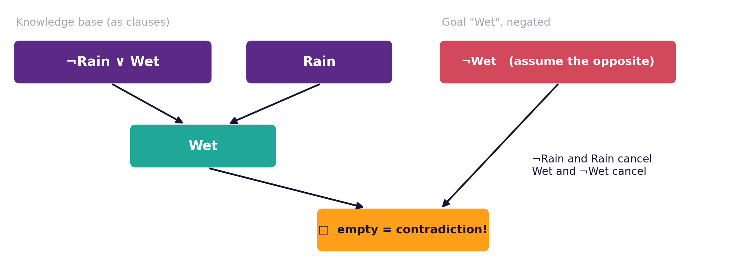
Resolution: Proof by Contradiction
Write everything as clauses (ORs): Rain → Wet becomes ¬Rain ∨ Wet
Add the OPPOSITE of the goal: ¬Wet
Cancel pairs like X and ¬X
Reach the empty clause □ → contradiction → the goal is proved
Prolog uses a form of resolution to answer queries.
CS4305 Artificial Intelligence | Lecture 8
13

Slide 14


Why Propositional Logic is Not Enough
To say "every student in this class studies" we would need one proposition per student: AliStudies, SaraStudies, UsmanStudies ... and we still could not say "every".
Objects
Predicates
Quantifiers
ali, sara, lahore, ai_course
properties and relations:
Student(ali), Teaches(bilal, ali)
∀ for all, ∃ there exists
Predicate (first-order) logic adds these three things.
CS4305 Artificial Intelligence | Lecture 8
14

Slide 15
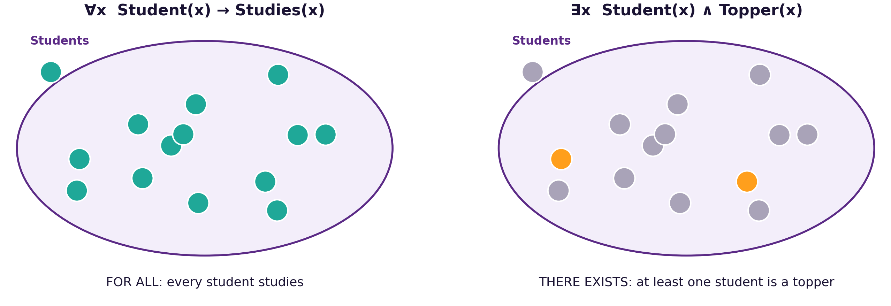
Predicate Logic: Quantifiers
Symbol | Read as | Usually joined with | Example
∀x | for all x / every x | → (IF-THEN) | ∀x Student(x) → Studies(x)
∃x | there exists an x / some x | ∧ (AND) | ∃x Student(x) ∧ Topper(x)
CS4305 Artificial Intelligence | Lecture 8
15

Slide 16
From English to Predicate Logic
English | Predicate logic
Ali is a student. | Student(ali)
Bilal teaches Ali. | Teaches(bilal, ali)
All students study. | ∀x Student(x) → Studies(x)
Some students are toppers. | ∃x Student(x) ∧ Topper(x)
No student is lazy. | ∀x Student(x) → ¬Lazy(x)
Every student has a teacher. | ∀x Student(x) → ∃y Teaches(y, x)
Common mistake: ∀x Student(x) ∧ Studies(x) means "EVERYTHING is a student and studies" — wrong! Use → with ∀.
CS4305 Artificial Intelligence | Lecture 8
16

Slide 17


Reasoning in Predicate Logic
The famous example
1. ∀x Man(x) → Mortal(x) (all men are mortal)
2. Man(socrates) (Socrates is a man)
3. Man(socrates) → Mortal(socrates) put x = socrates
4. Mortal(socrates) Modus Ponens on 3 and 2
Universal instantiation
Prolog connection
From "for all x", we may use any specific object in place of x.
mortal(X) :- man(X). is exactly ∀x Man(x) → Mortal(x)
CS4305 Artificial Intelligence | Lecture 8
17

Slide 18

Practical: Colab Lab 8
Open CS4305_Lab08_Logic.ipynb in Google Colab
Truth-table generator
IF-THEN as a promise
Tautologies
Any sentence, automatically
See when P → Q is false
Check De Morgan's laws
Model checking
sympy logic
∀ and ∃ in Python
Does the KB prove the goal?
CNF and proof by contradiction
all() and any() on students
In the notebook: each part starts with a 📊 picture that explains the idea, then the 💻 code, then 📝 lab tasks at the end.
CS4305 Artificial Intelligence | Lecture 8
18

Slide 19
Summary
KR = storing knowledge so a computer can reason; logic is the most exact method.
Propositions are true/false; connectives: ¬, ∧, ∨, →, ↔.
Truth tables list all 2ⁿ cases; P → Q is false only when P is true and Q is false.
Inference: Modus Ponens, Modus Tollens; resolution proves by contradiction.
KB ⊨ α when α is true in every situation where the KB is true.
Predicate logic adds objects, predicates and quantifiers: ∀ with →, ∃ with ∧.
CS4305 Artificial Intelligence | Lecture 8
19

Slide 20
Review Questions
What is knowledge representation? Name four KR methods.
Which of these are propositions: "Lahore is in Punjab", "Sit down", "5 > 3"?
Draw the truth table of (P ∨ Q) → ¬P.
Explain P → Q using the promise example. When is it false?
Use Modus Tollens: "If the battery is dead, the car won't start. The car started."
Translate: "Every teacher is a person" and "Some students play cricket".
Why is propositional logic not enough for "all students study"?
CS4305 Artificial Intelligence | Lecture 8
20

Slide 21

NEXT LECTURE
Knowledge Representation II: Rules
IF-THEN rules · production systems · forward and backward chaining

