Slide 1

CS4305 · LECTURE 9 · KNOWLEDGE REPRESENTATION
Knowledge Representation II: Rules
IF-THEN knowledge and the engines that use it

Slide 2
Recap and Today's Plan
Today we will learn
Last lecture
1
What a rule is
Propositional and predicate logic
Truth tables and entailment
Modus Ponens and resolution
2
Production systems
3
Forward chaining
4
Backward chaining
5
Conflict resolution
CS4305 Artificial Intelligence | Lecture 9
2

Slide 3





Rules: The Most Natural Way to Write Knowledge
A rule has two parts: IF <condition> THEN <conclusion or action>. People already think in rules!
Traffic
University
Doctor
Home
IF the light is red THEN stop.
IF CGPA < 2.0 THEN the student is on probation.
IF fever AND rash AND joint pain THEN suspect dengue.
IF temperature > 35 °C THEN switch on the AC.
Part | Other names | Example
IF part | condition, premise, antecedent, left-hand side | the light is red
THEN part | conclusion, action, consequent, right-hand side | stop
CS4305 Artificial Intelligence | Lecture 9
3

Slide 4


Two Kinds of Rules
Knowledge rules (deduction)
Action rules (reaction)
The THEN part adds a new FACT.
The THEN part DOES something.
IF animal has feathers
THEN animal is a bird
IF room is dirty
THEN suck
Used in expert systems to reason.
Used by agents (the vacuum robot in Lecture 1).
Link to logic: the rule IF P THEN Q is the logic sentence P → Q, used with Modus Ponens.
CS4305 Artificial Intelligence | Lecture 9
4

Slide 5
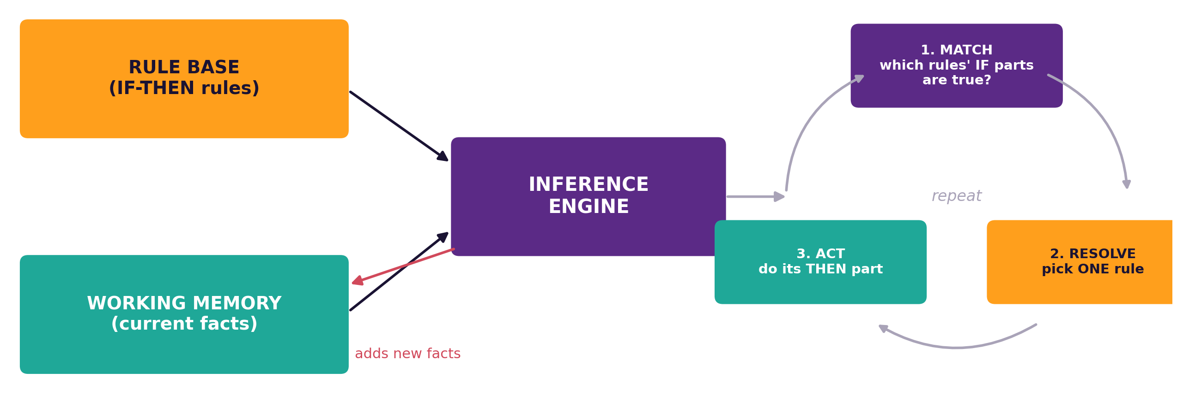
A Production (Rule-Based) System
Part | Job | Like...
Rule base | stores all IF-THEN rules | the doctor's medical knowledge
Working memory | stores facts about THIS case | this patient's symptoms
Inference engine | decides which rule to use next | the doctor's thinking
CS4305 Artificial Intelligence | Lecture 9
5

Slide 6
The Engine's Cycle: Match, Resolve, Act
1. MATCH
find all rules whose IF part is true
2. RESOLVE
if many match, choose ONE
3. ACT
do its THEN part (add a fact)
REPEAT
until no rule can fire or goal found
Word | Meaning
Rule fires | its THEN part is carried out
Conflict set | the list of rules that match in this cycle
Refraction | a rule does not fire twice on the same facts
Analogy: a student in an exam reads all questions (match), picks one to answer first (resolve), writes it (act), and repeats.
CS4305 Artificial Intelligence | Lecture 9
6

Slide 7

Our Example Knowledge Base: Animals
R1: IF has_hair THEN mammal
R2: IF gives_milk THEN mammal
R3: IF has_feathers THEN bird
R4: IF mammal AND eats_meat THEN carnivore
R5: IF carnivore AND tawny AND dark_spots THEN cheetah
R6: IF carnivore AND tawny AND black_stripes THEN tiger
R7: IF bird AND swims AND cannot_fly THEN penguin
Facts in working memory: has_hair, eats_meat, tawny, dark_spots. Question: what animal is it?
CS4305 Artificial Intelligence | Lecture 9
7

Slide 8
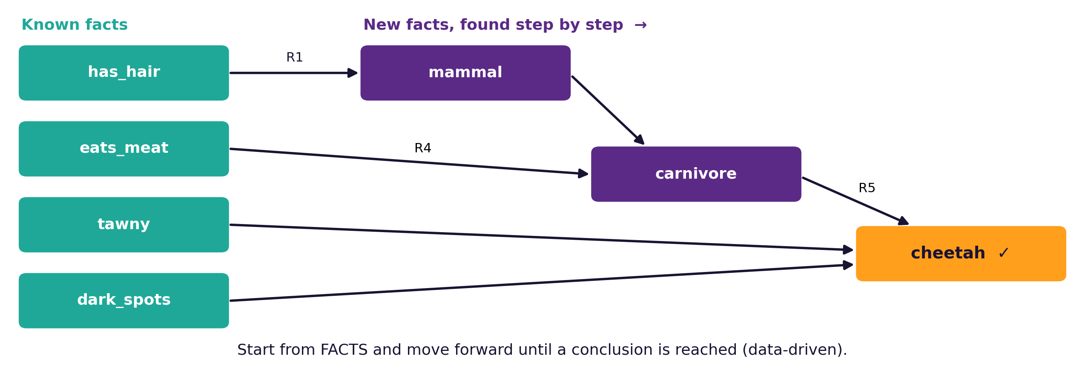

Forward Chaining (Data-Driven)
Cycle | Rules that match | Fire | New fact
1 | R1 | R1 | mammal
2 | R4 | R4 | carnivore
3 | R5 | R5 | cheetah
4 | none | — | STOP
Idea: start from what you KNOW, and keep firing rules forward until nothing new appears. Like a detective collecting clues until the answer shows up.
CS4305 Artificial Intelligence | Lecture 9
8

Slide 9
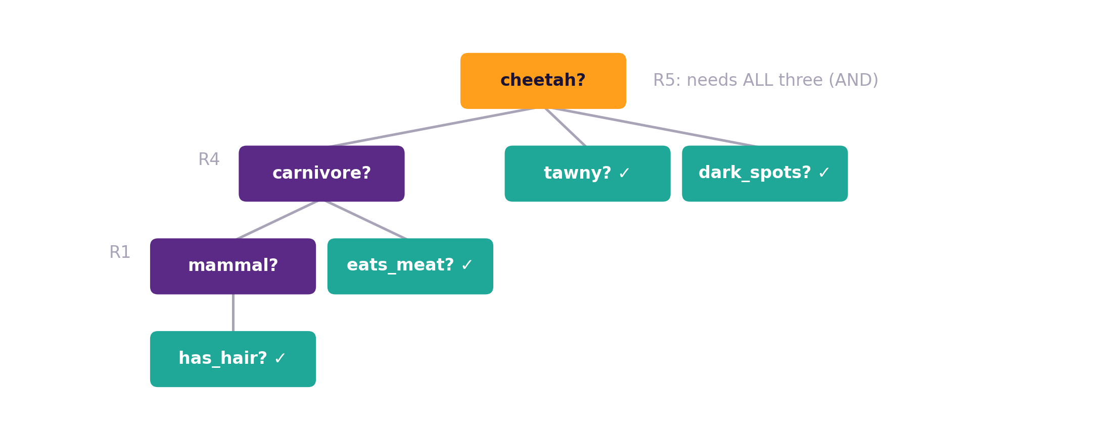
Backward Chaining (Goal-Driven)
Start with a guess: "Is it a cheetah?"
Find a rule with cheetah in its THEN part (R5)
Its IF parts become new sub-goals
Keep going back until you reach known facts (or ask the user)
Analogy: a doctor who suspects dengue and then checks only the symptoms that dengue needs. Prolog works this way.
CS4305 Artificial Intelligence | Lecture 9
9

Slide 10
Forward vs Backward Chaining
 | Forward chaining | Backward chaining
Starts from | facts (data) | a goal (hypothesis)
Direction | IF part → THEN part | THEN part → IF part
Also called | data-driven, bottom-up | goal-driven, top-down
Finds | everything that follows from the facts | only what is needed for the goal
Good when | few facts, many possible results (monitoring, planning) | a clear question to answer (diagnosis)
Example systems | CLIPS, XCON | Prolog, MYCIN
CS4305 Artificial Intelligence | Lecture 9
10

Slide 11
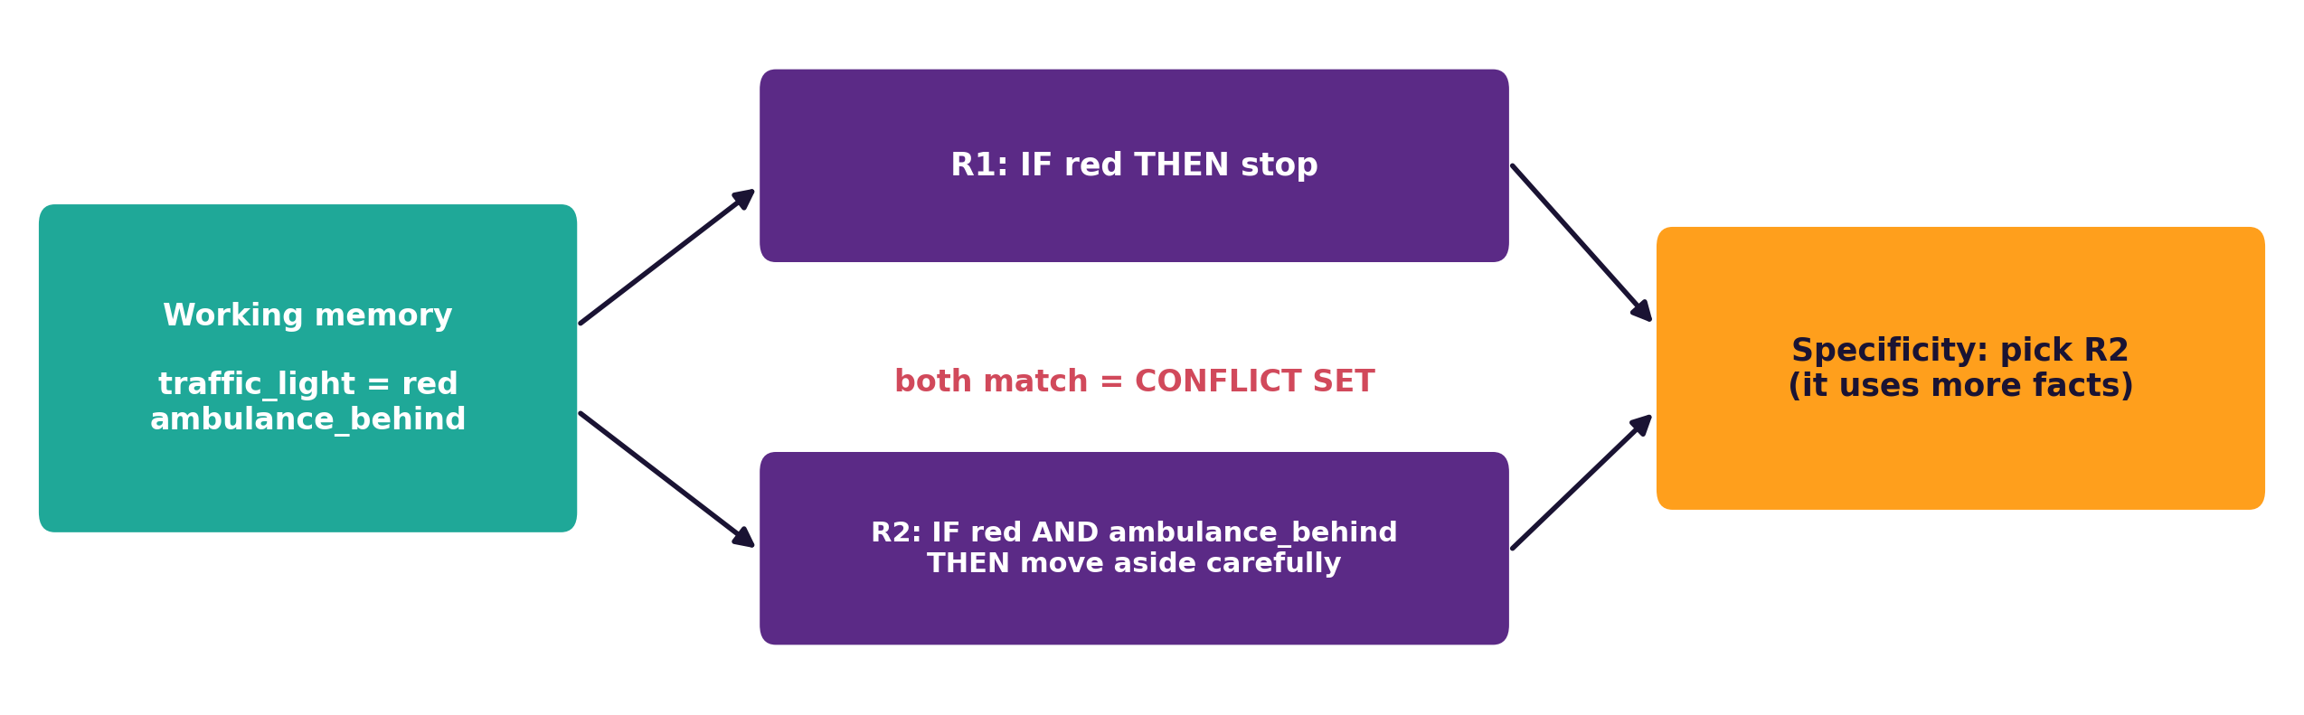
Conflict Resolution: When Many Rules Match
Strategy | Picks the rule that... | Here
First rule | comes first in the list | R1: stop
Specificity | has the most conditions (more exact) | R2: move aside
Priority (salience) | the expert marked as most important | R2: move aside
Recency | uses the newest facts | R2 (ambulance just arrived)
Refraction | has not already fired on these facts | (avoids endless loops)
CS4305 Artificial Intelligence | Lecture 9
11

Slide 12
Rule-Based Systems: Good and Bad Points
Advantages
Disadvantages
Natural: experts already talk in rules
Modular: add or remove one rule easily
Can explain answers ("because R5 fired")
Knowledge is separate from the engine
Thousands of rules become hard to manage
Rules can conflict or repeat each other
Cannot learn by themselves
Brittle: fail on cases no rule covers
Real knowledge is often uncertain (Lecture 11 adds certainty factors)
CS4305 Artificial Intelligence | Lecture 9
12

Slide 13





Practical: Colab Lab 9
Open CS4305_Lab09_Rules.ipynb in Google Colab
Rule base
Forward chaining
Backward chaining
11 animal rules
See every match-resolve-act cycle
A reasoning tree for 'cheetah'
Asking questions
Conflict strategies
Compare
The system asks only what it needs
First, specificity, priority, recency
Forward vs backward work
In the notebook: each part starts with a 📊 picture that explains the idea, then the 💻 code, then 📝 lab tasks at the end.
CS4305 Artificial Intelligence | Lecture 9
13

Slide 14
Summary
Rule = IF condition THEN conclusion/action; the same as P → Q in logic.
Production system = rule base + working memory + inference engine.
Engine cycle: match → resolve → act, repeated.
Forward chaining: facts → conclusions (data-driven).
Backward chaining: goal → sub-goals → facts (goal-driven).
Conflict resolution: first rule, specificity, priority, recency, refraction.
CS4305 Artificial Intelligence | Lecture 9
14

Slide 15
Review Questions
Write 4 IF-THEN rules for choosing what to wear based on the weather.
Draw the architecture of a production system and explain each part.
Explain the match–resolve–act cycle.
Using the animal rules, show forward chaining for: has_feathers, swims, cannot_fly.
Show backward chaining for the goal 'tiger' with facts has_hair, eats_meat, tawny.
Compare forward and backward chaining in a table.
What is a conflict set? Explain specificity and priority with an example.
CS4305 Artificial Intelligence | Lecture 9
15

Slide 16

NEXT LECTURE
Semantic Networks, Frames and Scripts
Knowledge as graphs, forms and stories

