Slide 1

CS4305 · LECTURE 10 · KNOWLEDGE REPRESENTATION
Semantic Networks, Frames and Scripts
Knowledge as graphs, forms and stories

Slide 2
Recap and Today's Plan
Today we will learn
Last lecture
1
Why we need structured knowledge
Logic: exact true/false sentences
Rules: IF-THEN knowledge
Forward and backward chaining
2
Semantic networks and inheritance
3
Frames: slots and fillers
4
Scripts: stories of usual events
5
Comparing all KR methods
CS4305 Artificial Intelligence | Lecture 10
2

Slide 3
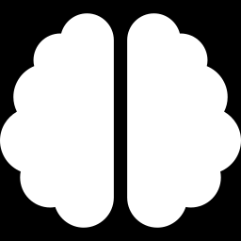
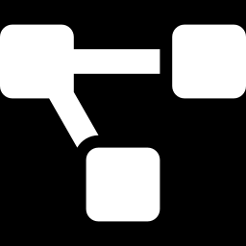
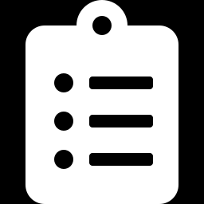
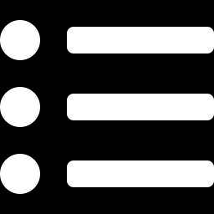
Why Structured Knowledge?
Logic and rules store knowledge as a long list of separate sentences. But our brain connects ideas: when you hear "bird", you immediately think wings, feathers, flying, eggs.
Semantic networks
Frames
Scripts
Knowledge as a GRAPH of connected concepts.
Knowledge as FORMS with fields about one object.
Knowledge as a STORY of what usually happens.
All three group related knowledge together, so it is faster to find and easier to understand.
CS4305 Artificial Intelligence | Lecture 10
3

Slide 4
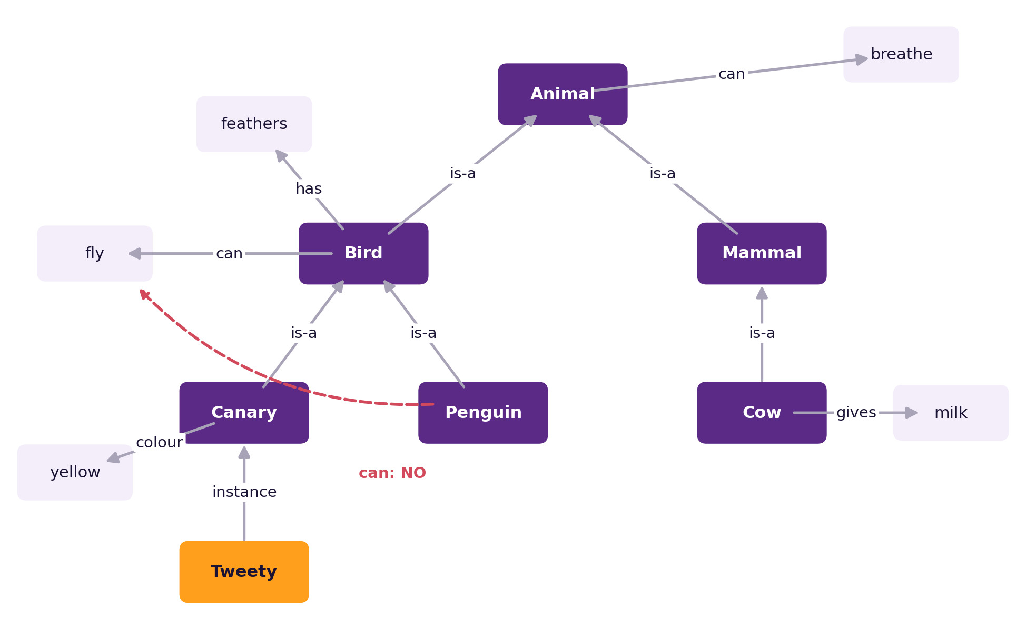
Semantic Networks
Semantic network = a graph where nodes are concepts and labelled arrows are relations between them. Introduced by Ross Quillian (1968).
Nodes: Bird, Canary, Tweety
Arrows: is-a, has, can, colour
Read an arrow as a sentence: Bird —can→ fly = "a bird can fly"
CS4305 Artificial Intelligence | Lecture 10
4

Slide 5
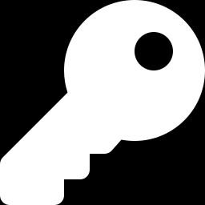
Important Kinds of Links
Link | Meaning | Example | Read as
is-a | a class belongs to a bigger class | Canary —is-a→ Bird | a canary is a kind of bird
instance | one individual belongs to a class | Tweety —instance→ Canary | Tweety is one canary
has / has-part | a part or property | Bird —has→ feathers | birds have feathers
can | an ability | Bird —can→ fly | birds can fly
other relations | any named relation | Cow —gives→ milk | cows give milk
Tip: is-a joins two CLASSES (Canary, Bird). instance joins an INDIVIDUAL to a class (Tweety, Canary).
CS4305 Artificial Intelligence | Lecture 10
5

Slide 6
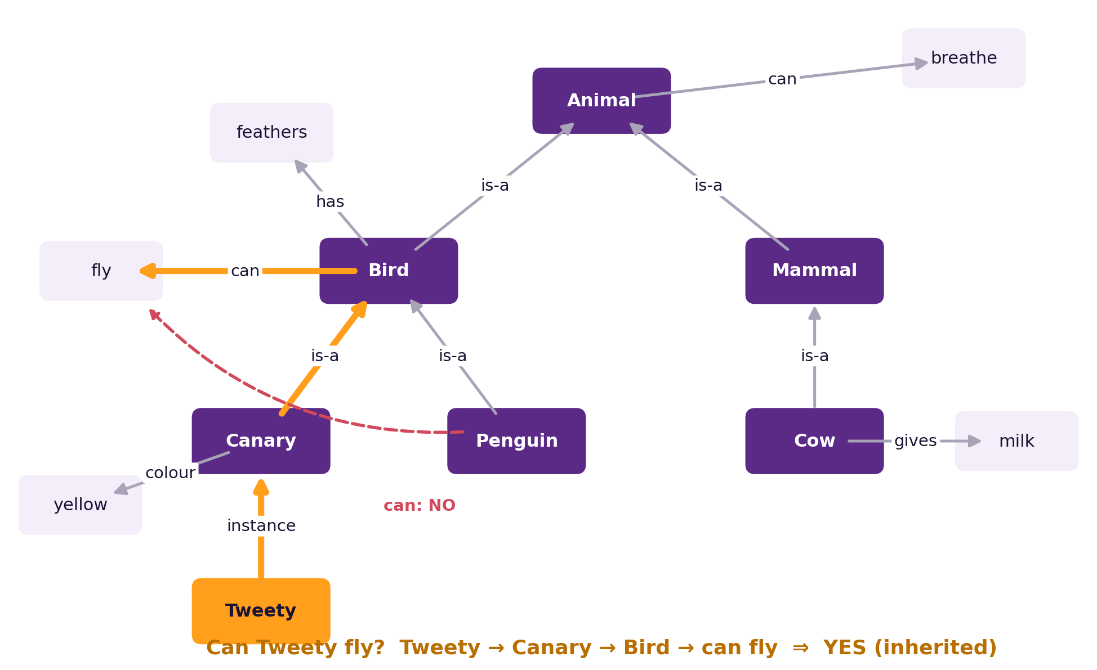
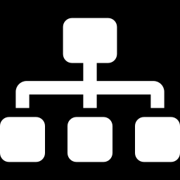

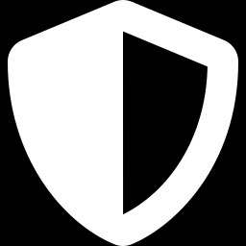
Inheritance: Knowledge for Free
We never wrote "Tweety can fly". The computer climbs the is-a links until it finds the answer.
Saves space: "can fly" is stored ONCE at Bird, not for every bird.
Exception: Penguin has its own "can: NO fly". The closer (lower) information wins.
CS4305 Artificial Intelligence | Lecture 10
6

Slide 7
Semantic Networks: Good and Bad Points
Advantages
Disadvantages
Easy to draw and understand
Related knowledge is close together
Inheritance saves a lot of space
Easy to answer "is X a kind of Y?"
Link names can mean different things to different people
Hard to say "all", "some" or "not" exactly
Exceptions make answers tricky
Large networks become messy
CS4305 Artificial Intelligence | Lecture 10
7

Slide 8
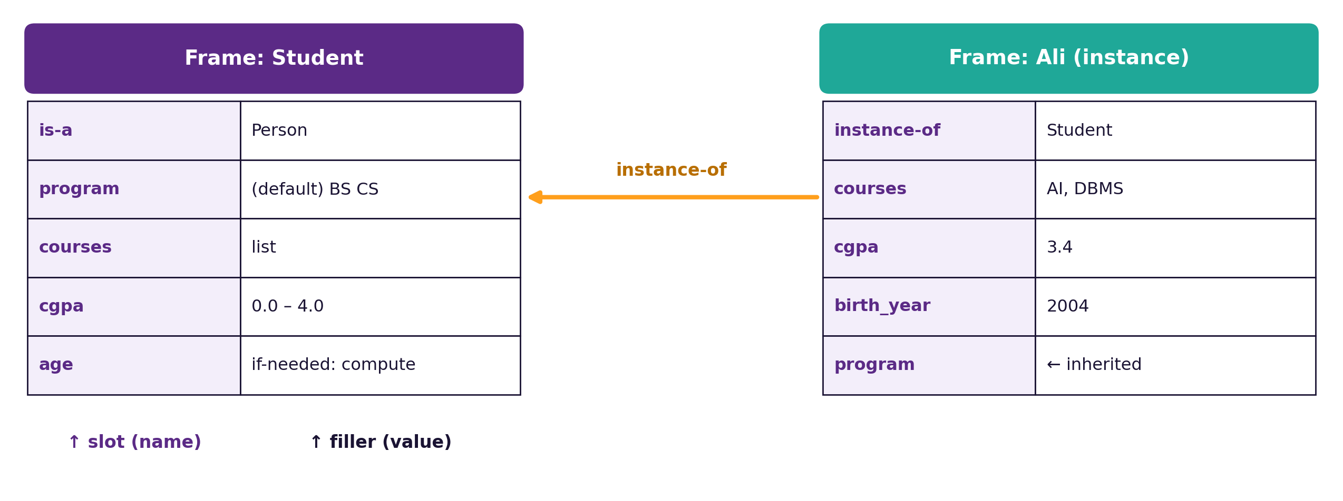
Frames: Knowledge as a Form
Frame (Marvin Minsky, 1974) = a data structure for one kind of object or situation, made of slots (fields) and fillers (values). Like a form you fill in at the bank.
CS4305 Artificial Intelligence | Lecture 10
8

Slide 9
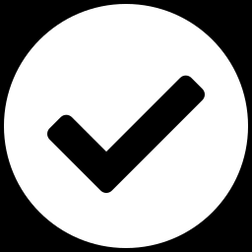
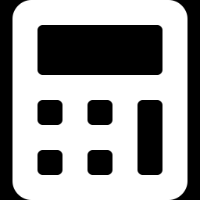
What Can a Slot Hold?
A value
A default value
cgpa: 3.4
courses: AI, DBMS
program: BS CS — used unless we say otherwise (Sara: BS AI).
An inherited value
A procedure
legs: 2 comes from the Person frame.
"if-needed": age = 2026 − birth_year, calculated only when someone asks.
Frames are the grandparents of classes and objects in Python, Java and C++.
CS4305 Artificial Intelligence | Lecture 10
9

Slide 10
Frames and Object-Oriented Programming
Frame idea | OOP idea | Example
frame | class | Student
instance frame | object | Ali
slot | attribute / field | cgpa
default value | default attribute value | program = "BS CS"
is-a link | inheritance (extends) | Student is-a Person
if-needed procedure | method / property | age computed from birth_year
Python
class Person:
legs = 2
class Student(Person):
program = "BS CS"
def age(self):
return 2026 - self.birth_year
CS4305 Artificial Intelligence | Lecture 10
10

Slide 11
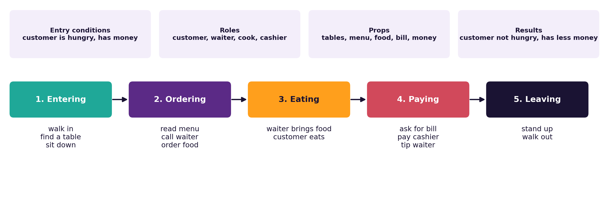
Scripts: Stories of What Usually Happens
Script (Roger Schank & Robert Abelson, 1977) = a frame for a SEQUENCE of events in a familiar situation, like going to a restaurant.
CS4305 Artificial Intelligence | Lecture 10
11

Slide 12
The Parts of a Script
Part | Meaning | Restaurant example
Entry conditions | must be true before the script starts | customer is hungry and has money
Roles | the people involved | customer, waiter, cook, cashier
Props | the objects used | table, menu, food, bill, money
Scenes | the events, in order | entering → ordering → eating → paying → leaving
Results | what is true after the script | customer is not hungry, has less money
Track | a variation of the script | fast-food, dhaba, fine dining
Class activity: write the script for "taking an exam in the exam hall".
CS4305 Artificial Intelligence | Lecture 10
12

Slide 13
Why Scripts Are Useful: Filling in the Gaps
A short story
"Ali went to a restaurant. He ordered biryani.
He left happily."
Question | Said in the story? | Answer using the script
Did Ali sit down? | No | Probably yes (Entering scene)
Did Ali eat the biryani? | No | Probably yes (Eating scene)
Did Ali pay? | No | Probably yes (Paying comes before Leaving)
Was Ali hungry before? | No | Yes (entry condition)
People understand stories this way all the time — scripts give computers the same common sense.
CS4305 Artificial Intelligence | Lecture 10
13

Slide 14
Comparing the KR Methods
Method | Knowledge looks like | Best for | Weakness
Logic | true/false sentences | exact proofs | hard to write, slow
Rules | IF-THEN | expert decisions | many rules become messy
Semantic network | graph of concepts | classes and inheritance | vague link meanings
Frames | forms with slots | describing objects | weak for complex reasoning
Scripts | sequence of events | understanding stories | only for familiar situations
Real systems often MIX them: e.g. frames for objects + rules for decisions.
CS4305 Artificial Intelligence | Lecture 10
14

Slide 15
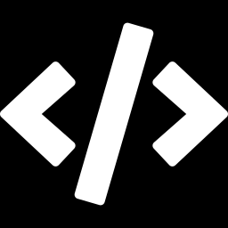
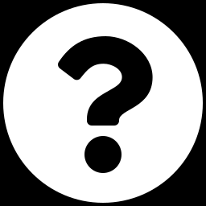
Practical: Colab Lab 10
Open CS4305_Lab10_Semantic_Nets_Frames_Scripts.ipynb in Google Colab
Build a network
Inheritance
Frames
With networkx, and draw it
What can Tweety do? A Penguin?
Slots, defaults and if-needed age
Frames vs classes
Restaurant script
Answer questions
The same idea in Python OOP
Fill in the missing events
"Did Ali pay?"
In the notebook: each part starts with a 📊 picture that explains the idea, then the 💻 code, then 📝 lab tasks at the end.
CS4305 Artificial Intelligence | Lecture 10
15

Slide 16
Summary
Semantic network: nodes = concepts, labelled arrows = relations (is-a, instance, has, can).
Inheritance: climb is-a links to find properties; lower exceptions win.
Frame: slots and fillers; values can be defaults, inherited or computed by procedures.
Frames led to classes and objects in OOP.
Script: entry conditions, roles, props, scenes, results — fills gaps in stories.
Choose the method that fits the knowledge; real systems mix methods.
CS4305 Artificial Intelligence | Lecture 10
16

Slide 17
Review Questions
Draw a semantic network for: vehicles, cars, bikes, wheels, engine, "my Mehran".
What is the difference between is-a and instance links?
Explain inheritance and exceptions with the penguin example.
Draw a frame for "Course" with at least 5 slots, including one default value.
What is an if-needed procedure? Give an example.
Write the script for "travelling by train": entry conditions, roles, props, scenes, results.
Compare semantic networks, frames and scripts in a table.
CS4305 Artificial Intelligence | Lecture 10
17

Slide 18

NEXT LECTURE
Expert Systems
Architecture · knowledge engineering · certainty factors · explanation

