Slide 1

CS4305 · LECTURE 11 · APPLICATIONS
Expert Systems
Putting an expert's knowledge inside a computer

Slide 2
Recap and Today's Plan
Today we will learn
Last lecture
1
What an expert system is
Logic, rules, semantic networks
Frames and scripts
Forward and backward chaining
2
Its architecture
3
How it is built (knowledge engineering)
4
Explanations: WHY and HOW
5
Handling uncertainty with certainty factors
CS4305 Artificial Intelligence | Lecture 11
2

Slide 3





What is an Expert System?
Expert system = a computer program that uses the knowledge of human experts to solve problems in ONE narrow area, at the level of an expert.
Narrow domain
Knowledge-based
Explains itself
Handles uncertainty
Only one area: blood infections, laptop faults, loan approval.
Uses rules and facts from experts, not general algorithms.
Can tell you WHY it asks and HOW it decided.
Works with "probably" and "maybe", not only yes/no.
This lecture brings together everything from Lectures 3–10: tools, rules, search and knowledge representation.
CS4305 Artificial Intelligence | Lecture 11
3

Slide 4
Human Expert vs Expert System
 | Human expert | Expert system
Available | working hours, one place | 24/7, many places at once
Cost | expensive, takes years to train | cheap to copy once built
Consistency | can be tired, forgetful or in a hurry | gives the same answer every time
Common sense | yes | no — only knows its rules
Learning | learns from new cases | must be updated by people
Creativity | can handle unusual cases | fails on cases no rule covers
Expert systems SUPPORT experts; they do not replace them.
CS4305 Artificial Intelligence | Lecture 11
4

Slide 5
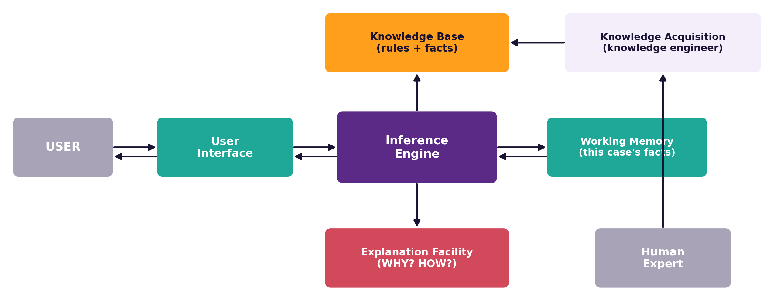
Architecture of an Expert System
CS4305 Artificial Intelligence | Lecture 11
5

Slide 6
What Each Part Does
Part | Job | Laptop Doctor (Lab 11)
Knowledge base | long-term expert knowledge: rules and facts | 7 rules about laptop faults
Working memory | facts about the CURRENT case | "fan is loud", "very hot"
Inference engine | applies rules to reach conclusions | backward chaining
Explanation facility | answers WHY and HOW questions | "R3 fired because..."
User interface | asks questions, shows results | yes / probably / maybe / no
Knowledge acquisition | helps add and update knowledge | the programmer adds rules
CS4305 Artificial Intelligence | Lecture 11
6

Slide 7



Famous Expert Systems
MYCIN (1970s, Stanford)
DENDRAL (1965, Stanford)
Diagnosed blood infections and suggested antibiotics. ~600 rules. Invented certainty factors.
Found the structure of chemical molecules — the first expert system.
XCON (1980, DEC)
PROSPECTOR (1970s, SRI)
Configured computer orders; said to save the company about $25 million a year.
Helped geologists find mineral deposits, including a valuable molybdenum site.
Today: rule engines inside bank loan approval, tax software, insurance claims and technical support.
CS4305 Artificial Intelligence | Lecture 11
7

Slide 8
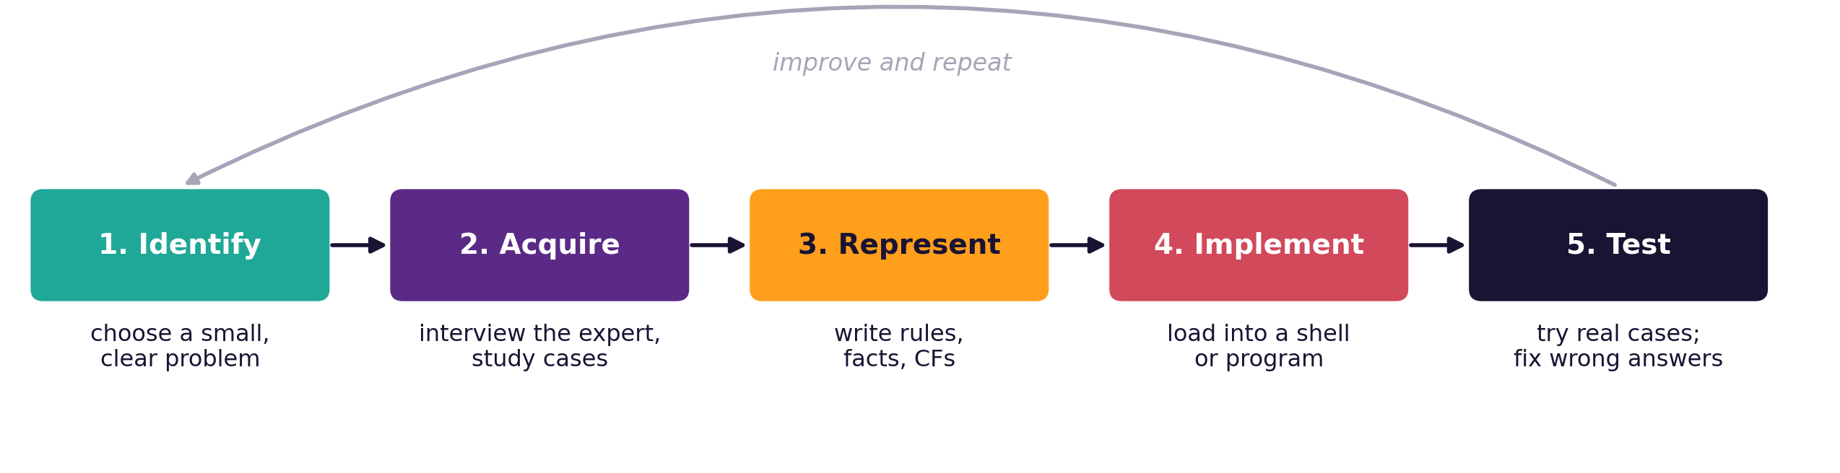



How is an Expert System Built? Knowledge Engineering
Domain expert
Knowledge engineer
End user
knows the subject (doctor, technician)
turns the expert's knowledge into rules
uses the finished system
CS4305 Artificial Intelligence | Lecture 11
8

Slide 9




The Hardest Part: The Knowledge Acquisition Bottleneck
Experts often cannot explain how they decide — it has become automatic for them. Getting knowledge OUT of their heads is slow and difficult.
Interviews
Observation
Case studies
Machine learning
Ask the expert questions about real cases.
Watch the expert work and note each step.
Go through old cases and their solutions.
Learn rules automatically from data (modern approach).
Analogy: an experienced cricket player "just knows" when to hit — but can they write it down as rules?
CS4305 Artificial Intelligence | Lecture 11
9

Slide 10
Explanation Facility: WHY and HOW
WHY — asked during the consultation
HOW — asked after the answer
System: Is the laptop very hot to touch?
User: why
System: I am testing rule R3:
IF fan_very_loud AND hot_to_touch
THEN overheating
User: yes
Diagnosis: overheating (CF 0.74)
HOW: R3 fired (fan loud AND hot)
→ CF 0.48
HOW: R4 fired (shuts down)
→ CF 0.50
Why explanations matter: users TRUST the answer, experts can CHECK the rules, and students can LEARN from the reasoning.
CS4305 Artificial Intelligence | Lecture 11
10

Slide 11
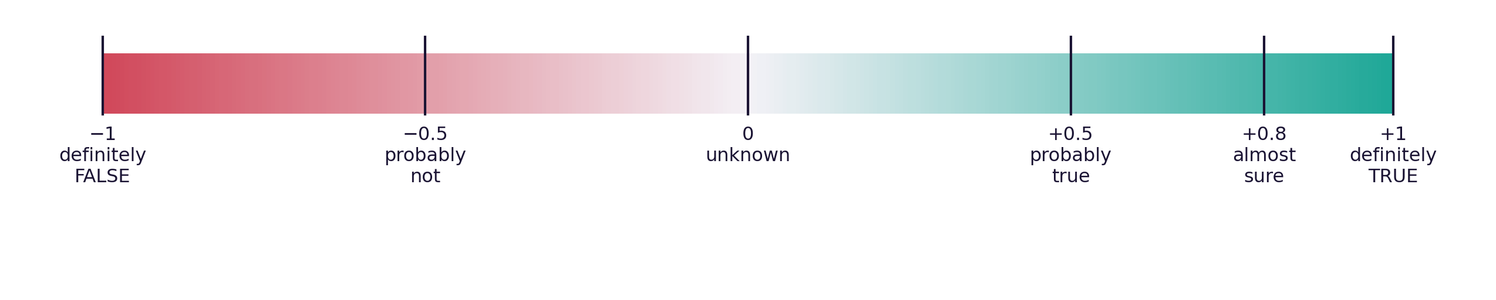
Dealing with Uncertainty: Certainty Factors
Real experts say "it is probably a virus", not "it is definitely a virus". MYCIN attached a certainty factor (CF) to every rule and fact.
A rule with a CF
IF fan_very_loud AND hot_to_touch THEN overheating (CF 0.8)
CS4305 Artificial Intelligence | Lecture 11
11

Slide 12

Calculating with Certainty Factors
Situation | Formula | Example
Conditions joined by AND | take the SMALLEST CF | min(1.0, 0.6) = 0.6
Conditions joined by OR | take the LARGEST CF | max(0.3, 0.7) = 0.7
Rule result | premise CF × rule CF | 0.6 × 0.8 = 0.48
Two rules, same conclusion | CF1 + CF2 × (1 − CF1) | 0.48 + 0.5 × 0.52 = 0.74
Idea: more independent evidence makes us more sure, but the CF never goes above 1.
CS4305 Artificial Intelligence | Lecture 11
12

Slide 13
Expert Systems: Advantages and Limitations
Advantages
Limitations
Keeps rare expert knowledge safe
Fast, consistent, always available
Explains its reasoning
Can train junior staff and students
Works in remote places without experts
Knowledge is hard and slow to collect
No common sense outside its domain
Does not learn by itself
Hard to maintain thousands of rules
Who is responsible if it is wrong?
CS4305 Artificial Intelligence | Lecture 11
13

Slide 14



Practical: Colab Lab 11
Open CS4305_Lab11_Expert_Systems.ipynb in Google Colab
Certainty factors
Knowledge base
Inference engine
Combine evidence step by step
7 laptop-repair rules with CFs
Backward chaining that asks questions
WHY and HOW
Your consultation
CLIPS with salience
The system explains itself
Answer the questions yourself
Priorities in a real shell
In the notebook: each part starts with a 📊 picture that explains the idea, then the 💻 code, then 📝 lab tasks at the end.
CS4305 Artificial Intelligence | Lecture 11
14

Slide 15
Summary
Expert system: expert knowledge + inference in one narrow domain.
Parts: knowledge base, working memory, inference engine, explanation, user interface, knowledge acquisition.
Examples: MYCIN, DENDRAL, XCON, PROSPECTOR; today's rule engines.
Knowledge engineering: identify, acquire, represent, implement, test — repeat.
Explanations: WHY (during) and HOW (after) build trust.
Certainty factors: −1 to +1; AND = min, rule = premise × CF, combine = CF1 + CF2(1 − CF1).
CS4305 Artificial Intelligence | Lecture 11
15

Slide 16
Review Questions
Define an expert system. Give four characteristics.
Draw the architecture of an expert system and explain each part.
Compare a human expert with an expert system (at least 5 points).
What is the knowledge acquisition bottleneck? How can it be reduced?
Explain WHY and HOW explanations with an example.
Two rules give CF 0.7 and CF 0.4 for the same disease. Find the combined CF.
A rule has CF 0.9 and its two conditions have CF 0.8 and 0.5. What CF does its conclusion get?
CS4305 Artificial Intelligence | Lecture 11
16

Slide 17

NEXT LECTURE
Natural Language Processing and Course Review
How computers understand language · putting the whole course together

