Slide 1

CS4305 · LECTURE 12 · APPLICATIONS
Natural Language Processing and Course Review
How computers work with human language — and how the whole course fits together

Slide 2
Recap and Today's Plan
Today we will learn
Last lecture
1
What NLP is and why it is hard
Expert system architecture
Knowledge engineering
WHY / HOW and certainty factors
2
The levels of NLP
3
Grammars and parse trees
4
NLP applications and chatbots
5
Review of the whole course
CS4305 Artificial Intelligence | Lecture 12
2

Slide 3




What is Natural Language Processing?
NLP = the branch of AI that helps computers understand, interpret and produce human languages like English and Urdu.
Understanding (NLU)
Generation (NLG)
Speech
text → meaning
"Book a ticket to Karachi" → book(ticket, Karachi)
meaning → text
weather data → "It will rain tomorrow"
voice → text → meaning → text → voice (voice assistants)
Everyday NLP: Google Translate, spell check, voice assistants, search engines, spam filters, chatbots.
CS4305 Artificial Intelligence | Lecture 12
3

Slide 4

Why is Language Hard for Computers? Ambiguity
Type | Example | Two meanings
Word (lexical) | "I went to the bank." | river bank or money bank?
Structure (syntactic) | "I saw the man with a telescope." | who has the telescope?
Reference | "Ali told Bilal that he passed." | who passed: Ali or Bilal?
Intention (pragmatic) | "Can you open the window?" | a question about ability, or a polite request?
Humans solve this with context and common sense in a split second. Computers must be taught — this is the central problem of NLP.
CS4305 Artificial Intelligence | Lecture 12
4

Slide 5
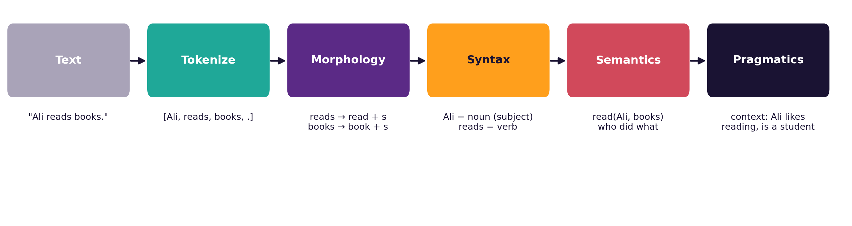
The Levels of NLP
Level | Question it answers
Morphology | How are words built? (read + s, un + happy)
Syntax | Is the sentence grammatical? What is its structure?
Semantics | What does it mean? (who did what to whom)
Pragmatics / discourse | What does the speaker really want, in this context?
CS4305 Artificial Intelligence | Lecture 12
5

Slide 6

First Steps: Tokens, Stems and Lemmas
Tokenization: split text into words
"Dr. Ahmed teaches AI. Don't miss it!"
→ [Dr., Ahmed, teaches, AI, ., Do, n't, miss, it, !]
Word | Stem (chop the end) | Lemma (dictionary form)
studies | studi | study
running | run | run
better | better | good
universities | univers | university
Why? so that "study", "studies" and "studying" are treated as the SAME word when searching or counting.
CS4305 Artificial Intelligence | Lecture 12
6

Slide 7


Syntax (1): Part-of-Speech Tagging
Sara
quickly
solved
the
difficult
assignment
noun (name)
adverb
verb (past)
determiner
adjective
noun
POS tagging labels each word with its grammatical role. It helps with meaning: in "I book a ticket", book is a VERB; in "I read a book", book is a NOUN.
Lab 12 uses NLTK, which tags words automatically with codes like NN (noun), VBD (past verb), JJ (adjective).
CS4305 Artificial Intelligence | Lecture 12
7

Slide 8
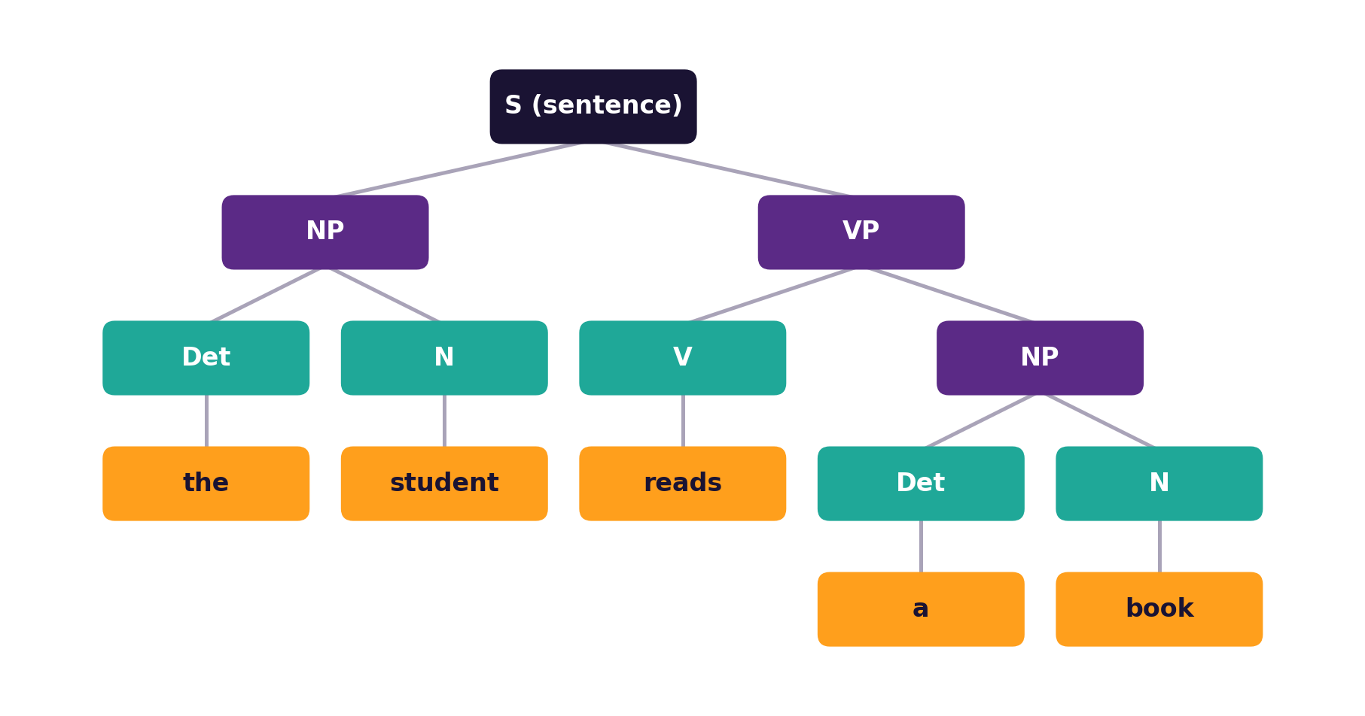
Syntax (2): Grammars and Parse Trees
A tiny grammar
S → NP VP
NP → Det N | Name
VP → V NP
Det → the | a
N → student | book
V → reads
S = sentence, NP = noun phrase, VP = verb phrase, Det = determiner, N = noun, V = verb
CS4305 Artificial Intelligence | Lecture 12
8

Slide 9
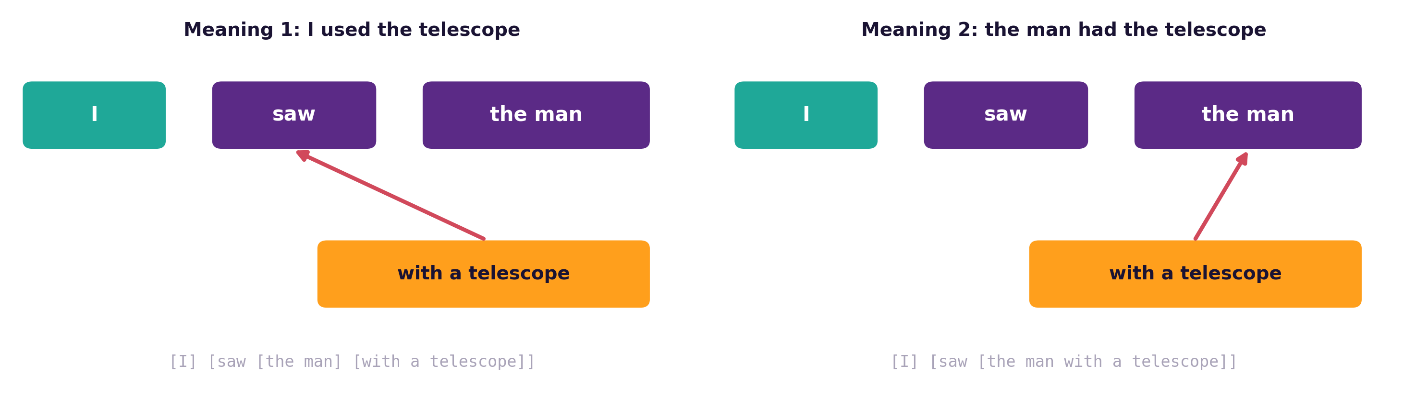

One Sentence, Two Parse Trees
The grammar allows both structures. The parser in Lab 12 finds both trees. Choosing the right one needs meaning and context.
CS4305 Artificial Intelligence | Lecture 12
9

Slide 10


Semantics and Pragmatics: Getting the Meaning
Semantics: literal meaning
Pragmatics: intended meaning
Who did what to whom?
What does the speaker really want?
"Can you pass the salt?" → please pass it (not "yes, I can")
"It's cold in here." → maybe close the window
"The restaurant was great, the bill was not!" → scripts help understand stories
"Ali gave Sara a book."
→ give(giver: Ali,
receiver: Sara,
object: book)
Links back to logic and frames (Lectures 8, 10)!
CS4305 Artificial Intelligence | Lecture 12
10

Slide 11


NLP Applications
Machine translation
Sentiment analysis
Spam filtering
English ↔ Urdu, from phrase rules to neural translation.
Are reviews or tweets positive or negative?
Classify emails using the words they contain.
Speech recognition
Search and Q&A
Chatbots
Voice typing, voice assistants, call centres.
Find answers inside millions of documents.
Help desks, customer service, AI assistants.
CS4305 Artificial Intelligence | Lecture 12
11

Slide 12
Chatbots: From ELIZA to Large Language Models
 | Rule-based chatbot | Large Language Model (LLM) chatbot
Example | ELIZA (1966), simple help desks | modern AI assistants (2022 onwards)
How it works | matches keywords and patterns written by people | predicts the next word, learned from huge amounts of text
Knowledge | only what the rules contain | very broad, learned from data
Strength | predictable, easy to control, explainable | fluent, flexible, handles new questions
Weakness | breaks on anything unexpected | can sound confident but be wrong; hard to explain
In Lab 12 you build a rule-based university help-desk bot — the same idea as ELIZA in Lab 1.
CS4305 Artificial Intelligence | Lecture 12
12

Slide 13

PART 2
Course Review
Twelve lectures, one big picture

Slide 14
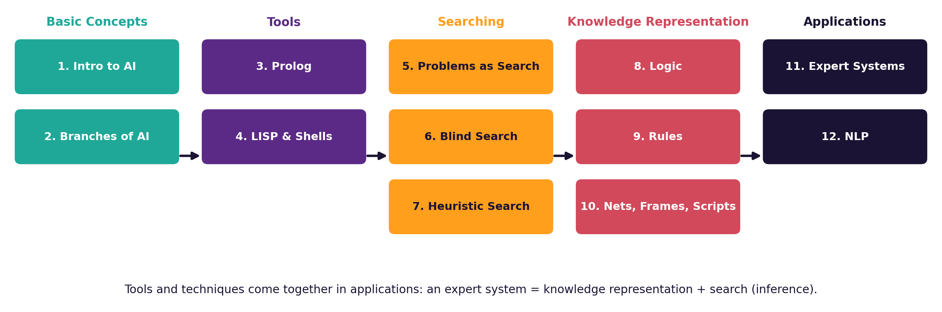
CS4305 on One Page
CS4305 Artificial Intelligence | Lecture 12
14

Slide 15
Key Ideas to Remember (1)
Topic | Remember this
Intelligence & AI | 4 approaches; Turing Test; rational agents do the right thing
Branches | ML, NLP, vision, robotics, expert systems, fuzzy logic
Prolog | facts, rules, queries; unification and backtracking
LISP & shells | prefix lists, car/cdr/cons; shell = engine with empty knowledge base
Problem as search | initial state, actions, result, goal test, path cost
Blind search | BFS (queue), DFS (stack), UCS (cheapest), IDDFS (best of both)
CS4305 Artificial Intelligence | Lecture 12
15

Slide 16
Key Ideas to Remember (2)
Topic | Remember this
Heuristic search | Greedy f = h; A* f = g + h (optimal if h admissible); hill climbing
Logic | truth tables; P → Q false only when T → F; ∀ with →, ∃ with ∧
Rules | match–resolve–act; forward (data-driven) vs backward (goal-driven)
Nets, frames, scripts | is-a inheritance; slots and defaults; scenes of usual events
Expert systems | KB + engine + explanation; certainty factors combine evidence
NLP | levels: morphology, syntax, semantics, pragmatics; ambiguity is the big problem
CS4305 Artificial Intelligence | Lecture 12
16

Slide 17

How Everything Connects
Example: a medical expert system that talks to patients uses almost the whole course.
NLP
understand "I have fever and rash"
Knowledge Representation
rules, frames for diseases
Search / Inference
backward chaining
Certainty factors
"dengue, CF 0.8"
NLP
reply in plain words
Tools such as Prolog, LISP or a shell like CLIPS make building it faster.
CS4305 Artificial Intelligence | Lecture 12
17

Slide 18



Practical: Colab Lab 12
Open CS4305_Lab12_NLP_and_Review.ipynb in Google Colab
Tokens & lemmas
POS tags
Parse trees
Split and normalise text
Label every word
Grammar + parser; spot bad sentences
Ambiguity
Sentiment & chatbot
Review quiz
Two trees for one sentence
Two small NLP applications
8 questions on the whole course
In the notebook: each part starts with a 📊 picture that explains the idea, then the 💻 code, then 📝 lab tasks at the end.
CS4305 Artificial Intelligence | Lecture 12
18

Slide 19
Summary
NLP = understanding and generating human language; ambiguity is the main challenge.
Levels: tokens → morphology → syntax → semantics → pragmatics.
Grammars give parse trees; one sentence can have several trees.
Applications: translation, sentiment, spam, speech, search, chatbots.
Chatbots moved from hand-written rules (ELIZA) to learned language models.
CS4305: concepts → tools → search → knowledge representation → applications.
CS4305 Artificial Intelligence | Lecture 12
19

Slide 20
Review Questions
Define NLP. Differentiate NLU and NLG with examples.
Give an example of lexical, syntactic and referential ambiguity.
List the levels of NLP and what each one does.
Differentiate stemming and lemmatization with two examples.
Write a small grammar and draw the parse tree for "a teacher helps the student".
Compare a rule-based chatbot with an LLM-based chatbot.
Explain how search, knowledge representation and NLP work together in one AI system.
CS4305 Artificial Intelligence | Lecture 12
20

Slide 21
THANK YOU
Good luck in your exams!
CS4305 Artificial Intelligence — questions and discussion

