Slide 1
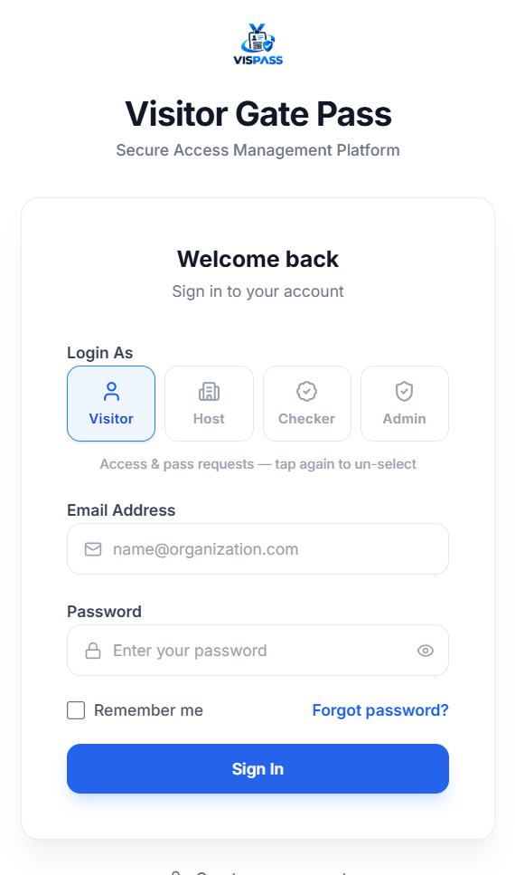
PROJECT INTRODUCTION
VISPASS
Visitor Entry & Gate Pass Management System
A digital solution for secure visitor registration and event entry.
Built with React.js, FastAPI and PostgreSQL.
Presented by: M. Hajmal Irfan
Department: B.E. CSE – Cyber Security
Live app: https://vispass-frontend.onrender.com/

Slide 2
Problem Statement
Traditional visitor entry depends on paper registers and manual verification.
1
Event hosts struggle to manage large numbers of visitor applications.
2
Manual approval and gate-pass generation consume time.
3
Paper records are hard to track, search and audit.
4
Security staff need a faster way to verify approved visitors.
5
VISPASS
2

Slide 3
Proposed Solution
A centralized digital platform to manage event-based visitor entry.
Hosts create and manage events.
Visitors submit details and apply for events.
Hosts accept or reject applications.
Approved visitors receive a unique QR gate pass.
Checkers scan the QR code to verify the pass and record entry.
All visitor and entry records are stored in the database.
Live application login
VISPASS
3

Slide 4
User Roles & Access Control
Host
Visitor
Checker (Security)
Admin
Create and manage events
Review visitor applications
Approve or reject visitors
View attendance and reports
Register and log in
Browse events and apply
Track application status
View QR pass after approval
Scan visitor QR codes
Verify pass validity
Record check-in and check-out
Manage users and access
Oversee system activity
Role-based access control (RBAC) restricts each user to authorized operations.
VISPASS
4

Slide 5
System Architecture
React.js
Frontend
UI & dashboards
FastAPI
Backend
REST APIs & business logic
PostgreSQL
Database
Application & entry records
→
→
JWT Authentication
Token-based login and role checks
QR Module
Generates and validates unique gate-pass tokens
File Storage
Securely stores visitor photos and ID proofs
VISPASS
5

Slide 6
Database Design
users
Account details and roles
visitor_profiles
Visitor contact and profile info
events
Title, host, venue, date, capacity
event_registrations
Applications, purpose, approval status
qr_passes
Unique QR tokens and validity
entry_logs
Checker, check-in and check-out
A host creates events; visitors apply; approved registrations receive QR passes; scans create entry logs.
VISPASS
6

Slide 7
Application Workflow
1
2
3
4
5
6
7
Host creates event
Visitor applies
Host approves / rejects
QR pass generated
Visitor shows QR at gate
Checker scans & verifies
Records stored in PostgreSQL
Approved applications move from the host to the gate in a single secure QR-based flow.
VISPASS
7

Slide 8
Benefits & Future Enhancements
Expected Benefits
Future Enhancements
Faster visitor verification
Reduced paperwork and manual effort
Centralized event and visitor records
Better access control and traceability
Easier attendance monitoring and reporting
Email or SMS notifications
QR pass expiry and duplicate-scan prevention
Analytics dashboard and downloadable reports
Multi-factor authentication and audit-log monitoring
VISPASS makes event registration and visitor entry more efficient, organized and secure.
VISPASS
8

