Slide 1



SUMMER
TRAINING
Instructor : Doaa M.Taha
Data Analyst

Slide 2
Session 5
Advanced Functions & Lists

Slide 3
Learning Outcomes
By the end of this session, you will be able to:
Understand variable-length arguments.
Use lambda functions.
Understand recursion.
Create and manipulate lists.
Access and update list elements.
Apply common list methods.

Slide 4
Review
Quick Questions
What is a function?
Difference between print() and return?
What is a parameter?
What is an argument?
What is a local variable?

Slide 5
Arbitrary Arguments (*args)
Sometimes we don't know how many arguments will be passed.
def total(*numbers):
print(numbers)
total)10,20)
total )1,2,3,4,5)
Total(2,6,8,5,7,9,7)

Slide 6
Example
def total(*numbers):
print(sum(numbers))
total(1,2,3)
total(10,20,30,40)
Exercise
Create
average(*numbers)

Slide 7
Keyword Arguments (**kwargs)
def student(**info):
print(info)
student(name="Ali", age=20, city="Cairo")

Slide 8
Lambda Function
A lambda is a small anonymous function.
Syntax
lambda arguments : expression
Example
square = lambda x : x*xprint(square(5))

Slide 9
More Lambda Examples add = lambda x,y :x+y print(add(5,3)) maximum = lambda a,b : a if a>b else b print(maximum(8,3))

Slide 10
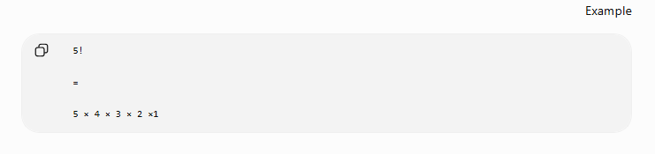
What is Recursion?
A recursive function calls itself.

Slide 11
Factorial Using Recursion
def factorial(n):
if n==1:
return 1
return n*factorial(n-1)
print(factorial(5))

Slide 12
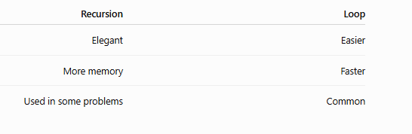
Recursion vs Loop

Slide 13
What is a List?
A list is a collection of multiple values.
Example
numbers=[10,20,30,40]
print(numbers)

Slide 14
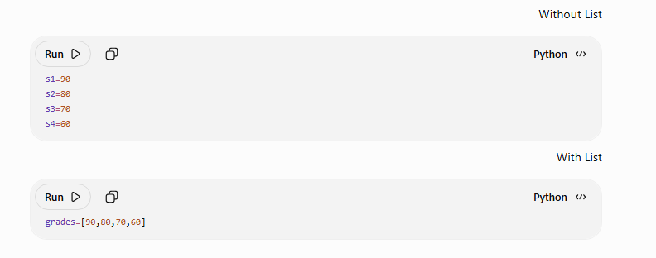
Why Lists?

Slide 15
Creating Lists names=["Ali","Ahmed","Sara"] numbers=[10,20,30] mixed=[1,"Ali",True,5.5]

Slide 16
Accessing Elements
names=["Ali","Ahmed","Sara"]
print(names[0])
print(names[2])
Negative Index
numbers=[10,20,30,40]
print(numbers[-1])
print(numbers[-2])

Slide 17

Updating List
List Length
numbers=[10,20,30]
numbers[1]=50
print(numbers)
names=["Ali","Sara","Ahmed"]
print(len(names))

Slide 18

Loop Through List
append()
numbers=[10,20,30]
for n in numbers:
print(n)
numbers=[10,20]
numbers.append(30)
print(numbers)

Slide 19
insert()
remove()
numbers=[10,30]
numbers.insert(1,20)
print(numbers)
numbers=[10,20,30]
numbers.remove(20)
print(numbers)
pop()
sort()
numbers=[10,20,30]
numbers.pop()
print(numbers)
numbers=[8,2,5,1]
numbers.sort()
print(numbers)

Slide 20
Practice
Create a list of students.
Add one student.
Remove one student.
Print all students.

Slide 21
Mini Project
Student Grade System
Create functions to
Add Grade
Remove Grade
Print Grades
Calculate Average
Find Highest Grade

Slide 22
“Task”
Largest Number
Smallest Number
Sum of List
AverageCount Even NumbersReverse ListSearch for ElementRemove DuplicatesSort DescendingStudent Management

