Slide 1



SUMMER
TRAINING
Instructor : Doaa Mohammed
Data Analyst

Slide 2
Session 2: Variables & Data Types

Slide 3
Session 2 Roadmap
01. Variables & Naming Conventions.
02. Core Data Types.
03. Type Casting & User Input.
4.Hands-on Lab: The Dynamic Calculator.
05. Thank You

Slide 4
Variables: Data Containers
Reserved memory slots to store values.
Dynamic Typing: Python automatically detects the data type.
Example: x = 10 (Assigning 10 to variable x).

Slide 5
Naming Conventions
Snake Case: Use my_variable_name (Standard Python style).
Rules: Must start with a letter or underscore, never a number.
Avoid: Keywords like print , int , str as variable names.

Slide 6
Introduction to Data Types
Integers (int): Whole numbers (e.g., 5, -10).
Floats (float): Numbers with decimals (e.g., 3.14).
Strings (str): Text enclosed in quotes (e.g., "Hello").
Booleans (bool): Logical values (True or False).

Slide 7
Numbers in Python
Operations: + , - , * , / .
/ =➔ Float
int vs float: Python manages the difference automatically in math.

Slide 8
Break Time! (15 Minutes)

Slide 9
Strings: The Basics
Concatenation: "Hello" + " " + "World".
Indexing: Accessing characters by position (starts at 0).

Slide 10
Questions :
What is the output of the following code: print("20" + "24")?
How can we add a space between these two strings: first_name = "NTI" and last_name = "Training"?
If word = "Python", what is the value of word[0]?
What will happen if we try to access word[10] in the string "Python"?

Slide 11
Task(1)
"Create a variable named course with the value 'Programming'. Write a print statement to show only the letter 'r' from this word."

Slide 12
Booleans: Logical Flow
Booleans: True or False
Used for decision-making.
Example: 10 > 5 = True.

Slide 13
Checkpoint: Mini-Quiz
Which of these is invalid?
user_name
1st_name
total_score
What type is 5.0?

Slide 14
Break Time! (15 Minutes)

Slide 15
Type Casting
Type Casting: Converting Types
int(): Convert to integer.
int(“20”) >>> 20
float(): Convert to decimal.
str(): Convert to string.

Slide 16
Questions :
What is the output of print(int(10.9))?
Can we convert the string "3.14" to an integer directly using int("3.14")?

Slide 17
Getting User Input
The input() Function
Captures user data as a String.
Example: name = input("Enter your name: ").

Slide 18
Handling Input & Casting
Problem: age = input("Age: ") stores "20" (text), not 20 (number).
Solution: age = int(input("Age: ")).

Slide 19
Error Handling Basics
What if a user enters "ABC" when you ask for a number?
Python will raise a ValueError.
Tip: Always validate user input.

Slide 20
Hands-on Lab 2: Calculator
Task 1: Ask user for two numbers.
Task 2: Perform addition, subtraction, multiplication.
Task 3: Print results with descriptive messages.

Slide 21
Quick Quiz
1.Which of the following is a VALID variable name in Python?
2nd_user
user-name
total_score
class
2.What is the data type of x = 10.0?
Int
Float
String
bool

Slide 22
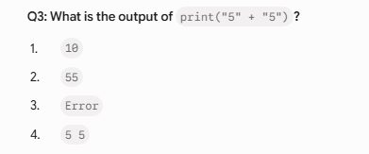
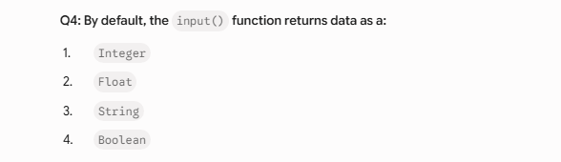

Slide 23
The Lab Challenge
Ask for user name and birth year.
Calculate current age (assuming 2026).
Print: "Hello [Name], you are [Age] years old!"

Slide 24
Summary
Variables store and manage data.
Naming conventions matter for professional code.
Input requires casting to work with numbers.

Slide 25
Questions?

Slide 26
Thank You
Keep practicing variables and input logic.
Instructor: Doaa Mohammed
Email: da9044964@gmail.com
See you in Session 3!

