Slide 1



SUMMER
TRAINING
Instructor : Doaa M.Taha
Data Analyst

Slide 2
Session 6 :Tuples & Sets

Slide 3
Learning Outcomes
By the end of this session, you will be able to:
Define tuples and sets.
Create tuples and sets.
Access tuple elements.
Understand tuple immutability.
Use common set methods.
Perform set operations.
Solve problems using tuples and sets.
r

Slide 4
Review
Quick Questions
What is a list?
Is a list mutable?
How do we add an element to a list?
How do we remove an element?
What is indexing?

Slide 5
What is a Tuple?
A tuple is an ordered collection of items.
A tuple is immutable, which means its values cannot be changed after creation.
Syntax
numbers = (10, 20, 30)

Slide 6
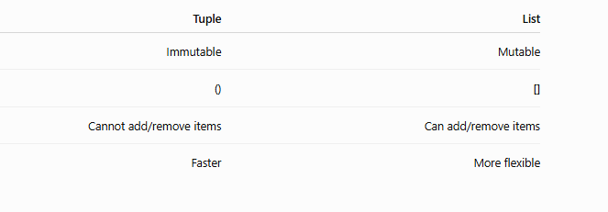
Tuple vs List

Slide 7
Creating Tuples
numbers = (10,20,30)
names = ("Ali","Sara","Ahmed")
mixed = (10,"Ali",True,3.5)
empty = ()

Slide 8
Accessing Tuple Elements
names = ("Ali","Sara","Ahmed")
print(names[0])
print(names[2])
print(names[-1])

Slide 9
Tuple Packing & Unpacking
student = ("Ali",20,"Cairo")
name, age, city = student
print(name)
print(age)
print(city)

Slide 10
Tuple Methods
Only two methods are available
numbers=(1,2,3,2,4,2)
print(numbers.count(2))
print(numbers.index(3))

Slide 11
Can We Modify a Tuple?
numbers=(10,20,30)
numbers[0]=100
Question❓
What will happen?
Answer: TypeError because tuples are immutable.

Slide 12
Practice
Create a tuple containing:
5 student names
Print:
First student
Last student
Number of students

Slide 13
What is a Set?
A set is an unordered collection of unique values.
Duplicate values are removed automatically.

Slide 14
Creating Sets
numbers = {1,2,3,4}
colors = {"Red","Blue","Green"}
Duplicate Values
numbers={1,2,3,2,1,4,5,5}
print(numbers)

Slide 15
Set Characteristics
Unordered
Mutable
No duplicate values
No indexing
Adding Elements
numbers={1,2,3}
numbers.add(4)
print(numbers)

Slide 16
Removing Elements
numbers={1,2,3,4}
numbers.remove(2)
print(numbers)
More Set Methods
numbers={1,2,3}
numbers.pop()
numbers.clear()

Slide 17

Union
A={1,2,3}
B={3,4,5}
print(A | B)
Intersection
A={1,2,3}
B={3,4,5}
print(A & B)

Slide 18
Difference
Practice
A={1,2,3}
B={3,4,5}
print(A-B)
Find:
Union
Intersection
Difference
between two sets.

Slide 19
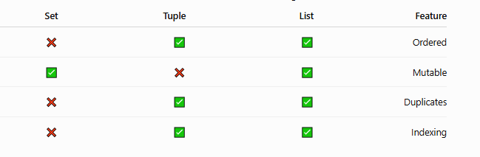
Comparison Table

Slide 20
Hands-on Lab
Write programs to:
Create a tuple of 5 numbers.
Find the length of a tuple.
Unpack a tuple.
Create a set from a list.
Remove duplicates.
Find union.
Find intersection.
Find difference.

Slide 21
Task
Student Information (Tuple)
Employee Information (Tuple)
Remove Duplicate Names
Union of Two Sets
Intersection of Two Sets
Difference Between Sets
Favorite Movies Set
Student Subjects Comparison

Slide 22
Thank You

