Slide 1



SUMMER
TRAINING
Instructor : Doaa M.Taha
Data Analyst

Slide 2
Session 8 : Working with Files in Python

Slide 3
Learning Outcomes
By the end of this session, you will be able to:
By the end of this session, you will be able to:
Understand file handling in Python.
Open and close files.
Read data from files.
Write data to files.
Append data to existing files.
Use the with statement.
Solve file handling problems.
r

Slide 4
Review
Quick Questions
What is a dictionary?
What is a key-value pair?
Which method returns all keys?
What is get() used for?

Slide 5
What is a File?
A file is used to store data permanently on your computer.
Examples:
.txt
.csv
.json
.py

Slide 6
Working on Different IDEs
VS Code
Create a .txt file manually.
Save it in the same folder as your Python file.
Google Colab
Create the file using Python code.
Or upload the file using the Files panel.

Slide 7
Why Do We Use Files?
Without files:
Data is lost when the program ends.
With files:
Data is saved permanently.
Easy to store and retrieve information.

Slide 8
Opening a File
file = open("students.txt", "r")
Parameters:
File Name
Mode

Slide 9
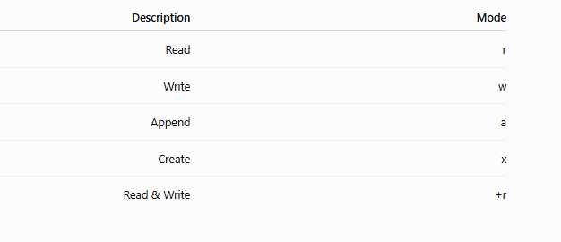
File Modes

Slide 10
Reading a File
file = open("students.txt", "r")
print(file.read())
file.close()
read()
Reads the entire file .
Example
print(file.read())

Slide 11
Break

Slide 12
readline()
Reads one line.
print(file.readline())
readlines()
Returns a list of all lines.
lines = file.readlines()
print(lines)

Slide 13
Closing Files
Always close files after using them.
file.close()
Writing to a File
file = open("students.txt", "w")
file.write("Ahmed")
file.close()

Slide 14
Appending Data
file = open("students.txt", "a")
file.write("\nSara")
file.close()
“A" adds data without deleting existing content.
Using with Statement
Advantages:
Automatically closes the file.
Cleaner code.

Slide 15
File Exists?
import os
print(os.path.exists("students.txt"))
Example
Save student names into a file.
with open("students.txt", "w") as file:
file.write("Ali\n")
file.write("Sara\n")

Slide 16
Hands-on Lab
Write programs to:
Create a text file.
Write names.
Read names.
Append data.
Count lines.
Count words.
Copy file content.
Display file content.

Slide 17
TASK
Student File
Employee File
Product File
Count Characters
Count Words
Count Lines
Copy File
Append Data
Search for a Name
Mini Student Record System

Slide 18
Thank You

