Slide 1
ROS-Industrial Developers Meeting (2015-1-12)
Shaun Edwards

Slide 2
Agenda
Intros (only new people) - 5 min
Repo status (highlights) - 10 min
Update on previous meeting action items - 5 min
New development discussions - 30 min
QTCreator ROS Plugin
MachineKit Integration
General announcements - 10 min

Slide 3
Intros (new people)
Who are you?
Where do you work?
Role in ROS-I: developer, maintainer, documenter, organizer, tester, looking for one

Slide 4
Repo Status (Highlights)
Current Development
New repos
staubli_experimental
godel
Upcoming Development
CRCL
MTConnect-CRCL bridge
Industrial core
Partial support for multiple motion groups
Open Issues
Canopen license status
UR C++ driver
See meeting notes for details

Slide 5
Previous Action Items
Follow up with Canonical, inform them of the ROS-I discussion
Ragnar pick and place – Shaun
CAD to ROS – Gijs/Paul
ROS-I hardware platform – Mirko
OPC UA Update

Slide 6
New Development
QTCreator ROS Plugin - Levi Armstrong
MachineKit Integration - Charles Steinkuehler

Slide 7
QT Creator ROS Plugin
Levi Armstrong

Slide 8
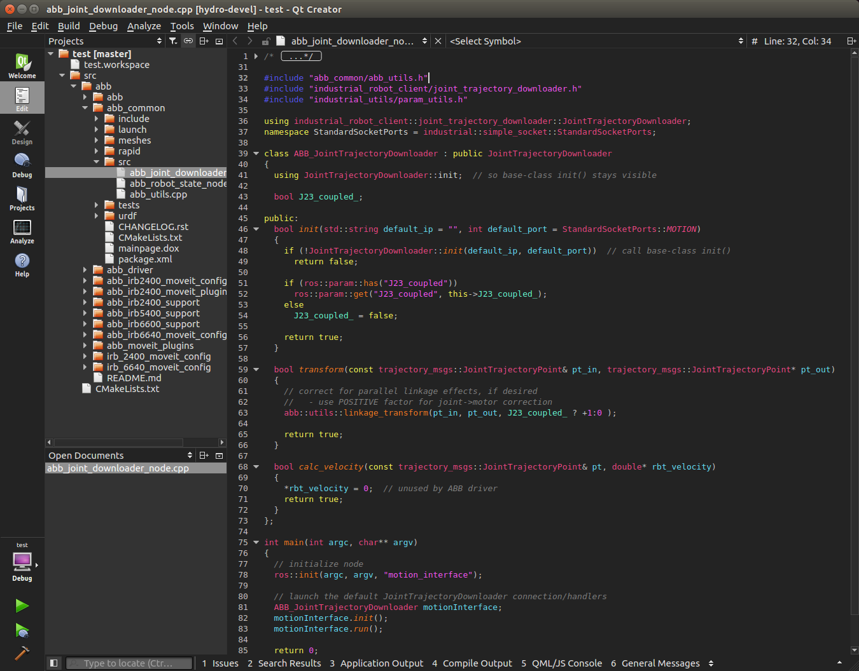
Customized IDE for ROS
Current Development
Project Manager
Future Development
Standard Templates
.launch, .msg, .srv, .urdf
New package
Basic node
User defined templates
Custom File Editors
.launch
.urdf
.macro
Formatting Tool
Provide ROS format warnings
Interface to existing ROS Tools
rosnode list
rosparam list
Dock all existing ROS GUI tools
Rqt
SMACH
Global Settings

Slide 9
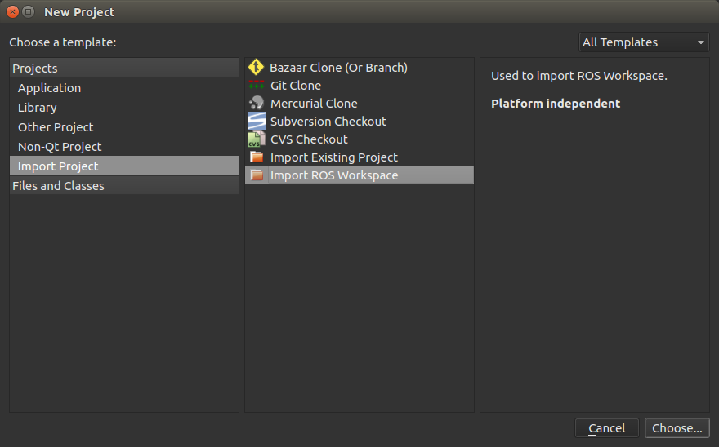
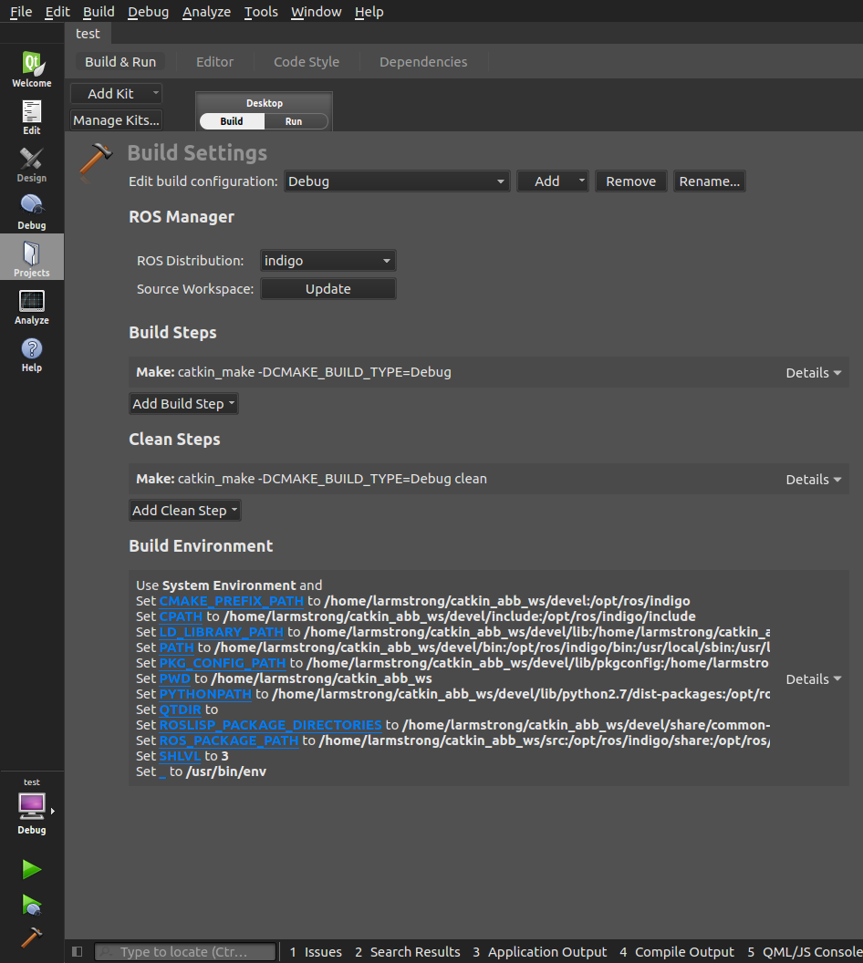
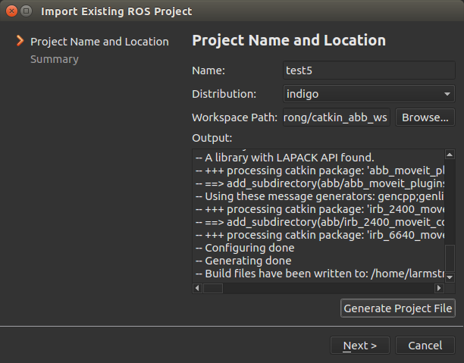
ROS Project Manager Plugin

Slide 10
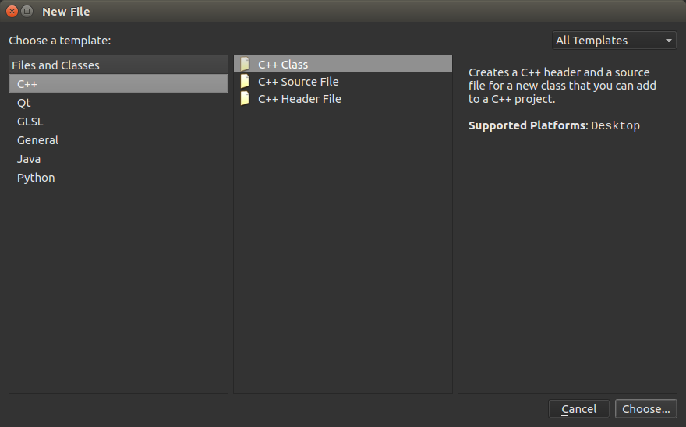
Repo Status (Highlights)
Current Development
Project Manager Plugin
Import project
Build Configuration
Upcoming Development
Project Manger Plugin
Run Configuration
ROS Template Plugin
Repo: https://github.com/Levi-Armstrong/ros_qtc_plugins
Ideas: https://github.com/Levi-Armstrong/ros_qtc_plugins/issues/3
Setup: https://github.com/Levi-Armstrong/ros_qtc_plugins/wiki/Setup-for-development.

Slide 11
Machinekit & ROS-Industrial (2015-1-12)
Charles Steinkuehler

Slide 12
Machinekit HAL
Virtual electronics lab-bench with real-world physical I/O
Lots of stock components (PID, stepgen, debounce, filters, etc)
Virtual wires (atomic values in shared memory)
Test equipment (HALScope, HALMeter)
Dynamic environment – No Compiling!
Components and signals can be added and deleted at run-time
Python and C bindings to create and interact with HAL objects
Real-world connectivity to physical signals
Step/direction, Encoders, PWM, GPIO, and other I/O available
x86 support for LPT and “smart” FPGA I/O cards (Open Source VHDL!)
BeagleBone supports GPIO driven by PRU for fine-grained timings
Can run without hardware in a simulated environment for testing

Slide 13
Connecting ROS to Machinekit
ROS Message ↔ Machinekit HAL
Directly connect signals (atomic values)
Ring and triple buffers for signal groups
Protobuf messages
Where to tie into ROS?
Value updates are easy (both directions)
“Middleware” is more complicated:
Joint homing & enforcing limits
Small time-scale path planning and closing servo loops
Can be in ROS or Machinekit or both
Reuse existing ROS code (ros_control?)

Slide 14
Example (Simple) Applications
Physical stepper tracking JointTrajectory messages from ROS:
https://youtu.be/b4O2KU2bLWE
Three stepper motors tracking 3D mouse:
https://youtu.be/m0OeaTcWTZA
Machinekit HAL values → ROS Message:
https://github.com/mhaberler/ros_hello_machinekit

Slide 15
Announcements
High-DOF Planning for Assembly –NIST Cooperative Agreement
Descartes/MoveIt improvements/extensions
Asus Xtion Pro Live availability - http://www.newegg.com/Product/Product.aspx?Item=N82E16826785030

Slide 16
Action Items
Incorporate Travis CI – It’s so easy - https://github.com/ros-industrial/industrial_ci/blob/master/README.rst
Close/address Issues/PRs

