Slide 1
TRACLabs Background
Established January 1997
Location: Houston Texas, near NASA Johnson Space Center
Purpose: Conducting world-class research in Automation and Robotics, with the mission to develop new technologies and products for emerging markets
20 full-time scientists and engineers

Slide 2
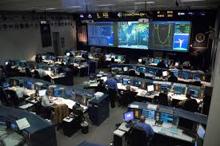
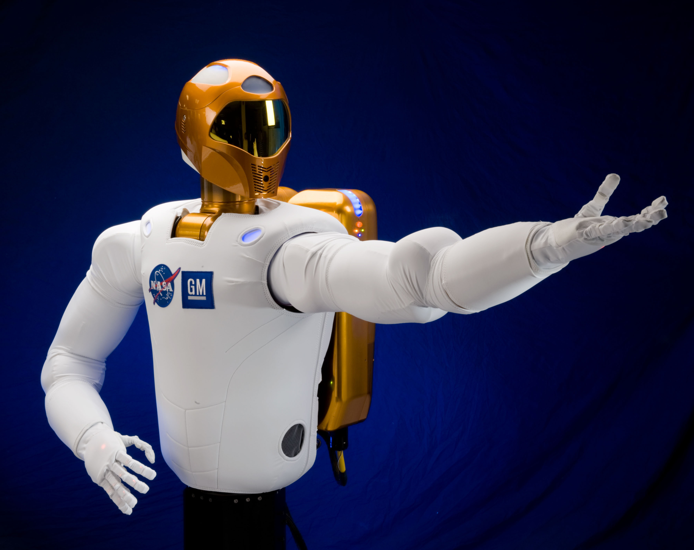
Research Areas
Decision Support
Task execution assistance
System modeling
Task planning
Data summarization
Robotics
Dexterous manipulation
Perception
Mobile robot navigation
Operator interfaces
Challenges
4th Place 2013 DARPA VRC
6th Place 2013 DARPA DRC Trials
9th Place 2015 DARPA DRC Finals

Slide 3
Manipulation Research Problem
DARPA Robotics Challenge and NASA humanoids needed to use tools, manipulate objects, and interact with complex environments.
Turning valves; using drills; walking over uneven terrain
MoveIt! is great for pick and place and avoiding obstacles, but lacks some of the technologies needed for robustly teleoperating humanoid robots performing the tasks above.

Slide 4
CRAFTSMAN
CRAFTSMAN is a NASA funded project that looks to integrate and generalize some of our DRC technologies into a ROS-compatible software suite that works for arbitrary robots.
Current CRAFTSMAN software suite:
TRAC-IK: Inverse Kinematics
Robot Interaction Tools: 3D Visualization/User Interface tools
Affordance Templates: process/task definition libraries

Slide 5
Improving Open Source IK
Iterative Inverse Jacobian methods suffer from a variety of issues:
Cannot handle joint limits
Some tricks can be done but do not fully handle all scenarios
Cannot handle tolerances in goals
Tolerances can be used each iteration to CHECK for success, but don’t inform the search.
Typically a single solution is found

Slide 6
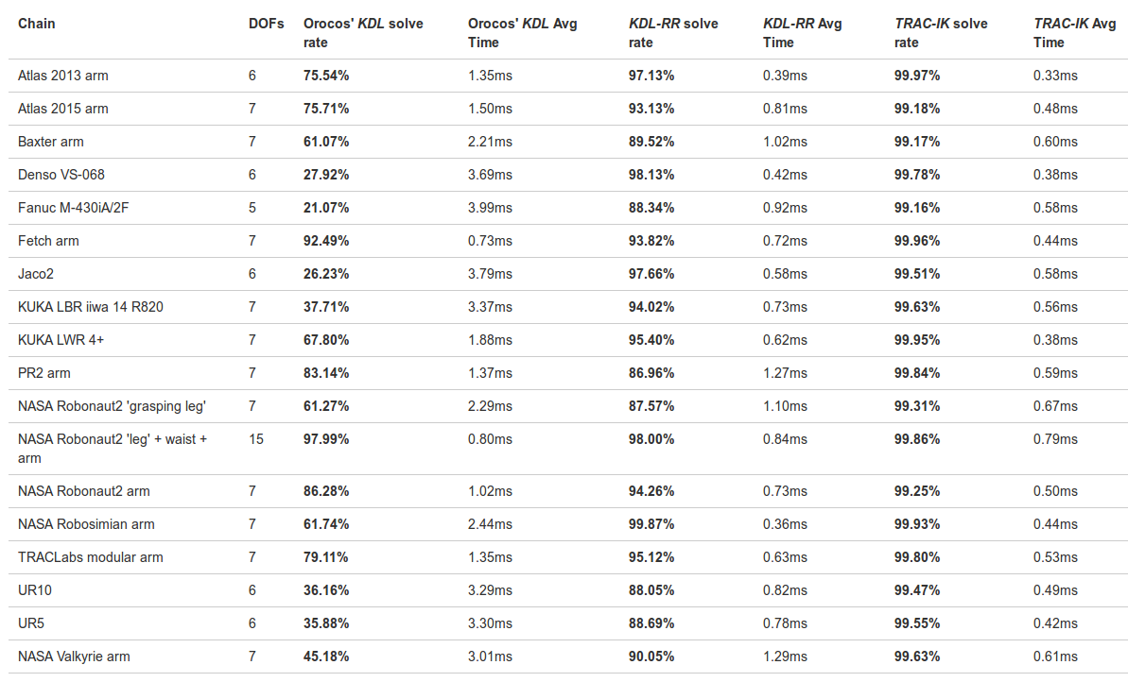
TRAC-IK https://bitbucket.org/traclabs/trac_ik

Slide 7
Additional Improvements
Publicly Released
Multiple solutions found if desired
Condition metrics used for sorting solutions
Manipulability; Min Distance from seed; Speed
Joints can be “frozen” when desired
Arbitrary end effector position/orientation constraints
MoveIt! Plugin available
Private (soon to be released)
Collision detection for robot self collisions pushed into IK
1KHz collision-free Cartesian trajectories

Slide 8
Robot Interaction Tools
Teleoperation Environment
Rviz front end to TRACLabs’ planners, TRAC-IK, and MoveIt! that provides the remote operator with improved situational awareness and commanding capabilities.

Slide 9
Robot Interaction Tools example
Video: https://www.youtube.com/watch?v=COpq03PHdi8

Slide 10
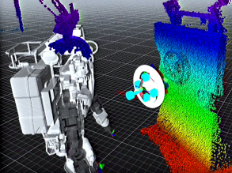
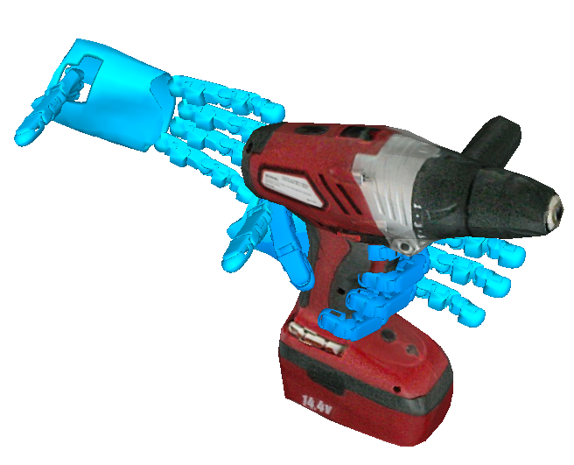
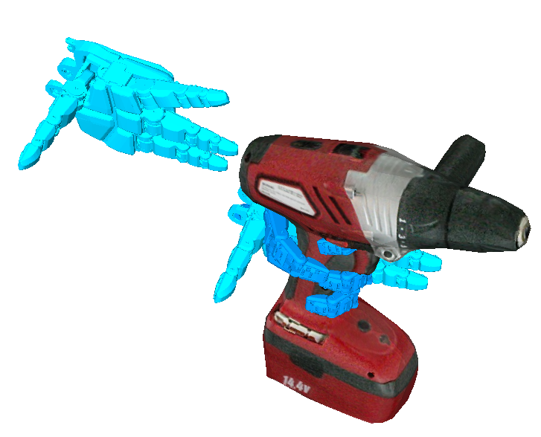
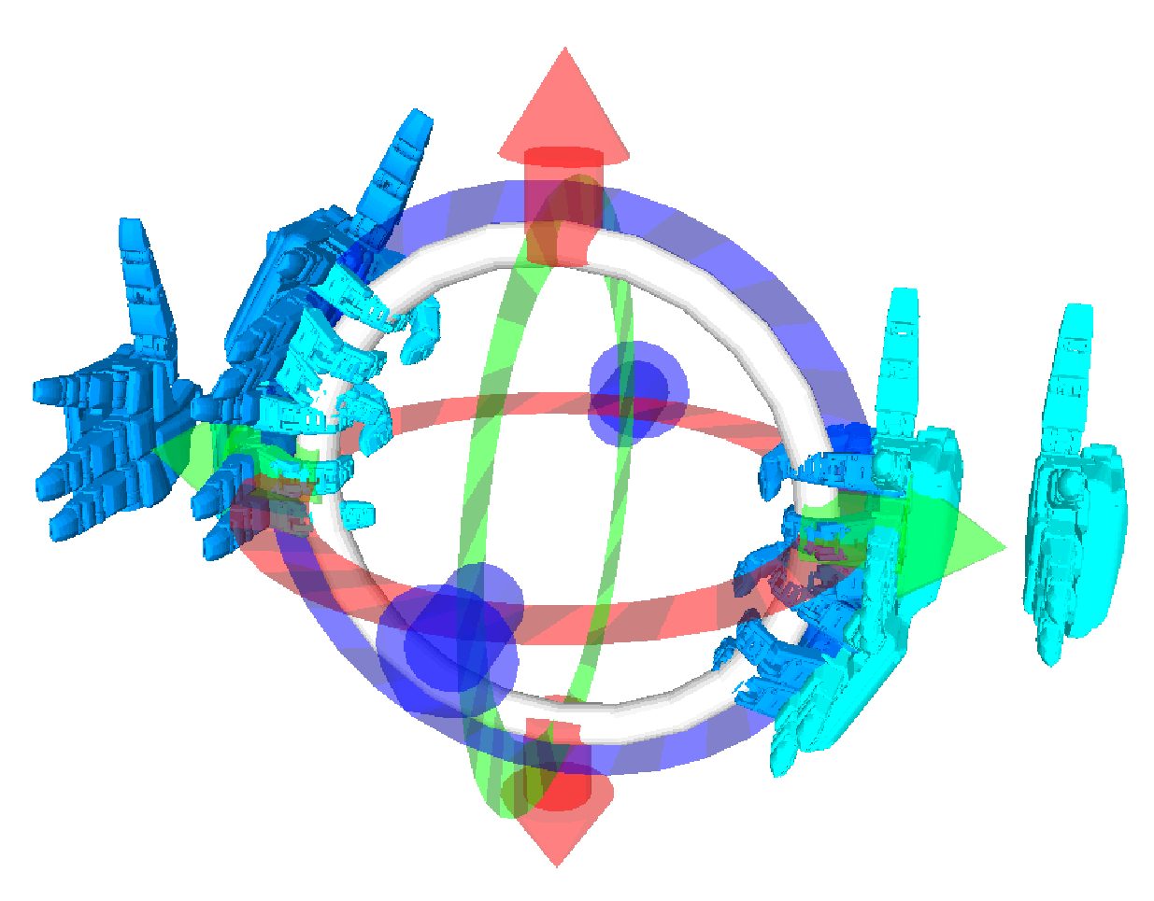
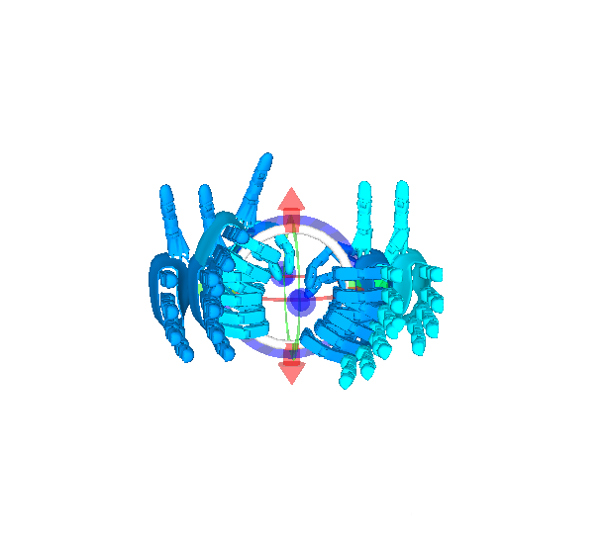
Affordance Templates
Interactive 3D task programming & execution framework
inherent generalization across robots, tasks, & environments
used on Robonaut 2, Valkyrie, Atlas, PR2, and Fetch
Supports different levels of shared & full autonomy
Intuitive graphical tools to set task parameters and get feedback from the robot
task transferability
between robots
adjustable to
task context

Slide 11
Opening Door Template
Video: https://www.youtube.com/watch?v=kYhJDx1wuuA

Slide 12
Mobility Templates
Video: https://www.youtube.com/watch?v=0Nbr5-ooBo4

Slide 13
NASA Habitat Demo
Video: https://www.youtube.com/watch?v=wf5a-HLw8Zk

Slide 14
Future Work
Adding force/impedance control to CRAFTSMAN
Support for reactive control
How to visualize commands in Rviz
Task conditioning metrics for TRAC-IK
“Achieve best initial configuration for using screw driver.”
Sorting IK by maximum obstacle distance
Avoiding obstacles as much as possible
Stance planning for best manipulator performance for tasks
Perceptual registration of object templates to sensory data

Slide 15
Thank You

