Slide 1
ROS-Industrial Developers Meeting (2016-03-08)
Shaun Edwards & Levi Armstrong

Slide 2
Agenda
Intros (only new people) - 5 min
Repo status (highlights) - 10 min
Update on previous meeting action items - 5 min
New development discussions - 30 min
Flex GUI
Curie (Dave Coleman)
General announcements - 10 min

Slide 3
Intros (new people)
Who are you?
Where do you work?
Role in ROS-I: developer, maintainer, documenter, organizer, tester, looking for one

Slide 4
Repo Status (Highlights)
Current Development
New repos
Flex GUI
Reorganized Teams
Industrial Core Jade Release
Upcoming Development
?
Open Issues
?
See meeting notes for details

Slide 5
Statistics
Closed issues 2015
Issues from ROS-I: 204
Issues from ROS-I Consortium: 40
Pull Requests in 2015
Pull requests from ROS-I : 251
Pull requests from the ROS-I Consortium: 76
New Repositories in 2015
Repos from the ROS-I : 11
Repos from the ROS-I Consortium: 6
Sources:
http://github.com/ros-industrial/
https://github.com/ros-industrial-consortium

Slide 6
Previous Action Items
Motoman Indigo release - Shaun
UR modern driver transfer – Shaun
Ubuntu Snappy
CAD-to-ROS App Hvass/Gijs
ROS-I Platform – Mirko
Experimental Repo’s - Shaun

Slide 7
New Development
Bezzier – Victor
CRCL – Fred Proctor

Slide 8
FLEX GUI overview
Laszlo Nagy

Slide 9
Project curie overview
Dave Coleman

Slide 10
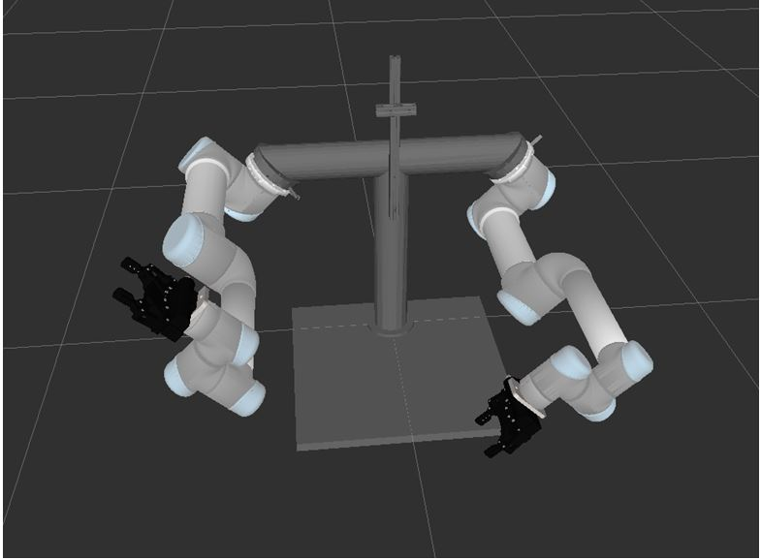
High DOF Planning for Assembly Processes "Project Curie" Overview
Dave Coleman | dave@dav.ee
University of Colorado, Boulder

Slide 11
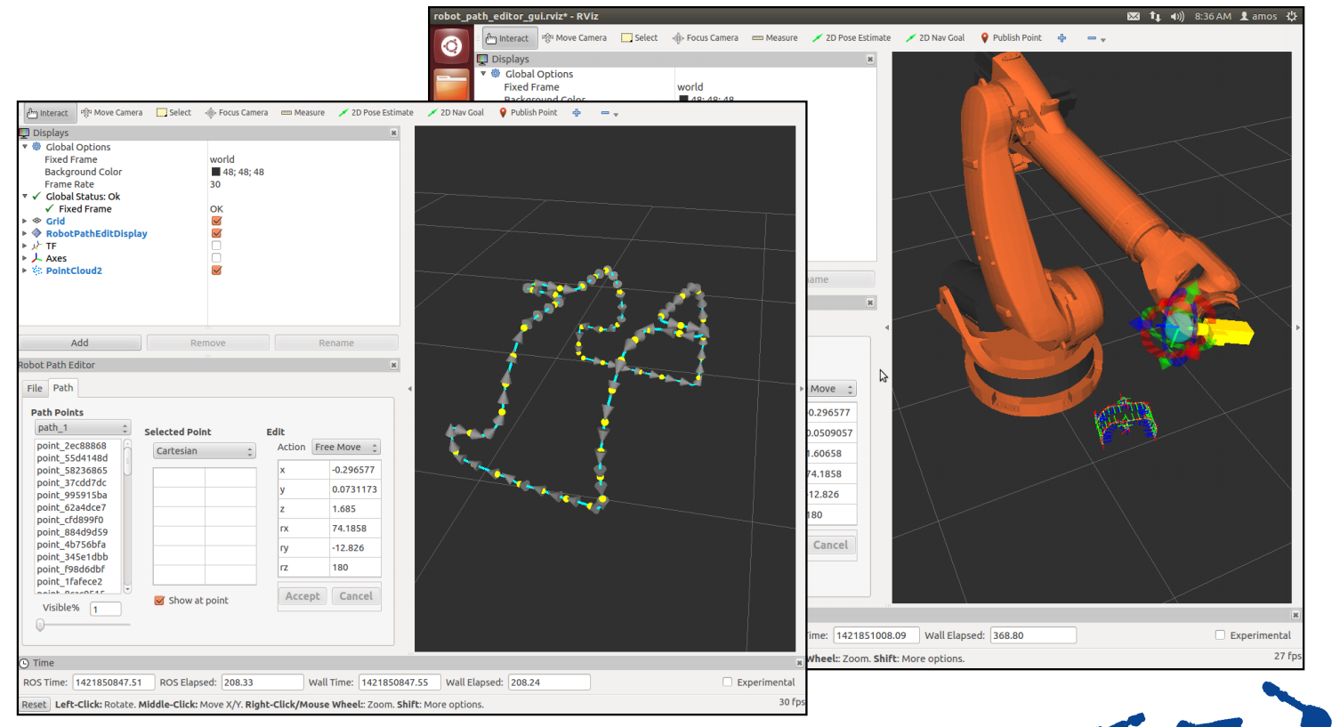
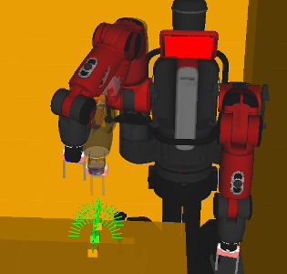
Hybrid Cartesian and Sampling-Based Planning
Cartesian-Space Path Highly Constrained
Free Space Path (Configuration-space) Constrained only at start and goal state

Slide 12
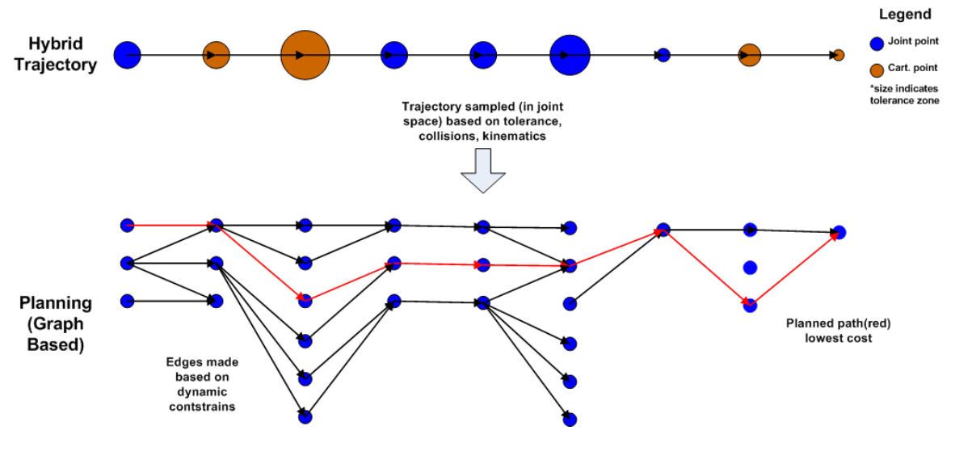
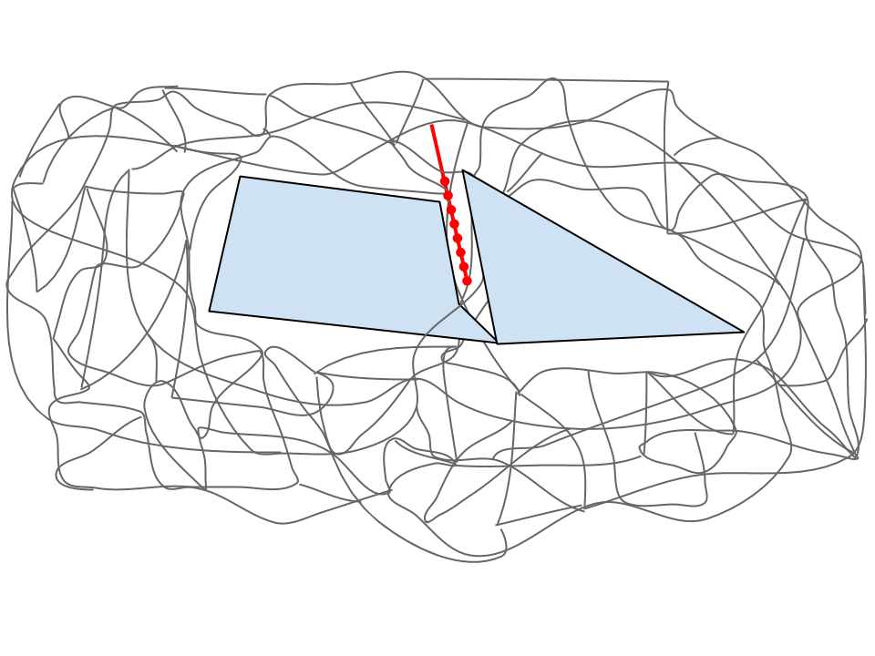
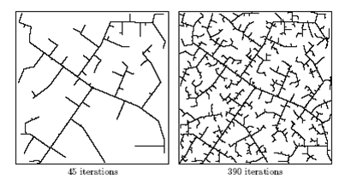
Hybrid Cartesian and Sampling-Based Planning
Descartes
Hybrid
Use Descartes as an additional "sampler" for a Probabilistic Roadmap planner
Insert Cartesian path into full Configuration-space search graph
Add an extra "task" dimension
RRT

Slide 13
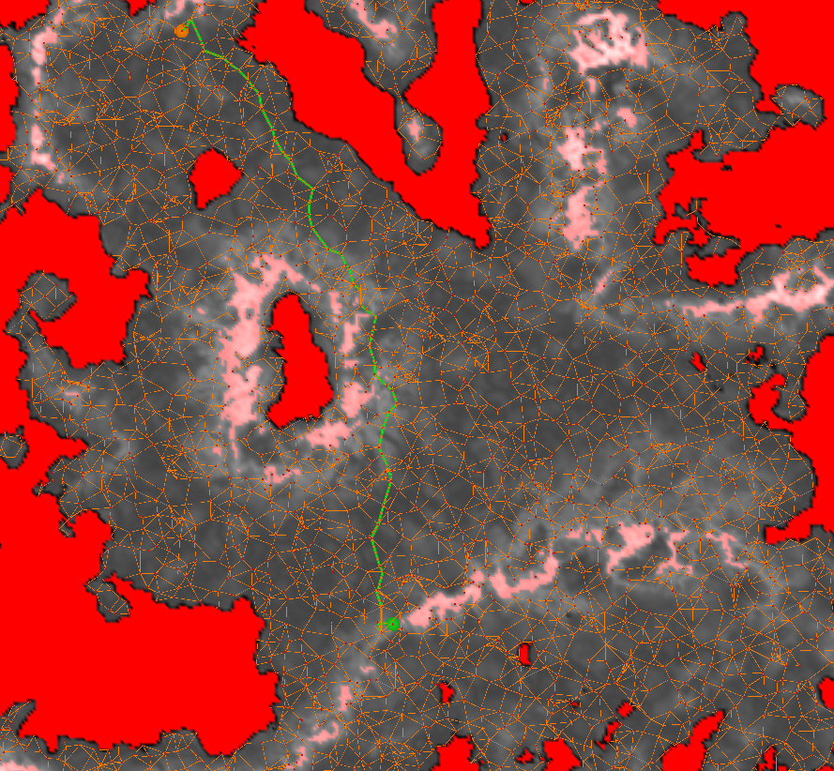
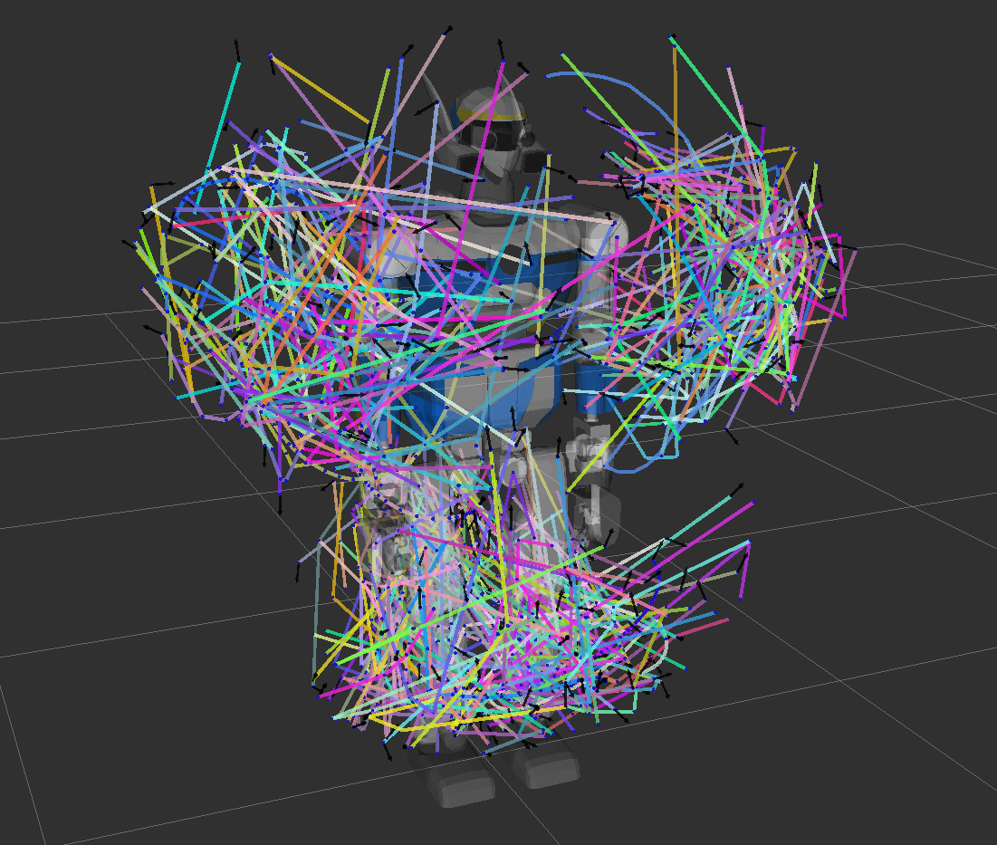
Dealing with High Dimensional Search Spaces
Utilize experience-based planners
Cache results of high-DOF spaces
Reduce need to solve the closed-chain problem
Keep roadmap sparse

Slide 14
Announcements
ROS Industrial Events – Mirko/Hvass

Slide 15
Action Items
Incorporate Travis CI – It’s so easy - https://github.com/ros-industrial/industrial_ci/blob/master/README.rst
Close/address Issues/PRs
Jade Releases

