Slide 1



Job Link : Job Seeker Website
Senior Project by: Ahmad Youssef and Hakam Agha
Supervised by: Dr. Hussein Nasrallah
Committee Member: Dr. Nour Akkad
www.joblink.com
A.Y: +961 76-696034
H.A: +961 71-991998

Slide 2
Outline:
Introduction
Problem Statement
Similar Systems
System Design
Implementation
Future Work
Conclusion

Slide 3
Introduction:
JobLink Overview
This platform offers an intuitive layout
JobLink features diverse job categories
Job seekers can create detailed profiles showcasing
JobLink provides tools, resources, and tips
JobLink focus on diversity and inclusion, promoting equal opportunities

Slide 4
Outline:
Introduction
Problem Statement
Similar Systems
System Design
Implementation
Future Work
Conclusion

Slide 5
Problem statement:
Challenges Faced By Job Seekers
Irrelevant Job Listing
Lack of Personalization
Networking Challenges
Mobile Optimization Issues
Barriers For Certain Demographics
Lack of Feedback

Slide 6
Outline:
Introduction
Problem Statement
Similar Systems
System Design
Implementation
Future Work
Conclusion

Slide 7



Similar systems:
LinkedIn
Indeed
Glassdoor

Slide 8
Outline:
Introduction
Problem Statement
Similar Systems
System Design
Implementation
Future Work
Conclusion

Slide 9

System Design: Proposed design
A website that allows users to access all the services they might need remotely:
Detailed user profiles
Personalized dashboards
Advanced search options
Company profiles and reviews
Integrate messaging and questions with admin.

Slide 10
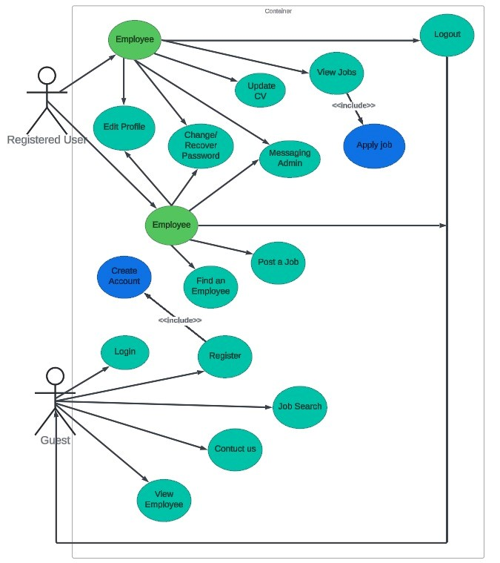

System Design: Use case Diagrams
User Use Case Diagram

Slide 11
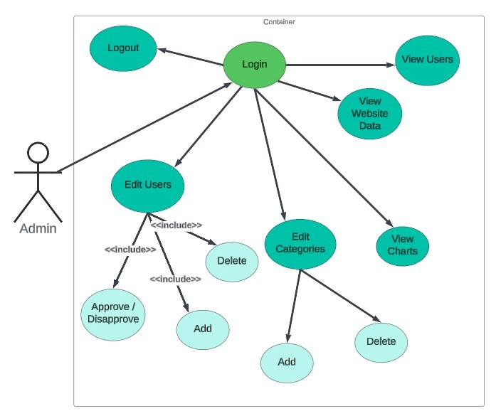
System Design: Use case Diagrams
Admin Use Case Diagram

Slide 12
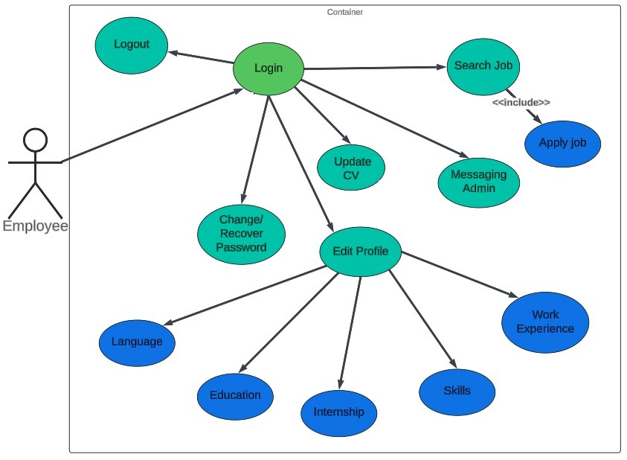
System Design: Use case Diagrams
Employee Use Case
Diagram

Slide 13
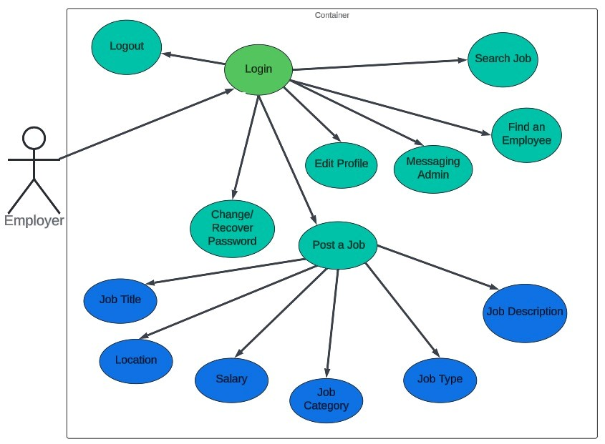
System Design: Use case Diagrams
Employer Use Case
Diagram

Slide 14
Outline:
Introduction
Problem Statement
Similar Systems
System Design
Implementation
Future Work
Conclusion

Slide 15





Implementation Tools:
CSS
JavaScript
Xampp
MysQl
php

Slide 16
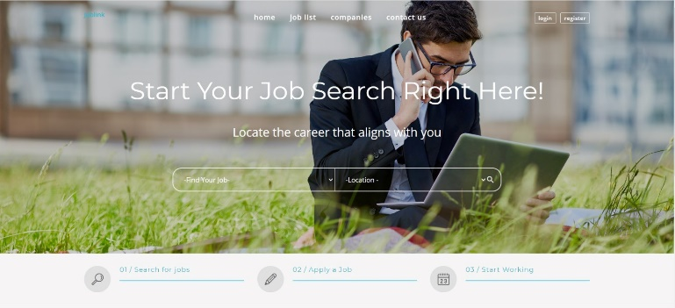
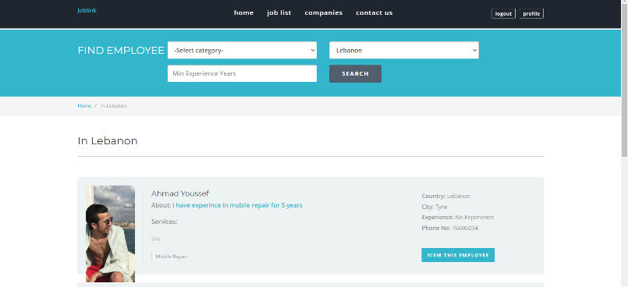
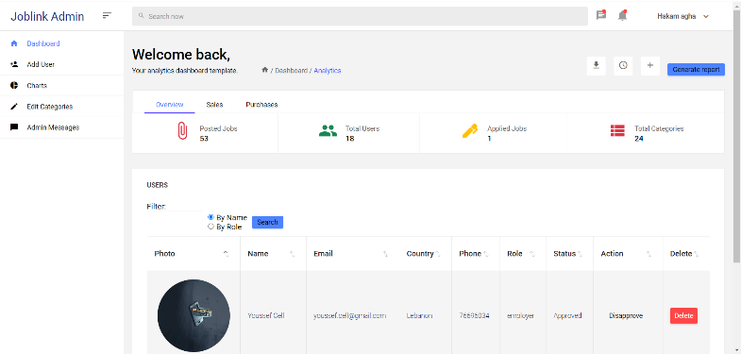
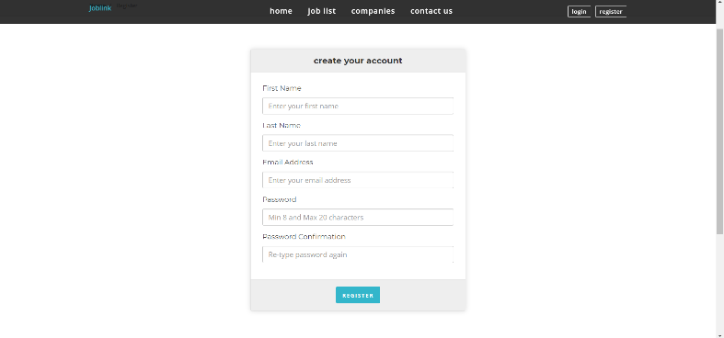
WEBSITE :

Slide 17
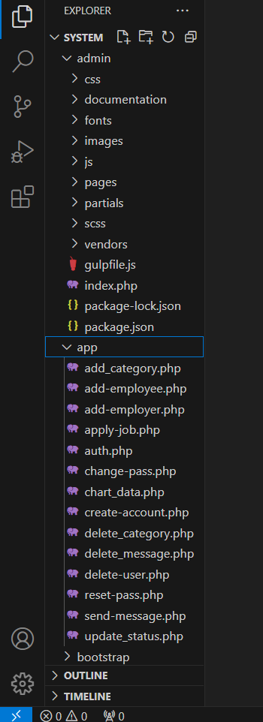
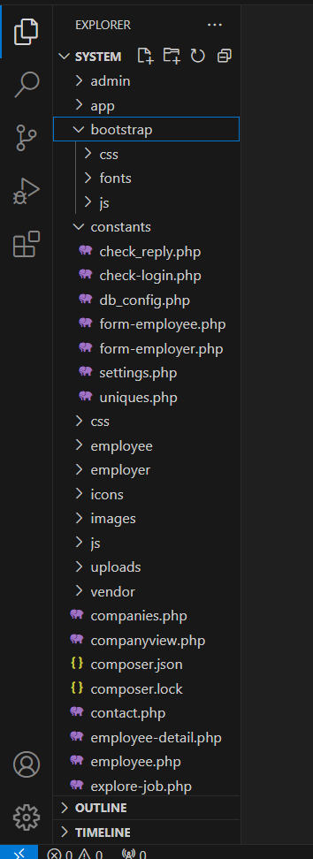
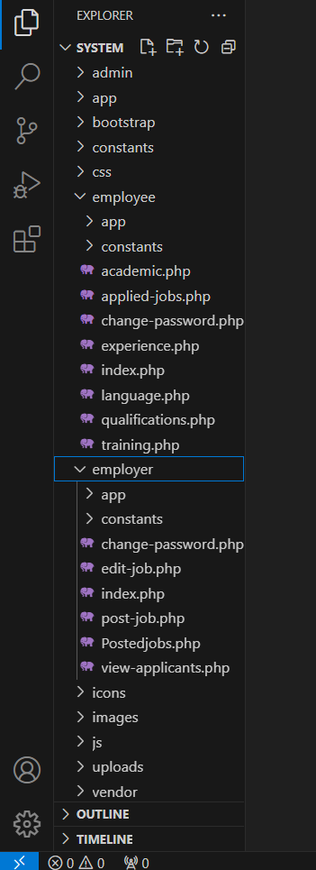
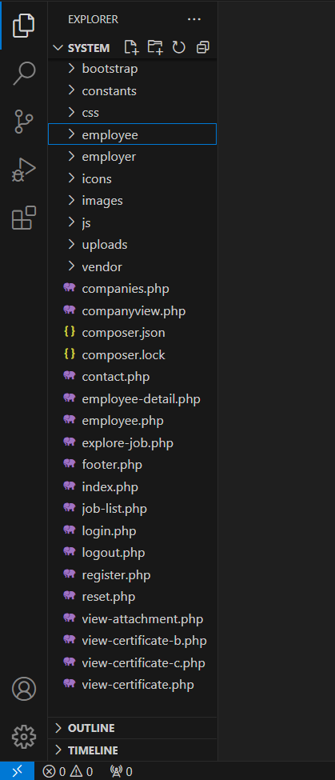
Implementation Summary :

Slide 18
Outline:
Introduction
Problem Statement
Similar Systems
System Design
Implementation
Future Work
Conclusion

Slide 19
Conclusion :
Invaluable Resource
User Friendly Design
Personalized Recommendations
Community Support
Commitment To Evolution

Slide 20
Outline:
Introduction
Problem Statement
Similar Systems
System Design
Implementation
Future Work
Conclusion

Slide 21
Future Work :
Enhanced AI Recommendations
Mobile Optimization
Integration of Soft Skills Assessment
Community Features

Slide 22

Job Link : Job Seeker Website
Thank You For Your Time
www.joblink.com
A.Y: +961 76-696034
H.A: +961 71-991998
LET’S GO TO OUR WEBSITE

