Slide 1

AC PROPHET
AI-Driven Peak Season Operations & Dispatch Control Center

Slide 2

Strategic Vision & Value Proposition
The Peak Season Challenge
During extreme summer waves, manual dispatching fails to optimize workforce capacity, leading to accumulating backlogs and reduced customer satisfaction.
The AI Revolution
AC PROPHET shifts operations from reactive firefighting to predictive, automated capacity management.
Operational Efficiency Reimagined
Achieve up to 40% reduction in average wait times through intelligent load balancing and zero-touch tactical dispatching.

Slide 3
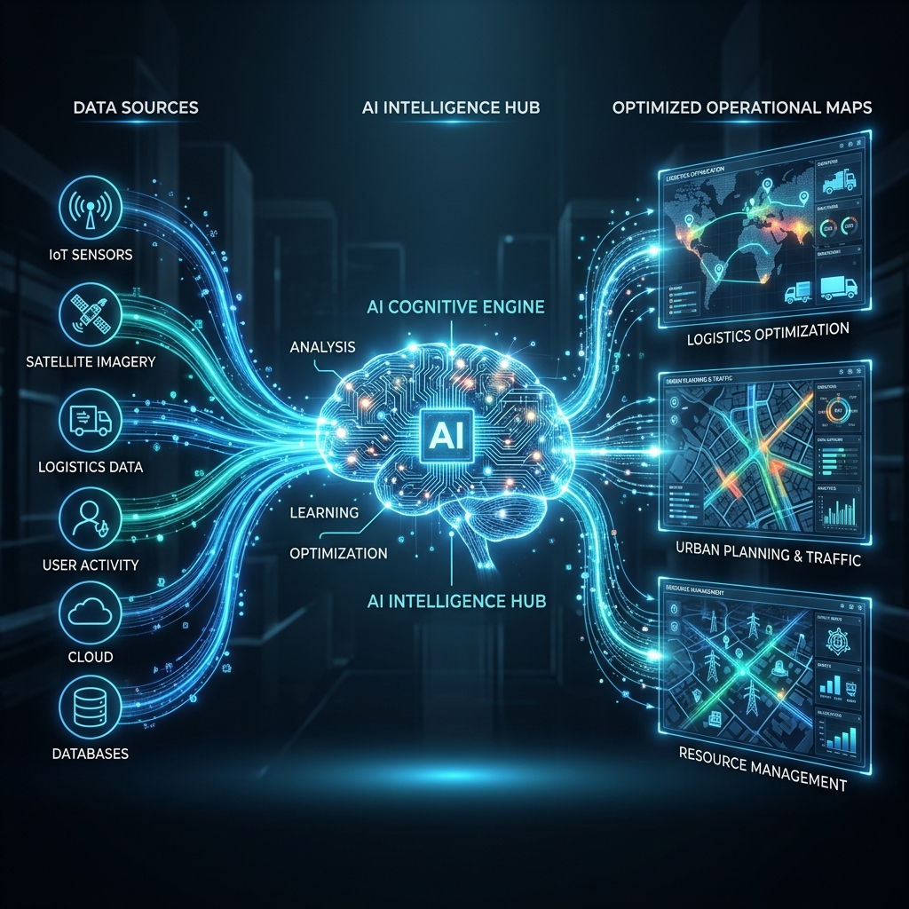
Next-Generation Multi-Agent Architecture
1. Forecaster Agent
Fuses 7-day weather predictions with historical backlog trends to predict real incoming daily volumes.
2. Watchdog Agent
Cross-references predictions against daily service capacities, identifying critical failure zones and wait-time bottlenecks.
3. Commander Agent
Autonomously drafts tactical orders to shift resources from underutilized districts to critical zones before delays occur.

Slide 4
Future-Proof & Cloud Ready
Operational Impact
• Eliminates manual guessing in dispatch
• Instantly visualizes crisis zones
• Provides actionable, written orders daily
• Maintains high CSAT during extreme heat
Google Cloud Roadmap
• Serverless execution with Cloud Run
• Cost-effective, scale-to-zero infrastructure
• Live Google Sheets API integrations
• 100% Data persistence & enterprise security

Slide 5
Transforming Operations, Today.
Thank You | AI Multi-Agent Group

