Slide 1
AC PROPHET
Heatwave-Driven Demand & Service Capacity Analysis
A 3-Year Historical Study of Temperature, Purchase Behaviors, and Service Bottlenecks
Samsung HVAC Decision Support Dashboard | Business Development & AI Agent Group

Slide 2
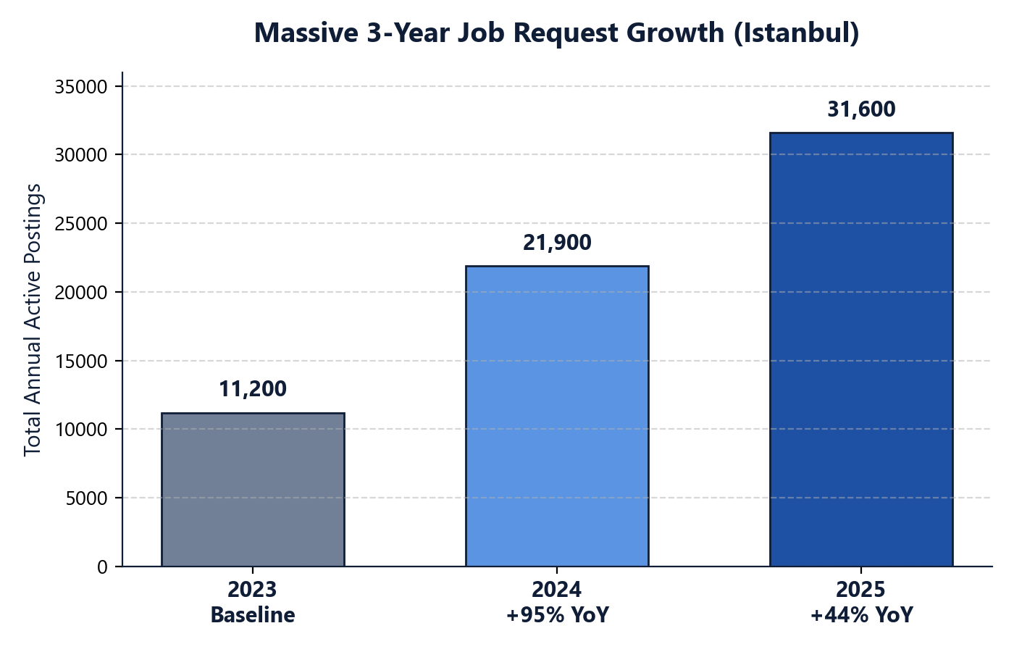
1. Executive Summary & Historical Growth
Strategic Insights & Volume Trends
• Objective: Quantify weather impacts on service request volumes and identify capacity thresholds.
• Massive YoY Volume Expansion in Istanbul: • 2023 Season: 11,200 baseline jobs • 2024 Season: 21,900 jobs (+95% YoY growth) • 2025 Season: 31,600 jobs (+44% YoY growth / 3x in 2 years)
• Simpson's Paradox Note: Fast overall volume growth masks daily weather signals in combined pools. Detrending data year-by-year is required to reveal the true correlation.

Slide 3
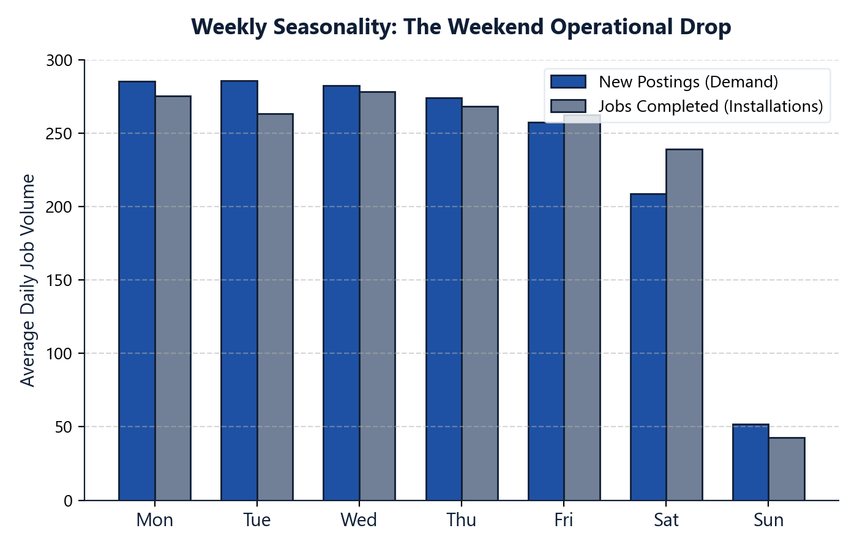
2. Weekly Seasonality & Weather Correlation
The Weekend Operational Drop
• Weekend Drop: Weekday postings average 282-286 jobs, while Sundays collapse to just 51 new postings and 42 completions.
• This heavy 7-day cyclical seasonality introduces massive weekend noise that completely hides temperature effects on a daily basis.
• Smoothing the series with a 7-day rolling window uncovers a very strong positive correlation between Apparent Temp & jobs:
• 2023 Season Correlation (7-day Smoothed): • Apparent Temp vs Demand (Postings): 0.7828 • Apparent Temp vs Installations (Completions): 0.7774

Slide 4
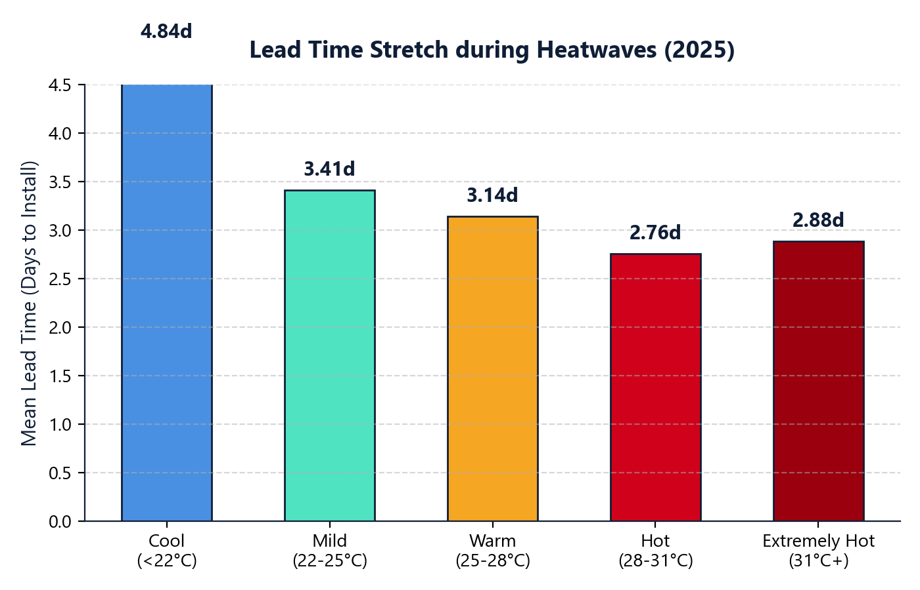
3. Capacity Bottlenecks & Lead Time Stretch
How Heatwaves Stretch Backlogs
• Lead Time Definition: Exact days between posting date and completion date (COMPLETE_DT - POSTING_DATE).
• Capacity Saturation Proof (2025 Data): • Cool Weather (<22°C): Median lead time is 0 days. • Hot Weather (28-31°C): Median lead time rises to 2 days. • Extremely Hot (31°C+): Median lead time reaches 3 days.
• During extreme heatwaves, technician limits are fully saturated, stretching average installation times and leaving 10% of customers waiting over 7 days.

Slide 5
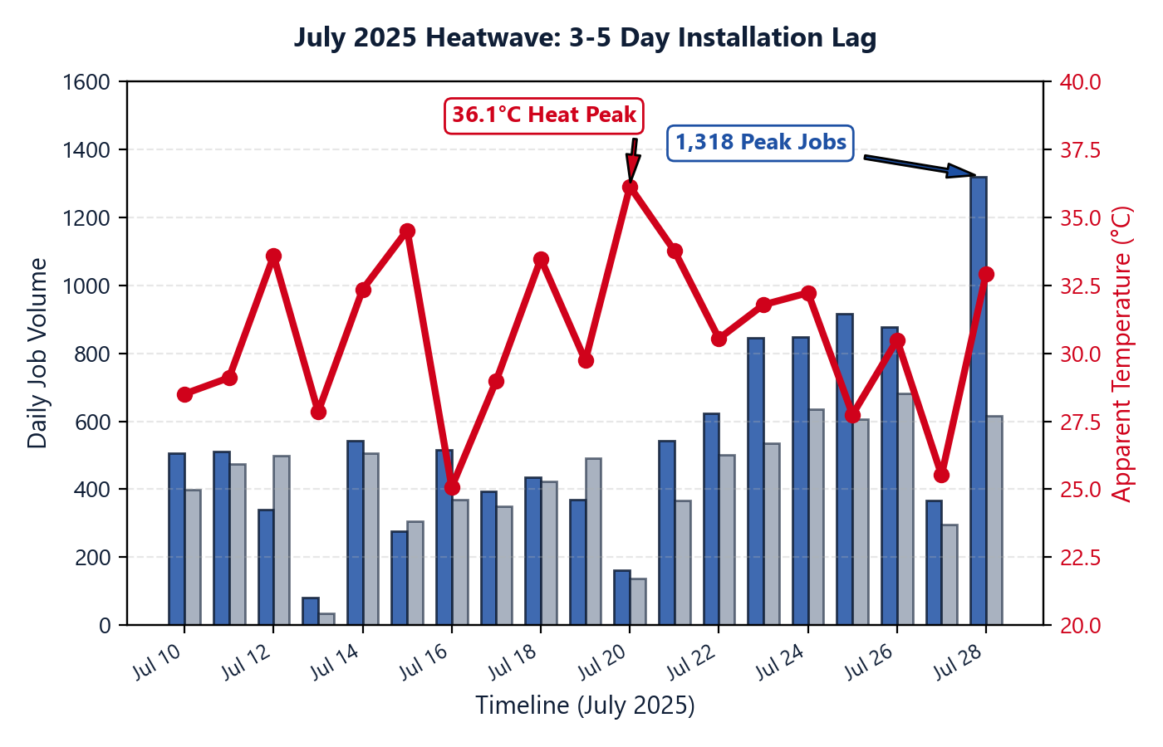
4. July 2025 Heatwave Case Study
Chronology of the 3-5 Day Lag
• July 20 (Sunday): Extreme Apparent Temp reaches 36.1°C, triggering immediate online bookings.
• July 21-25: Daily postings skyrocket, peaking at 916 new jobs on Friday, July 25.
• July 28 (Monday): Postings reach an absolute peak of 1,318 new jobs following the heatwaves.
• Installation Lag: Completed installations peak at 635 on July 24 and 681 on July 26, delayed by exactly 3 to 5 days behind the temperature peak.

Slide 6
5. Strategic Recommendations
Predictive Capacity & Dispatch
• Weather Threshold Alerter: Trigger automated operational alerts and prepare extra teams 1-2 days before a forecasted Apparent Temp > 28°C event.
• Dynamic Backlog Routing: Automatically redirect carryover backlogs to adjacent low-stress service centers with active team buffers.
• Pre-emptive Technician Shift: Pre-arrange technician shifts and overtime limits to align with the peak lag waves (3-5 days post-heatwave).
Data-Driven Operations & Inventory
• Forecaster Integration: Sync warehouse inventory stock levels with the 7-day Forecaster Agent outputs to prevent logistics shortages during demand surges.
• Smart Maintenance Scheduling: Schedule technician vacations, training and IT system upgrades exclusively during cool periods (<22°C Apparent Temp).
• Model Improvements: Incorporate relative humidity into baseline predictive models to capture the true Apparent Temperature, which is a far better predictor than dry-bulb temperature.

Slide 7
Thank You!
AC PROPHET - Operational Stability & Capacity Dispatch Model

