Slide 1
A CNN-based Cow Interaction Watchdog
Håkan Ardö, Oleksiy Guzhva, Mikael Nilsson

Slide 2
Introduction
Animal behaviour scientists
Social interactions - counts
Lots of uninteresting events
Automated watchdog

Slide 3
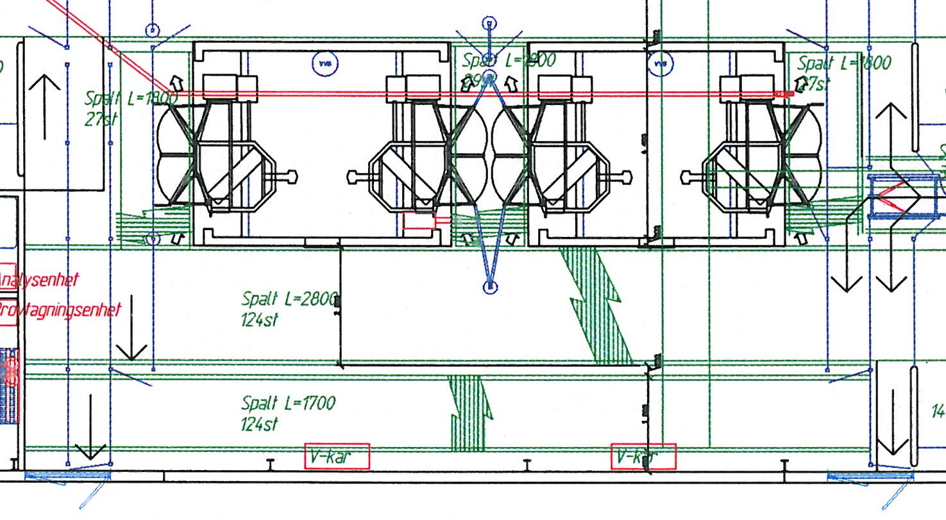
Pilot study
Dairy barn in the south of Sweden
252 Swedish Holstein cows
Four automatic milking robots
Common waiting area (6x18 meters)

Slide 4
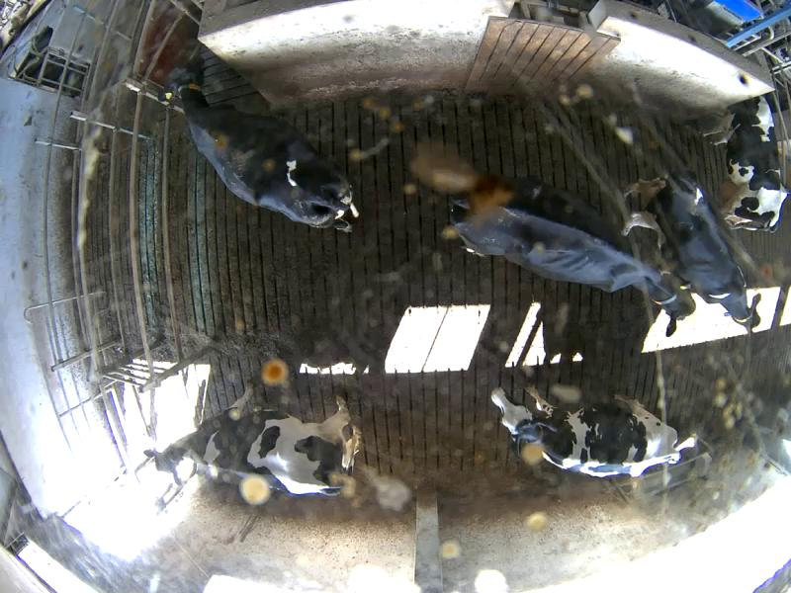
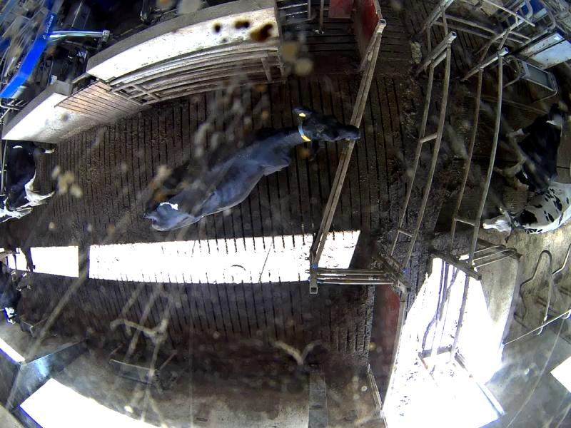
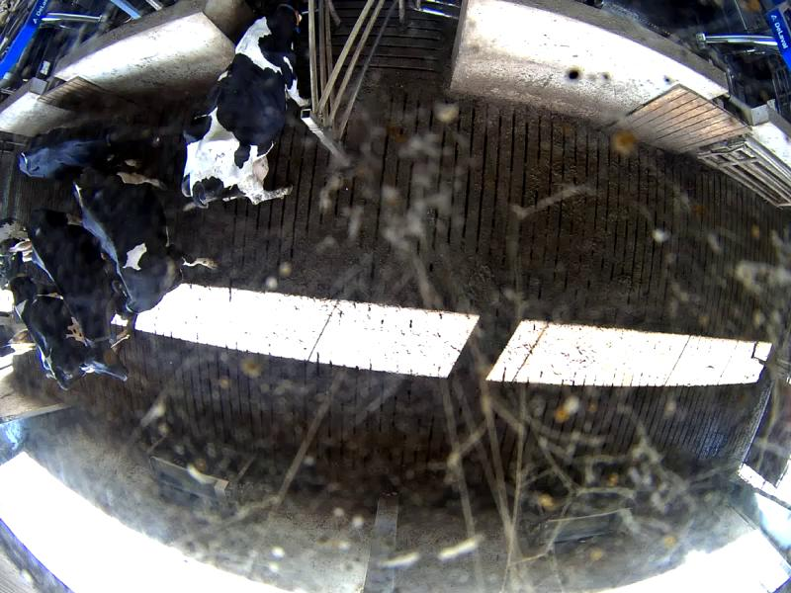
Experimental setup
Three 134 degree cameras at 3.6 m

Slide 5
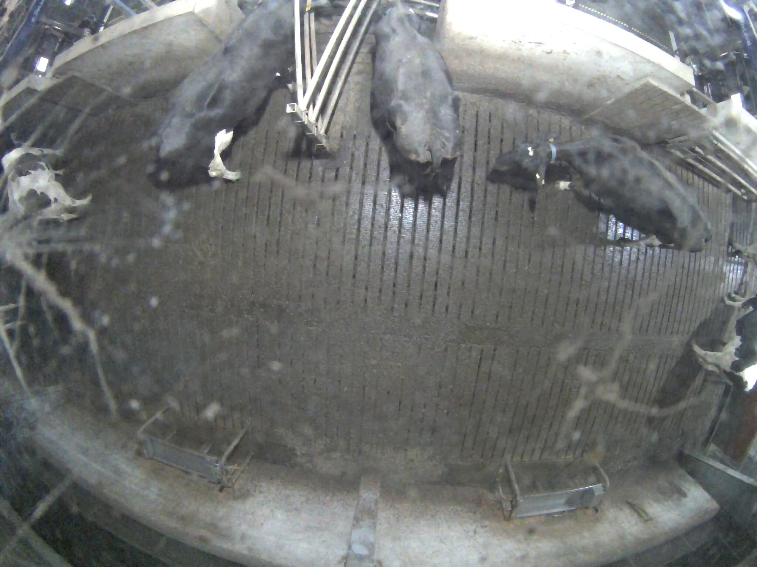
Calibration

Slide 6
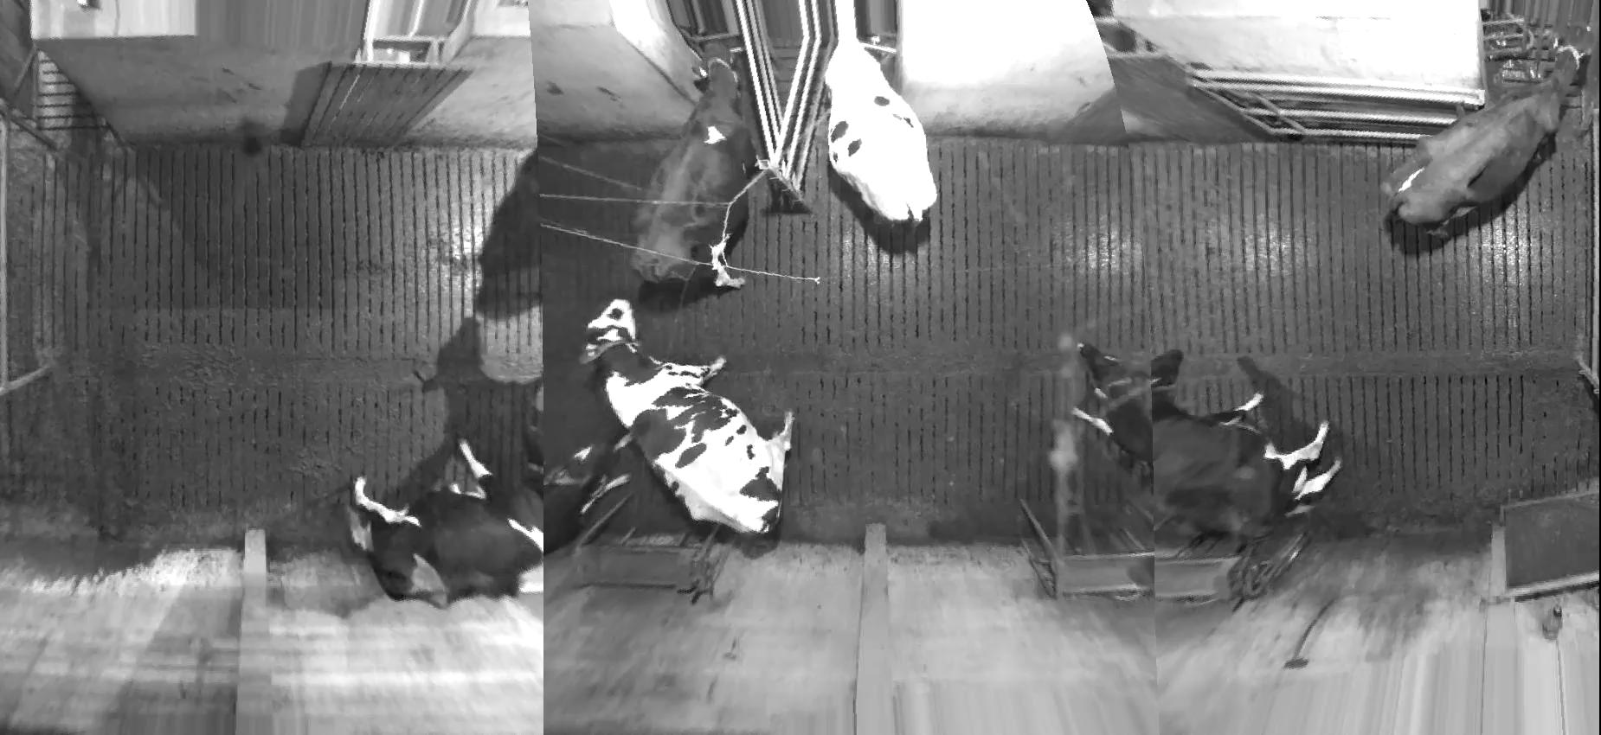
Calibration

Slide 7
Training data
1722 images
6399 cows
44793 landmarks
Augmentation
  Position
  Rotation

Slide 8
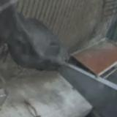
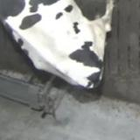
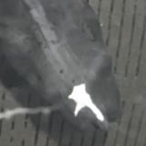
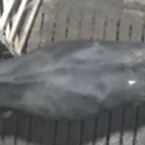
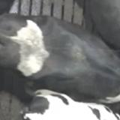
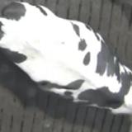
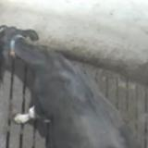
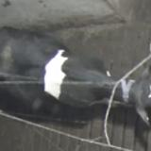
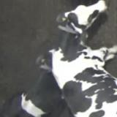
Landmark examples
Parts segmentation
  Back examples
  Middle examples
  Front examples

Slide 9
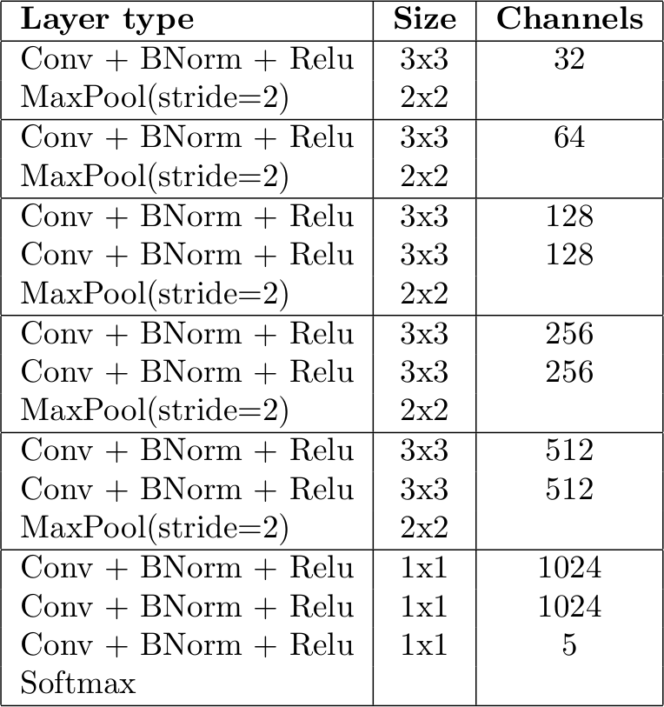
Landmark detector
Fully convolutional CNN
Similar to VGG
Batch normalisation
Output classes
  Head
  Front
  Middle
  Back
  Ground

Slide 10
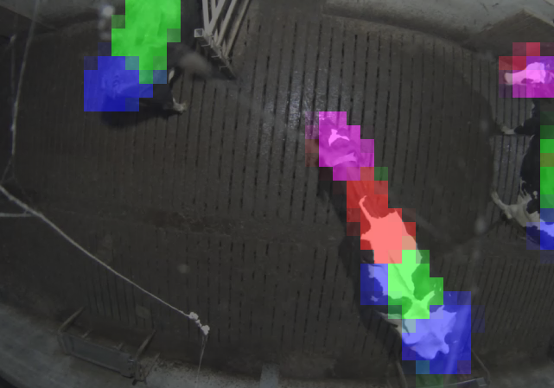
Landmark detection results

Slide 11
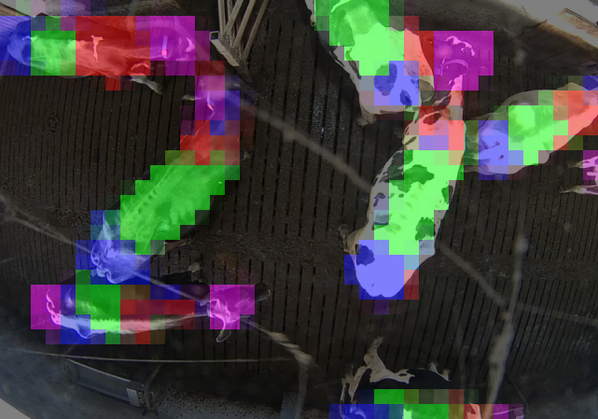
Landmark detection results

Slide 12
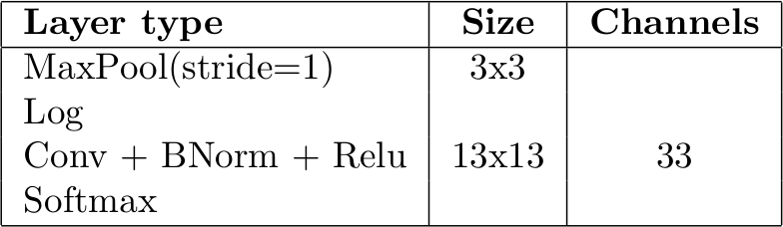
Cow detector
CNN
32 cow orientation classes
1 background class

Slide 13
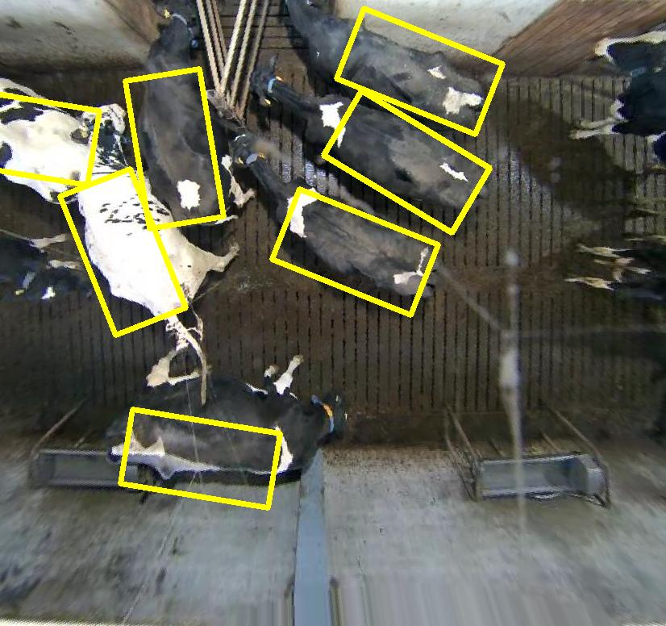
Cow detections

Slide 14
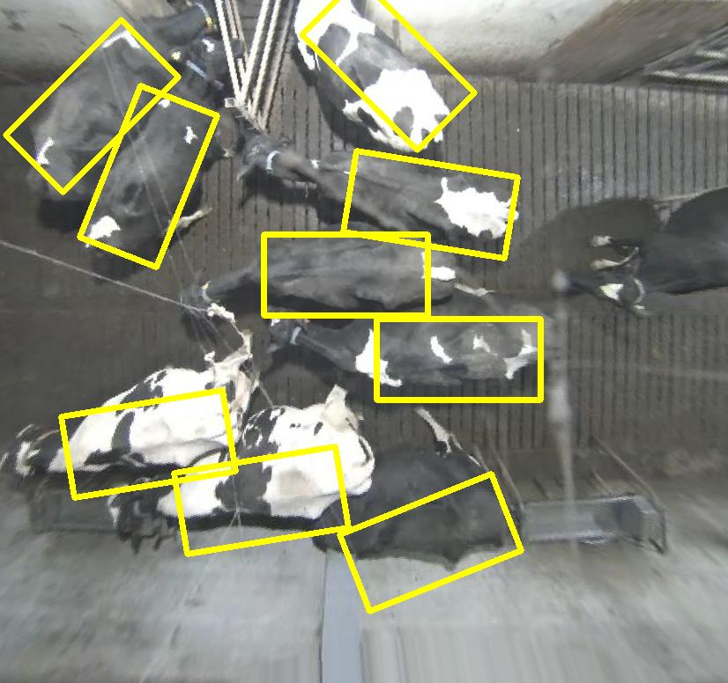
Cow detections

Slide 15
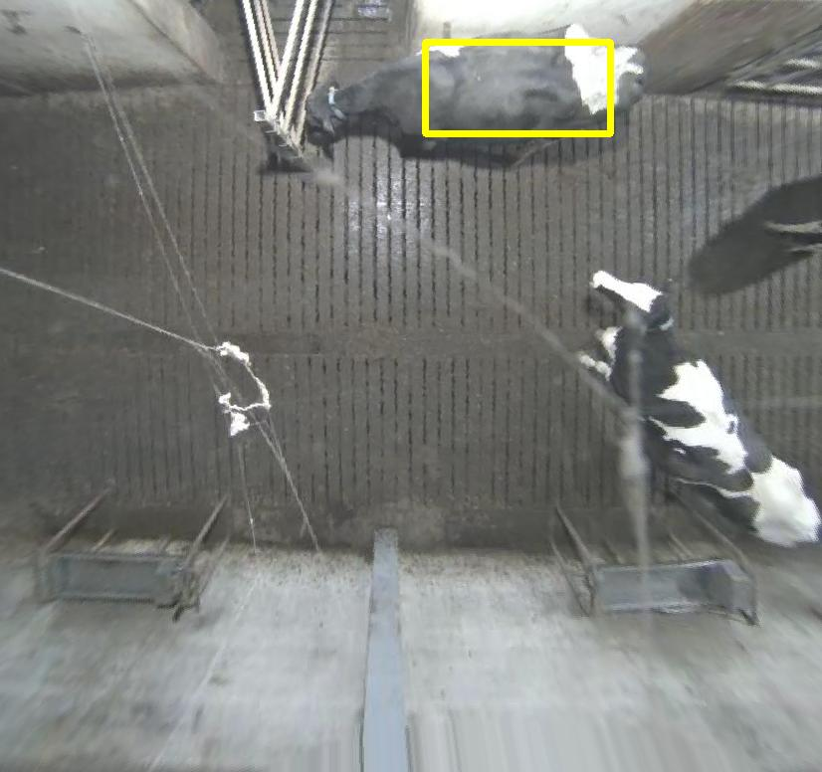
Cow detection failures

Slide 16
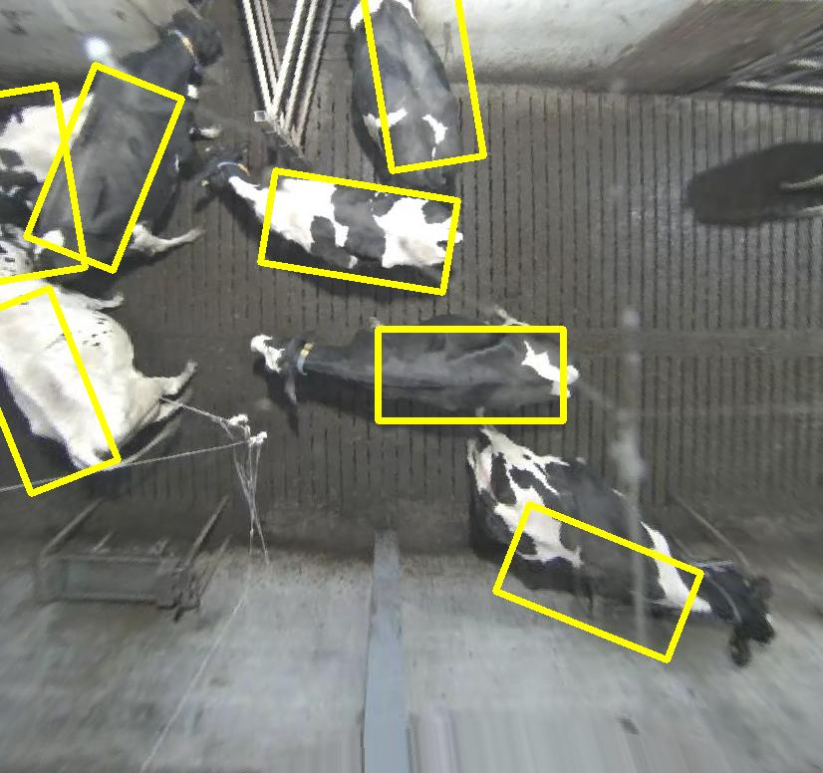
Cow detections failures

Slide 17
Watchdog evaluation
Two or more cows?
Discard 38 % of the recordings
50 + 50 random frames out of 6400
97 % of the images were perfectly interpreted
Those 100 images contain 222 cows
1 miss, 2 extra detections
99.6 % hit rate
0.9% false alarm rate

Slide 18
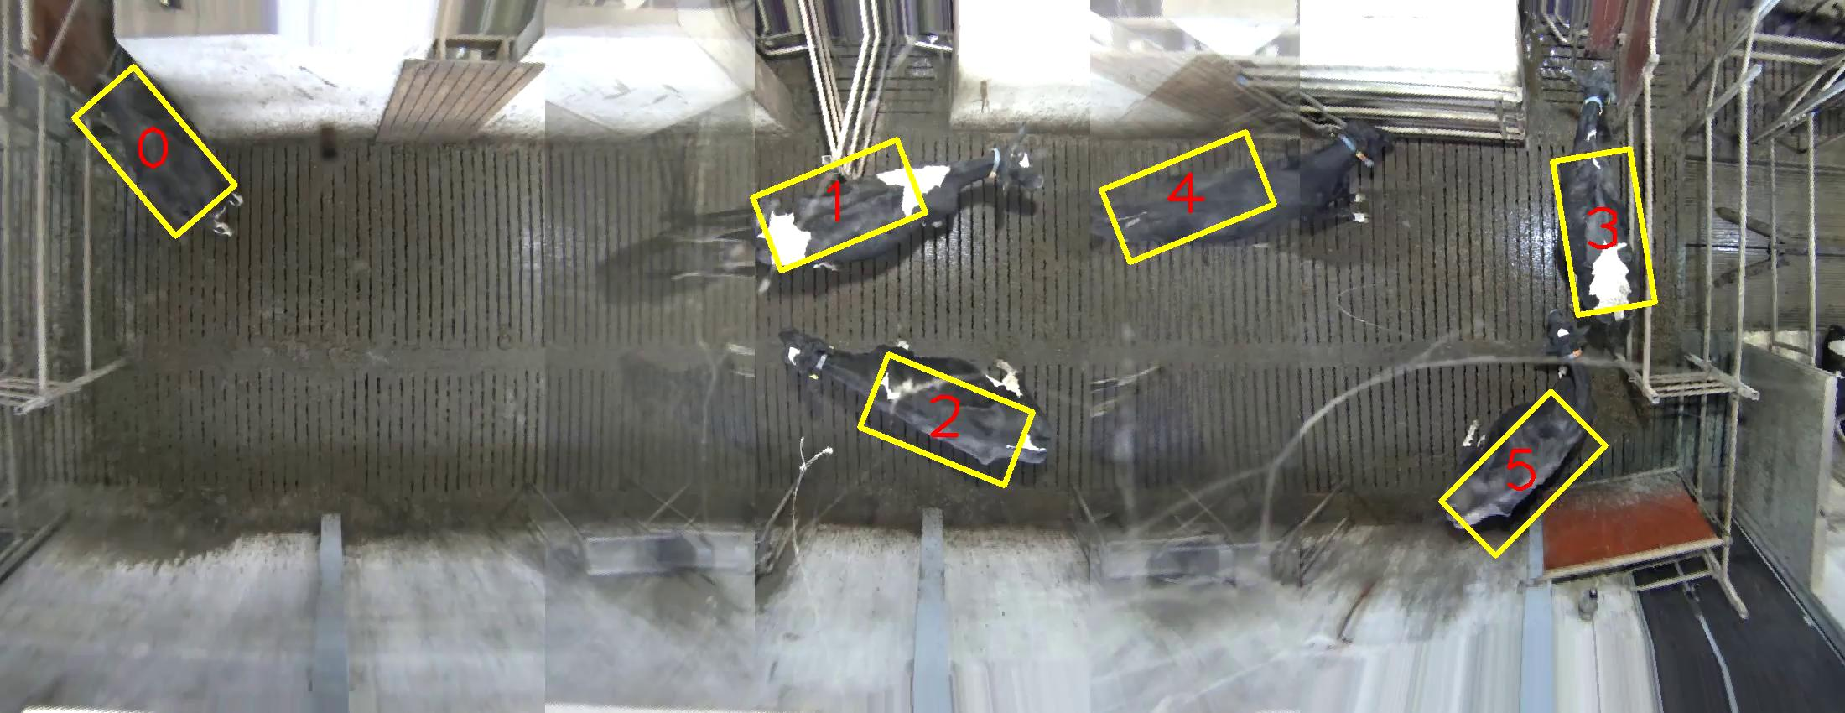
Tracking

Slide 19
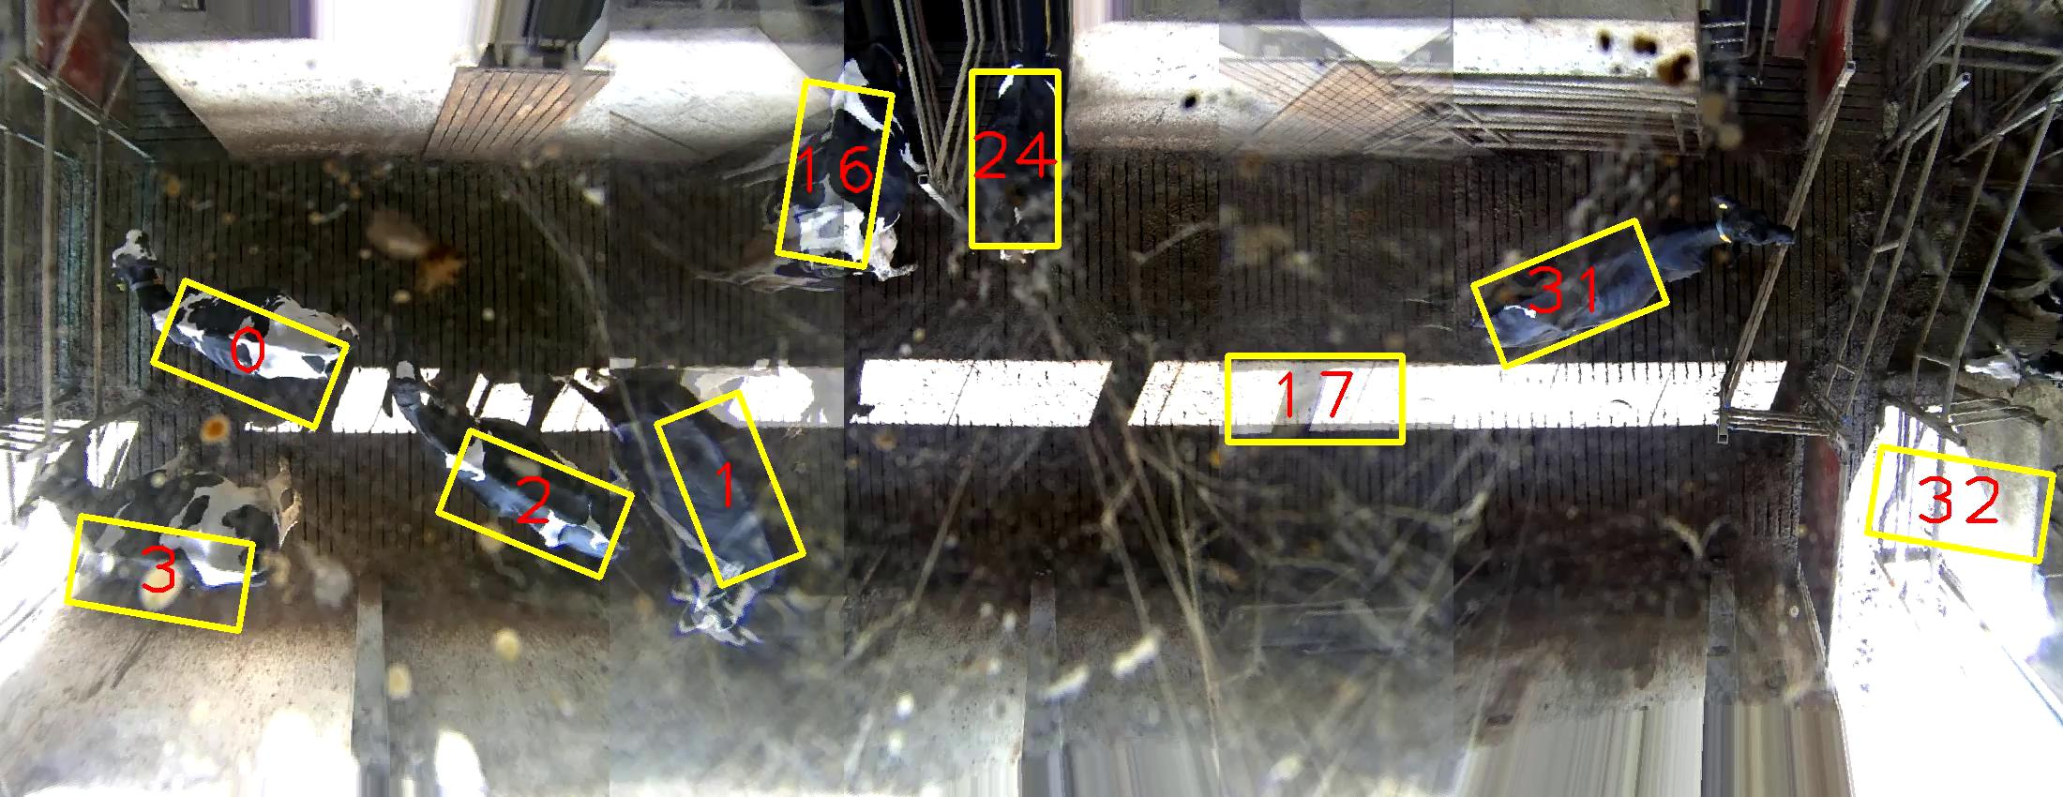
Half a year later...

