Slide 1
COMPSCI X433.7 - Machine Learning With TensorFlow
Final Project: Blood Cell Image Classification Using CNN
Hakan Egeli, June 26, 2018

Slide 2
Blood Cell Image Classification Using CNN
Project Review
Code Review
Visualization with Tensorboard

Slide 3
About
Project goal is to build an image classifier using Tensorflow to recognize the different cell types and to examine the challenges and the feasibility of building such a model.
Blood Cell Images dataset available from Kaggle (https://www.kaggle.com/paultimothymooney/blood-cells)
The Blood Cell Images dataset contains only 410 original images which were later augmented and a larger dataset of 12000 images was created.
Cell types are: Eosinophils, Neutrophils, Lymphocytes, Monocytes. Basophils were left out due to low number of original samples.

Slide 4
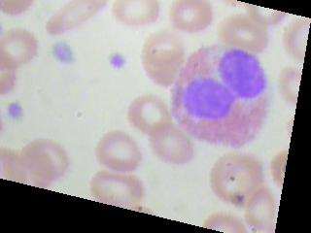
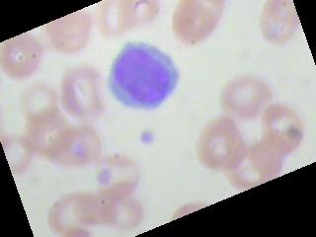
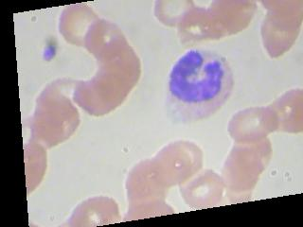
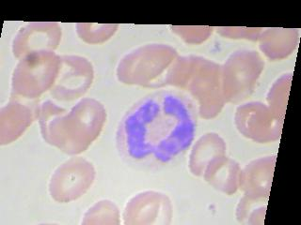
Blood Cell Images
EOSINOPHIL
LYMPHOCYTE
MONOCYTE
NEUTROPHIL

Slide 5
Network
Flat
INPUT
CONV1
CONV2
FC
OUTPUT
CONV3
CONV4
…
40x30x32
20x15x64
80x60x16
128
4
160x120x3
160x120x16
10x7x64

Slide 6
Findings
Data Pipeline Performance
CPU vs GPU Performance
Visualization of the Model

Slide 7
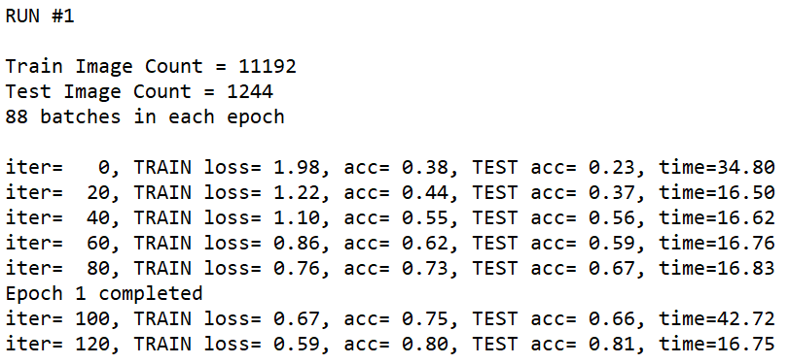
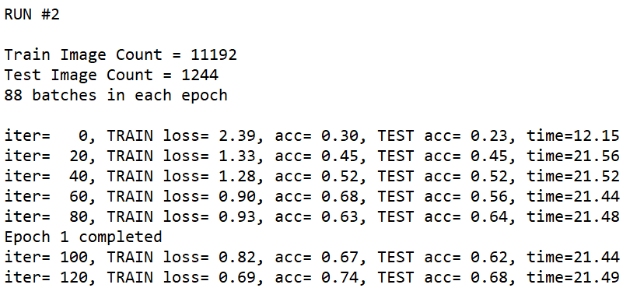
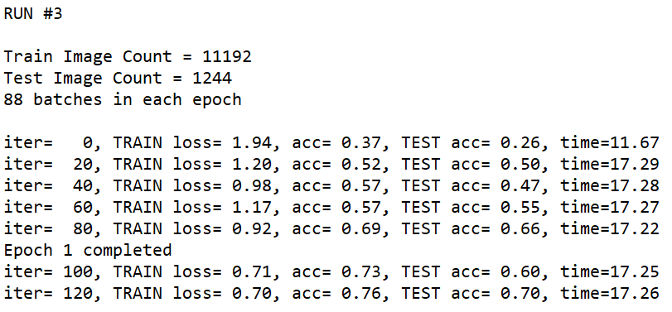
Data Pipeline Performance

Slide 8
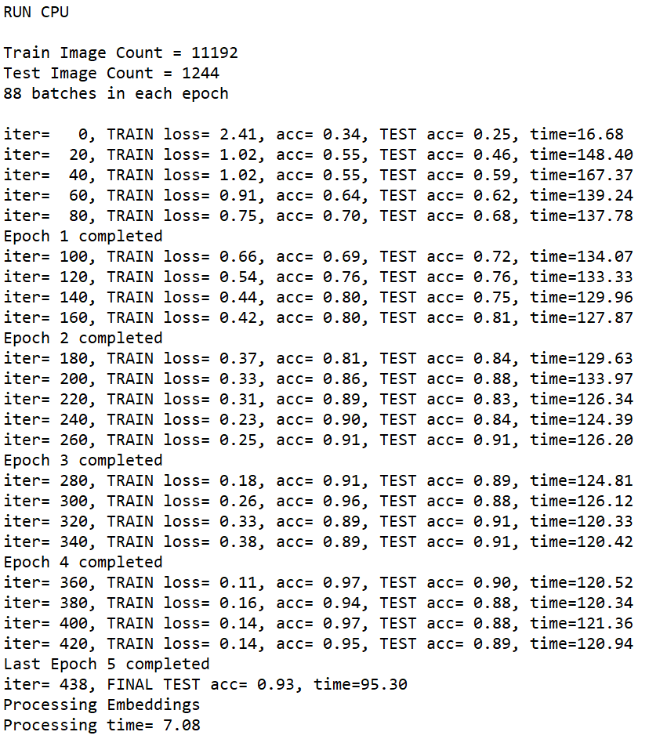
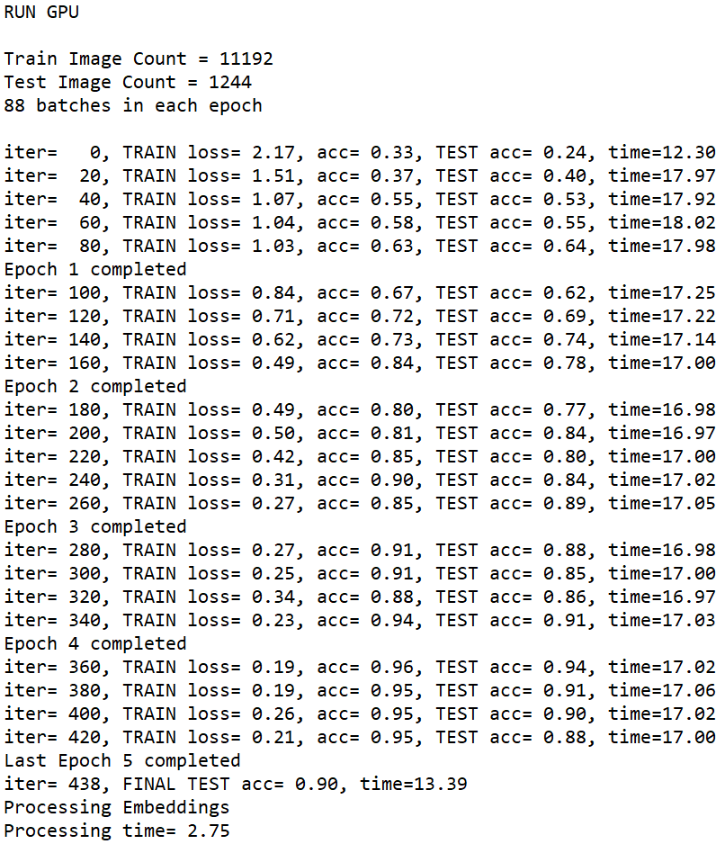
CPU vs GPU Performance
Total CPU Training Time 45.82 minutes, Total GPU Training Time 6.23 minutes. Gain 7.36X!

Slide 9
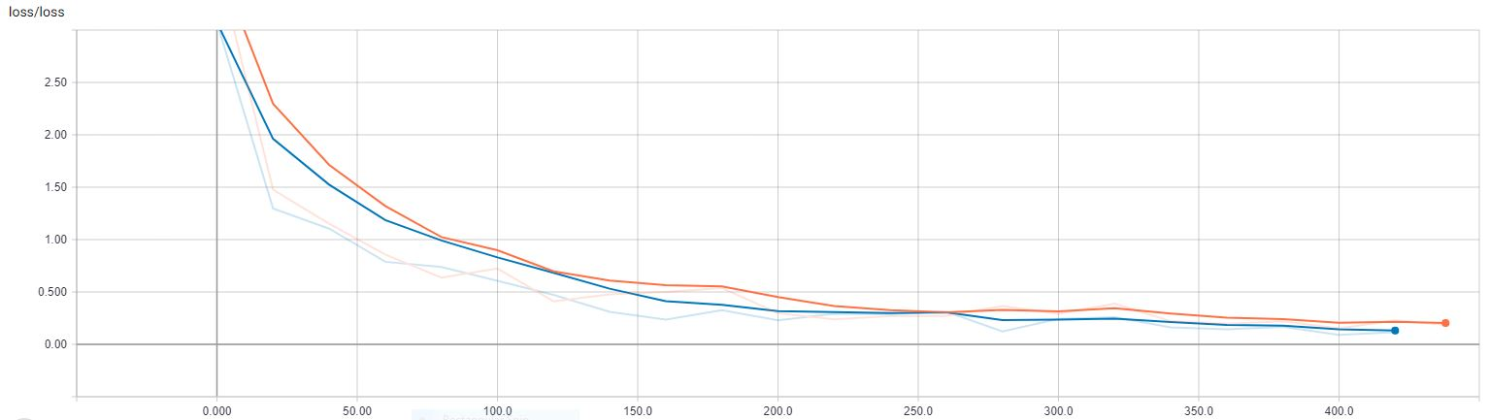
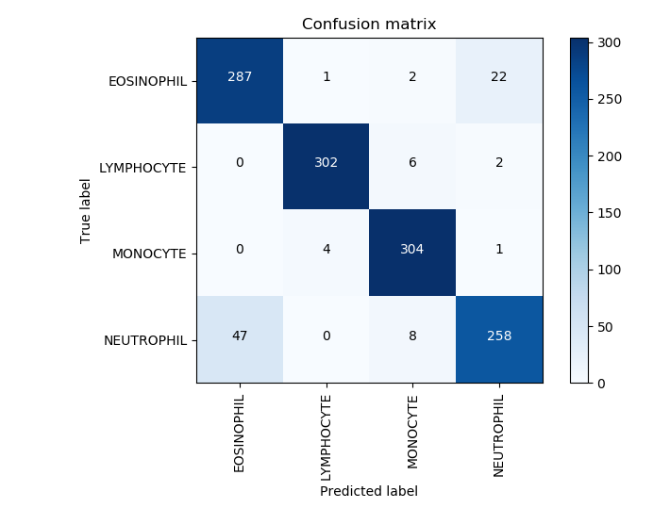
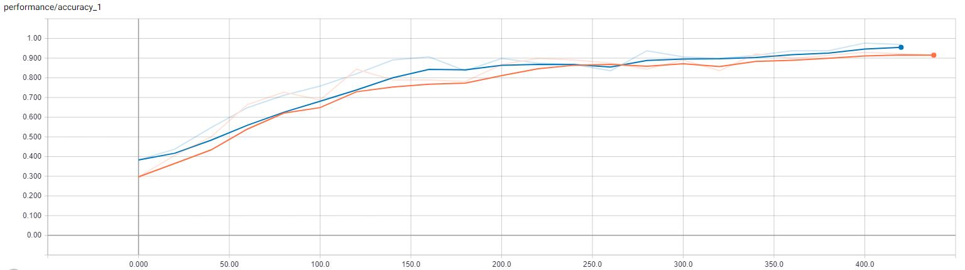
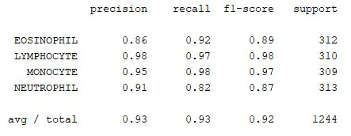
Performance

Slide 10
Useful Links
tf.data (https://youtu.be/uIcqeP7MFH0)
Tensorflow Embeddings (https://youtu.be/eBbEDRsCmv4?t=1081)
Batch Normalization (https://towardsdatascience.com/batch-normalization-in-neural-networks-1ac91516821c)
SGD, Momentum, RMSPRop, and Adam Optimization (https://devblogs.nvidia.com/deep-learning-nutshell-history-training/)

Slide 11
Code Review

