Slide 1
Graduation Design Project (BTP) (2024/2025 Spring)
Final Presentation
A Sustainable and Inclusive Agricultural Business Model Design
Doç. Dr. Nihan Yıldırım
Doç. Dr. Derya Gültekin
Naci Hakan İlgün 070190213
Nihat Devrim Şen 070210741

Slide 2




Goal, Scope and Purpose
Ensuring Access
to Organic Food
Prioritizing
Women Employment
Support for
Local Development
Fair Sharing
of Income
“The goal is not just to farm,
but to cultivate equity, trust, and sustainability.”

Slide 3
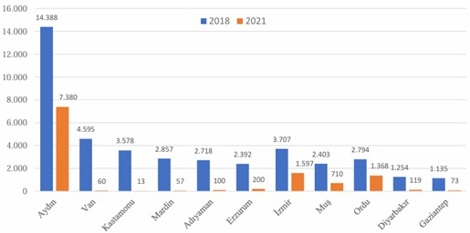
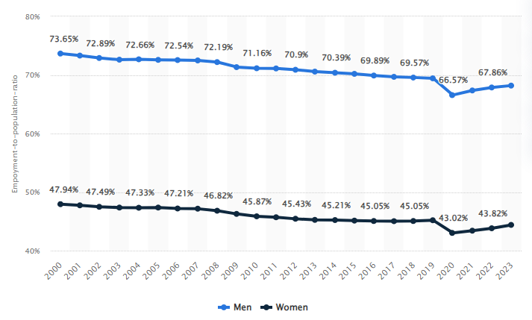
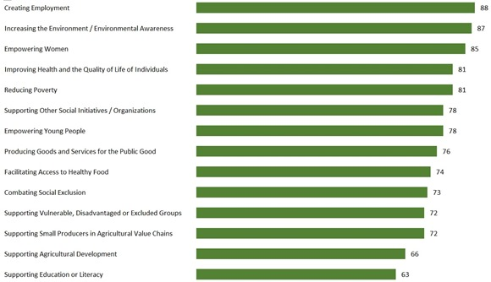
Problem Definition
1. Difficulty in Accessing Safe Food
2. Women Employment Problems
3. Weakness of the Cooperative Structure in Agriculture

Slide 4
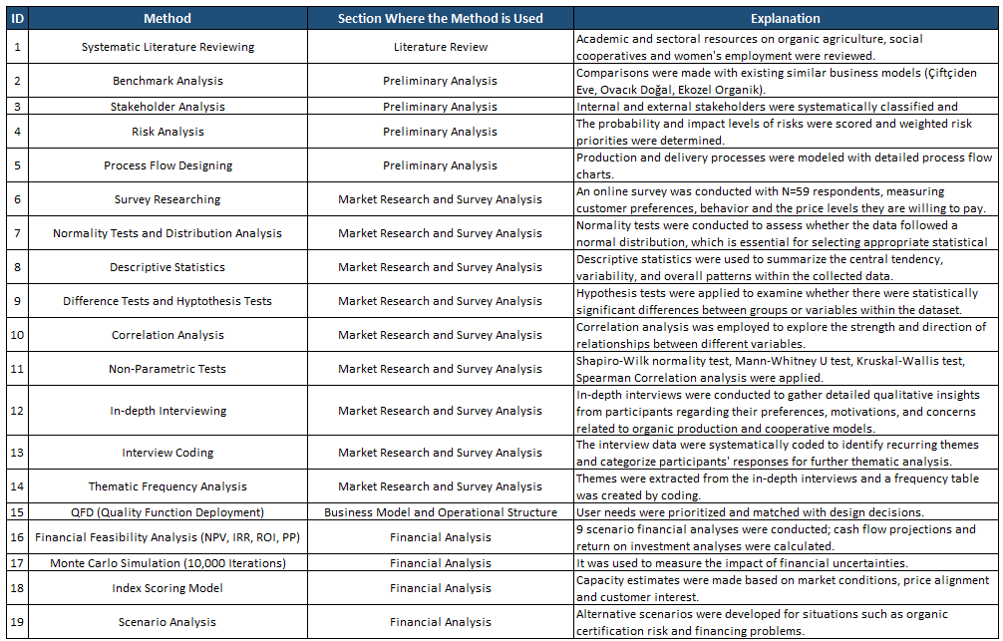
Methodology

Slide 5
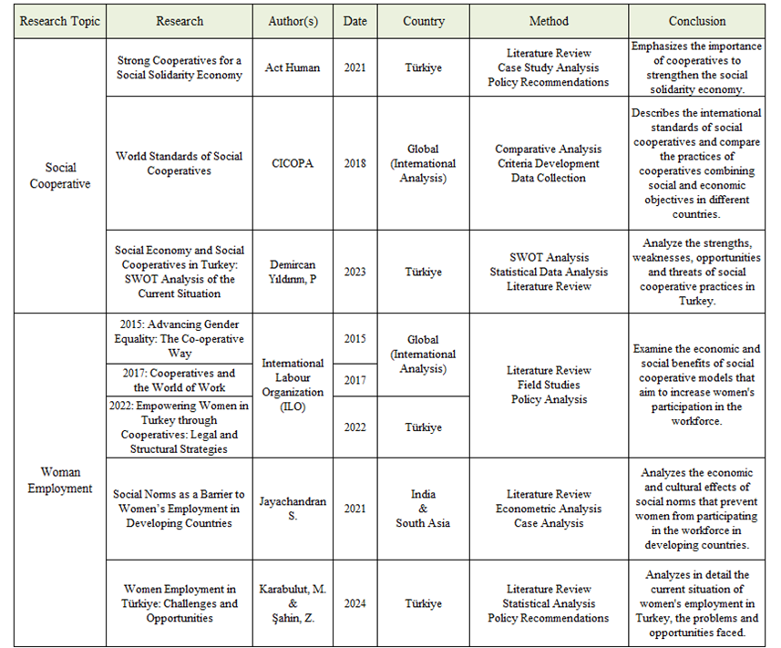
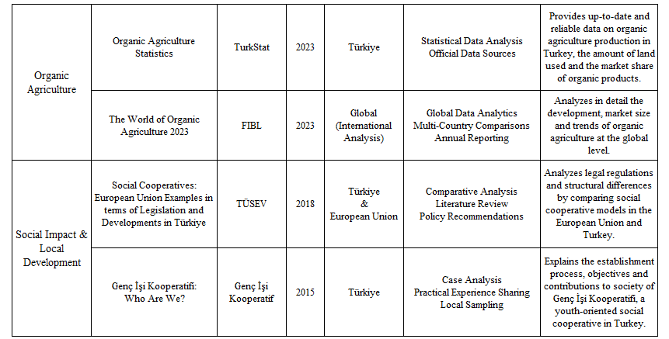
Literature Research

Slide 6
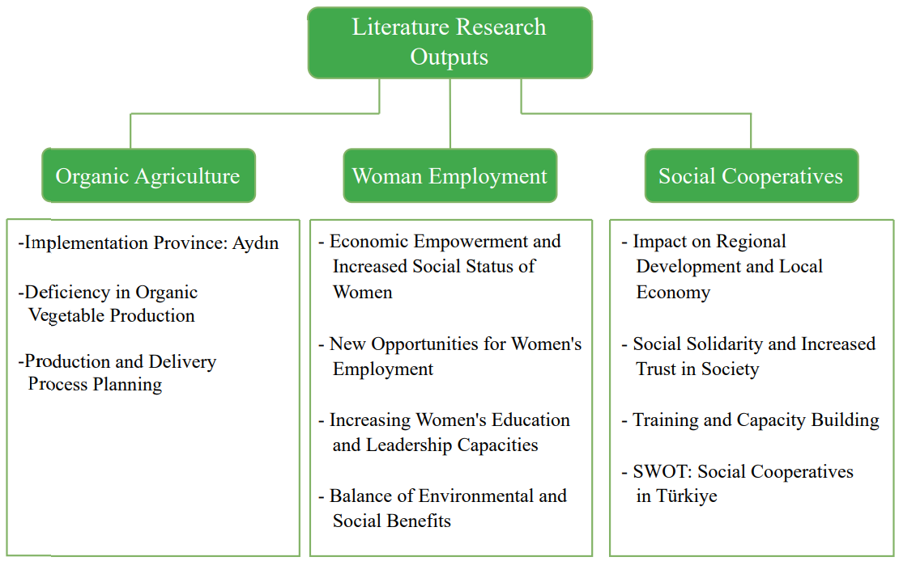
Outputs of the Literature Research

Slide 7
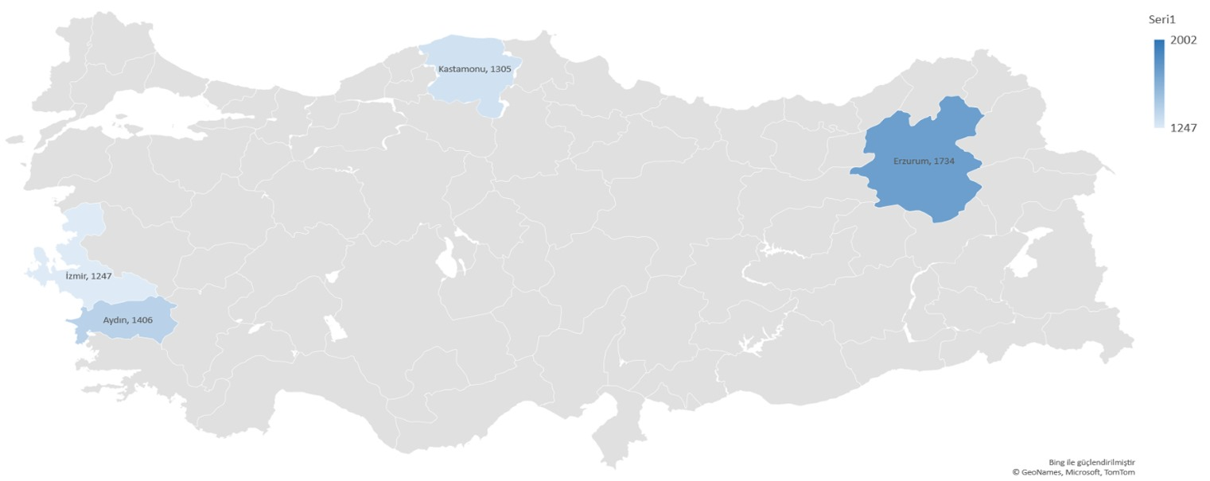

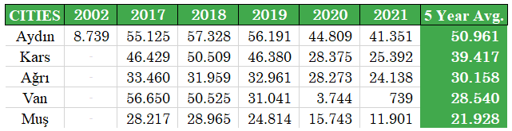
Outputs of the Literature Research
Implementation Province: Aydın
Figure: Provinces with the highest number of organic farmers (NUTS3) (2022) (TurkStat, 2023)
Table: Distribution of organic plant production areas by province in Türkiye (hectares) (MoAF, 2022)

Slide 8
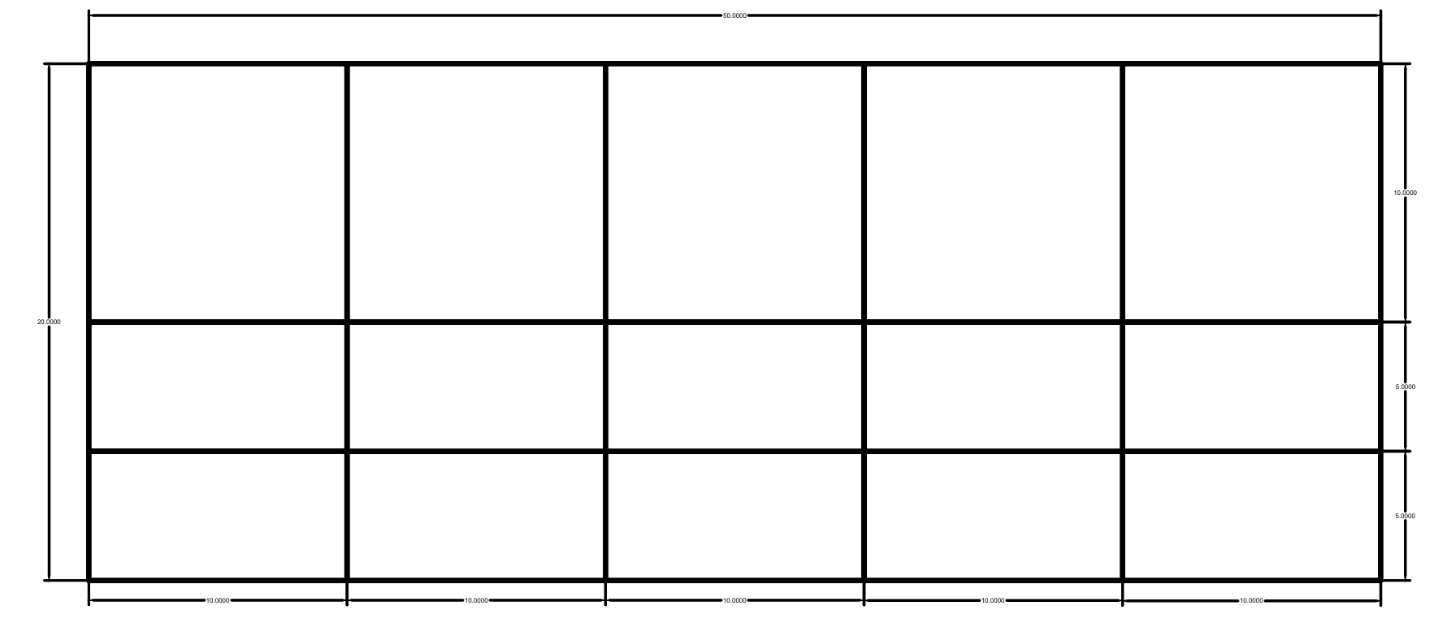
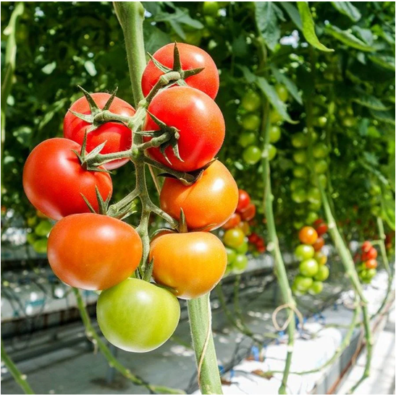
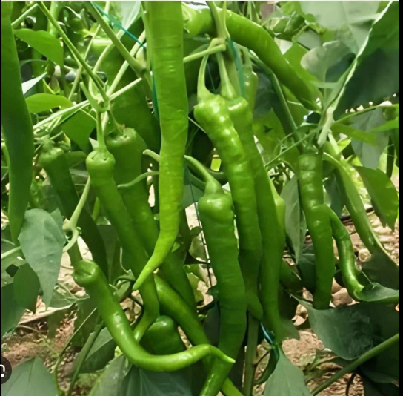
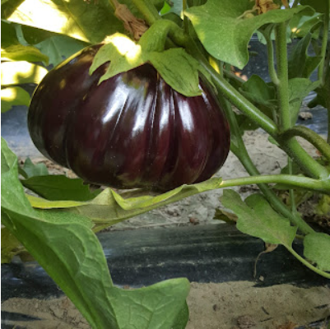
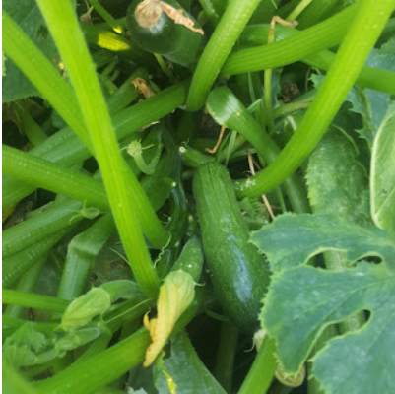
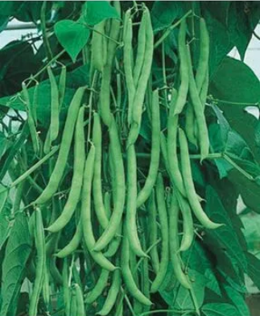
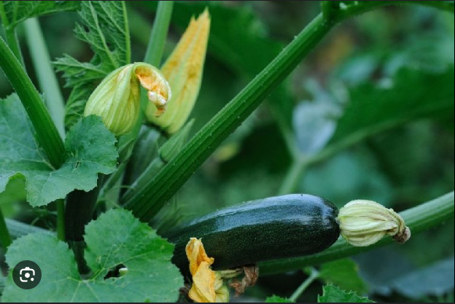
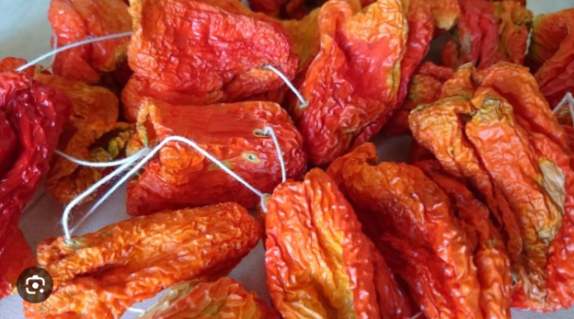
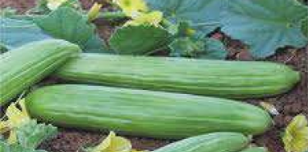
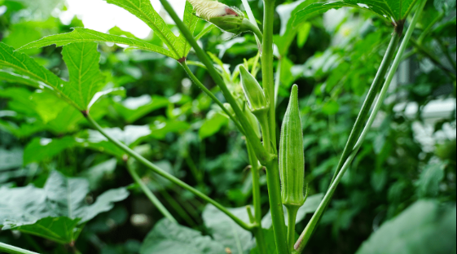
Senin Bahçen Model
Tomato
Pepper
Eggplant
Beans
Cucumber
Zucchini
Gherkin
Okra
Stuffed Pepper
*Visualization of 50 m² and 100 m² rented plots within a 1 decare (1000 m²) agricultural land.

Slide 9
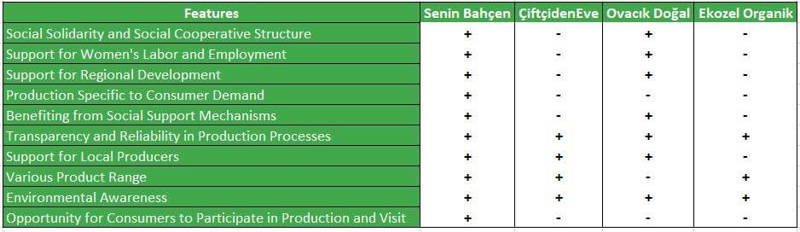




Benchmark Analysis

Slide 10
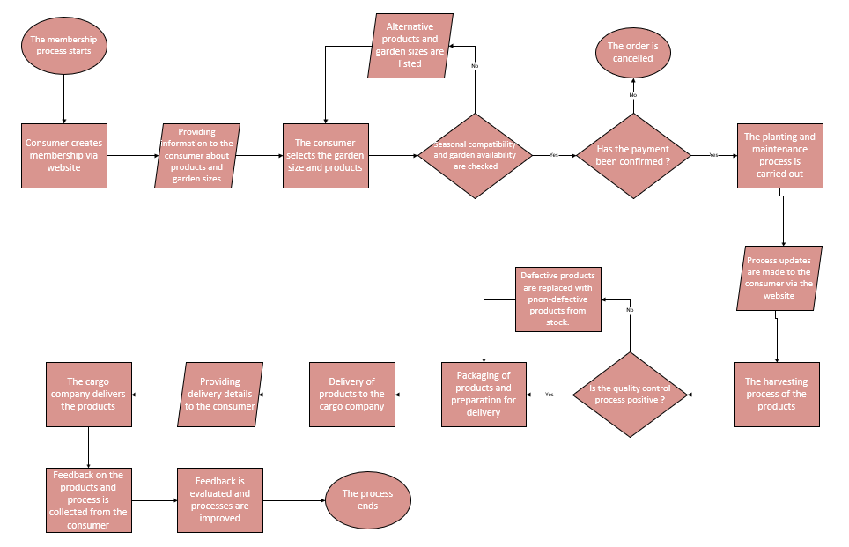
Process Flow Design

Slide 11



Survey Background
🎯
Survey Goal:
Assessing the compatibility of our business model with the expectations, values ​​and behaviors of our potential customers.
22 Questions in Five Categories
59 Respondents
Question Design Approach
Demographic Information
Urban & Educated
Model-driven Questions
Healthy Living Orientation
Target-aligned Sample
Value-fit Focused
Attitudes Towards Transparency and Sustainability
Online Reach
Benchmark-based
Majority 18-44
Vegetable Consumption Habits
Assumption Testing
Demand for Organic Products

Slide 12



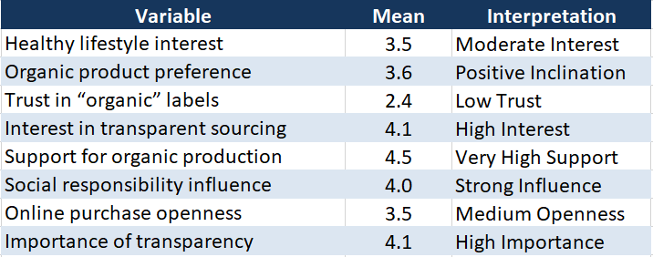
Distribution Checks & General Trends
Histograms
QQ-plots
Shapiro-Wilk Test
Data is not normally distributed (Shapiro-Wilk p < 0.05)
Therefore, non-parametric methods were applied.

Slide 13
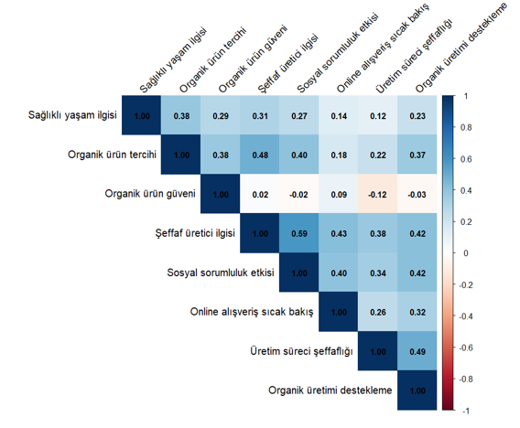
Correlation Analysis
Spearman Correlation
Variables | ρ | Strength
Transparent sourcing ↔ Social responsibility | 0.59 | Strong positive
Organic preference ↔ Transparent sourcing | 0.48 | Moderate
Transparency importance ↔ Organic support | 0.49 | Moderate
Healthy lifestyle ↔ Organic preference | 0.38 | Moderate

Slide 14
Hypotheses & Final Insights
Hypothesis | Variable Comparison | Result
H1 | Gender → Trust in organic labels | ✅ Significant (p = 0.0016)
H2 | Education → Healthy lifestyle interest | ✅ Significant (p < 0.01)
H3 | Education → Organic product preference | ✅ Significant (p < 0.01)
H4 | Education → Transparent sourcing interest | ✅ Significant (p < 0.01)
🎯Key Takeaways:
People want access to healthy food regardless of age or income.
Trust in organic labels remains critically low.
Education boosts awareness and demand for organic products.
🌱
“Our model directly responds to these findings by offering transparent, socially responsible, and accessible organic farming.”

Slide 15
Participant Demographics

Slide 16




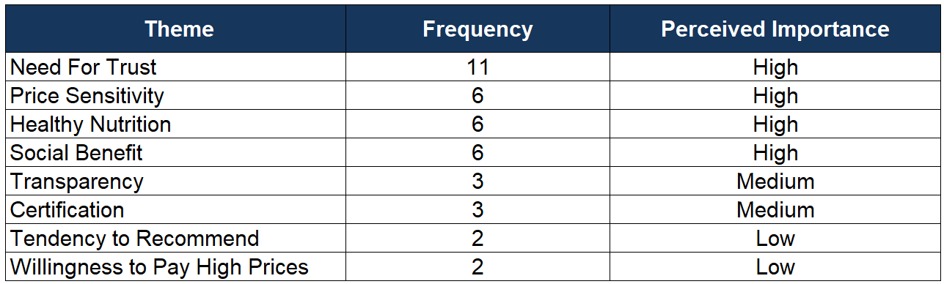
Interviews
14 Open-ended Questions
5 People
28–58
years old
Urban & Educated
“We support small producers instead of the rich. The problems you mentioned are actually Türkiye’s problems.” (Interviewer 1, male, age 58)

Slide 17
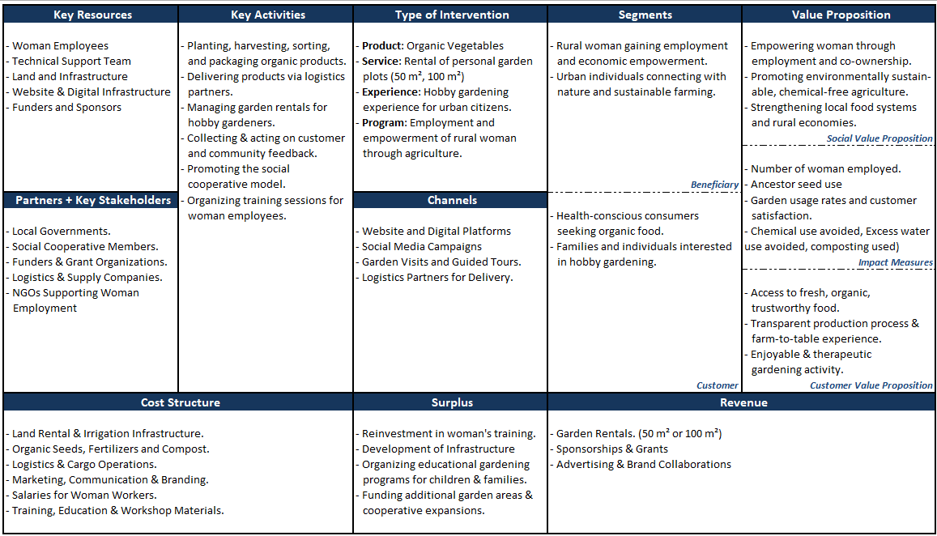
Social Business Model Canvas

Slide 18
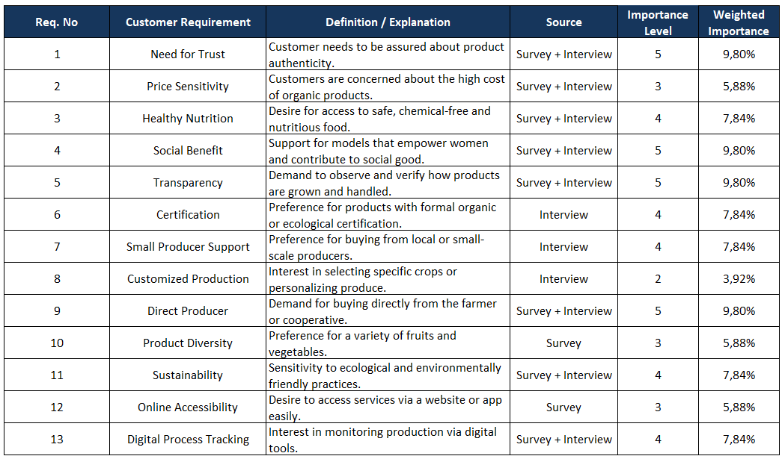
Requirement List

Slide 19
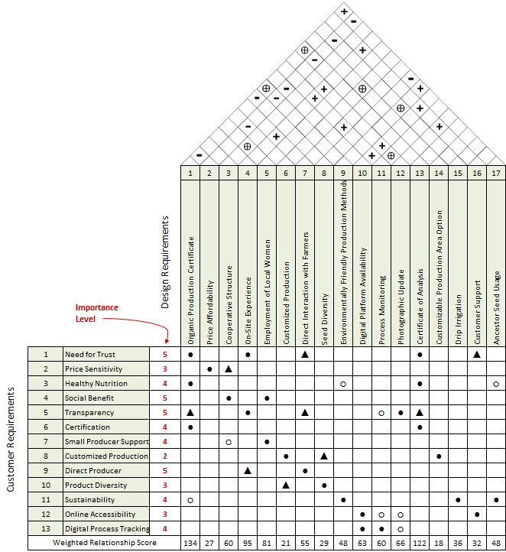
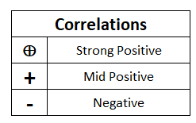

House of Quality

Slide 20
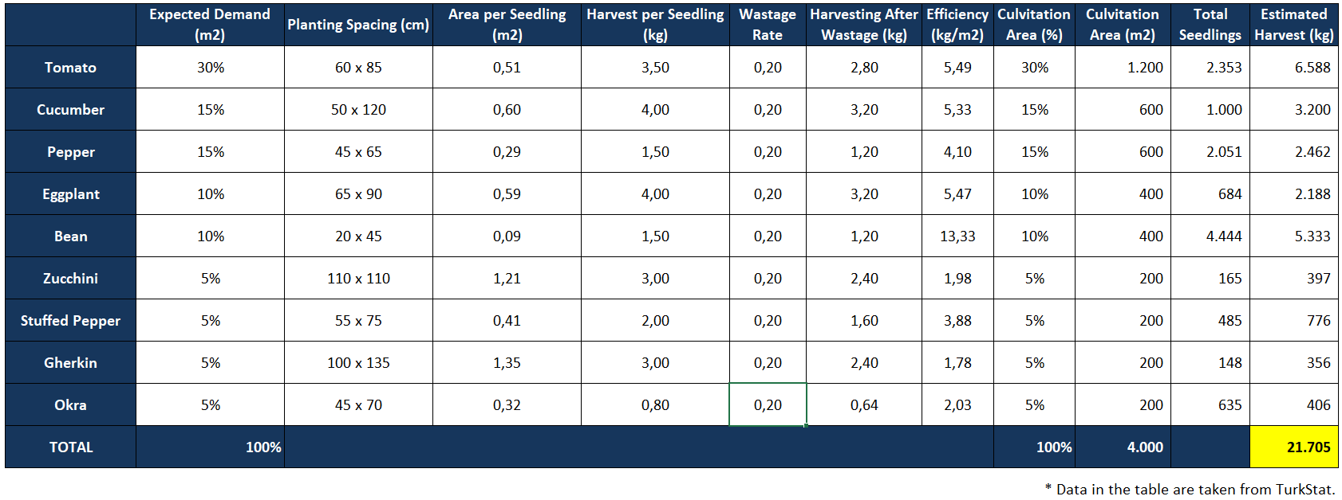
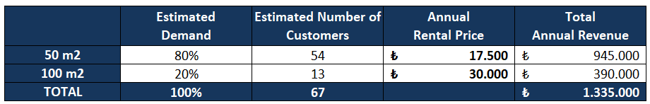
Technical Specifications

Slide 21
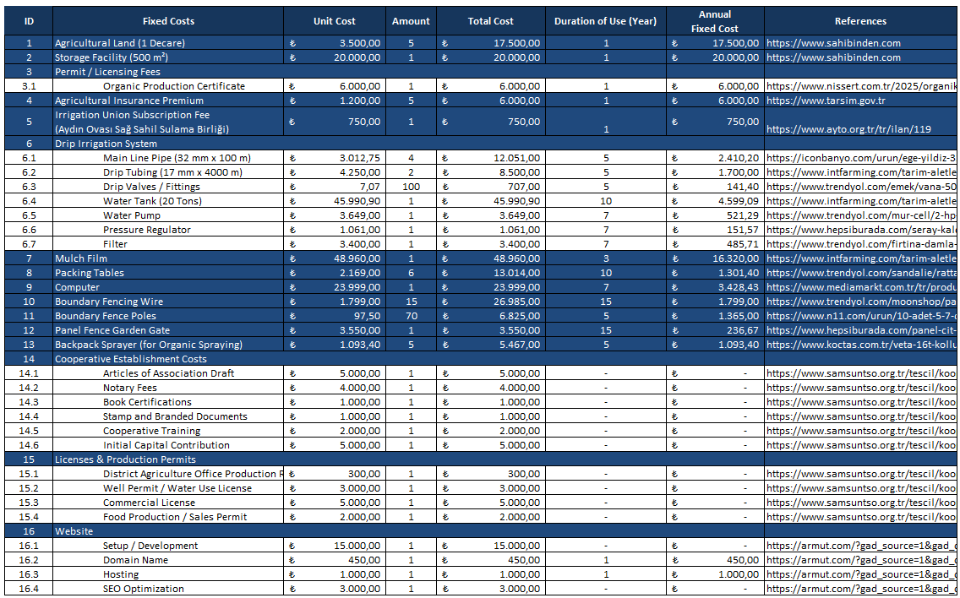
Initial Investment Items

Slide 22
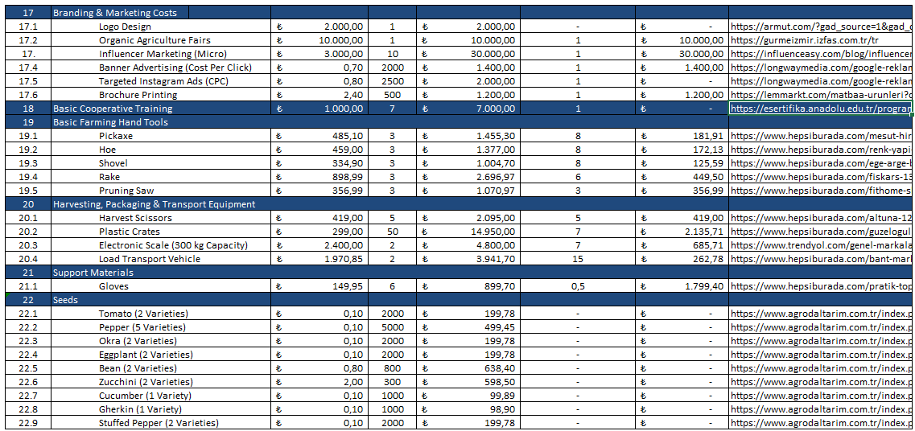
Initial Investment Items (Cont’d)

Slide 23
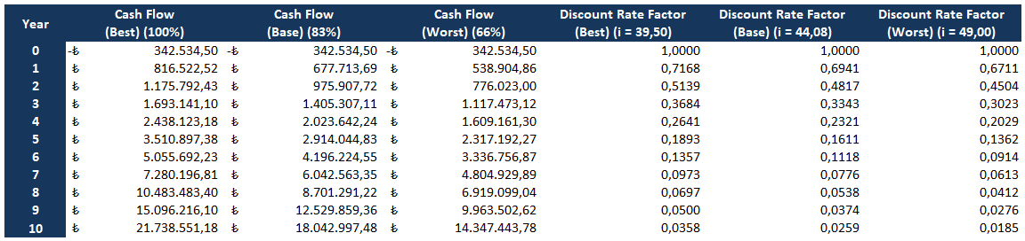
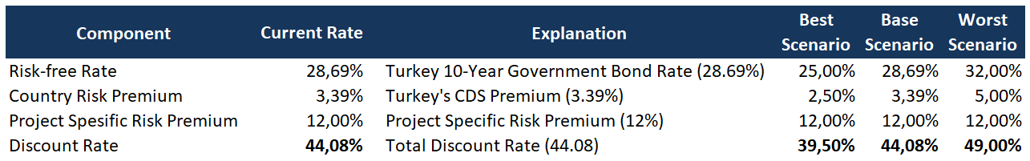
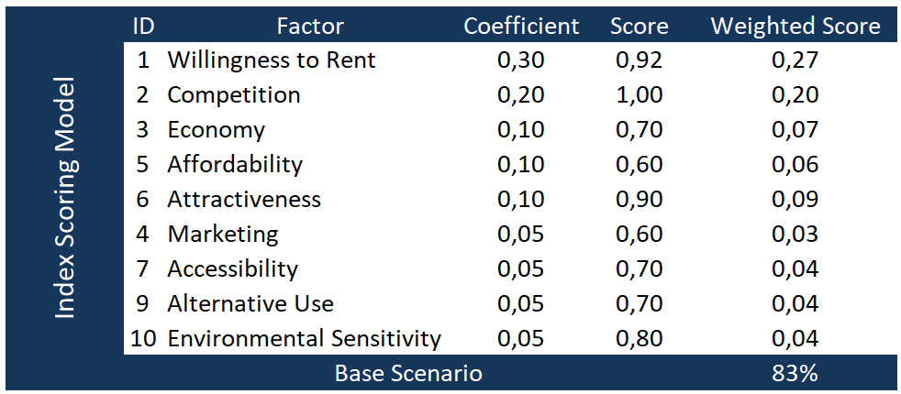
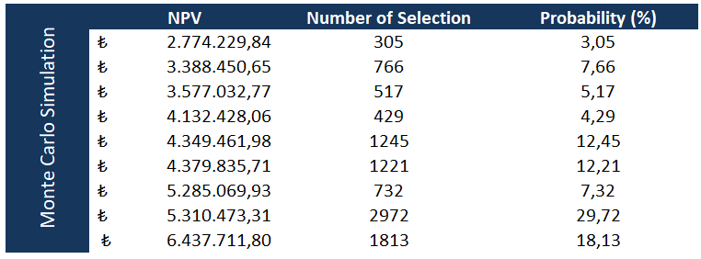
Financial Statements

Slide 24
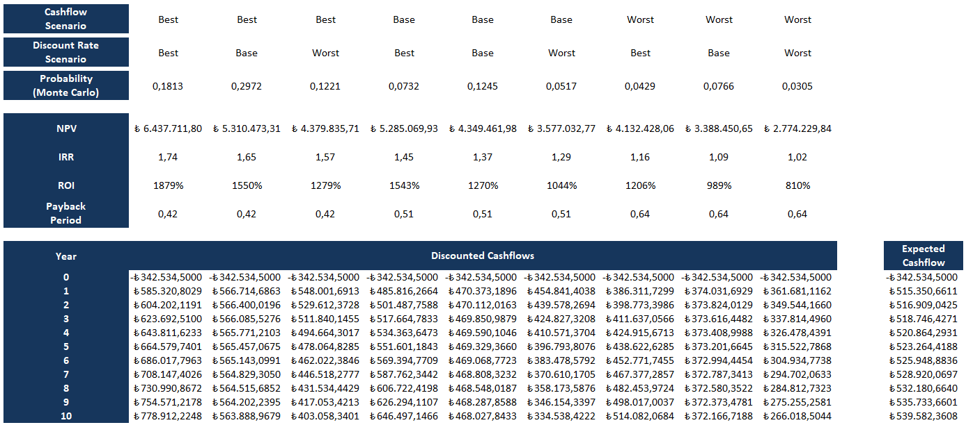
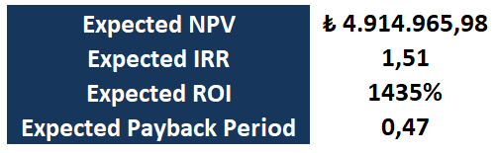
Financial Statements (Cont’d)

Slide 25
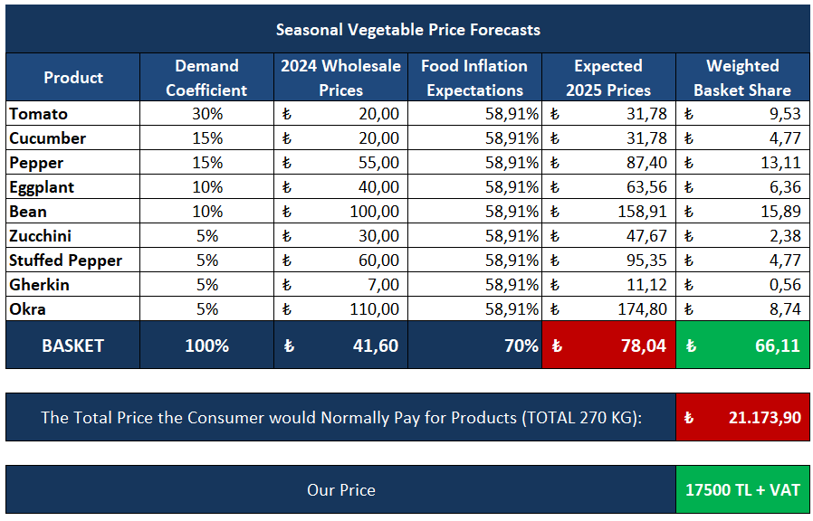
What is the Economic Value We Offer?

Slide 26



Legal Feasibility
Operates under Law No. 1163 as a women-led Cooperative.
Complies with organic farming and food safety regulations.
All legal registrations and certifications obtained.
Eligible for national grants and public support programs.
Risks managed through legal consultancy and standardized contracts.

Slide 27
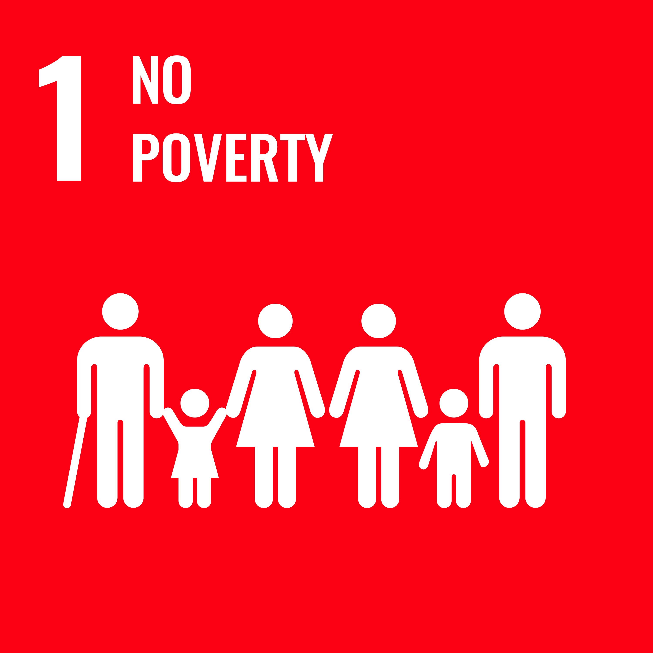


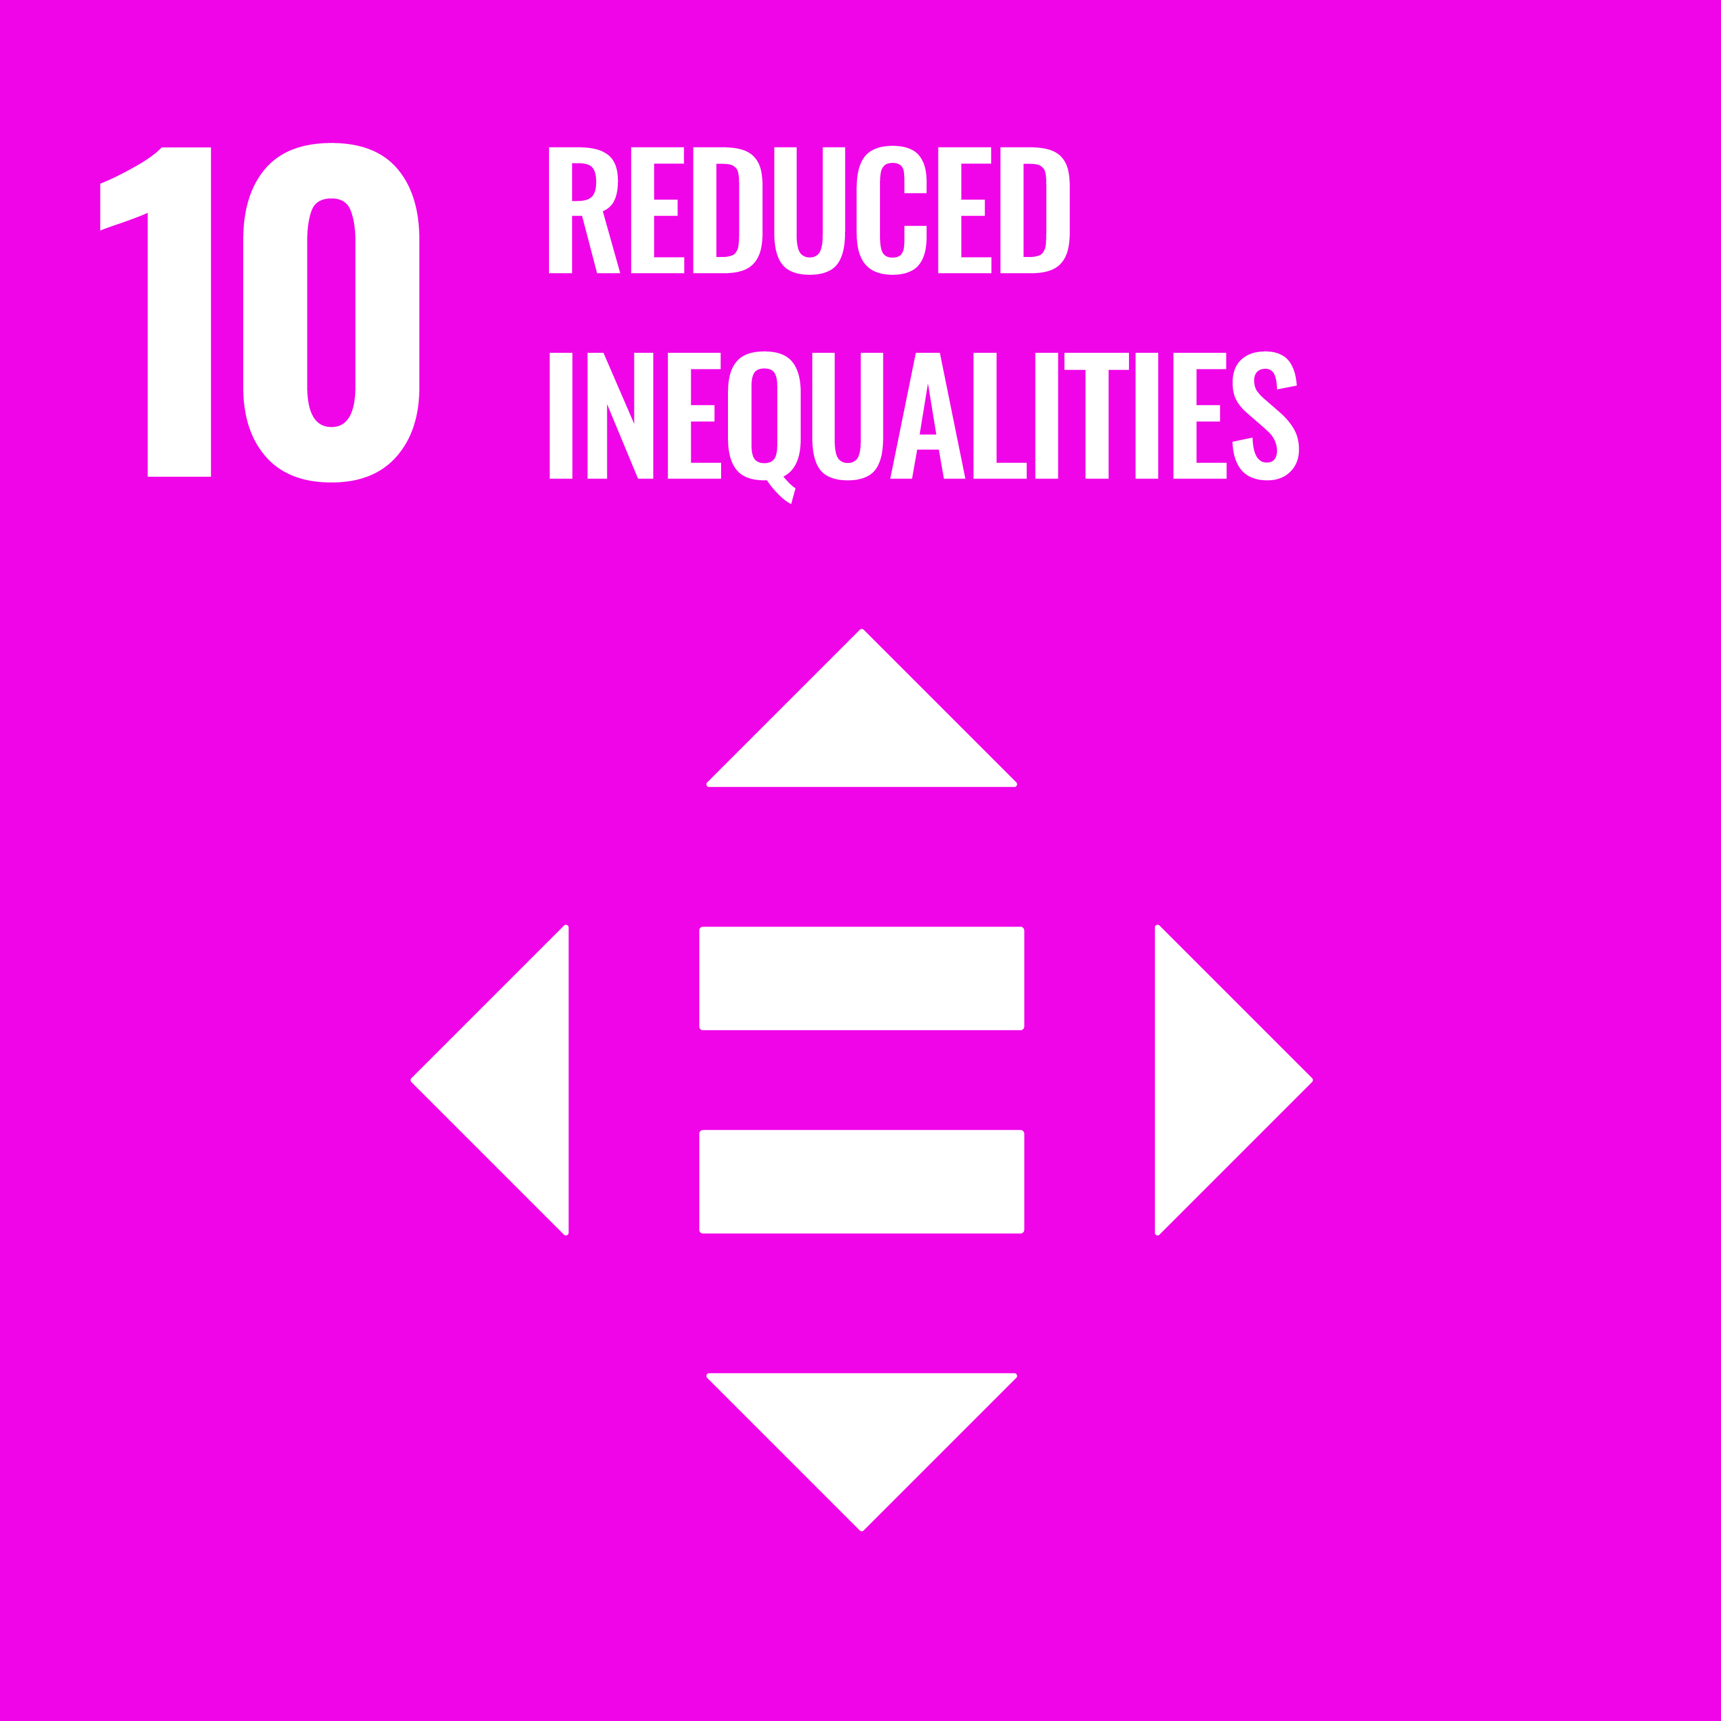
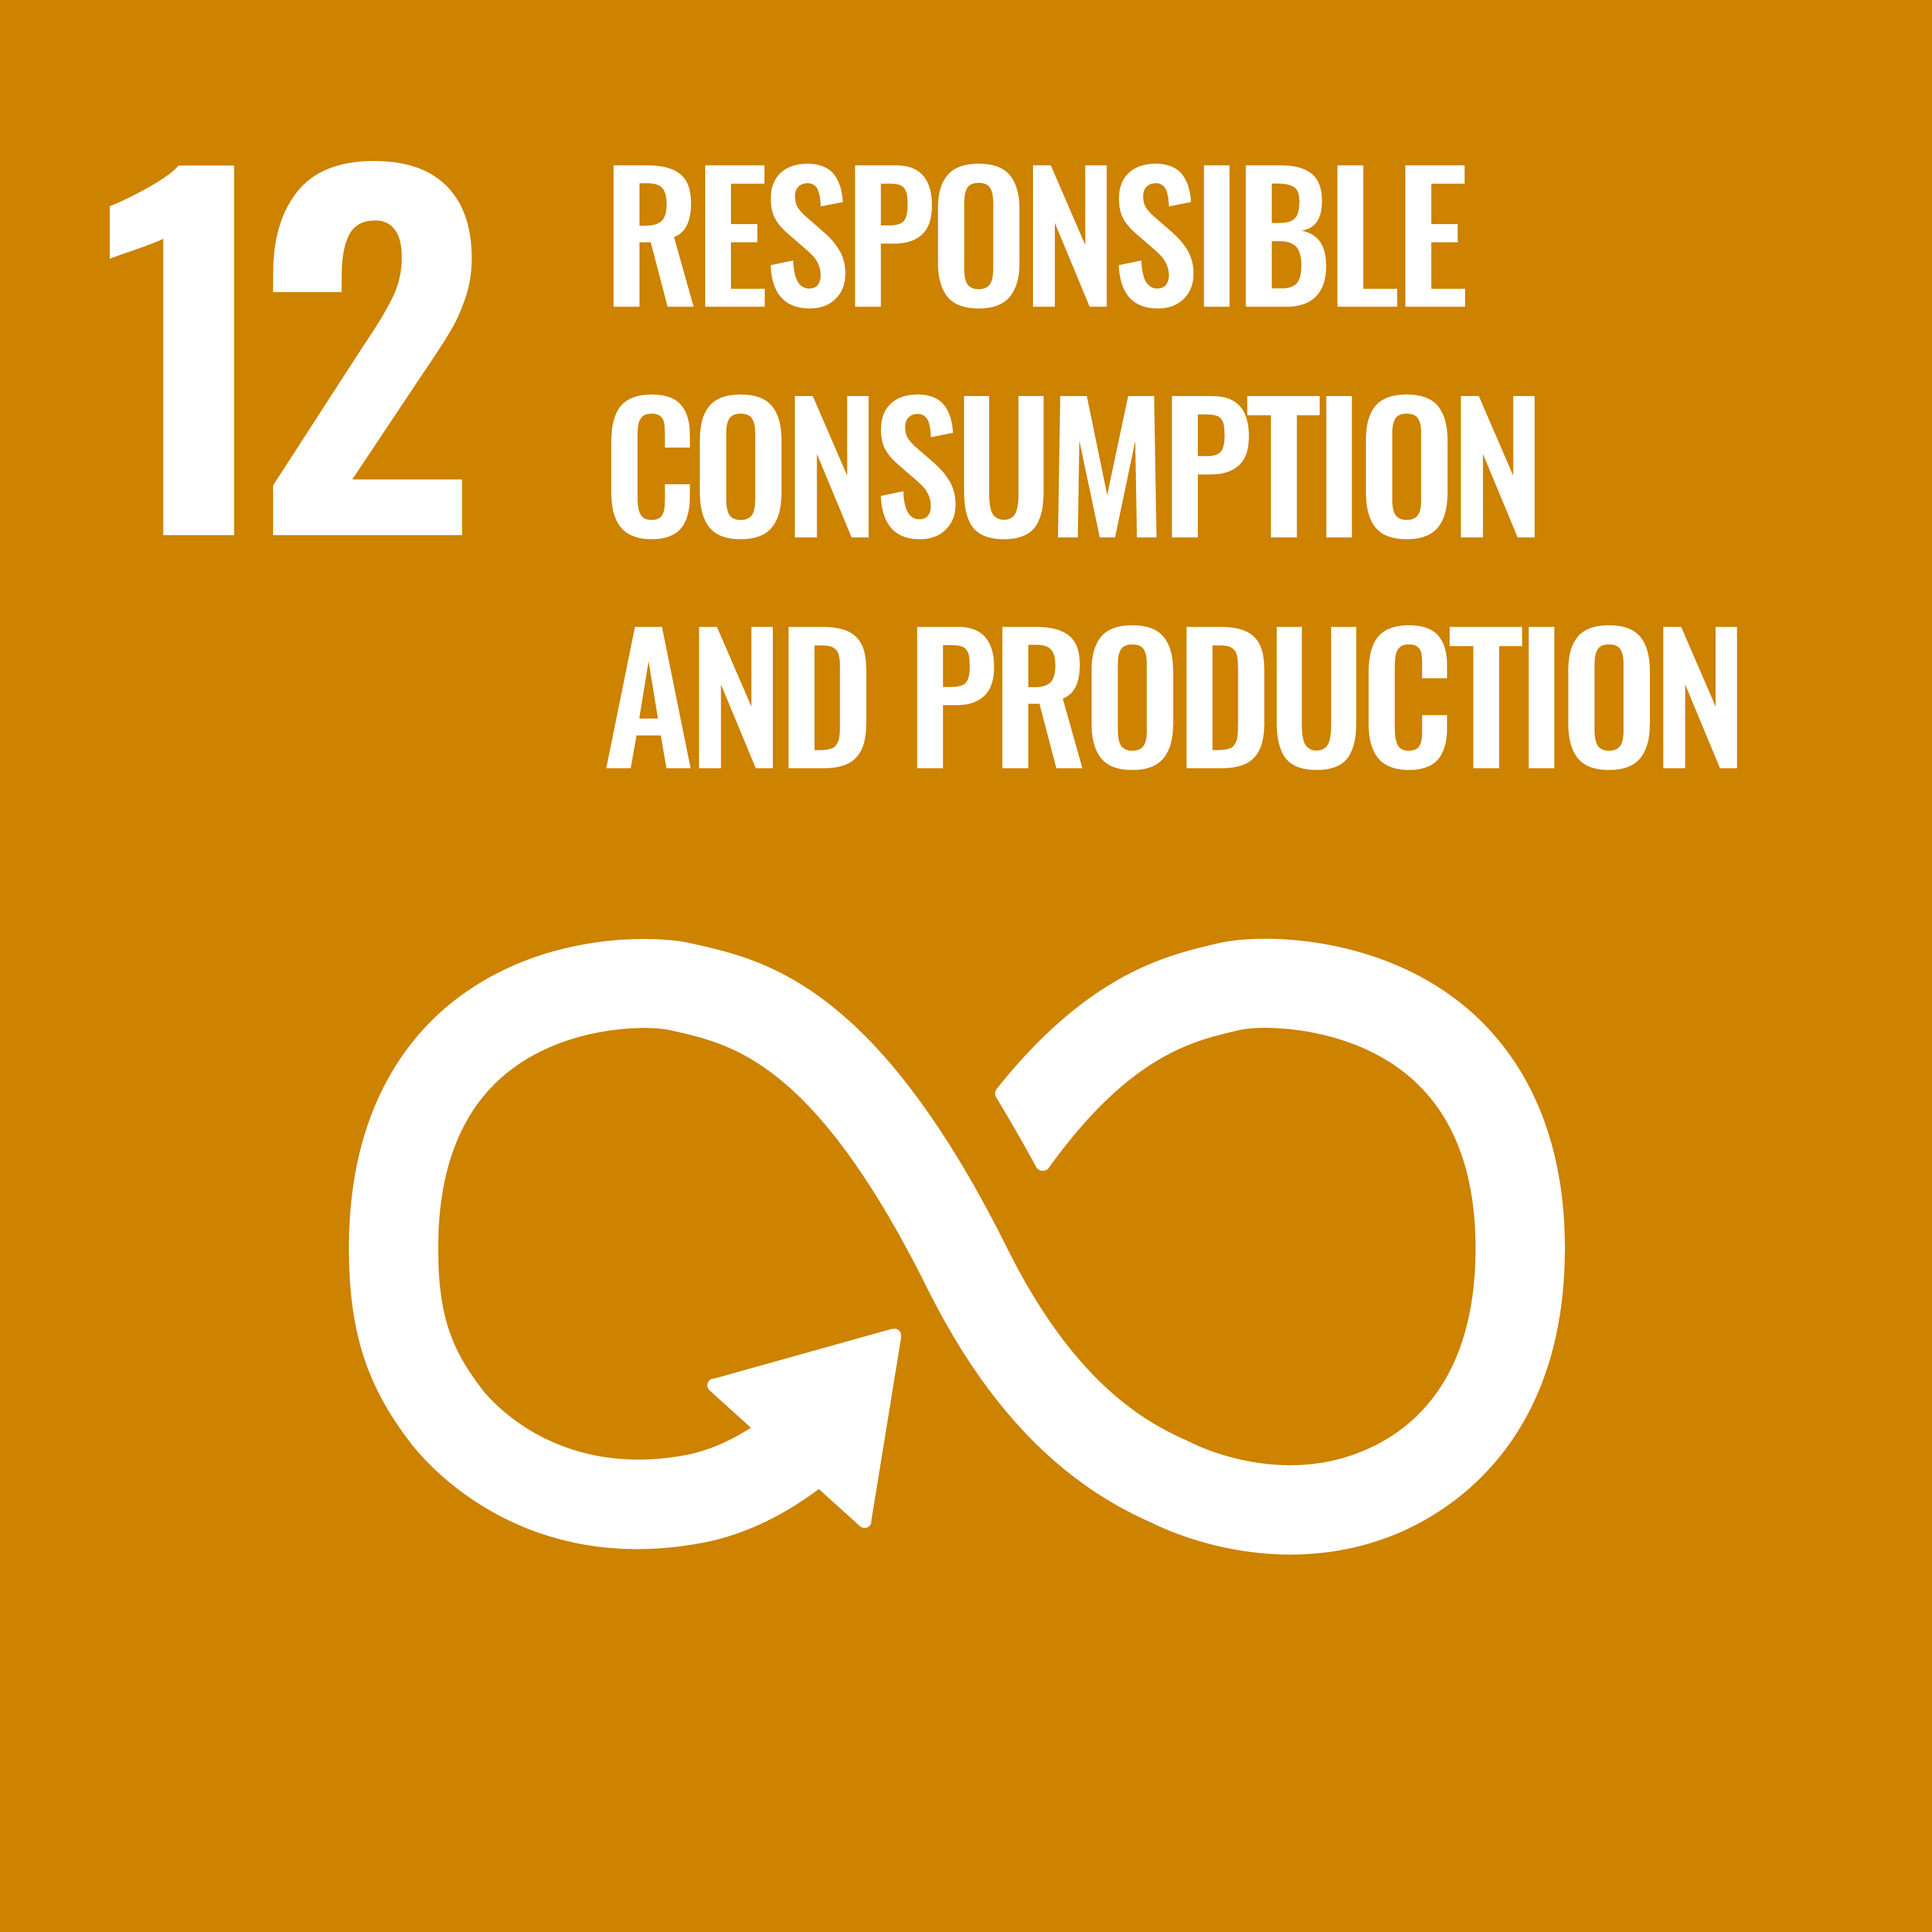

Alignment with SDG’s of UN

Slide 28
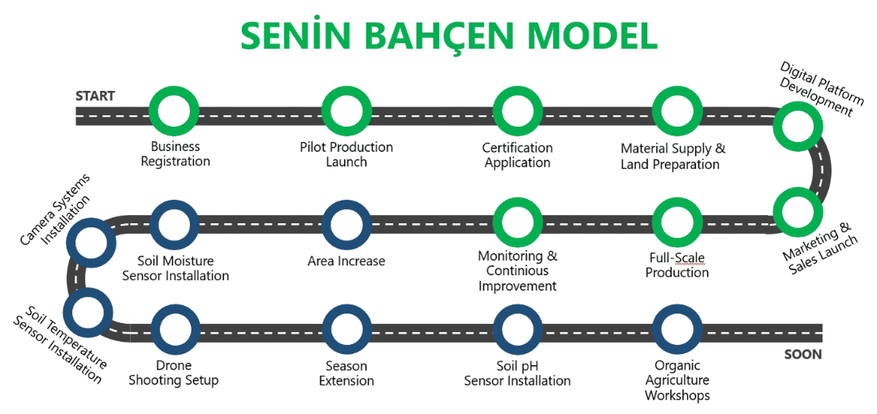
Project Roadmap

Slide 29
THANK YOU !

