Slide 1
Graduation Design Project (BTP) (2024/2025 Spring)
Interim Presentation
A Sustainable and Inclusive Agricultural Business Model Design
Doç. Dr. Nihan Yıldırım
Doç. Dr. Derya Gültekin
Naci Hakan İlgün 070190213
Nihat Devrim Şen 070210741

Slide 2
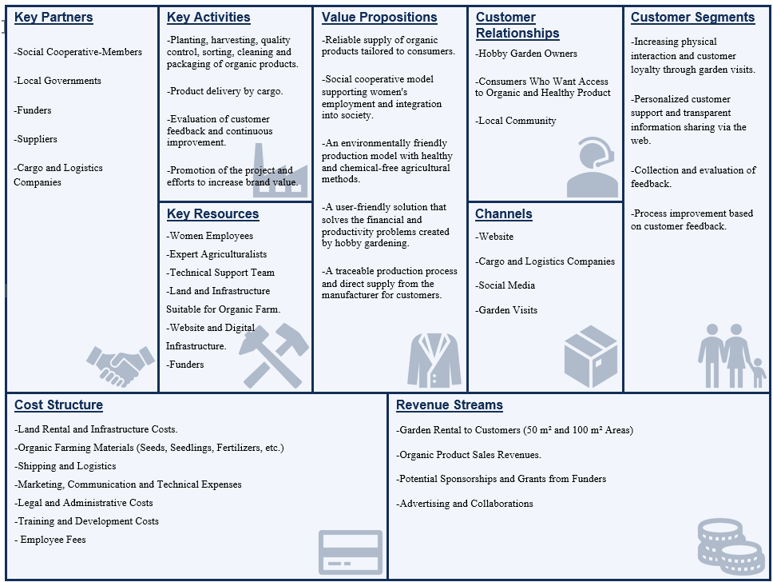
Business Model Canvas

Slide 3
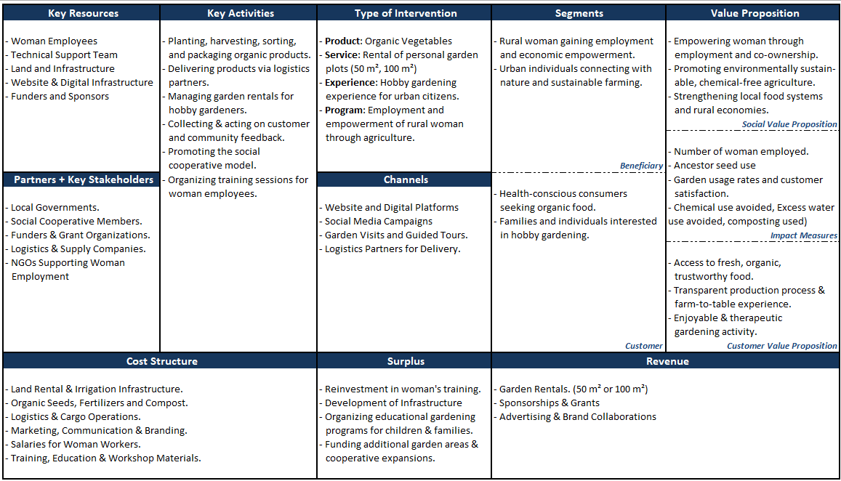
Social Business Model Canvas

Slide 4
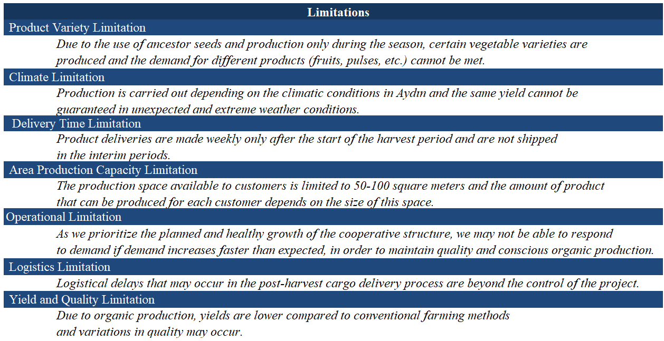
Limitations

Slide 5
Concept Generation
Data Sources
1. Survey 2. Interview
👥
59 People
👥
3 People
- Organic Products
- Social Responsibility Sensitivity
- Process Transparency.
- Motivations
- Priorities
- Hesitations
⚡️
⚡️
How We Progressed?
General trends were identified with quantitative data obtained from the questionnaires.
These trends were confirmed and elaborated with interview data.
Concept Generation was carried out based on the needs emerging from both sources.
Transition Flow from Data to Solutions:
Survey + Interview ➔ Needs List ➔ Solution Ideas

Slide 6
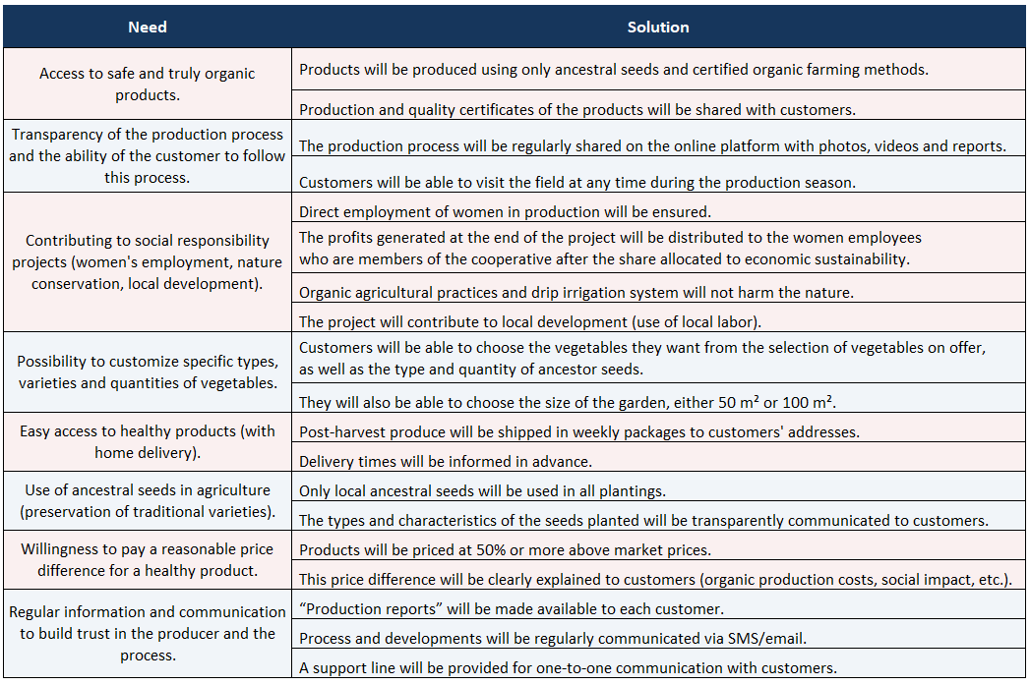
Concept Generation (Cont’d)

Slide 7
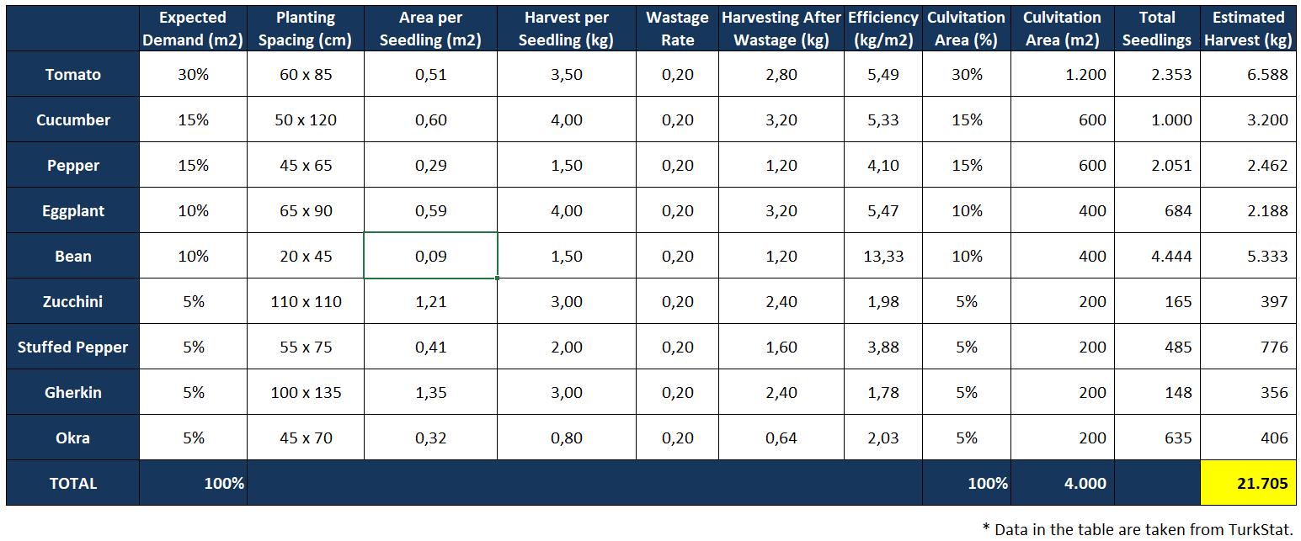
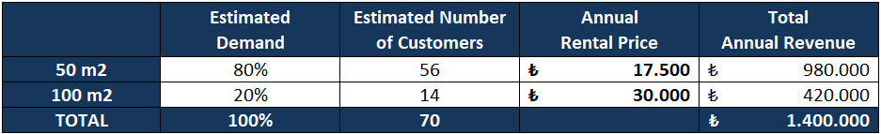
Technical Specifications

Slide 8
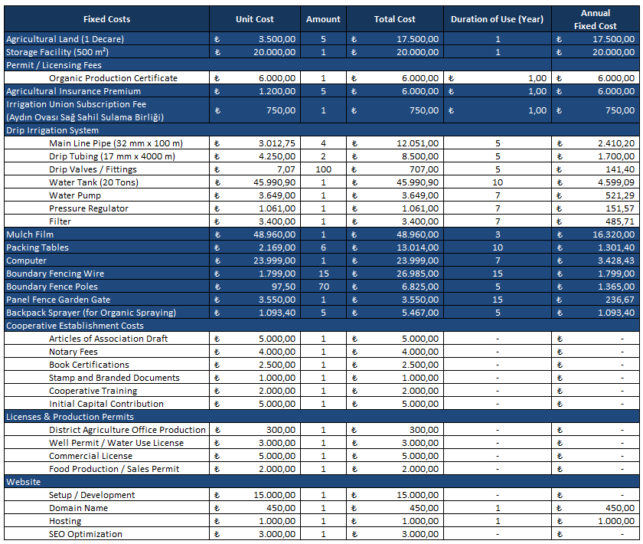
Initial Investment Items

Slide 9
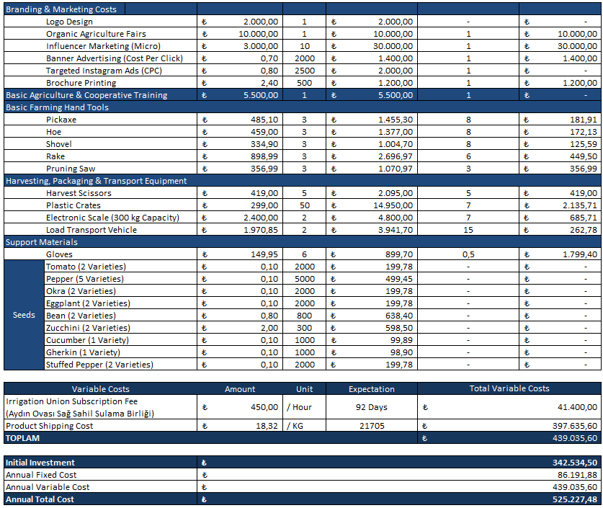
Initial Investment Items (Cont’d)

Slide 10
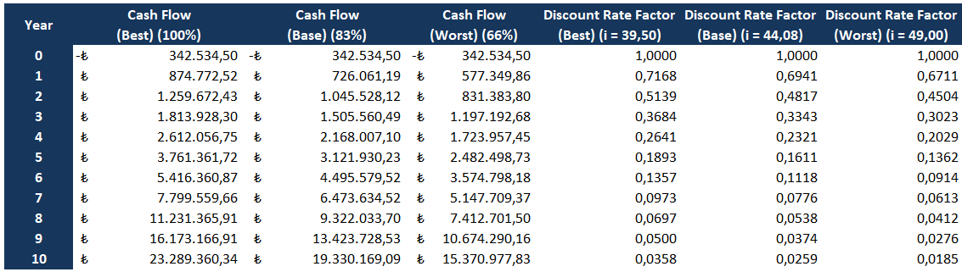
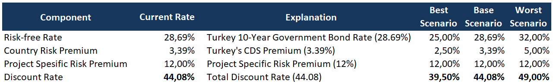
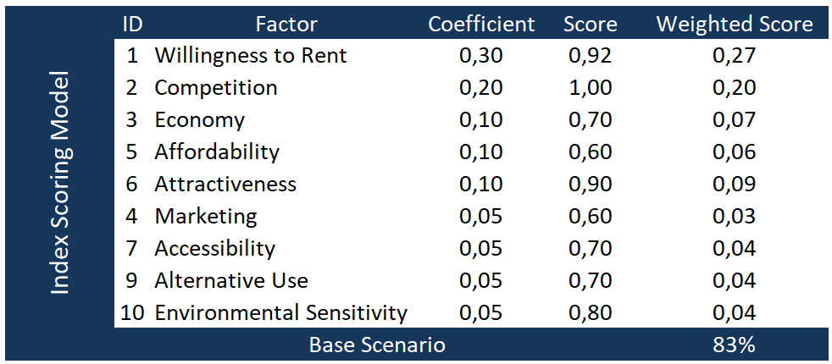
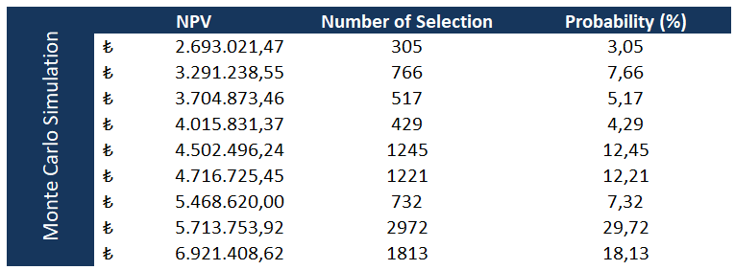
Financial Statements

Slide 11
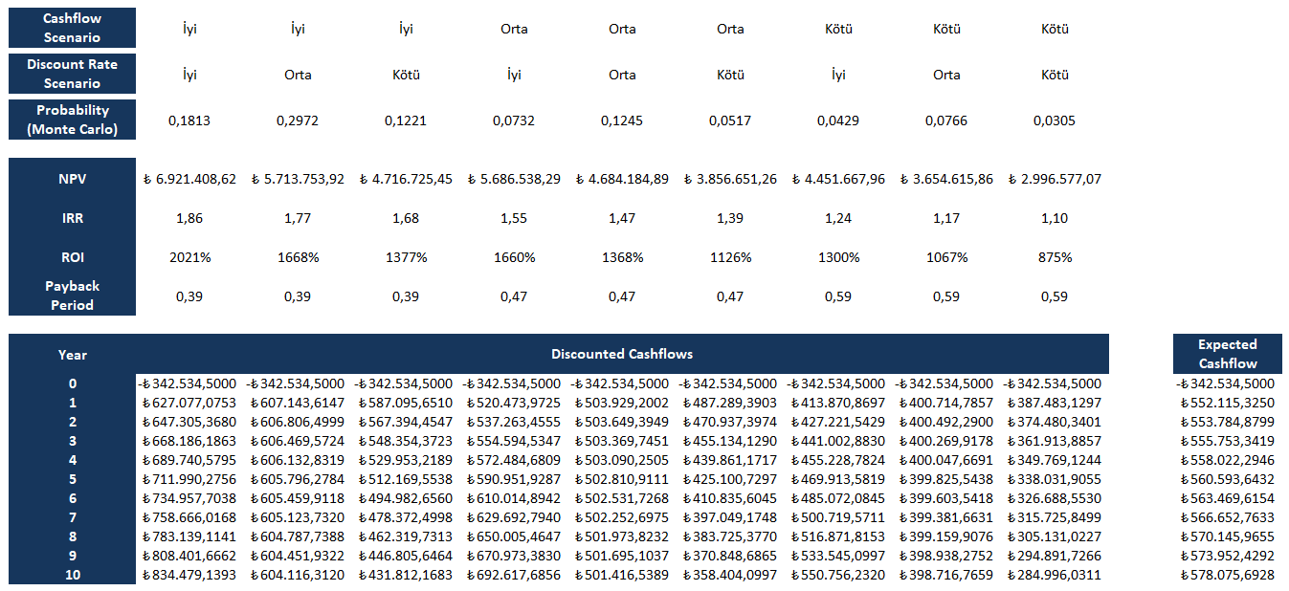
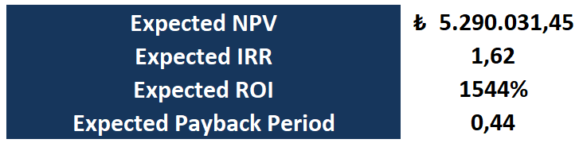
Financial Statements (Cont’d)

Slide 12
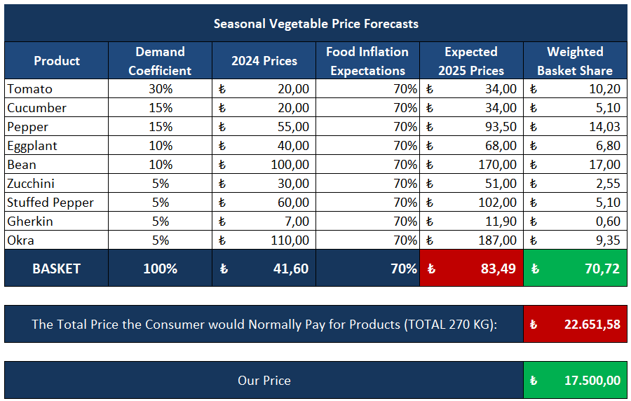
What is the Economic Value We Offer?

Slide 13
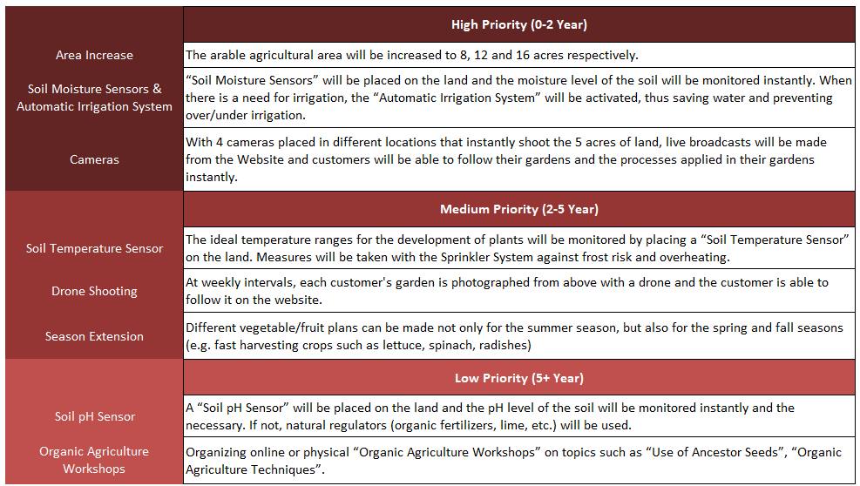
Capacity Development Plan

Slide 14

Project Pulse
PROJECT PULSE
DATA
RESEARCH
SYSTEM DESIGN
MARKETING
FINANCIAL ANALYSIS
FEASIBILIY ANALYSIS
CONCLUSION
PROBLEM DEFINITION
PROJECT GOAL
PROJECT SOLUTION
LITERATURE RESEARCH
QUALITATIVE RESEARCH
BENCHMARKING
BUSINESS MODEL CANVAS
STAKEHOLDER ANALYSIS
RESEARCH OUTPUTS
RISK ANALYSIS
FINAL EVALUATION
IMPLEMENTATION ROADMAP
SUSTAINABILITY PLAN
✓
✓
PROCESS FLOW DESIGN
BUSINESS MODEL DEVELOPMENT PRODUCTION & SUPPLY CHAIN STRUCTURE COOPERATIVE & COMMUNITY ENGAGEMENT WEBSITE DESIGN & DEVELOPMENT
✓
BRANDING & POSITIONING STRATEGY
✓
✓
REVENUE STRUCTURE
COST STRUCTURE
NPV & ROI CALCULATION PRICING STRATEGY
INVESTMENT & FUNDING OPPORTUNITIRES
OPERATIONAL FEASIBILITY
ECONOMIC FEASIBILITY
LEGAL FEASIBILITY
SOCIAL FEASIBILITY
✓
✓
DIGITAL MARKETING
✓
✓
✓
✓
✓
✓
✓
CAMPAIGNS & ADVERTISEMENT PLAN
✓
✓
✓
CUSTOMER RELATIONS
✓
✓
✓
✓

Slide 15
References
https://ms.hmb.gov.tr/uploads/2024/09/Web_Kamu_Borc_Yonetimi_Raporu_Agustos_2024.pdf
https://burdur.tarimorman.gov.tr/Lists/KutuMenu/Attachments/6/2022%20BRİFİNG%20%282%29.pdf
https://ms.hmb.gov.tr/uploads/2025/03/Ekonomi-Sunumu_TUR.pdf
https://iconbanyo.com/urun/ege-yildiz-32-mm-10-atu-siyah-kangal-boru-100-metre
https://www.intfarming.com/tarim-aletleri/damlama-sulama-borusu/yassi-damlama-borusu-50-cm-delikli-17-lik
https://www.trendyol.com/emek/vana-50-ad-damla-sulama-parcasi-aparati-damlama-borusu-hortumu-parcasi-ekleme-baglanti-parcalari-p-34374307
https://www.hepsiburada.com/seray-kalde-su-basinc-dusurucu-regulator-3-4-rakorlu-ve-manometreli-pm-HBC000010F3NM
https://www.trendyol.com/firtina-damla-sulama/2-63-ayakli-filtre-p-150180429
https://www.intfarming.com/tarim-aletleri/deliksiz-malc-naylonu
https://www.trendyol.com/sandalie/rattan-90x150-camsiz-kahve-masa-bahce-balkon-teras-p-194971985
https://www.mediamarkt.com.tr/tr/product/_lenovo-ideapad-1ryzen-7-5700u16gb-ram512gb-ssd156w11laptop-gri-82r400rttx-1241318.html
https://www.trendyol.com/moonshop/paket-hidrofor-otomatik-sistem-su-pompasi-5-yil-garantili-qb60-ve-hidrofor-2-yil-garantili-p-640305394
https://www.n11.com/urun/10-adet-5-7-cm-ahsap-direk-150-cm-ahsap-direk-cit-diregi-19585127?magaza=evdekorazi#unf-review
https://www.hepsiburada.com/panel-cit-bahce-kapisi-gobek-kilitli-kollu-100x100-pm-HBC00007UIO96
https://www.koctas.com.tr/veta-16t-kollu-sirt-tipi-ilaclama-makinesi-16-l/p/5000766637?_gl=1*2ifb5f*_up*MQ..*_gs*MQ..&gclid=CjwKCAjw5PK_BhBBEiwAL7GTPZ-XFv00jTPYvEb_WS4tyMEyQM01bhqmVNpDAwA24-3CsmygM_Vj2hoCf68QAvD_BwE&gclsrc=aw.ds
https://www.hepsiburada.com/mesut-hirdavat-mesut-sapli-kazma-pm-HBC000016M5GQ
https://www.hepsiburada.com/renk-yapi-ruyasi-capa-duz-uclu-sapli-gurgen-sap-capa-iki-uclu-sivri-duz-fide-dibi-acmak-icin-pm-HBC000049YRT7
https://www.agrodaltarim.com.tr/index.php?route=product/search&search=BİBER&category_id=5812&sub_category=true&description=true

Slide 16
References (Cont’d)
https://ms.hmb.gov.tr/uploads/2024/09/Web_Kamu_Borc_Yonetimi_Raporu_Agustos_2024.pdf
https://www.hepsiburada.com/ege-arge-bahce-bel-kuregi-yesil-boyali-sapli-pm-HB00000V62VS
https://www.hepsiburada.com/fiskars-135715-1016036-solid-toprak-tirmigi-pm-hrmps135715
https://www.hepsiburada.com/fithome-sht-018-caki-tipi-180-mm-katlanir-budama-testeresi-p-HBCV00008730MD?magaza=elfenercim
https://www.hepsiburada.com/altuna-1280-cicek-meyve-hasat-makasi-kisa-bicakli-pm-HB00000R37KN
https://www.hepsiburada.com/guzelogullari-tarim-zeytin-ve-meyve-sebze-kasasi-20-kg-kapasiteli-pm-HBC00007FENGH
https://www.trendyol.com/genel-markalar/300-kg-elektronik-terazi-sarjli-kantar-arka-korumali-tarti-40x50-cm-tabla-fiyat-hesaplamali-p-39625176
https://www.hepsiburada.com/bant-marketim-katlanir-yuk-tasima-arabasi-portatif-tip-pm-HB000003Q0NT
https://www.hepsiburada.com/pratik-toprak-kazma-ekme-capalama-icin-korumali-bahce-bahcivan-eldiveni-pm-HBC00000YY9Q4
https://www.agrodaltarim.com.tr/index.php?route=product/search&search=DOMATES&category_id=5812&sub_category=true&description=true
https://www.agrodaltarim.com.tr/index.php?route=product/search&search=BİBER&category_id=5812&sub_category=true&description=true
https://www.agrodaltarim.com.tr/index.php?route=product/search&search=bamya%20&category_id=5812&sub_category=true&description=true
https://www.agrodaltarim.com.tr/index.php?route=product/search&search=PATLICAN&category_id=5812&sub_category=true&description=true
https://www.agrodaltarim.com.tr/index.php?route=product/search&search=FASULYE&category_id=5812&sub_category=true&description=true
https://www.agrodaltarim.com.tr/index.php?route=product/search&search=kabak%20&category_id=5812&sub_category=true&description=true
https://www.agrodaltarim.com.tr/index.php?route=product/search&search=salatalık&category_id=5812&sub_category=true&description=true
https://www.agrodaltarim.com.tr/index.php?route=product/search&search=acur&category_id=5812&sub_category=true&description=true

Slide 17
THANK YOU !

