Slide 1
NTIR 2026 WORKSHOP · HANDS-ON
Building a Chatbot with RAG from Scratch
A Hands-On Guide to Retrieval-Augmented Generation,
Agents, and Hallucination Prevention
Hakan Tugrul Otal
PhD Student · Dept. of Information Sciences & Technology
University at Albany, SUNY
Notes:
**Hook:** "Welcome. In the next 75 minutes we're going to build a chatbot that actually knows things — and can prove it."
- Introduce yourself briefly: Hakan, PhD student at UAlbany SUNY, Info Sciences & Technology.
- Workshop is fully hands-on. Everything runs in Colab — no install, no GPU required.
- Goal: by the end, you'll have a working **Agentic RAG** chatbot running in your browser.
**Transition:** "Here's how the next hour is going to flow."

Slide 2
02 / 15
Today's plan
About the presenter
Agenda
PhD Student, Information Sciences & Technology
Research: LLMs, NLP, applied machine learning
University at Albany, SUNY
1
The hallucination problem
Why LLMs confidently make things up
2
RAG: the core pipeline
Retrieve → Augment → Generate
3
Agentic RAG
Multi-step reasoning + verification
4
Hands-on in Google Colab
Build it end-to-end, live
By the end, you'll have a working agentic RAG chatbot in your browser.
Notes:
**Hook:** "Four beats: the problem, the fix, the upgrade, and then we build it."
- **Problem:** LLMs hallucinate — and it matters in the real world.
- **Fix:** RAG — Retrieve, Augment, Generate. The core pipeline.
- **Upgrade:** Agentic RAG — multi-step reasoning + verification.
- **Build:** we do it live in Colab over Mary Shelley's *Frankenstein*.
- You can follow along or just watch — either is fine.
**Transition:** "Let's start with the problem — why do we even need RAG?"

Slide 3
03 / 15
LLMs hallucinate.
Why does this happen?
REAL WORLD EXAMPLE
LLMs predict plausible text,
not true text.
"A New York lawyer used ChatGPT to draft a legal brief. It cited six court cases — all fabricated. The judge fined him $5,000."
They have no internal notion of evidence or citation.
If the training data doesn't contain the answer, the model doesn't say "I don't know" — it invents something that sounds right.
Mata v. Avianca, 2023
RAG is one of the strongest, cheapest defenses.
Notes:
**Hook:** "In 2023, a lawyer in New York used ChatGPT to write a legal brief. The brief cited six cases — every single one was fabricated. He was fined $5,000."
- This is *Mata v. Avianca*. Real case. Google it later.
- Not a ChatGPT-specific bug — it's how every LLM works by default.
- Key line: **LLMs predict plausible text, not true text.**
- No internal notion of "evidence" or "source" — they just continue the pattern.
- When training data doesn't have the answer, the model doesn't say "I don't know" — it invents something that *sounds* right.
- This is called **hallucination**. It's the #1 reason LLMs aren't trusted in production.
**Ask the room:** *"Who here has seen an LLM confidently give them a wrong answer?"* (hands will go up)
**Transition:** "So how do we fix it? Turns out there are three options, with very different cost profiles."

Slide 4
04 / 15
Three ways to give an LLM new knowledge
CHEAP
EXPENSIVE
TODAY'S TOPIC
Prompt engineering
Fine-tuning
RAG
$
$$$
$$
Stuff facts into the prompt directly. Works for small contexts, breaks at scale.
Retrain the model on your data. Great for style and tone, bad for facts that change.
Retrieve relevant docs at query time, pass them in as context. Factual, updatable, auditable.
RAG = give the model an open-book exam instead of making it memorize.
Notes:
**Hook:** "You've got three dials to turn, and they don't cost the same."
- **Prompt engineering ($)** — stuff facts directly into the prompt. Fast, cheap. Breaks when context grows. Good for a handful of facts, not a whole knowledge base.
- **Fine-tuning ($$$)** — retrain the model on your data. Great for *style and tone*. Terrible for *facts that change* — you'd have to retrain every time your data updates.
- **RAG ($$)** — retrieve relevant docs at query time, pass them in as context. **Factual. Updatable. Auditable.**
- One-liner to remember: **RAG gives the model an open-book exam instead of making it memorize.**
**Transition:** "This next slide is the single most important one in the deck. If you take a photo of anything, take it of this."

Slide 5
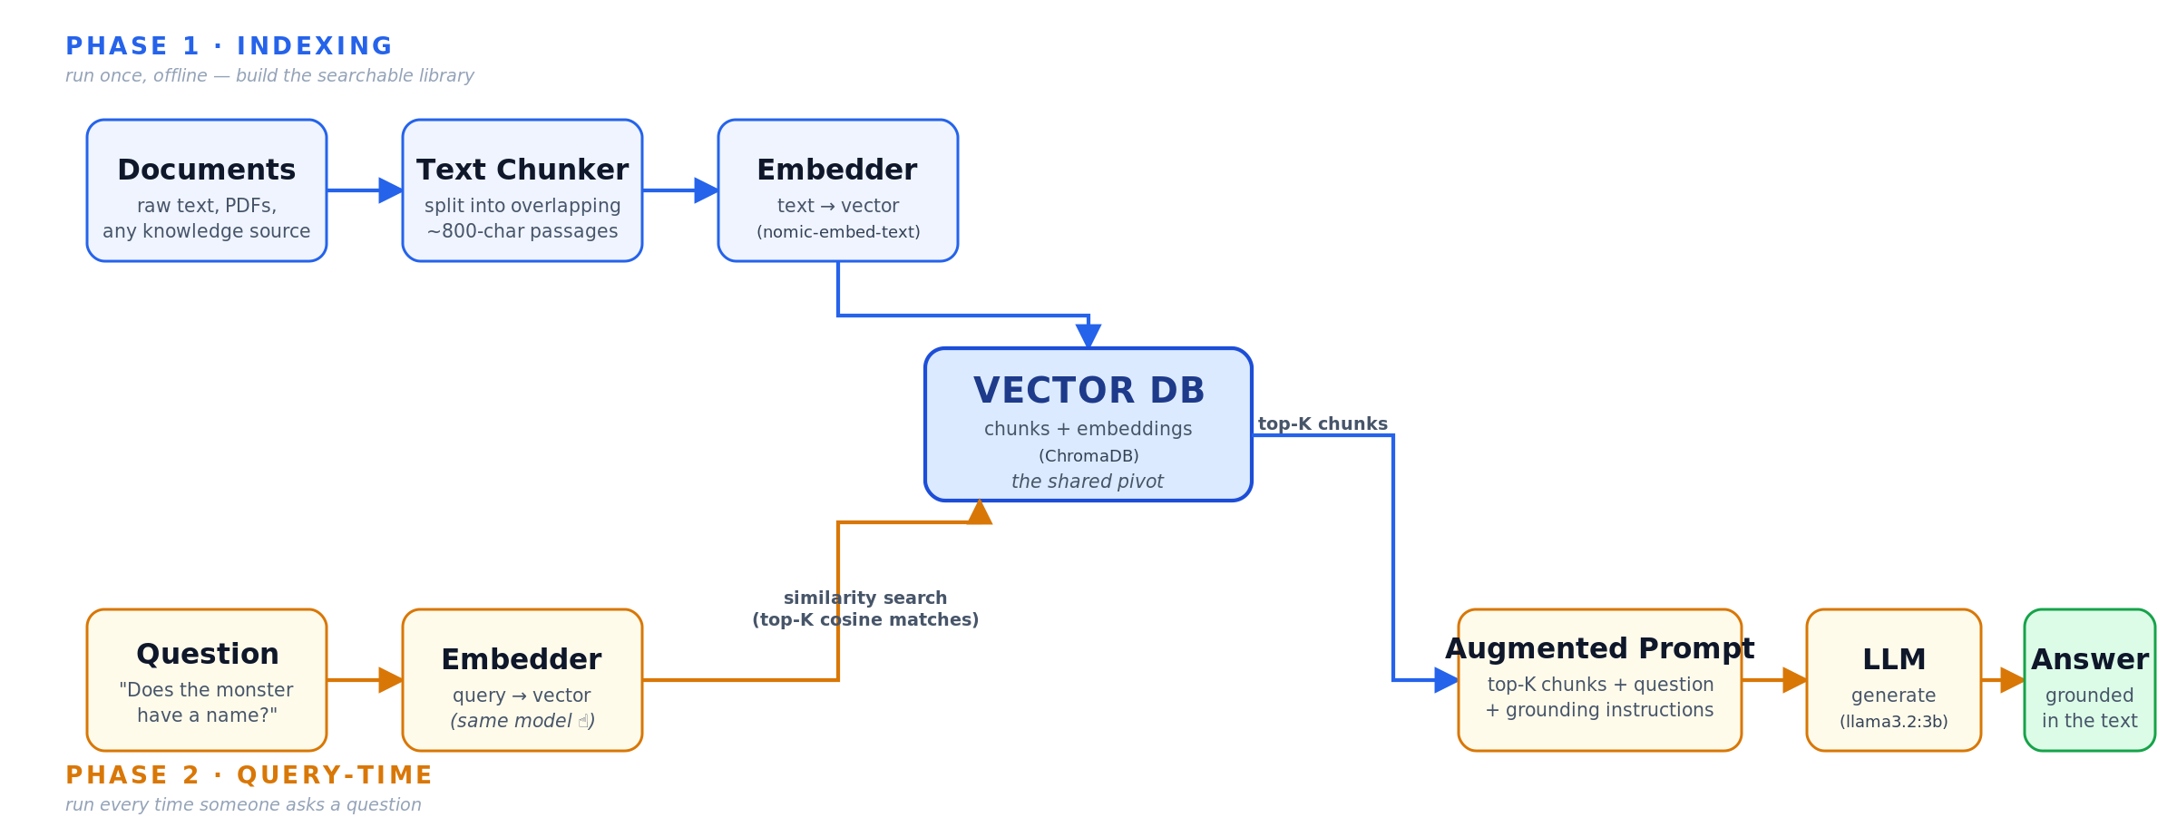
05 / 15
How RAG works
The most important slide in this deck. You should be able to draw it from memory.
Notes:
**Hook:** "RAG is really two separate pipelines sharing one piece of infrastructure."
Walk the diagram left-to-right, top-to-bottom:
- **Phase 1 — Indexing (top lane, blue).** Run **once**, offline.
- **Documents** → break into **chunks** (~800 chars) → **embed** each chunk into a vector → store in **Vector DB**.
- **Phase 2 — Query-time (bottom lane, amber).** Run **every single question**.
- **Question** → embed with the **same model** → **similarity search** against the Vector DB → pull the **top-K chunks** back.
- Stuff those chunks into an **Augmented Prompt** together with the original question and grounding instructions.
- Send to the **LLM** → get a **grounded Answer**.
- The **Vector DB in the middle is the shared pivot** — indexing writes to it, querying reads from it.
- The embedding model is used *twice* — same model, both times. Critical.
**Callout:** "If you only remember one slide from today, remember this one. Every RAG paper, every RAG system, every framework — they're all variations on this diagram."
**Transition:** "Let's zoom into the weird part — what does it mean to 'embed' text?"

Slide 6
06 / 15
RAG in motion
ONE QUESTION, STEP BY STEP
1
2
3
4
Question arrives
Embed the query
Retrieve top-K
Grounded answer
USER INPUT
768-DIM VECTOR
TOP CHUNK (EXCERPT)
LLM OUTPUT
"Does the monster
have a name?"
[ 0.08, -0.21,
0.44, -0.03,
0.17, ... ]
"...I had selected
his features as
beautiful. Beautiful!
Great God!..."
"No. Shelley never
names him — he is
referred to as 'the
creature,' 'wretch,'
'daemon.'"
plain text from
the user
same model as
indexing phase
cosine match
from Vector DB
cites the text,
refuses to invent
The shape of every RAG call — regardless of framework, model, or corpus.

Slide 7
07 / 15
Embeddings: turning meaning into math
KEY IDEA
Similar meaning →
similar vectors.
cat
kitten
An embedding model maps text into a high-dimensional space (typically 384, 768, or 1536 dimensions).
"Cat" and "kitten" end up near each other. "Cat" and "airplane" end up far apart.
Similarity = cosine of the angle between vectors.
dog
car
truck
airplane
Vector space (simplified 2D projection)
In the workshop: we'll use nomic-embed-text (768-dim) via Ollama.
Notes:
**Hook:** "An embedding is a way to convert *meaning* into *coordinates*."
- Embedding model = takes text, spits out a vector (typically 384, 768, or 1536 dimensions).
- **The trick:** similar meaning → similar vectors.
- "Cat" and "kitten" land next to each other. "Cat" and "airplane" land far apart.
- Similarity is measured by **cosine of the angle** between two vectors.
- In the diagram here — cats/kittens/dogs cluster in one region, cars/trucks/airplanes in another.
- **Our choice:** `nomic-embed-text` (768-dim), runs locally via Ollama.
**Transition:** "OK, embeddings sound magical. But the step *before* embedding is the one that silently kills most RAG systems."

Slide 8
08 / 15
Chunking: where most RAG systems quietly die
STRATEGIES
KEY KNOBS
Fixed-length
800
Split every N characters. Fast. Breaks sentences mid-word.
Sentence-based
Split at sentence boundaries. Better, but loses paragraph context.
chars · chunk size (our default)
Recursive
100
Try paragraphs → sentences → words, with overlap. Balanced default.
Semantic
Split where meaning shifts (embedding similarity drops). Best quality, most compute.
chars · overlap (~12%)
Bad chunks → bad retrieval → bad answers, no matter how smart the LLM is.
Notes:
**Hook:** "Bad chunks → bad retrieval → bad answers. Doesn't matter how smart your LLM is."
- **Fixed-length:** split every N chars. Fast, dumb, breaks words mid-sentence.
- **Sentence-based:** split at sentence boundaries. Better, but loses paragraph context.
- **Recursive (our pick):** try paragraphs → sentences → words, with overlap. Balanced default.
- **Semantic:** split where *meaning* shifts (embedding similarity drops). Best quality, slowest.
- Two knobs matter: **chunk size** (we use 800 chars) and **overlap** (we use 100 chars, ~12%).
- Overlap matters — it keeps context from getting sliced across boundaries.
**Transition:** "So that's Simple RAG: chunk, embed, retrieve, generate. Now let's make it smarter."

Slide 9
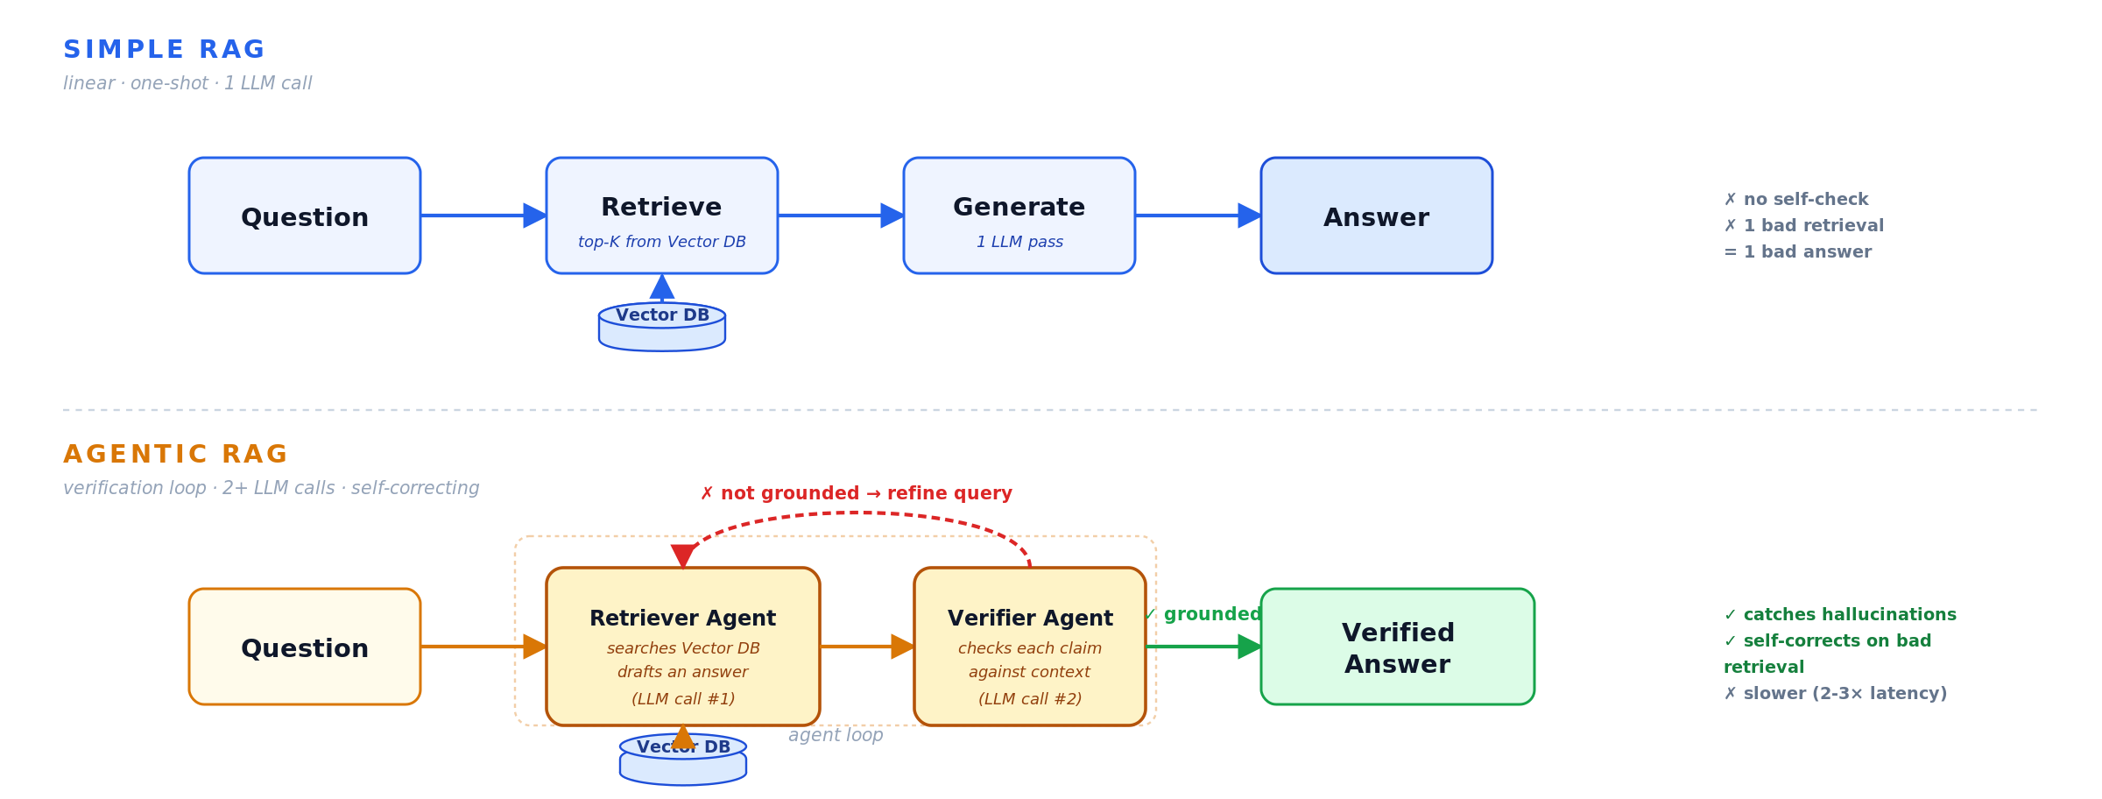
09 / 15
From simple RAG to Agentic RAG
The verifier catches hallucinations the single-pass system misses. Slower, more robust.
Notes:
**Hook:** "Simple RAG is one shot. Agentic RAG gives the system a second opinion."
- **Simple RAG:** Question → Retrieve → Generate → Answer. Fast. Single pass. Can still hallucinate if retrieval is noisy.
- **Agentic RAG** — what we'll actually build today:
- **Retriever Agent** searches the vector DB and drafts an answer.
- **Verifier Agent** reads the draft and checks every claim against the retrieved context.
- If something doesn't check out, it flags it or rewrites.
- Tradeoff: **slower, but much more robust.** 2-3x the latency, far fewer hallucinations.
- This is the pattern in recent papers like Self-RAG and CRAG (corrective RAG).
**Transition:** "Here's the stack we're going to use to build all of this."

Slide 10
10 / 15
Our tech stack
Ollama
LangChain
ChromaDB
Local LLM runtime
RAG primitives & glue
Vector database
CrewAI
Gradio
Ragas
Multi-agent orchestration
Chat UI (3 lines of code)
Evaluation metrics
Everything open-source. Everything runs on a free Colab tier.
Notes:
**Hook:** "Six tools. All open-source. All free. All runs on Colab's free tier."
- **Ollama** — local LLM runtime (serves `llama3.2:3b`).
- **LangChain** — RAG primitives: loaders, splitters, retrievers.
- **ChromaDB** — lightweight vector database.
- **CrewAI** — multi-agent orchestration (Retriever + Verifier).
- **Gradio** — chat UI in ~3 lines of code.
- **Ragas** — evaluation metrics for RAG systems.
**Transition:** "Before we build — one slide on how we know the system is actually working."

Slide 11
11 / 15
Evaluation & hallucination defenses
CORE METRICS
HALLUCINATION DEFENSES
Faithfulness
Answer Relevancy
Strict grounding prompt — "answer only from context"
"I don't know" escape hatch
Require citations / direct quotes
Verifier agent (second LLM pass)
Guardrails: structured output, PII scrubbing
Is every claim supported by the retrieved context?
Does the answer actually address the question?
Context Precision
Context Recall
Are the retrieved chunks useful?
Did we retrieve all we needed?
Prompting gets you 80%. The rest is verification, eval, and ops.
Notes:
**Hook:** "You can't just eyeball a RAG system. You need metrics, and you need defenses."
- **Four core Ragas metrics:**
- **Faithfulness** — is every claim in the answer supported by the retrieved context?
- **Answer Relevancy** — does the answer actually address the question?
- **Context Precision** — are the retrieved chunks useful?
- **Context Recall** — did we retrieve everything we needed?
- **Defense stack** (in order of ROI):
- Strict grounding prompt ("answer only from context").
- Explicit "I don't know" escape hatch.
- Require citations / direct quotes.
- Verifier agent (second LLM pass).
- Guardrails: structured output, PII scrubbing.
- **Rule of thumb:** prompting gets you 80%. The rest is verification, eval, and ops.
**Transition:** "OK — enough theory. Here's exactly what we're about to build, step by step."

Slide 12
12 / 15
When RAG isn't the answer
KNOW THE LIMITS
REACH FOR INSTEAD
Multi-hop reasoning
Aggregation & counting
Multi-hop
→ Query decomposition or agentic planners
Questions that require chaining facts across many chunks. Top-K retrieval returns documents, not reasoning.
"How many chapters mention X?" That's a database query, not a similarity search.
Aggregation
→ Text-to-SQL or code interpreters
Fresh news
→ Web search tools + frequent re-indexing
Fresh news
Tiny corpora
Tiny corpora
→ Just use a long-context prompt
Your index is only as fresh as your last re-index. No amount of retrieval invents tomorrow's headlines.
If all your docs fit in the prompt, just stuff them in. RAG adds overhead with no benefit.
Exact recall
→ Keyword search (BM25) or hybrid retrieval
RAG is the right tool most of the time. It's not the only tool.

Slide 13
13 / 15
RAG in the wild
WHERE TEAMS ARE SHIPPING THIS
Customer Support
Internal Knowledge
Developer Tools
Product docs → chatbot that answers with citations and escalates only when it should.
Wiki, Confluence, Slack — a search that actually answers instead of linking 20 pages.
Code and API docs that answer "how do I call this?" with the exact snippet and source file.
Intercom · Zendesk AI · Notion AI
Glean · Elastic · Copilot for M365
Cursor · Sourcegraph Cody · GitHub Copilot
Research & Legal
Healthcare
Personal Knowledge
Papers, case law, regulations — answers with every claim traced back to a citation.
Clinical guidelines, drug interactions, internal protocols with mandatory provenance.
Your notes, files, bookmarks as a second brain. Search across everything you've ever read.
Harvey · Elicit · Consensus
Abridge · Hippocratic AI · Nuance DAX
Mem · Obsidian · Reflect
Anywhere grounded, cited answers beat confident guesses — which is most places.

Slide 14
14 / 15
What we'll build
0
1
2
3
Setup
Plain LLM chat
Chunk Frankenstein
Embed & store
Ollama on Colab + deps
Show the hallucination
LangChain + recursive splitter
Nomic + ChromaDB
4
5
6
7
Simple RAG chain
Agentic RAG
Gradio chat UI
Head-to-head compare
LCEL with strict grounding
CrewAI: Retriever + Verifier
Public-shareable link
Plain vs Simple vs Agentic
The finale: we compare all three approaches head-to-head on real questions.
Notes:
**Hook:** "Eight numbered sections in the notebook. We'll work through them together."
Walk the grid quickly — don't dwell:
- **§0 Setup** — Ollama on Colab + deps.
- **§1 Plain LLM chat** — show the hallucination live.
- **§2 Chunk Frankenstein** — LangChain recursive splitter.
- **§3 Embed & store** — Nomic embeddings + ChromaDB.
- **§4 Simple RAG chain** — LCEL with strict grounding.
- **§5 Agentic RAG** — CrewAI with Retriever + Verifier.
- **§6 Gradio chat UI** — public shareable link.
- **§7 Head-to-head compare** — Plain vs Simple vs Agentic on the same questions.
- **The finale:** the famous hallucination question — *"What is the monster's name?"* — and we watch the three systems handle it very differently.
**Transition:** "Open the workshop page and let's go."

Slide 15
Let's build.
OPEN THE NOTEBOOK
hakanotal.github.io/workshop-rag-chatbot
1. Open the workshop page in your browser
2. Click Open notebook in Colab
3. Runtime → Run all (takes ~2-3 min)
Notes:
**Hook:** "Three steps to get running."
- Open **`hakanotal.github.io/workshop-rag-chatbot`** in your browser.
- Click **"Open notebook in Colab"**.
- In Colab: **Runtime → Run all**. Takes about 2-3 minutes to install everything.
- While that's running, stretch. Grab water. We're building for the next hour.
**Handoff:** "Any questions before we dive in?"

