Slide 1

Complete System Modeling
for
Integrated Modular Motor Drive
Mesut Uğur
14/10/2019
mesut.ugur@metu.edu.tr

Slide 2
Content
Simplest inverter model
Parasitics added
Unbalance on load
Rectifier added
2-parallel with and without interleaving
2-parallel – parasitics added
2-parallel – load and module unbalance
2-parallel – rectifier added
2-series with and without interleaving
2-series – parasitics added
2-series – load and module unbalance
2-series – rectifier added

Slide 3
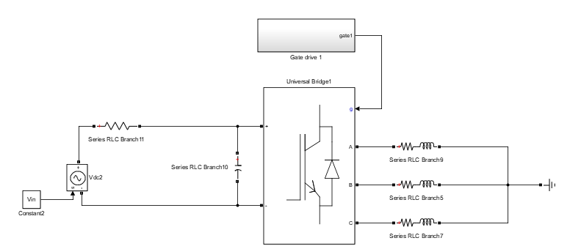
Simplest inverter model
Single module 3-phase inverter
Load is balanced RL load
DC bus is ideal current source
Sinusoidal PWM – fsw = 10kHz
Generic parameters: pf = 0.9, ma = 0.9
270Vdc, 2kW system
DC bus input current is almost DC
No LF harmonic injection from input
No HF harmonic flow from output
Iin
Idc
SA, SB, SC
Isa
Vin
Vab
Isb
Vdc
Vbc
Isc
Iin = 7.4A, Icaprms = 4.8A, Vdcrip = 6% (15uF), Isrms = 8.6A
Iin ripple is made 4% (almost DC)

Slide 4
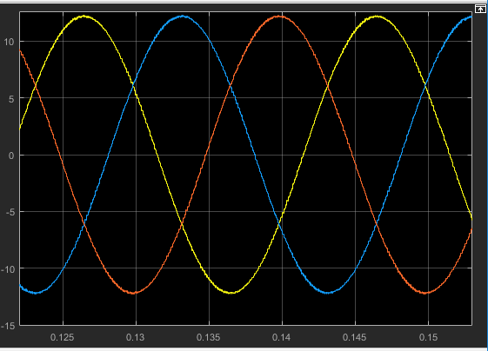
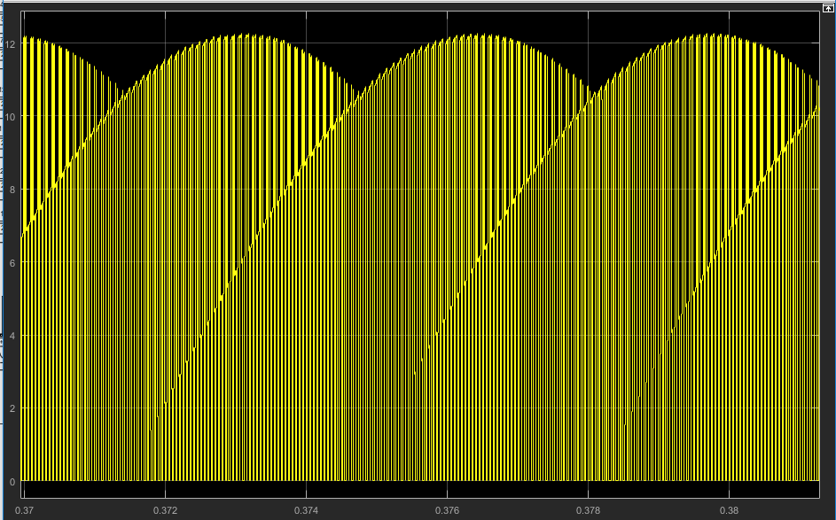
Simplest inverter model
Isa, Isb, Isc
SA, SB and SC can currently be modeled in all aspects. We also have an analytical model.
Using the Sx models, Isx models can easily be obtained.
Using these two, Idc is also obtained analytically, which is good.
When parasitics inside the PCB are ignored, we can assume that Idc is not affected (as a model) by input side (input current, rectifier etc.)
Existance of parasitics is another matter, see the next section.
Idc = SAIsa + SBIsb + SCIsc
Low harmonic content in Isx’s is due to large inductive load.
This looks like 300 Hz ripple, well, it is not ☺
See next slides.

Slide 5
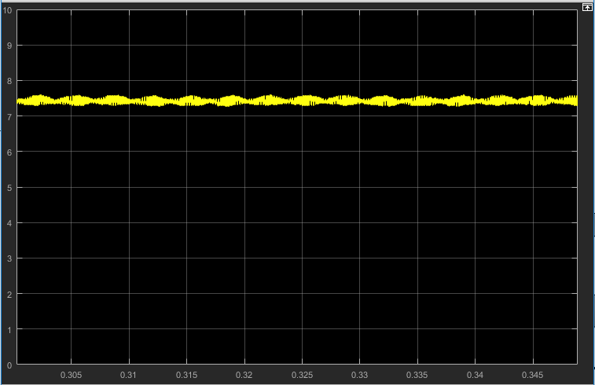
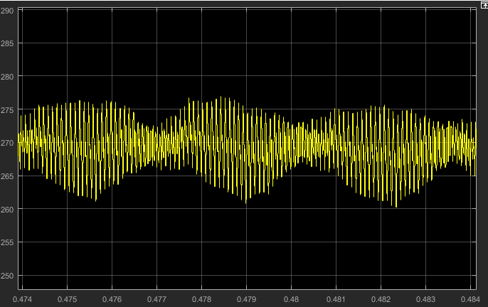
Simplest inverter model
Iin
This is intentionally made almost DC, trying to exert all the ripple content to capacitors. It is achieved by putting a large resistor to input.
Vdc ripple content is ideally obtained with simple capacitor equation (voltage is integral of current).
When ESR and ESL are considered, this model is more complex, which is not modeled here.
Practically, there are three capacitors which have parasitics in between, making the analysis way more complex.
Therefore these effects are not considered in this simplest model.
Vdc
This looks like 300 Hz ripple, well, it is not ☺
See next slides.

Slide 6
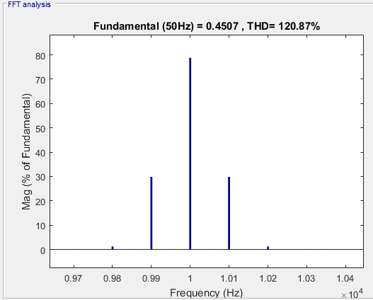
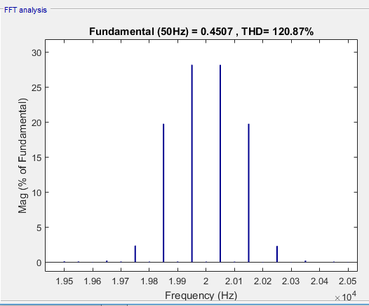
Simplest inverter model
SA - Around fsw
SA harmonics are due to the nature of PWM and can be manipulated (not in the scope of this study right now.)
Some harmonics are 120 degrees apart in 3 phases (SA,SB,SC), some are inphase.
When currents are balanced, 120 degrees apart harmonics cancel in the multiplication in Idc formula. Only inphase component are reflected to the DC bus.
These are analytically modeled by @EnesAyaz!
 | SA |  | SB |  | SC
Freq | Mag(%) | Phase(deg) | Mag(%) | Phase(deg) | Mag(%) | Phase(deg)
9900 | 27 | 90 | 27 | -30 | 27 | 210
10000 | 71 | 90 | 72 | 90 | 72 | 90
10100 | 27 | 90 | 27 | 210 | 27 | -30
19850 | 18 | 0 | 18 | 0 | 18 | 0
19950 | 25 | 0 | 25 | 120 | 25 | 240
20050 | 25 | 180 | 25 | 60 | 25 | -60
20150 | 18 | 180 | 18 | 180 | 18 | 180
SA - Around 2*fsw

Slide 7
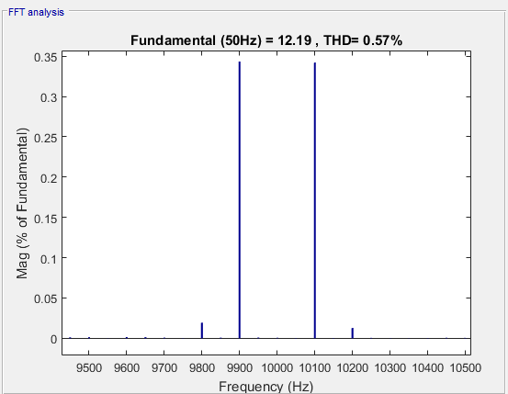
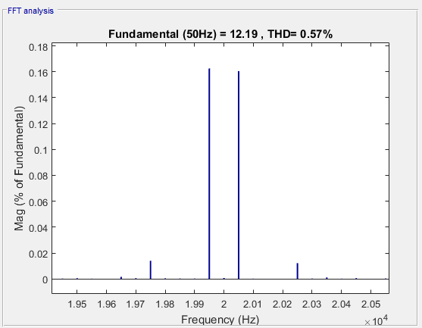
Simplest inverter model
Isa - Around fsw
Due to wye connection (?), the inphase components of Sx harmonics are not seen in phase currents.
Again, these are under balanced conditions. Unbalance will be analyzed separately.
All the current harmonics are 120 degrees apart.
Their magnitudes and phase depend on load angle, Vdc, load values etc.
 | Isa |  | Isb |  | Isc
Freq | Mag(%) | Phase(deg) | Mag(%) | Phase(deg) | Mag(%) | Phase(deg)
9900 | 0.34 | -2 | 0.34 | 238 | 0.34 | 118
10000 | 0 |  | 0 |  | 0
10100 | 0.34 | -2 | 0.34 | 118 | 27 | 238
19850 | 0 |  | 0 |  | 0
19950 | 0.16 | 264 | 0.16 | 24 | 25 | 144
20050 | 0.16 | 84 | 0.16 | -36 | 25 | 204
20150 | 0 |  | 0 |  | 0
Isa - Around 2*fsw

Slide 8
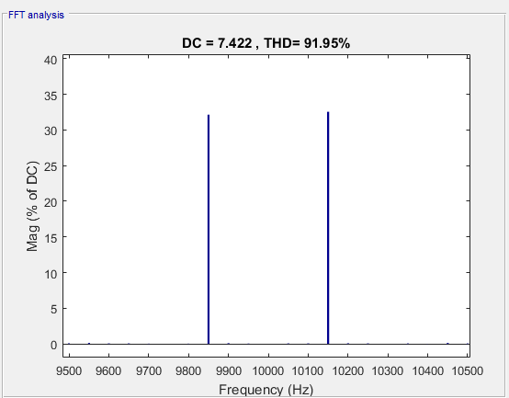
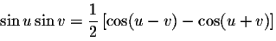
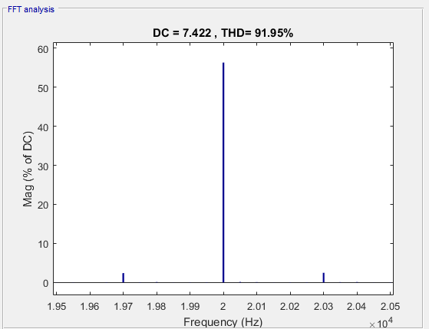
Simplest inverter model
Idc - Around fsw
Idc is formed by the the sum of the multiplication Sx and Isx of each phase. This multiplication creates new harmonic frequencies by the trigonometric rules ((x+y) and (x-y)) .
Most of these components, under balanced conditions cancel out because of the 120 degrees apart form. Only the in-phase components remain which are multiplied by the large DC and fundamental components of Sx and Isx.
Also, some frequencies are shifted by 50 Hz due to multiplication with fundamental. All in all, we have the following remaining:
Idc - Around 2*fsw
 | Idc
Freq | Mag(%) | Phase(deg)
9900 | 32 | 204
10000 | 0
10100 | 33 | -32
19850 | 0
19950 | 0
20000 | 56 | 263
20050 | 0
20150 | 0
A more detailed explanation can be given by the analytical model (which is in many pages ☺)

Slide 9

Simplest inverter model
Envelope phenomenon
We have seen that there are two sideband harmonics near switching frequency: 9850 Hz & 10150 Hz.
They can be expressed as: A sin(2π9850t + φ1) + A sin(2π10150t + φ2)
They can also be rewritten as: 2A sin(2π10000t + (φ1 + φ2)/2) sin(2π150t + (φ1- φ2)/2)
The same harmonic content can be represented with the multiplication two components which are: fsw and 3xfo. The 150 Hz is therefore seen as an envelope.
All in all, there is no actual low order (300 Hz etc.) harmonic injection from the inverter to the DC bus provided that the load is balanced.
Envelope

Slide 10
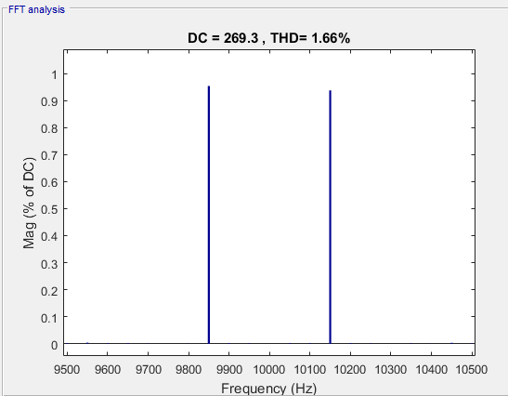
Simplest inverter model
Vdc - Around fsw
Idc harmonics are directly injected to Icap (well, almost…). Therefore, their presence on the DC bus voltage is also directly reflected.
Magnitudes are determined by switching frequency and capacitance.
Of course, phase of those harmonics change, which will be important in interleaving studies.
Same envelope phenomenon is seen here.
Envelope

Slide 11
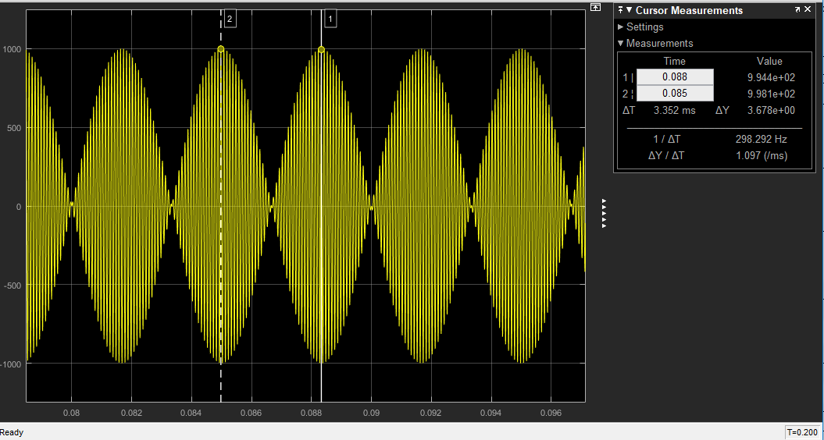
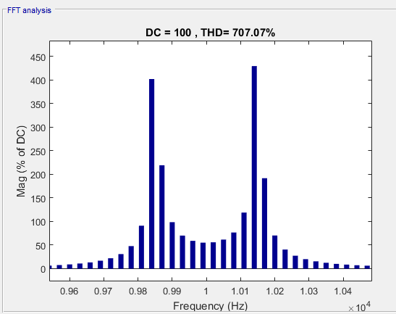
Simplest inverter model
More about envelope
Here, a 150Hz and a 10000Hz source are multiplied.
Envelope is shown above.
The harmonic content is shown on the left.
9850Hz & 1150Hz are dominant.
Actually, this is the reverse of what we have.
We may (and will) use this for DC bus bulky capacitor size reduction in the future !

Slide 12
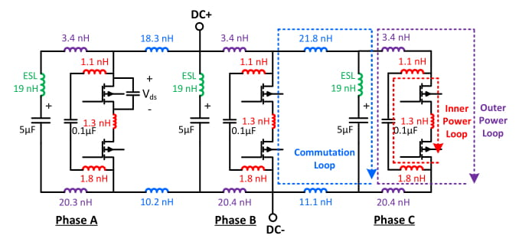
Parasitics added model
Inner power loop consists of seramic capacitors and handles the switching oscillation (in the order of 100MHz). It is directly related to the device Vds breakdown (out of scope).
Outer power loop consists of the large film capacitor (5 uF each). It is the loop where the switching harmonics (components of Idc) flow, which is our interest.
In commutation loops, the switching harmonic current flows from one phase to a capacitor belonging to a different phase. Therefore, our «single Idc» assumption fails.
There is a stray inductance between all components, consequently resulting in increase on capacitor stress.

Slide 13
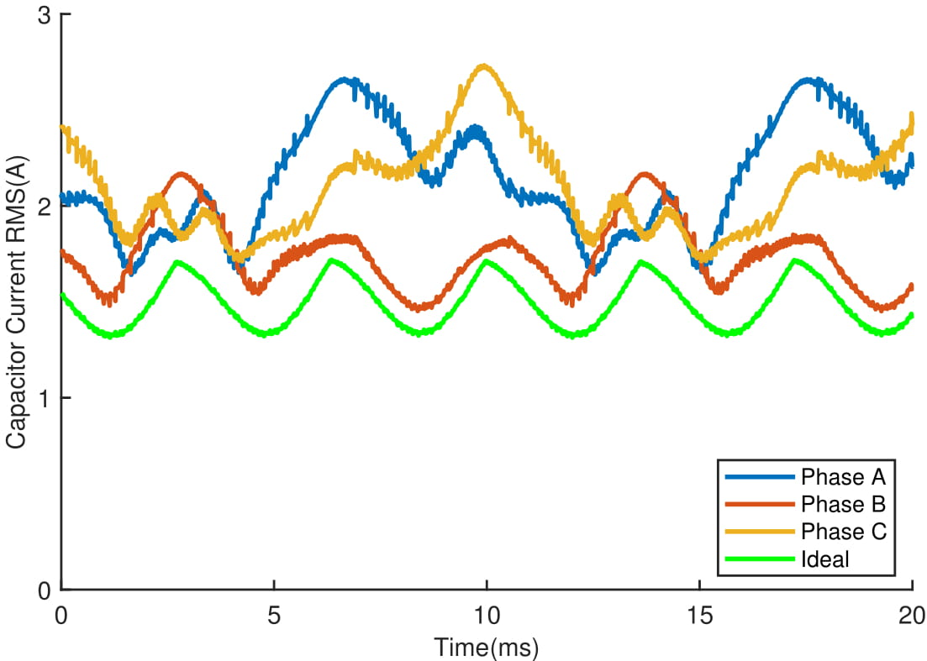
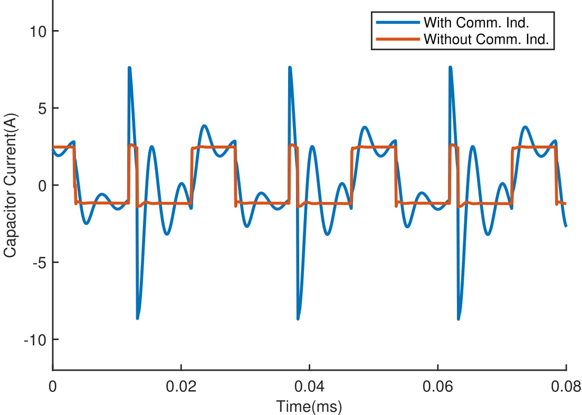
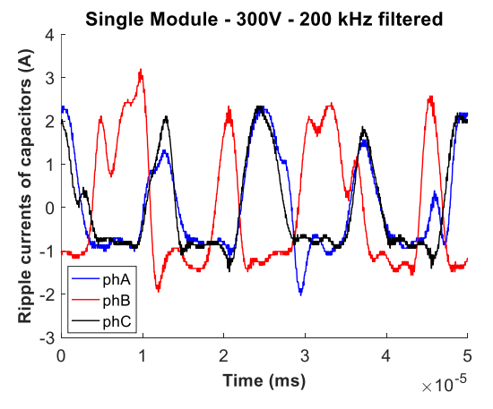
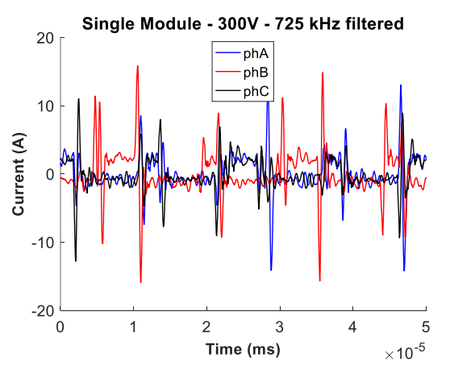
Parasitics added model
The DC bus design affects the distribution capacitor stress.
Below results are simulation results for the previus inverter (V2)
Below are the test results:

Slide 14
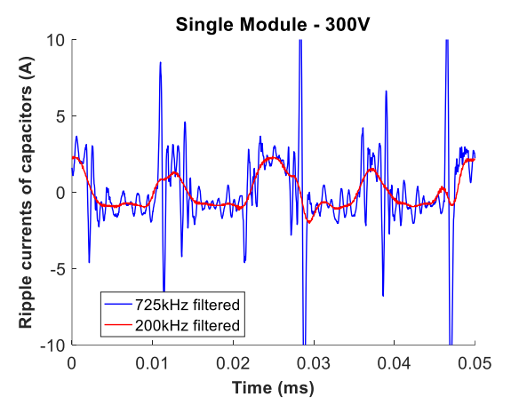
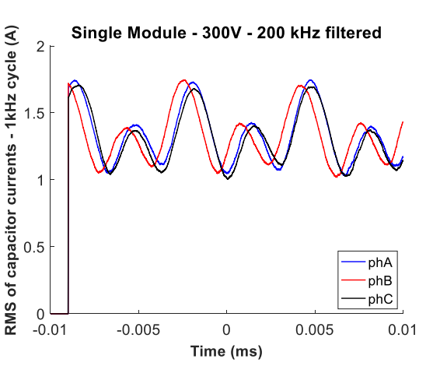
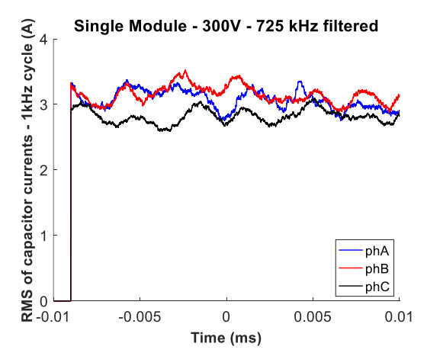
Parasitics added model
A cleaner result:
Note that, test results are obtained by measuring each capacitor voltage, and obtaining their current using integral (ESR, ESL etc. are neglected)
RMS comparison:

Slide 15

Parasitics added model
Study on the parasitics added model is still ongoing.
First, the simulation results should be renewed with V1.3 board.
FFT analysis is to applied for a better understanding.
An analytical model using impedance models is developed, still ongoing.

Slide 16
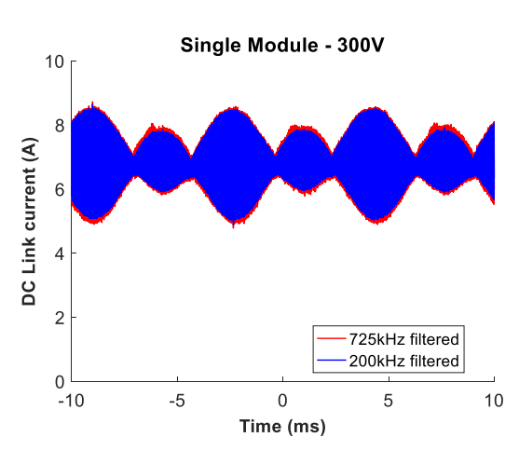
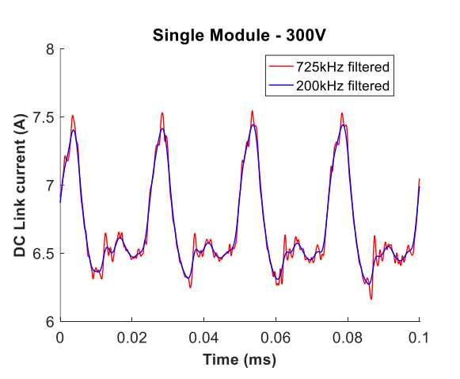
Rectifier added model
Let us first look at the test results, where rectifier is used.
Here, we see that the input current is not ideal DC. It is composed of:
Switching frequency harmonics.
Low order harmonics.
Unbalanced envelope.
The switching harmonics are due to the fact that the source is not an infinite bus and the bulky capacitor at rectifier output draws some of the high frequency ripple.
The low order harmonics may be of many things: rectifier 6th harmonic, unbalance etc…
Here those phenomena will be examined separately for better understanding.

Slide 17
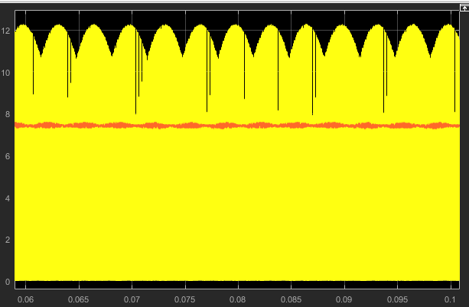
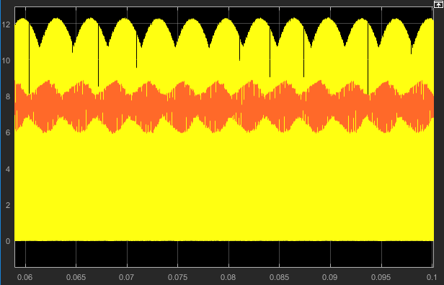
Rectifier added model
First, the previously mentioned effect is created by reducing the series Rin resistance so that some harmonics can flow to the input:
Rin
Iin
Idc
Yellow: Idc
Orange: Iin
Rin = 50 Ohms Rin = 5 Ohms

Slide 18
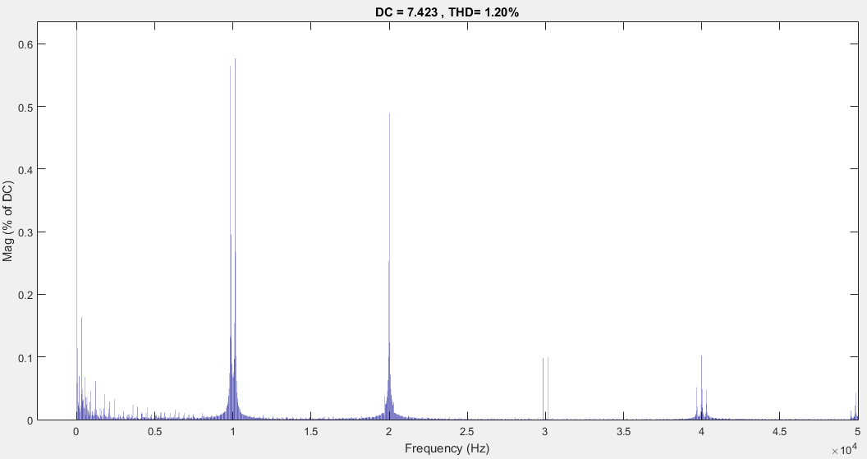
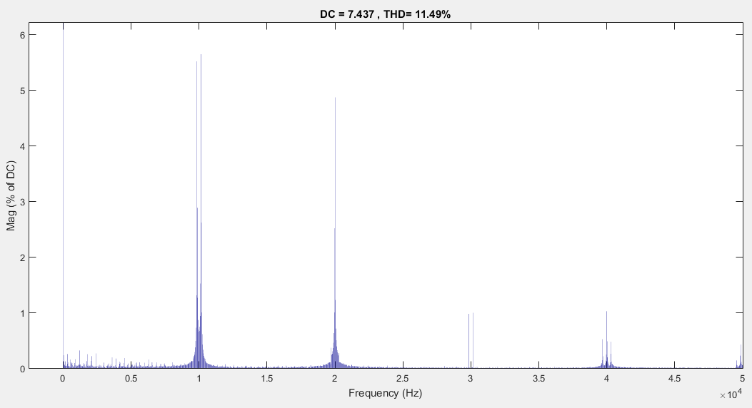
Rectifier added model
Some of the switching harmonics flow to the input as shown below, when the resistance is decreased.
Rin = 50 Ohms Rin = 5 Ohms
 | Rin = 50 Ohms | Rin = 5 Ohms
Icap-RMS | 4.825 A | 4.795 A
Iin-DC | 7.422 A | 7.435 A
Iin-RMS | 7.423 A | 7.459 A
Idc-DC | 7.422 A | 7.435 A
Idc-RMS | 8.853 A | 8.868 A
Numericly, it seems that it did not make large difference.
Let us look at specific harmonics:
9850 Hz | Rin = 50 Ohms | Rin = 5 Ohms | 20000 Hz | Rin = 50 Ohms | Rin = 5 Ohms
Icap | 2.384 | 2.335 | Icap | 4.178 | 4.162
Iin | 0.051 | 0.503 | Iin | 0.044 | 0.441
Idc | 2.385 | 2.388 | Idc | 4.179 | 4.186

Slide 19
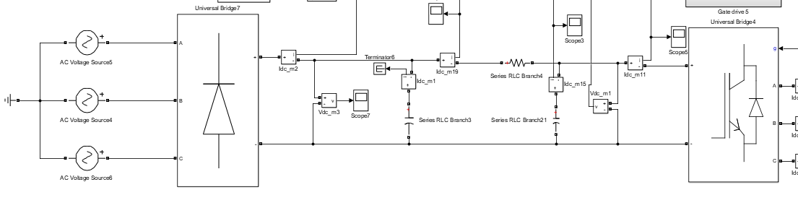
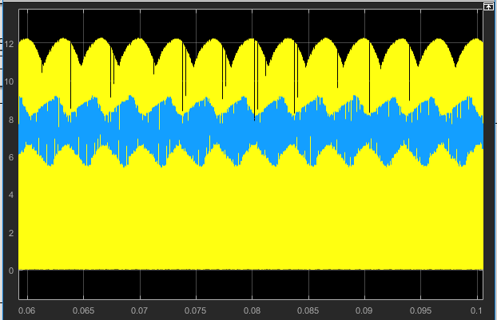
Rectifier added model
Rmid (Represents cabling etc.)
Now, let us add an actual rectifier:
Bulky capacitor
(1.1mF)
Film capacitors
(15uF)
With small Rmid, the Idc ripple mostly flows through the bulky capacitor since its impedance is 100 times smaller. But, this is not the case as seen from the experimental results. Therefore, Rmid is made 4 Ohms for now and the following result is obtained:

Slide 20
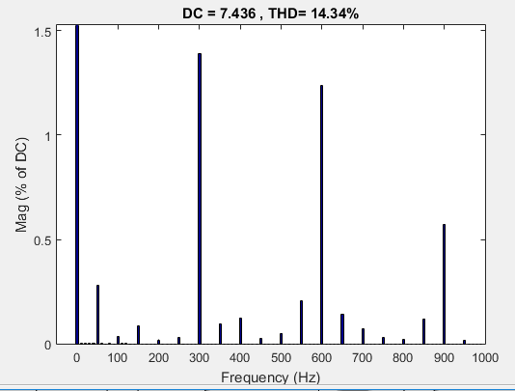
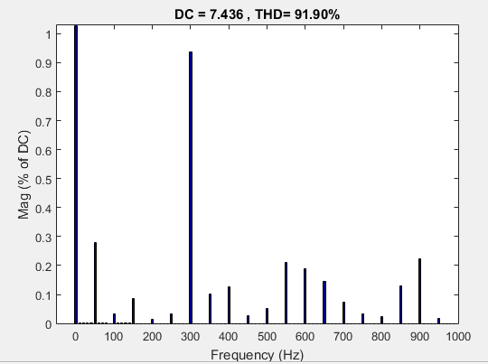
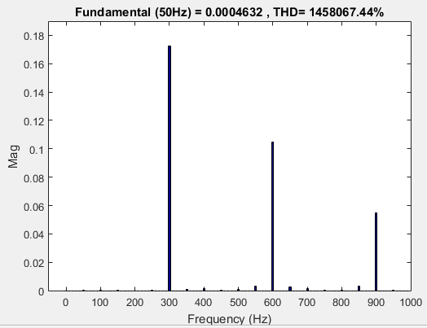
Rectifier added model
When compared with the model with small Rin (5 Ohms) and ideal DC source, the results are similar considering high order harmonics (related to switching frequency).
But, one should note that it is not possible to have a 4 Ohms resistor in between the rectifier and inverter. Its loss will be more than 250 Watts alone !!!
This situation is not still clear and should be worked on.
As for the low order harmonics:
Iin Idc Icap
Note that this is not percent
None of these harmonics existed before, as obviously they are due to the nature of 3-phase full-bridge rectifier.

Slide 21
Rectifier added model
Add stuff from analytical model

Slide 22
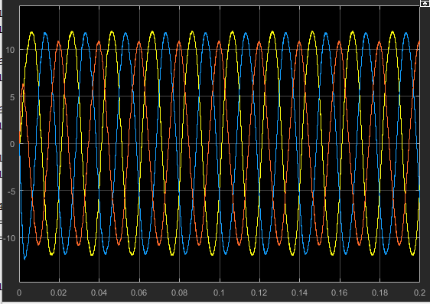
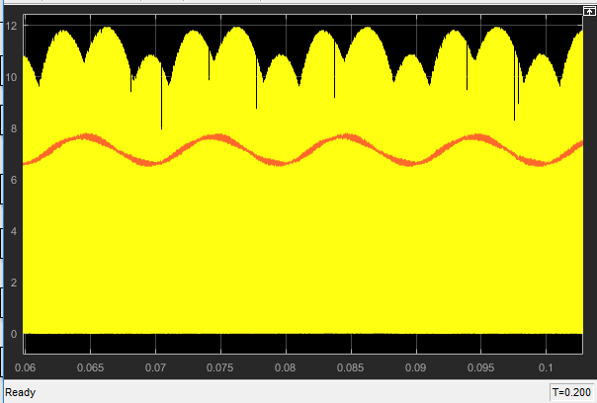
Unbalance on Load
RloadC is made 1.5 times its nominal value. The model is simplest infinite bus model.
Phase currents
Idc (yellow) and Iin (orange)
Obviously, phase currents are unbalanced. This unbalance shows up in inverter DC current (Idc).
The reflected low order harmonic has 100 Hz frequency.
Remember the formula: Idc = SAIsa + SBIsb + SCIsc
Previously, the terms with 50Hz x 50Hz were cancelled since the terms had balanced 3-phase form. Now, they are unbalanced and 100 Hz component appears due to those terms.

Slide 23
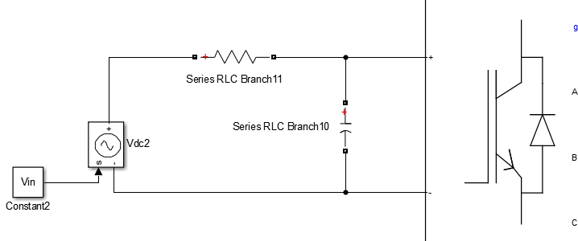
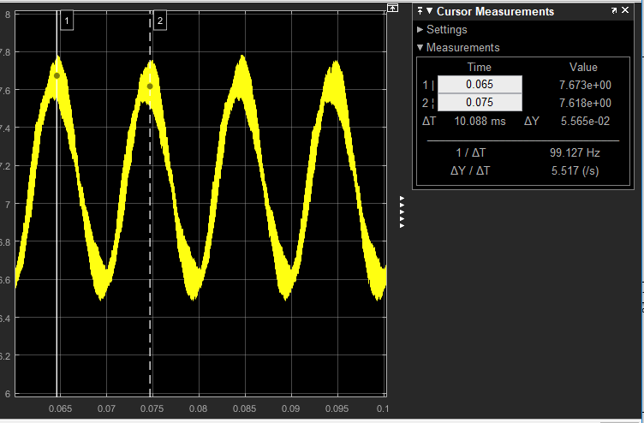
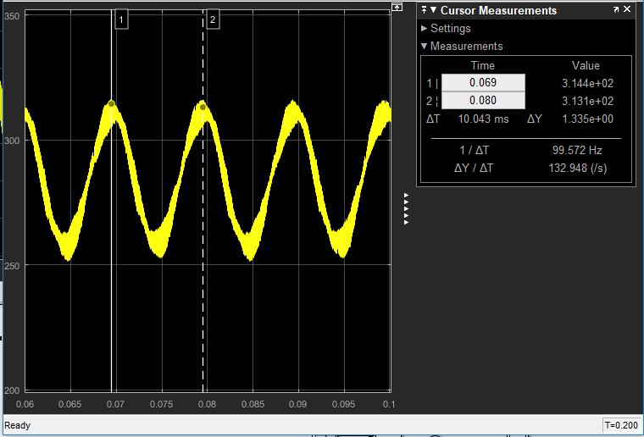
Unbalance on Load
The 100 Hz in Idc is constant for a given load condition. Some of it travels through the capacitor and some travels through the input.
The capacitor ripple current causes 100 Hz ripple on DC bus voltage (Vdc). It is large since capacitors impedance at 100 Hz is much higher compared to high frequency harmonics.
Iin
Idc
Note that, the 100 Hz ripple on Vdc will cause other low order harmonics on AC side. And then those harmonics will cause more harmonics on DC side. There is an «egg-chicken» relationship between them.
Icap
Vdc
Vin
Iin
Vdc

Slide 24
Unbalance on Load
Comparison of ideal and nonideal DC bus cases:
When infinite bus, capacitor has a larger piece of the harmonic and the voltage ripple is much higher.
The increase in Idc ripple cannot be explained !
It is realised that the unbalance in phase current is increased in 5 Ohms case.
100 Hz | Rin = 50 Ohms | Rin = 5 Ohms
Idc | 0.588 A | 0.896 A
Icap | 0.251 A | 0.042 A
Iin | 0.532 A | 0.895 A
Vdc | 26.57 V | 4.48 V
LloadC is made 1.5 times its nominal value now:
100 Hz | Rin = 50 Ohms | Rin = 5 Ohms
Idc | 0.340 A | 0.518 A
Icap | 0.145 A | 0.025 A
Iin | 0.308 A | 0.518 A
Vdc | 15.38 V | 2.59 V
Similar result. Magnitude change depends on other paramaters, but the trend is the same.
Both RloadC and LloadC is made 1.5 times its nominal value now:
100 Hz | Rin = 50 Ohms | Rin = 5 Ohms
Idc | 0.663 A | 0.964 A
Icap | 0.283 A | 0.045 A
Iin | 0.600 A | 0.963 A
Vdc | 30.00 V | 4.82 V
Worst case, as expected.
With resistive unbalance, effect inductive unbalance is very small.
This is due tot the fact that, resistance and power factor of load phases are deciding parameters of unbalance.

Slide 25
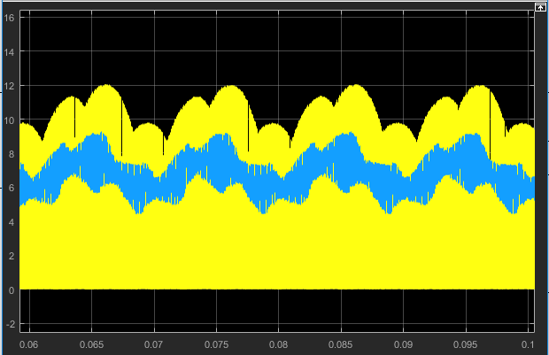
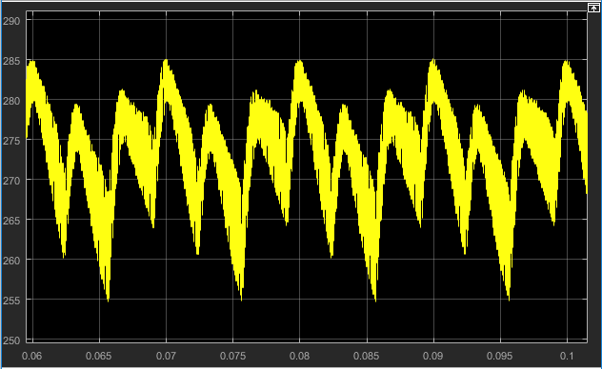
Unbalance on Load
Now, apply this to the model with rectifier (RloadC = 1.5xNominal, Rmid = 4 Ohms):
Idc (yellow) and Iin (blue)
Vdc

Slide 26
Unbalance on Load

Slide 27
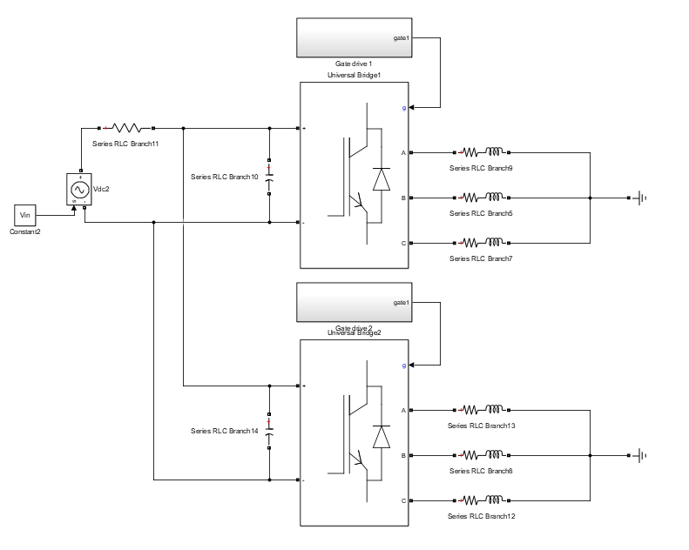
2-parallel with and without interleaving
Iin
Iin1
Idc1
Vdc1
Iin2
Idc2
Vdc2

Slide 28
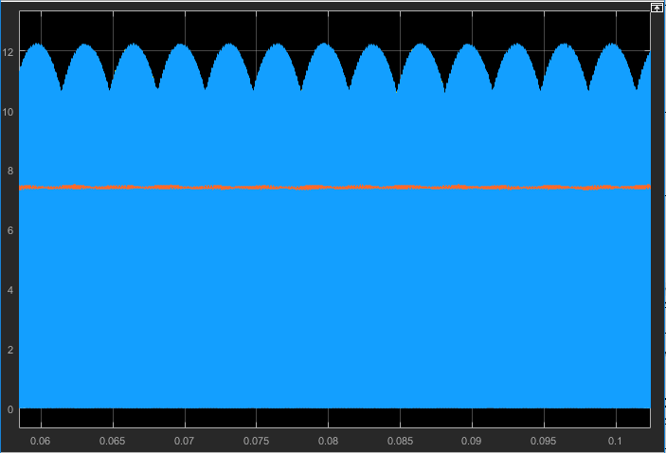
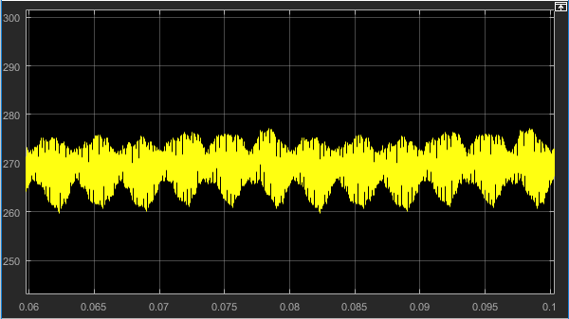
2-parallel with and without interleaving
In the simplest model with 2-parallel inverters, Vdc1 and Vdc2 are the same. Therefore, the system is like there is a common DC bus capacitor with 30 uF capacitance.
In practice, this is not the case due to parasitics.
Results of simplest model without interleaving:
Idc1 (blue), Idc2 (yellow) and Iin (orange)
Idc1 = Idc2 for no interleaving
Vdc
Nothing really new here. All DC components have 2xoriginal magnitude. Total output power is now 4 kW.

Slide 29
2-parallel with and without interleaving
Interleaving is applied now with 180 degrees.
 | With interleaving | Without interleaving
Idc1-DC | 7.417 A | 7.417 A
Idc2-DC | 7.417 A | 7.417 A
Idc1-RMS | 8.847 A | 8.847 A
Idc2-RMS | 8.847 A | 8.847 A
Icap1-RMS | 3.650 A | 4.823 A
Icap2-RMS | 3.650 A | 4.823 A
Iin-DC | 14.83 A | 14.83 A
Iin-RMS | 14.83 A | 14.83 A
Vdc-pp | 3.08 % | 6.50 %

Slide 30
2-parallel with and without interleaving
The idea is that, ripples of one inverter (Idc1) around switching frequency are supplied by the other (Idc2) since they are made out of phase. Therefore, those ripples do not flow through the capacitors.
It is assumed here that the high frequency harmonics on Iin are negligible small.
 | With interleaving |  | Without interleaving
Icap1-9850 | 0 | - | 2.38 | 204⁰
Icap2-9850 | 0 | - | 2.38 | 204⁰
Idc1-9850 | 2.38 | 204⁰ | 2.38 | 204⁰
Idc2-9850 | 2.38 | 24⁰ | 2.38 | 204⁰
Icap1-20000 | 4.18 | 263⁰ | 4.18 | 263⁰
Icap2-20000 | 4.18 | 263⁰ | 4.18 | 263⁰
Idc1-20000 | 4.18 | 263⁰ | 4.18 | 263⁰
Idc2-20000 | 4.18 | 263⁰ | 4.18 | 263⁰
Ripples around fsw
Ripples around 2xfsw

Slide 31
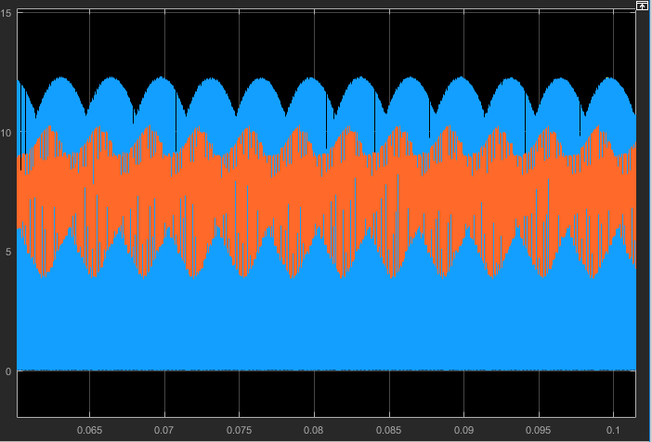
2-parallel with and without interleaving
Now, what if the DC bus input has rectifier-like behavior (Rin = 1 Ohm)?
Idc1 (blue), Idc2 (yellow) and Iin (orange)
Idc1 = Idc2 for no interleaving
It is working !
 | With interleaving | Without interleaving
Idc1-DC | 7.437 A | 7.432 A
Idc2-DC | 7.437 A | 7.432 A
Idc1-RMS | 8.871 A | 8.864 A
Idc2-RMS | 8.871 A | 8.864 A
Icap1-RMS | 3.573 A | 4.625 A
Icap2-RMS | 3.573 A | 4.625 A
Iin-DC | 14.86 A | 14.86 A
Iin-RMS | 14.96 A | 15.12 A
Vdc-pp | 2.16 % | 4.78 %
Very similar behavior.
Next, we can try:
Adding an actual rectifier
Creating phase and module unbalance
Adding parasitics

Slide 32
2-parallel with and without interleaving
 | Without interleaving |  | With interleaving
Icap1-9850 | 2.363 A | -151⁰ | 0 | ⁻
Icap2-9850 | 2.363 A | -151⁰ | 0 | ⁻
Idc1-9850 | 2.385 A | -159⁰ | 2.385 A | -159⁰
Idc2-9850 | 2.385 A | -159⁰ | 2.385 A | 21⁰
Iin-9850 | 0.637 A | 119⁰ | 0 | ⁻
Icap1-20000 | 4.186 A | -97⁰ | 4.186 A | -97⁰
Icap2-20000 | 4.186 A | -97⁰ | 4.186 A | -97⁰
Idc1-20000 | 4.195 A | -101⁰ | 4.195 A | -101⁰
Idc2-20000 | 4.195 A | -101⁰ | 4.195 A | -101⁰
Iin-20000 | 0.555 A | 173⁰ | 0.555 A | 173⁰
With actual rectifier (Rmid = 4 Ohms):
Icap-RMS = 4.831 A
Icap-RMS = 3.671 A
 | Without interleaving |  | With interleaving
Icap1-9850 | 2.409 A | -130⁰ | 0 | ⁻
Icap2-9850 | 2.409 A | -130⁰ | 0 | ⁻
Idc1-9850 | 2.746 A | -159⁰ | 2.385 A | -159⁰
Idc2-9850 | 2.746 A | -159⁰ | 2.385 A | 21⁰
Iin-9850 | 2.606 A | 140⁰ | 0 | ⁻
Icap1-20000 | 4.671 A | -86⁰ | 4.671 A | -86⁰
Icap2-20000 | 4.671 A | -86⁰ | 4.671 A | -86⁰
Idc1-20000 | 4.837 A | -101⁰ | 4.837 A | -101⁰
Idc2-20000 | 4.837 A | -101⁰ | 4.837 A | -101⁰
Iin-20000 | 2.475 A | 176⁰ | 2.475 A | 176⁰
With actual rectifier (Rmid = 1 Ohms):
Icap-RMS = 5.343 A
Icap-RMS = 4.138 A

Slide 33
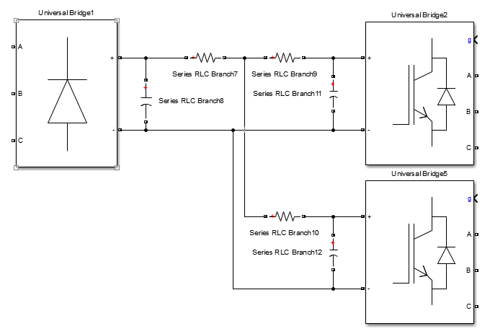
2-parallel with and without interleaving
 | Without interleaving |  | With interleaving
Icap1-9850 | 2.242 A | -139⁰ | 1.622 A | -111⁰
Icap2-9850 | 2.242 A | -139⁰ | 1.622 A | 69⁰
Idc1-9850 | 2.385 A | -159⁰ | 2.385 A | -159⁰
Idc2-9850 | 2.385 A | -159⁰ | 2.385 A | 21⁰
Iin-9850 | 1.614 A | 132⁰ | 0 | ⁻
Icap1-20000 | 4.135 A | -91⁰ | 4.134 A | -91⁰
Icap2-20000 | 4.135 A | -91⁰ | 4.134 A | -91⁰
Idc1-20000 | 4.201 A | -101⁰ | 4.200 A | -101⁰
Idc2-20000 | 4.201 A | -101⁰ | 4.200 A | -101⁰
Iin-20000 | 1.461 A | 180⁰ | 1.460 A | 180⁰
With actual rectifier (Rmid = 1 Ohms)
Additional 1 Ohms are added to each module DC bus:
Icap-RMS = 4.750 A
Icap-RMS = 4.469 A
When the two resistors are added (1 Ohms), the positive effect of interleaving decreased as presented above.
However, it still decreases the RMS of each capacitor.
Adding parasitics inductances is another matter.

Slide 34
2-parallel with and without interleaving
 | Without interleaving |  | With interleaving
Icap1-9850 | 2.242 A | -139⁰ | 1.622 A | -111⁰
Icap2-9850 | 2.242 A | -139⁰ | 1.622 A | 69⁰
Idc1-9850 | 2.385 A | -159⁰ | 2.385 A | -159⁰
Idc2-9850 | 2.385 A | -159⁰ | 2.385 A | 21⁰
Iin-9850 | 1.614 A | 132⁰ | 0 | ⁻
Icap1-20000 | 4.135 A | -91⁰ | 4.134 A | -91⁰
Icap2-20000 | 4.135 A | -91⁰ | 4.134 A | -91⁰
Idc1-20000 | 4.201 A | -101⁰ | 4.200 A | -101⁰
Idc2-20000 | 4.201 A | -101⁰ | 4.200 A | -101⁰
Iin-20000 | 1.461 A | 180⁰ | 1.460 A | 180⁰
With actual rectifier (Rmid = 1 Ohms)
Additional 1 Ohms are added to each module DC bus:
Icap-RMS = 4.750 A
Icap-RMS = 4.469 A
When the two resistors are added (1 Ohms), the positive effect of interleaving decreased as presented above.
However, it still decreases the RMS of each capacitor.
Adding parasitics inductances is another matter.

Slide 35
2-parallel with and without interleaving
With

Slide 36
2-parallel with and without interleaving
With

Slide 38
Thank you !
mesut.ugur@metu.edu.tr

