Slide 1

Complete System Modeling
for
Integrated Modular Motor Drive
Mesut Uğur
14/10/2019
mesut.ugur@metu.edu.tr

Slide 2
Content
Simplest inverter model
Parasitics added
Unbalance on load
Rectifier added
2-parallel with and without interleaving
2-parallel – parasitics added
2-parallel – load and module unbalance
2-parallel – rectifier added
2-series with and without interleaving
2-series – parasitics added
2-series – load and module unbalance
2-series – rectifier added

Slide 3
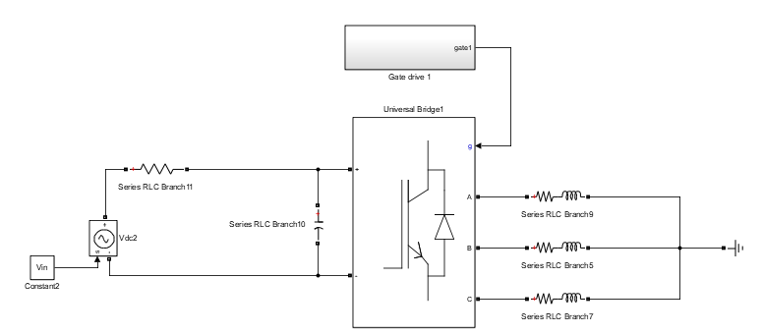
Simplest inverter model
Single module 3-phase inverter
Load is balanced RL load
DC bus is ideal current source
Sinusoidal PWM – fsw = 10kHz
Generic parameters: pf = 0.9, ma = 0.9
270Vdc, 2kW system
DC bus input current is almost DC
No LF harmonic injection from input
No HF harmonic flow from output
Iin
Idc
SA, SB, SC
Isa
Vin
Vab
Isb
Vdc
Vbc
Isc
Iin = 7.4A, Icaprms = 4.8A, Vdcrip = 6% (15uF), Isrms = 8.6A
Iin ripple is made 4%

Slide 4
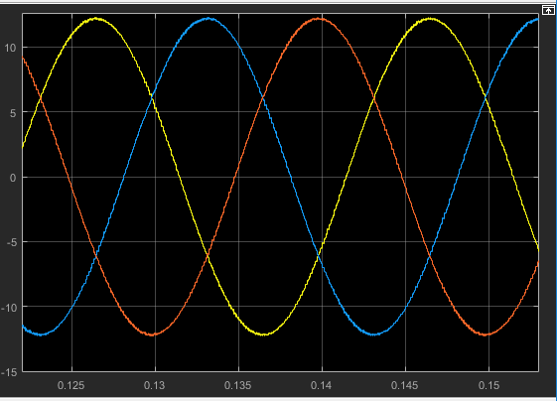
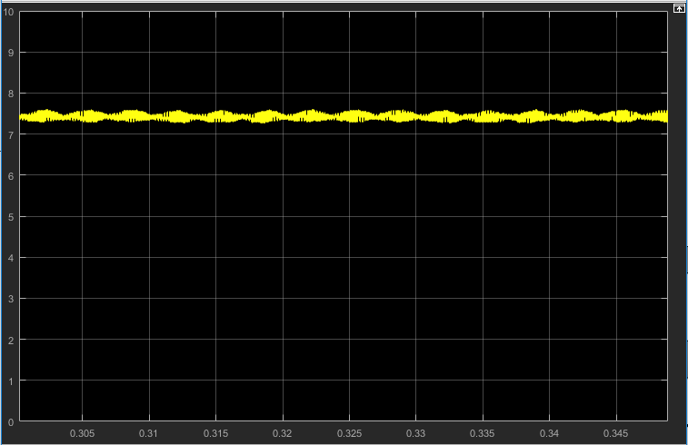
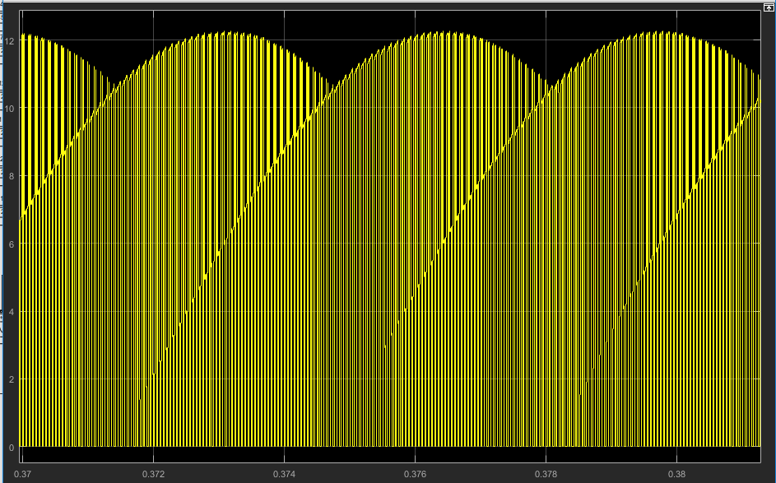
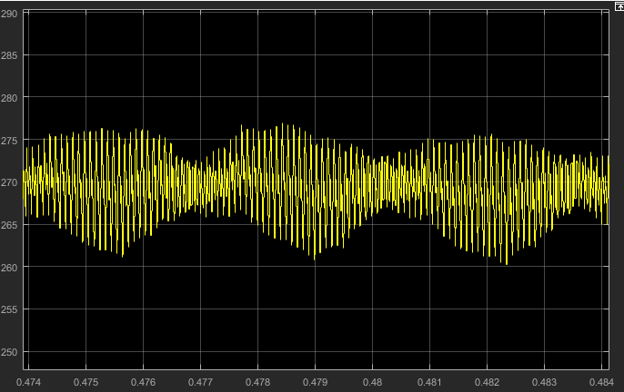
Simplest inverter model
Isa, Isb, Isc
Iin
Idc = SAIsa + SBIsb + SCIsc
Vdc

Slide 5
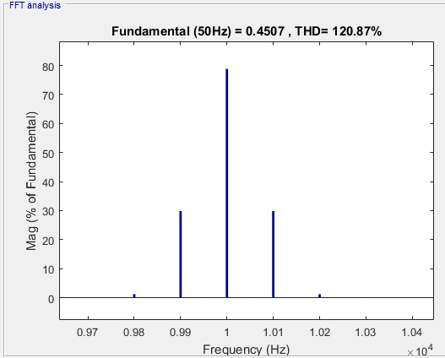
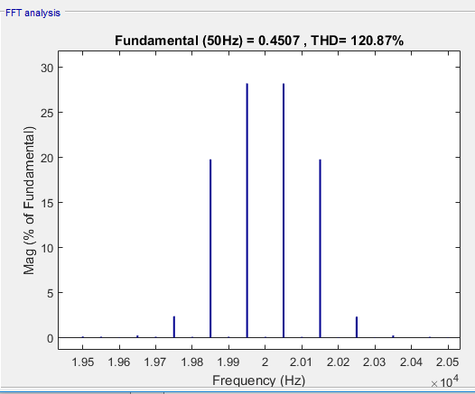
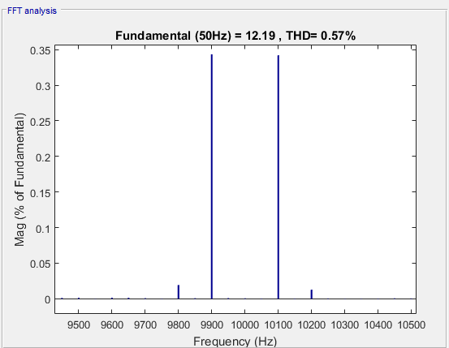
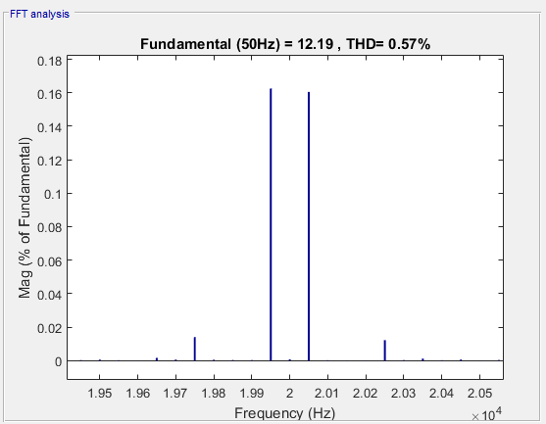
Simplest inverter model
SA - Around fsw
SA - Around 2*fsw
Isa - Around fsw
Isa - Around 2*fsw

Slide 6
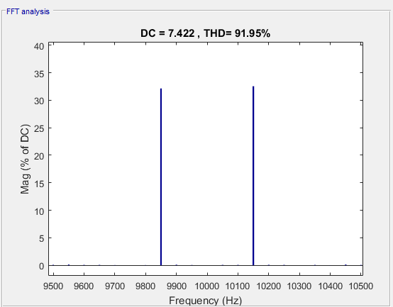
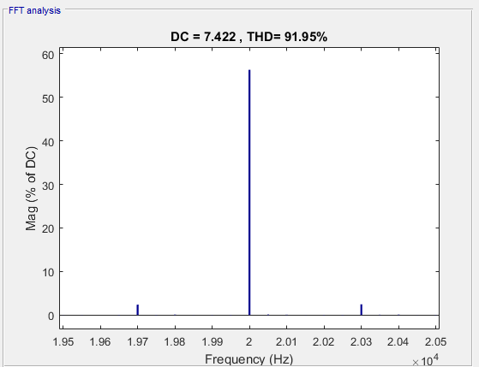
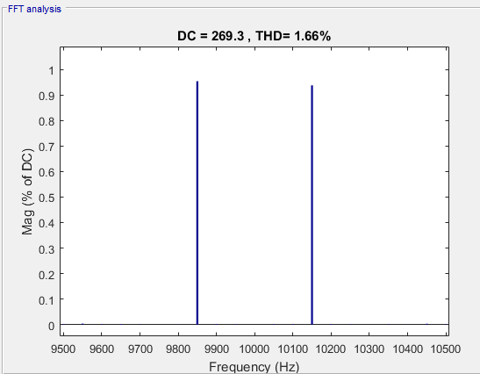
Simplest inverter model
Idc - Around fsw
Idc - Around 2*fsw
Idc harmonics are directly injected to Icap (well, almost). Therefore, their presence on the DC bus voltage is also directly, also affected by frequency and capacitance.
Vdc - Around fsw
There is no 300 Hz component in neither of the quantites. There is an envelope phenomenon here.

Slide 7
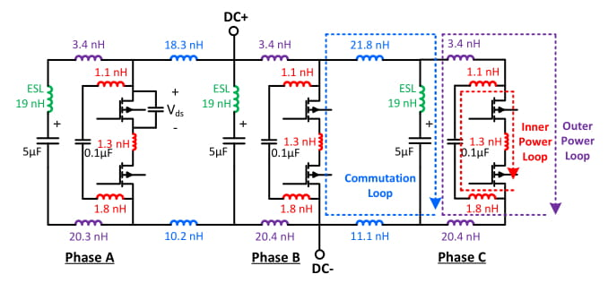
Parasitics added model
Inner power loop consists of seramic capacitors and handles the switching oscillation (in the order of 100MHz). It is directly related to the device Vds breakdown.
Outer power loop consists of the large film capacitor (5 uF each). It is the loop where the switching harmonics (component of Idc) flow.
In commutation loops, the switching harmonic current flows from one phase to a capacitor belonging to a different phase. Therefore, our «single Idc» assumption fails here.
There is a stray inductance between all components, conswquently resulting in increase on capacitor stress.

Slide 8
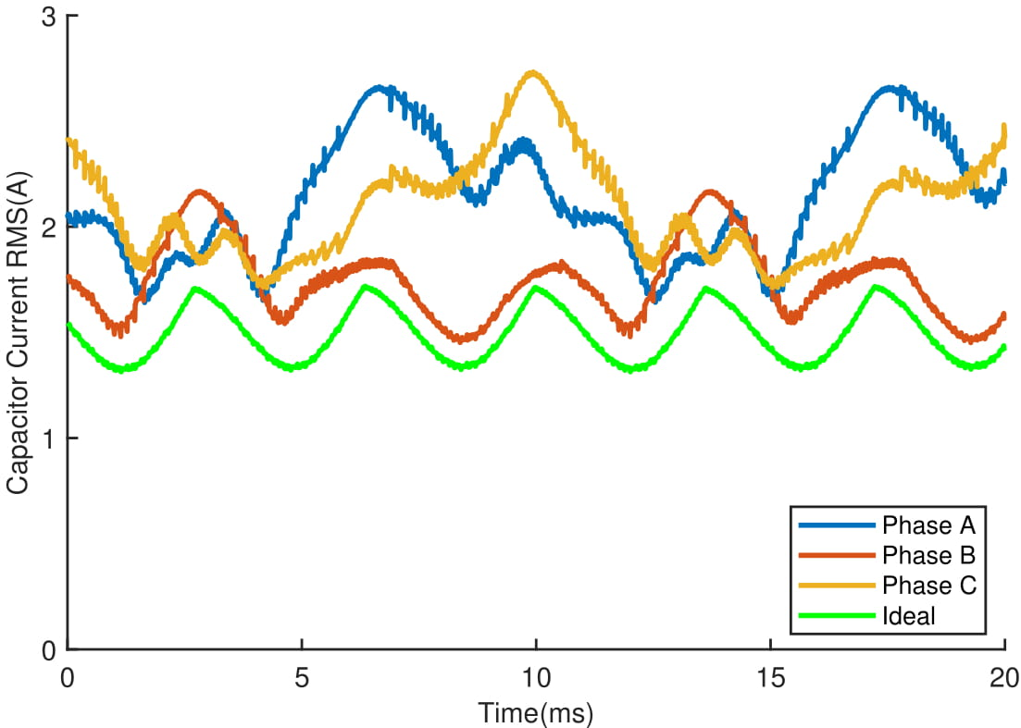
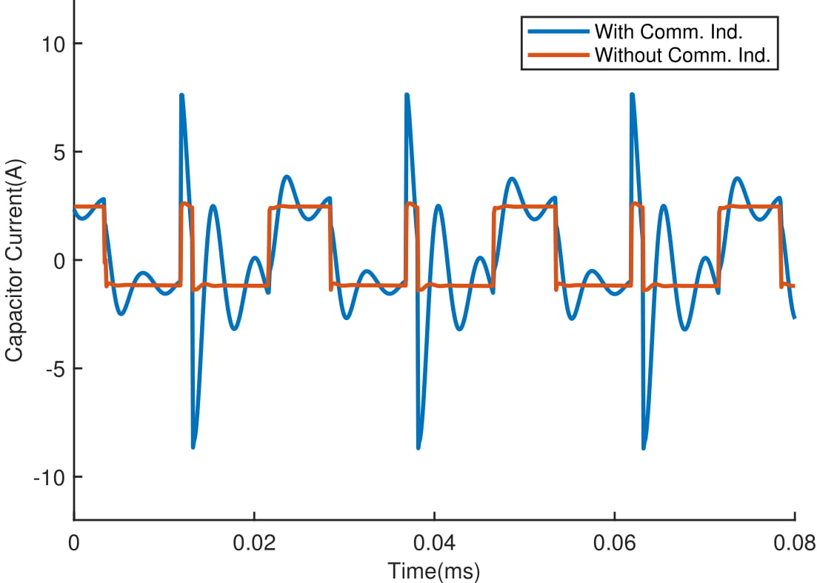
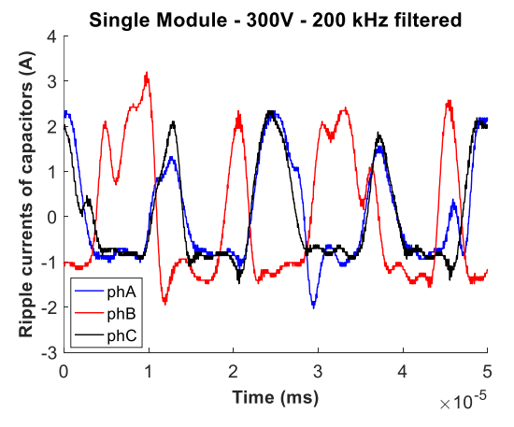
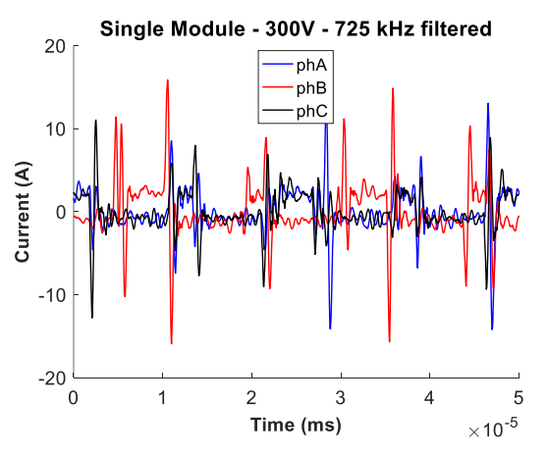
Parasitics added model
The DC bus design affects the distribution capacitor stress.
Below resulşts are simulation results for the previus inverter (V2)
Below is the test result:

Slide 9
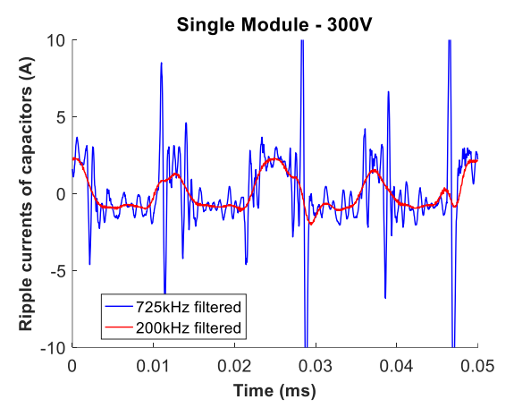
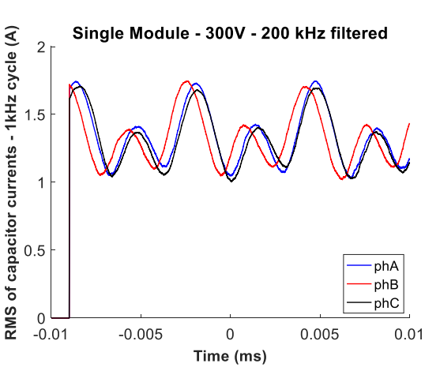
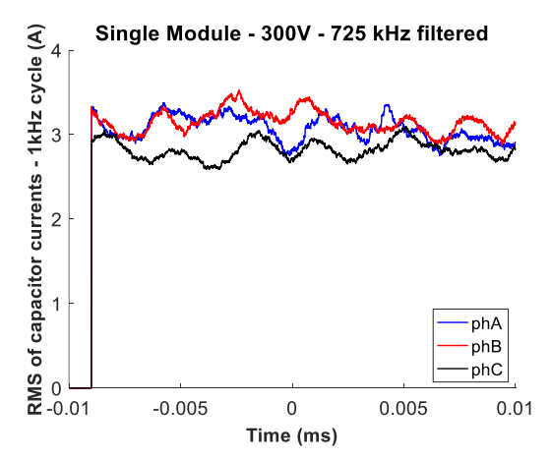
Parasitics added model
A cleaner result:
Note that, test results are obtained by measuring each capacitor voltage, and obtaining their current using integral (ESR, ESL etc. are neglected)
RMS comparison:

Slide 10
Parasitics added model
Study on the parasitics added model is still ongoing.
First, the simulation results should be renewed.
FFT analysis is to applied for a better understanding.
An analytical model using impedance models is developed, still ongoing.

Slide 11
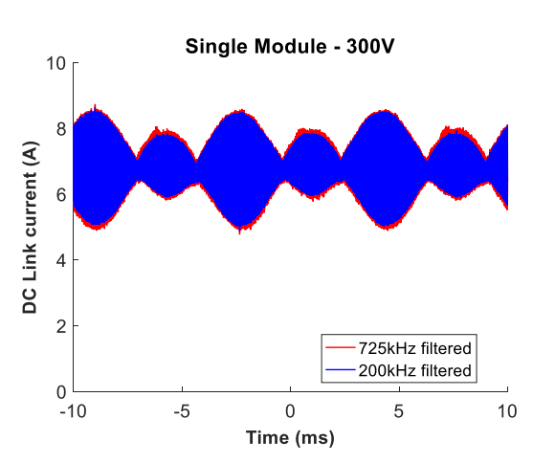
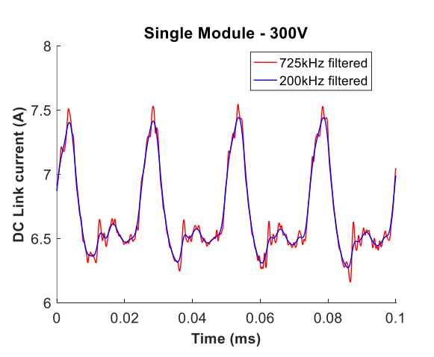
Rectifier added model
Let us first look at the test results, where rectifier is used.

Slide 12
Thank you !
mesut.ugur@metu.edu.tr

