Slide 1
mlcompass
A Schema-Bounded LLM Narrator for Machine-Learning Pipeline Diagnosis
Hakan Sabuniş · Yusuf Ünlü
Istanbul Medipol University · School of Engineering and Natural Sciences
github.com/hakansabunis/mlcompass · pypi.org/project/mlcompass · v0.8.1 · MIT

Slide 2
The problem
2 / 13
ML engineering is a chain of single-purpose tools — and none of them advise.
• pandas-profiling shows you the data.
  It doesn't know which column you're trying to predict.
• Weights & Biases tracks your runs.
  It doesn't tell you the loss curve looks like overfitting.
• Copilot and Cursor complete your code.
  They'll happily generate Adam(momentum=0.9) — which is invalid.
• Existing LLM assistants hallucinate.
  They invent column names that don't exist and propose fixes for problems that aren't real.
146,932 hallucinated citations were observed across arXiv, bioRxiv and SSRN in 2025 alone [Zhao et al., 2026].
mlcompass — Capstone Project — Sabuniş & Ünlü

Slide 3
mlcompass in 30 seconds
3 / 13
An open-source CLI that follows you through the whole ML pipeline — and is allowed to explain but not to invent.
Eleven commands cover every pipeline stage:
init → advise → audit → watch → compare → evaluate → deploy
+ status · monitor · optimize · agent
Four surfaces, one tool layer:
CLI · MCP server (Claude Desktop / Cursor / Claude Code) · Self-driving agent · Slash commands
Shared on-disk project context (.mlcompass/) so we remember what was decided yesterday.
mlcompass — Capstone Project — Sabuniş & Ünlü

Slide 4
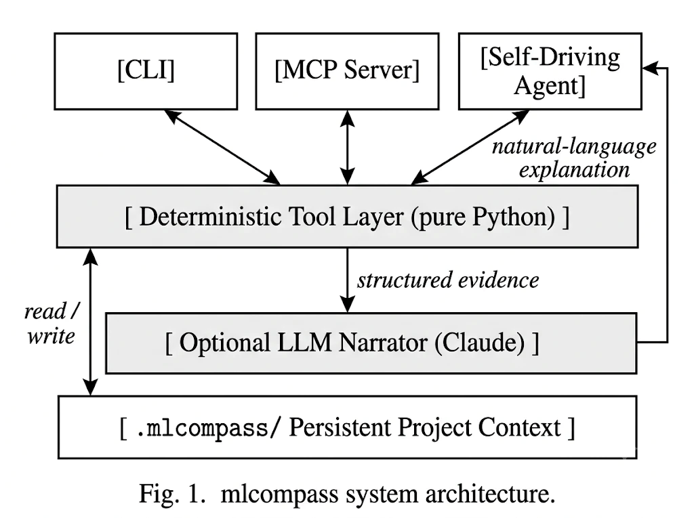
System architecture
4 / 13
Three user-facing surfaces sit on top of a two-layer brain over a persistent project-context folder.
Fig. 1. mlcompass system architecture (also Fig. 1 in the paper).
mlcompass — Capstone Project — Sabuniş & Ünlü

Slide 5
The two-layer brain
5 / 13
Facts come from pure code. Narration comes from a Claude agent on top, never the other way around.
Deterministic Tool Layer (pure Python)
Optional Claude Narrator (--llm)
• Reads CSVs with pandas
• Parses training scripts with ast
• Computes Pearson + Spearman + perfect-match
• Returns structured dict — never free text
• Cannot hallucinate by construction
• Receives the dict from below
• Explains it in natural language
• Runs under a 3-layer contract (next slide)
• Bound at call time to the evidence's column set
• Skipped entirely with --no-llm (offline path)
src/mlcompass/tools/
src/mlcompass/agents/
mlcompass — Capstone Project — Sabuniş & Ünlü

Slide 6
The anti-hallucination contract
6 / 13
Three layers. Each one alone is weak. Together they are strict.
Layer 1
Deterministic evidence
Layer 2
Strict prompt
Layer 3
Runtime schema boundary
• Pure Python. No LLM.
• Computes max(|ρ_P|, |ρ_S|).
• Emits a dict E of candidate leak columns.
• Cite only items in E.
• Say cannot_determine when unsure.
• No code patches — manual checks only.
• Tool-input enum is generated from E.
• SDK rejects any out-of-evidence column.
• Worst-case guarantee, not just guidance.
Layer 3 is the load-bearing piece — prompts are advisory, schemas are enforcement.
mlcompass — Capstone Project — Sabuniş & Ünlü

Slide 7
Worked example — Ames House Prices
7 / 13
A user accidentally includes log_price when training a model to predict saleprice. R² = 1.000.
Layer 1 — Evidence
Pearson ρ_P(log_price, y) ≈ 0.94 · Spearman ρ_S = 1.00 · perfect-match 98.7 %
→ log_price flagged as candidate (max correlation = 1.00, threshold 0.97).
Layer 2 — Narrator (Claude)
"log_price has Spearman = 1.00 with the target — almost certainly a transformed leak.
Recommend manually checking the feature pipeline for any column derived from the target."
Layer 3 — Schema boundary
columns_referenced enum = {log_price, near_proxy, feature_3, …, feature_12}
log_price ∈ enum → response ships. If the LLM had emitted 'revenue', SDK would reject and retry.
mlcompass — Capstone Project — Sabuniş & Ünlü

Slide 8
Results — phantom-column fabrication rate
8 / 13
Synthetic regression test set. N = 200 narrator responses per configuration. Claude 3.5 Sonnet.
Configuration | Rate | Wilson 95% CI
Layer 1 (no prompt, no schema) | 8.0 % | [ 4.93 , 12.66 ]
Layer 1 + 2 (strict prompt) | 1.0 % | [ 0.27 , 3.56 ]
Layer 1 + 2 + 3 (schema-enforced) | 0.0 % | [ 0.00 , 1.83 ]
Takeaway
Prompt engineering reduces fabrication 8× (8.0 % → 1.0 %), but does not eliminate it. The runtime schema boundary brings the observed rate to 0 — a worst-case guarantee, not just an average.
mlcompass — Capstone Project — Sabuniş & Ünlü

Slide 9
Field tests — 5 Kaggle datasets, 11 real bugs
9 / 13
Every release dry-ran on a real Kaggle dataset before shipping. Each bug locked in by a regression test.
Test | Dataset | Patch | Bugs caught
1 | Telco Churn | — | baseline — pipeline runs end-to-end
2 | Ames House Prices | v0.7.0 | missing target name, year-col, sparse-col crash
3 | Titanic | v0.7.1 | missing 'survived' target name
4 | Penguins | v0.7.2 | multiclass mis-detected, MCP ledger gap
5 | Insurance Charges | v0.7.3 | missing 'charges' target, MCP state fields
Real datasets find bugs synthetic ones don't — none of the 11 bugs had been anticipated by our unit-test suite.
mlcompass — Capstone Project — Sabuniş & Ünlü

Slide 10
The 11 slash commands & live demo
10 / 13
Eleven Claude Code slash commands — each maps to one mlcompass tool. Installed with one command, no JSON config.
$ mlcompass install-slash-commands --scope user
/mlc-init
/mlc-advise
/mlc-audit
/mlc-watch
Start a new mlcompass project
Analyze CSV — target, warnings, models
Static analysis of training script (8 rules)
Scan log: NaN / divergence / overfit
/mlc-compare
/mlc-evaluate
/mlc-leak
/mlc-deploy
Side-by-side diff of two training runs
Metrics + auto leakage panel on perfect R²
Focused leakage check on predictions
Production-readiness check (Lambda / Docker)
/mlc-status
/mlc-monitor
/mlc-optimize
Show project history + current state
PSI / KS / chi² drift (CLI fallback)
HPO recommender (CLI fallback)
› /mlc-init insurance-demo
→ .mlcompass/ project folder created
› /mlc-advise demo-data/insurance.csv
→ target = 'charges', regression
› /mlc-evaluate demo-data/predictions_with_leak.csv
→ R² = 1.000 → automatic leakage panel
› /mlc-status
→ project history summary
mlcompass — Capstone Project — Sabuniş & Ünlü
Highlighted cards = used in today's demo · Dashed-style (gray) = CLI fallback · Backup: pre-recorded MP4 on USB

Slide 11
Challenges we faced
11 / 13
Four problems we hit, and what we learned.
• Prompt engineering wasn't enough.
  We spent a week trying to make the LLM stop fabricating columns through prompts alone. Got from 8 % to 1 %. Still wrong 1 % of the time. Fix: enforce at the schema layer, not the prompt layer.
• CLI and MCP server drifted apart.
  Same underlying functions, different behavior. CLI was writing to the ledger, MCP wasn't. Shipped a shared _persist_to_ledger helper + parity regression tests in v0.7.2 and v0.7.3.
• Synthetic unit tests missed real bugs.
  Eleven bugs surfaced from 5 Kaggle datasets — zero predicted from our pre-existing test suite. Moved to a field-test-then-patch release cadence.
• Reviewer feedback on the paper.
  Three peer reviewers identified weak statistical claims, missing baselines, implicit threat model. Released v0.8.1 with Wilson 95 % CIs, reproducibility scripts, threat model doc, limitations doc, per-bug detail.
mlcompass — Capstone Project — Sabuniş & Ünlü

Slide 12
Limitations + future work
12 / 13
What we did NOT measure
Planned for v0.9 / v1.0
• Cross-model generalization
  All experiments use Claude 3.5 Sonnet. GPT-4 / Llama-3 / Gemini behavior unverified.
• Constrained-generation baseline
  We do not directly benchmark against Outlines or OpenAI strict: true mode.
• External user study
  Used by the two authors + classmates only. No third-party evaluation.
• Other hallucination types
  Miscalibrated confidence, causal misattribution, prompt-injection compliance — out of scope.
• OpenAI backend
  Lets us repeat Table I on GPT-4 + strict: true and report cross-provider rates.
• Outlines benchmark
  Same task through Outlines on Llama-3-8B. Side-by-side fabrication rates.
• N = 2000 live run
  Tightens Wilson CIs. Reproducible via scripts/reproduce_hallucination_ablation.py.
• Plug-in system
  Domain-specific analysers (HuggingFace, PyTorch Lightning) without modifying core.
mlcompass — Capstone Project — Sabuniş & Ünlü

Slide 13
Thank you
Questions?
Project
github.com/hakansabunis/mlcompass
Install
pip install mlcompass
Paper
paper/Capstone_Report.pdf in the repo
Authors
Hakan Sabuniş · Yusuf Ünlü

