Slide 1
Lecture 25
Pulse-Width Modulation (PWM) Techniques
Instructor: Prof. Ali Keyhani
Contact Person:
E-mail: keyhani.1@osu.edu
Tel.: 614-292-4430
Department of Electrical and Computer Engineering
The Ohio State University
1

Slide 2
ORGANIZATION
I. Voltage Source Inverter (VSI)
A. Six-Step VSI
B. Pulse-Width Modulated VSI
II. PWM Methods
A. Sine PWM
B. Hysteresis (Bang-bang)
C. Space Vector PWM
III. References
2

Slide 3
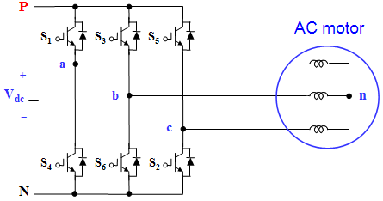
I. Voltage Source Inverter (VSI)
A. Six-Step VSI (1)
Six-Step three-phase Voltage Source Inverter
Fig. 1 Three-phase voltage source inverter.
3

Slide 4
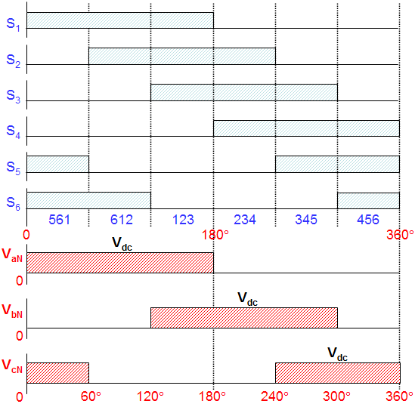
I. Voltage Source Inverter (VSI)
A. Six-Step VSI (2)
Gating signals, switching sequence and line to negative voltages
Fig. 2 Waveforms of gating signals, switching sequence, line to negative voltages
for six-step voltage source inverter.
4

Slide 5
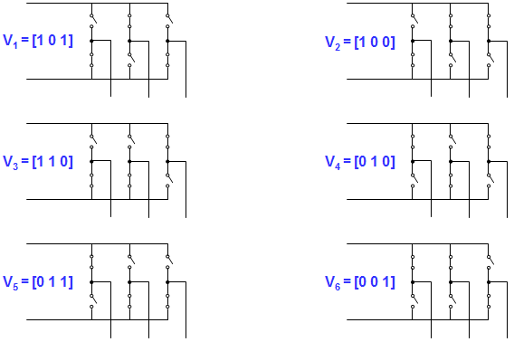
I. Voltage Source Inverter (VSI)
A. Six-Step VSI (3)
Switching Sequence:
561 (V₁) → 612 (V₂) → 123 (V₃) → 234 (V₄) → 345 (V₅) → 456 (V₆) → 561 (V₁)
where, 561 means that S₅, S₆ and S₁ are switched on
Fig. 3 Six inverter voltage vectors for six-step voltage source inverter.
5

Slide 6
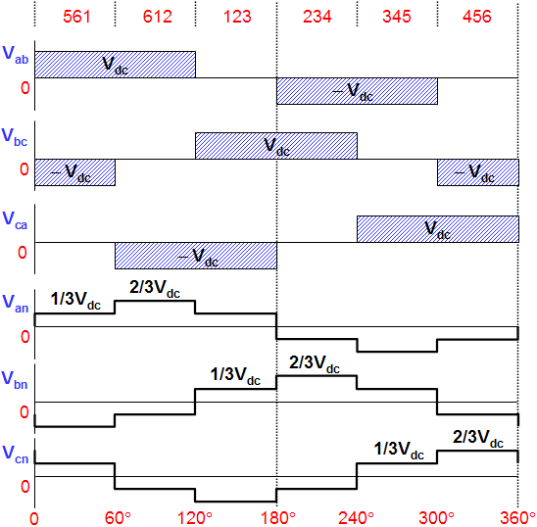
I. Voltage Source Inverter (VSI)
A. Six-Step VSI (4)
Line to line voltages (V_{ab}, V_{bc}, V_{ca}) and line to neutral voltages (V_{an}, V_{bn}, V_{cn})
Line to line voltages
V_{ab} = V_{aN} - V_{bN}
V_{bc} = V_{bN} - V_{cN}
V_{ca} = V_{cN} - V_{aN}
Phase voltages
V_{an} = 2/3V_{aN} - 1/3V_{bN} - 1/3V_{cN}
V_{bn} = -1/3V_{aN} + 2/3V_{bN} - 1/3V_{cN}
V_{cn} = -1/3V_{aN} - 1/3V_{bN} + 2/3V_{cN}
Fig. 4 Waveforms of line to neutral (phase) voltages and line to line voltages
for six-step voltage source inverter.
6

Slide 7
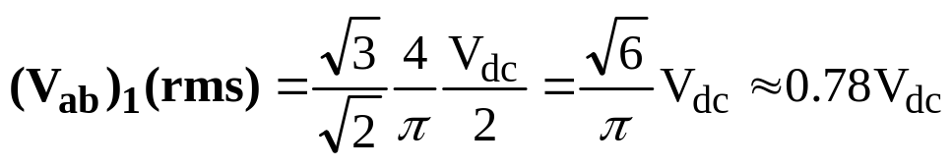
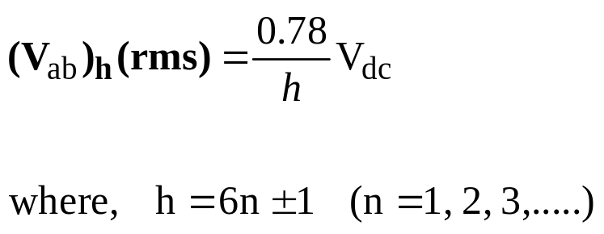
I. Voltage Source Inverter (VSI)
A. Six-Step VSI (5)
Amplitude of line to line voltages (V_{ab}, V_{bc}, V_{ca})
Fundamental Frequency Component (V_{ab})₁
Harmonic Frequency Components (V_{ab})_{h}
: amplitudes of harmonics decrease inversely proportional to their harmonic order
7

Slide 8
I. Voltage Source Inverter (VSI)
A. Six-Step VSI (6)
Characteristics of Six-step VSI
It is called “six-step inverter” because of the presence of six “steps”
in the line to neutral (phase) voltage waveform
Harmonics of order three and multiples of three are absent from
both the line to line and the line to neutral voltages
and consequently absent from the currents
Output amplitude in a three-phase inverter can be controlled
by only change of DC-link voltage (V_{dc})
8

Slide 9
I. Voltage Source Inverter (VSI)
B. Pulse-Width Modulated VSI (1)
Objective of PWM
Control of inverter output voltage
Reduction of harmonics
Disadvantages of PWM
Increase of switching losses due to high PWM frequency
Reduction of available voltage
EMI problems due to high-order harmonics
9

Slide 10
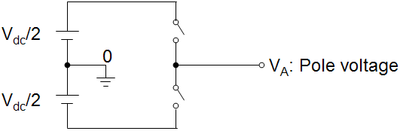
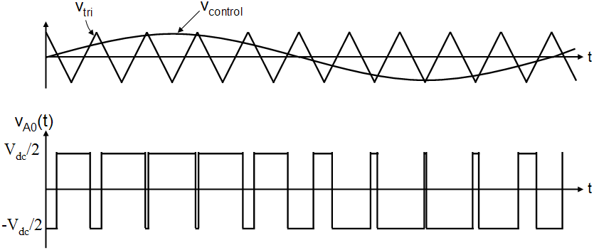
I. Voltage Source Inverter (VSI)
B. Pulse-Width Modulated VSI (2)
Pulse-Width Modulation (PWM)
Fig. 5 Pulse-width modulation.
10

Slide 11
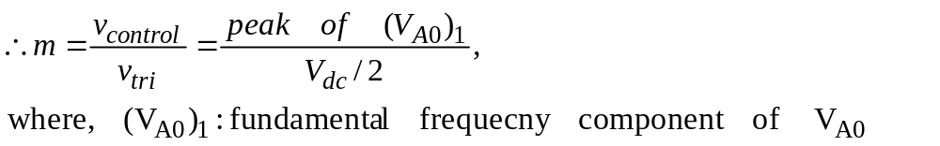
I. Voltage Source Inverter (VSI)
B. Pulse-Width Modulated VSI (3)
Inverter output voltage
When v_{control} > v_{tri}, V_{A0} = V_{dc}/2
When v_{control} < v_{tri}, V_{A0} = -V_{dc}/2
Control of inverter output voltage
PWM frequency is the same as the frequency of v_{tri}
Amplitude is controlled by the peak value of v_{control}
Fundamental frequency is controlled by the frequency of v_{control}
Modulation Index (m)
11

Slide 12
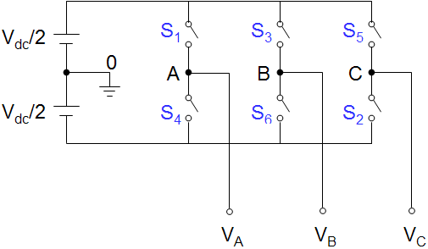
II. PWM METHODS
A. Sine PWM (1)
Three-phase inverter
Fig. 6 Three-phase Sine PWM inverter.
12

Slide 13
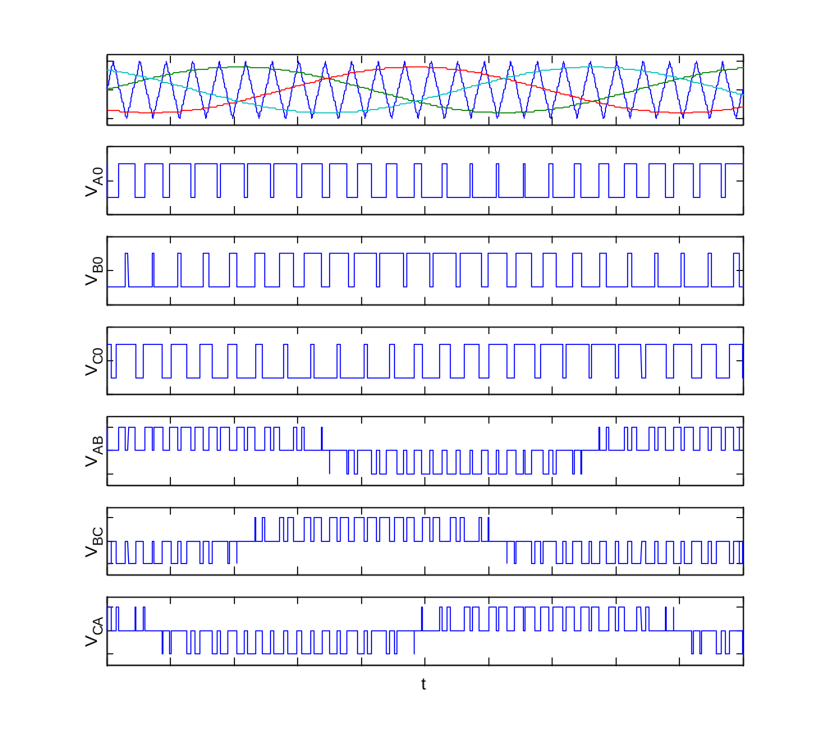
II. PWM METHODS
A. Sine PWM (2)
Three-phase sine PWM waveforms
v_{tri}
v_{control_A}
v_{control_B}
v_{control_C}
Frequency of v_{tri} and v_{control}
Frequency of v_{tri} = f_{s}
Frequency of v_{control} = f₁
where, f_{s} = PWM frequency
f₁ = Fundamental frequency
Inverter output voltage
When v_{control} > v_{tri}, V_{A0} = V_{dc}/2
When v_{control} < v_{tri}, V_{A0} = -V_{dc}/2
where, V_{AB} = V_{A0} – V_{B0}
V_{BC} = V_{B0} – V_{C0}
V_{CA} = V_{C0} – V_{A0}
Fig. 7 Waveforms of three-phase sine PWM inverter.
13

Slide 14
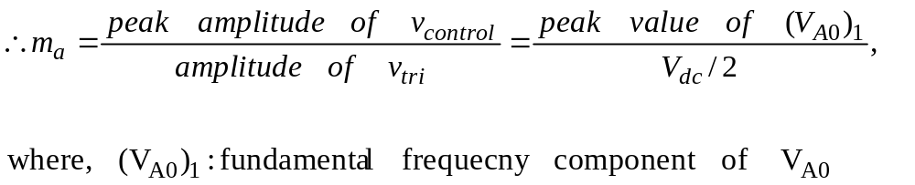
II. PWM METHODS
A. Sine PWM (3)
Amplitude modulation ratio (m_{a})
Frequency modulation ratio (m_{f})
m_{f} should be an odd integer
if m_{f} is not an integer, there may exist sunhamonics at output voltage
if m_{f} is not odd, DC component may exist and even harmonics are present at output voltage
m_{f} should be a multiple of 3 for three-phase PWM inverter
An odd multiple of 3 and even harmonics are suppressed
14

Slide 15
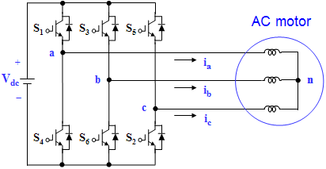
II. PWM METHODS
B. Hysteresis (Bang-bang) PWM (1)
Three-phase inverter for hysteresis Current Control
Fig. 8 Three-phase inverter for hysteresis current control.
15

Slide 16

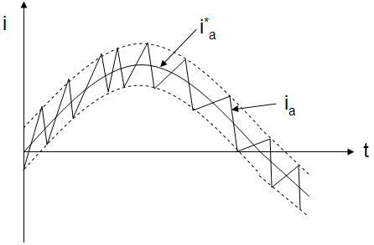
II. PWM METHODS
B. Hysteresis (Bang-bang) PWM (2)
Hysteresis Current Controller
Fig. 9 Hysteresis current controller at Phase “a”.
16

Slide 17
II. PWM METHODS
B. Hysteresis (Bang-bang) PWM (3)
Characteristics of hysteresis Current Control
Advantages
Excellent dynamic response
Low cost and easy implementation
Drawbacks
Large current ripple in steady-state
Variation of switching frequency
No intercommunication between each hysterisis controller of three phases
and hence no strategy to generate zero-voltage vectors.
As a result, the switching frequency increases at lower modulation index and
the signal will leave the hysteresis band whenever the zero vector is turned on.
The modulation process generates subharmonic components
17

Slide 18
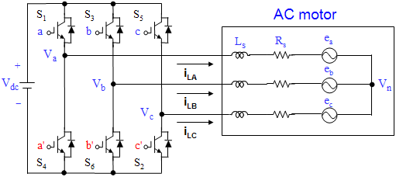
II. PWM METHODS
C. Space Vector PWM (1)
Output voltages of three-phase inverter (1)
where, upper transistors: S₁, S₃, S₅
lower transistors: S₄, S₆, S₂
switching variable vector: a, b, c
Fig. 10 Three-phase power inverter.
18

Slide 19
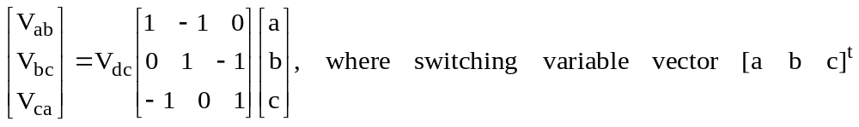
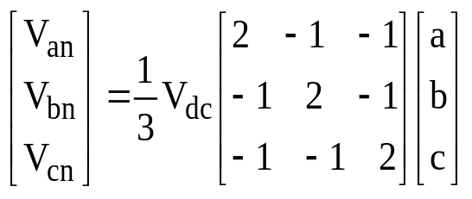
II. PWM METHODS
C. Space Vector PWM (2)
Output voltages of three-phase inverter (2)
⬧ S₁ through S₆ are the six power transistors that shape the ouput voltage
⬧ When an upper switch is turned on (i.e., a, b or c is “1”), the corresponding lower
switch is turned off (i.e., a', b' or c' is “0”)
Eight possible combinations of on and off patterns for the three upper transistors (S₁, S₃, S₅)
⬧ Line to line voltage vector [V_{ab} V_{bc} V_{ca}]^{t}
⬧ Line to neutral (phase) voltage vector [V_{an} V_{bn} V_{cn}]^{t}
19

Slide 20
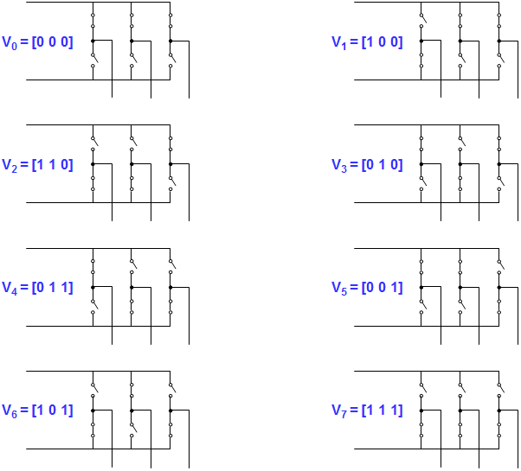
II. PWM METHODS
C. Space Vector PWM (3)
Output voltages of three-phase inverter (3)
The eight inverter voltage vectors (V₀ to V₇)
20

Slide 21
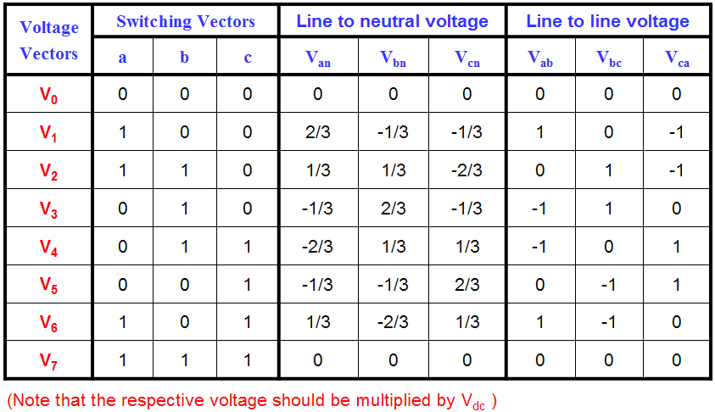
II. PWM METHODS
C. Space Vector PWM (4)
Output voltages of three-phase inverter (4)
The eight combinations, phase voltages and output line to line voltages
21

Slide 22
II. PWM METHODS
C. Space Vector PWM (5)
Principle of Space Vector PWM
Treats the sinusoidal voltage as a constant amplitude vector rotating
at constant frequency
This PWM technique approximates the reference voltage V_{ref} by a combination
of the eight switching patterns (V₀ to V₇)
CoordinateTransformation (abc reference frame to the stationary d-q frame)
: A three-phase voltage vector is transformed into a vector in the stationary d-q coordinate
frame which represents the spatial vector sum of the three-phase voltage
The vectors (V₁ to V₆) divide the plane into six sectors (each sector: 60 degrees)
V_{ref} is generated by two adjacent non-zero vectors and two zero vectors
22

Slide 23
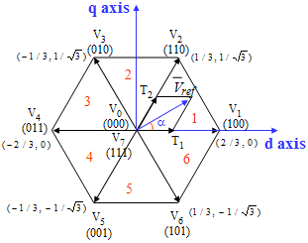
II. PWM METHODS
C. Space Vector PWM (6)
Basic switching vectors and Sectors
6 active vectors (V₁,V₂, V₃, V₄, V₅, V₆)
Axes of a hexagonal
DC link voltage is supplied to the load
Each sector (1 to 6): 60 degrees
2 zero vectors (V₀, V₇)
At origin
No voltage is supplied to the load
Fig. 11 Basic switching vectors and sectors.
23

Slide 24
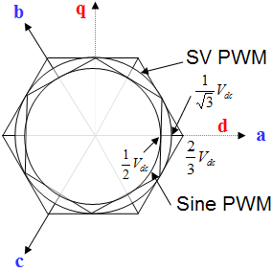
II. PWM METHODS
C. Space Vector PWM (7)
Comparison of Sine PWM and Space Vector PWM (1)
Fig. 12 Locus comparison of maximum linear control voltage
in Sine PWM and SV PWM.
24

Slide 25
II. PWM METHODS
C. Space Vector PWM (8)
Comparison of Sine PWM and Space Vector PWM (2)
Space Vector PWM generates less harmonic distortion
in the output voltage or currents in comparison with sine PWM
Space Vector PWM provides more efficient use of supply voltage
in comparison with sine PWM
Sine PWM
: Locus of the reference vector is the inside of a circle with radius of 1/2 V_{dc}
Space Vector PWM
: Locus of the reference vector is the inside of a circle with radius of 1/√3 V_{dc}
∴ Voltage Utilization: Space Vector PWM = 2/√3 times of Sine PWM
25

Slide 26
II. PWM METHODS
C. Space Vector PWM (9)
Realization of Space Vector PWM
Step 1. Determine V_{d}, V_{q}, V_{ref}, and angle (α)
Step 2. Determine time duration T₁, T₂, T₀
Step 3. Determine the switching time of each transistor (S₁ to S₆)
26

Slide 27
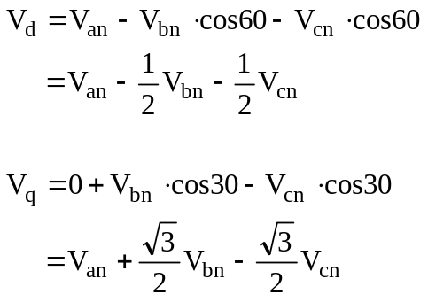
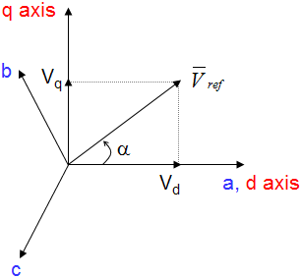
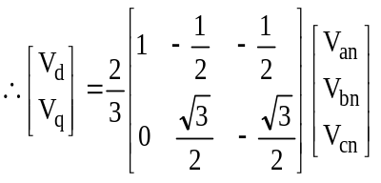
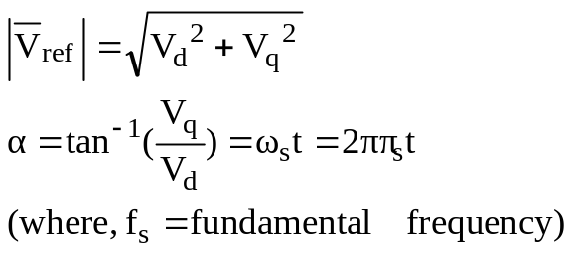
II. PWM METHODS
C. Space Vector PWM (10)
Step 1. Determine V_{d}, V_{q}, V_{ref}, and angle (α)
Coordinate transformation
: abc to dq
Fig. 13 Voltage Space Vector and its components in (d, q).
27

Slide 28
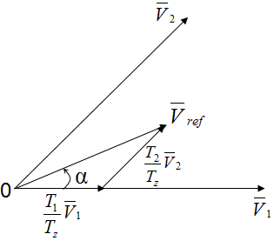
II. PWM METHODS
C. Space Vector PWM (11)
Step 2. Determine time duration T₁, T₂, T₀ (1)
Fig. 14 Reference vector as a combination of adjacent vectors at sector 1.
28

Slide 29
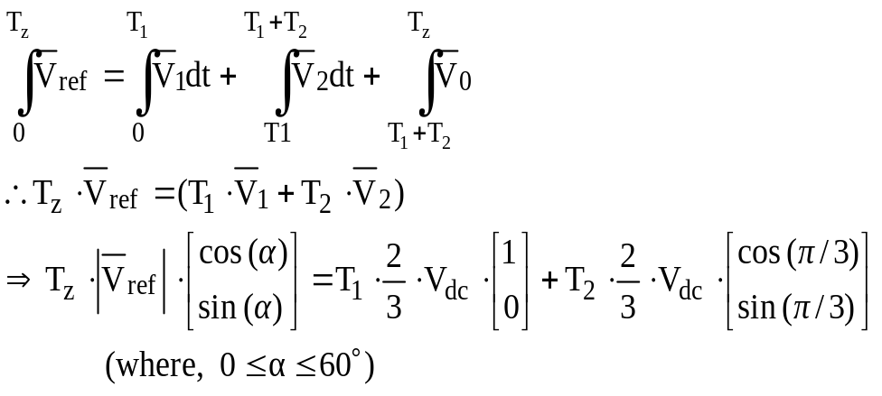
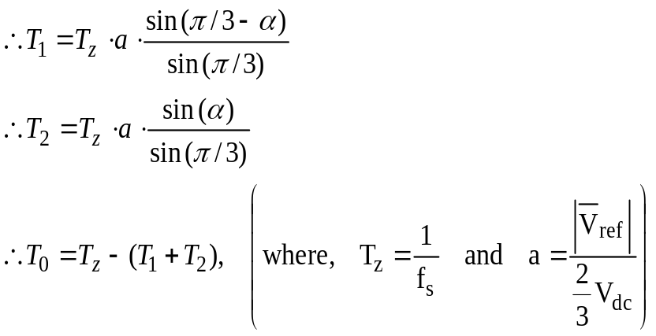
II. PWM METHODS
C. Space Vector PWM (12)
Step 2. Determine time duration T₁, T₂, T₀ (2)
Switching time duration at Sector 1
29

Slide 30
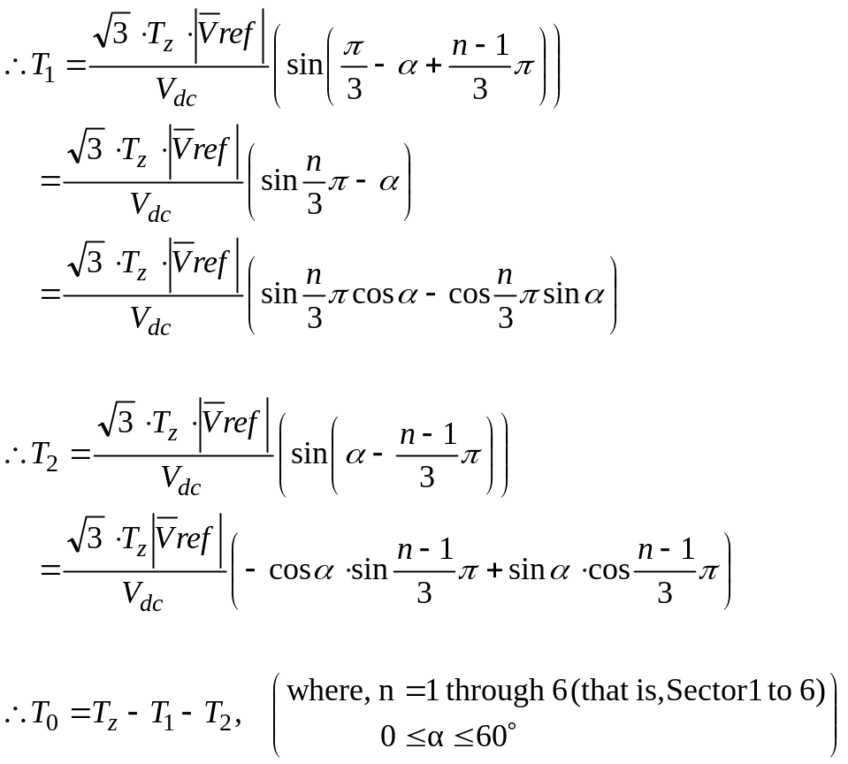
II. PWM METHODS
C. Space Vector PWM (13)
Step 2. Determine time duration T₁, T₂, T₀ (3)
Switching time duration at any Sector
30

Slide 31
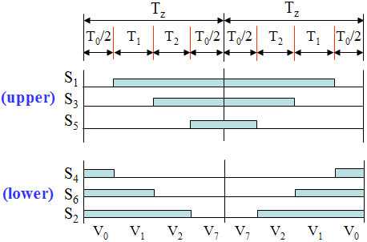
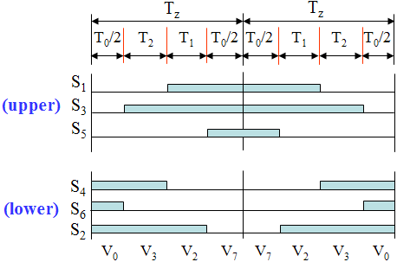
II. PWM METHODS
C. Space Vector PWM (14)
Step 3. Determine the switching time of each transistor (S₁ to S₆) (1)
(a) Sector 1.
(b) Sector 2.
Fig. 15 Space Vector PWM switching patterns at each sector.
31

Slide 32
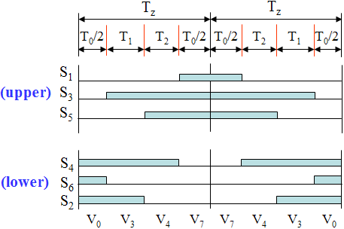
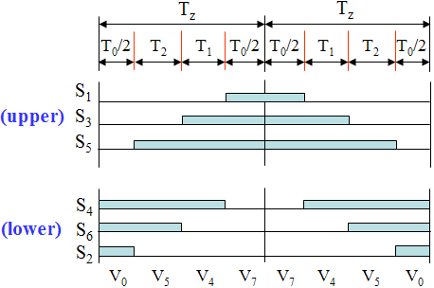
II. PWM METHODS
C. Space Vector PWM (15)
Step 3. Determine the switching time of each transistor (S₁ to S₆) (2)
(c) Sector 3.
(d) Sector 4.
Fig. 15 Space Vector PWM switching patterns at each sector.
32

Slide 33
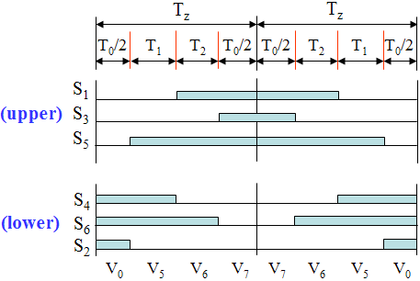
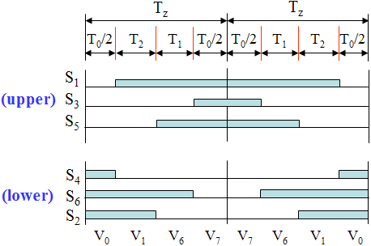
II. PWM METHODS
C. Space Vector PWM (16)
Step 3. Determine the switching time of each transistor (S₁ to S₆) (3)
(e) Sector 5.
(f) Sector 6.
Fig. 15 Space Vector PWM switching patterns at each sector.
33

Slide 34
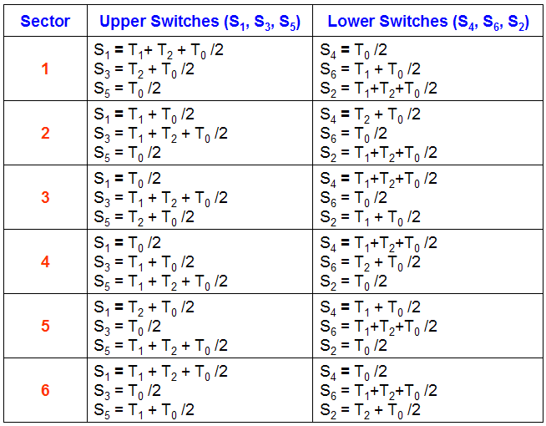
II. PWM METHODS
C. Space Vector PWM (17)
Step 3. Determine the switching time of each transistor (S₁ to S₆) (4)
Table 1. Switching Time Table at Each Sector
34

Slide 35
III. REFERENCES
[1] N. Mohan, W. P. Robbin, and T. Undeland, Power Electronics: Converters,
Applications, and Design, 2nd ed. New York: Wiley, 1995.
[2] B. K. Bose, Power Electronics and Variable Frequency Drives:Technology
and Applications. IEEE Press, 1997.
[3] H.W. van der Broeck, H.-C. Skudelny, and G.V. Stanke, “Analysis and
realization of a pulsewidth modulator based on voltage space vectors,”
IEEE Transactions on Industry Applications, vol.24, pp. 142-150, 1988.
35

