Slide 1
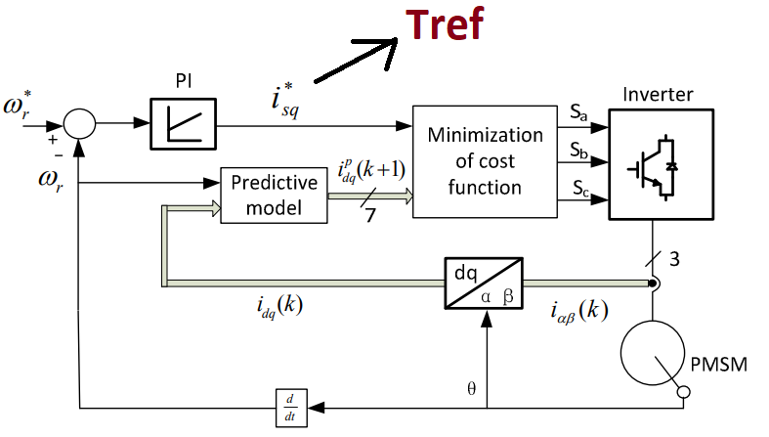
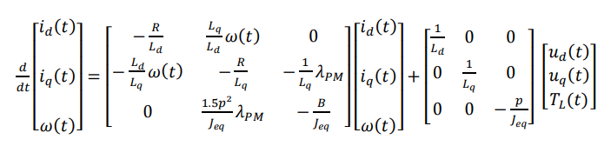
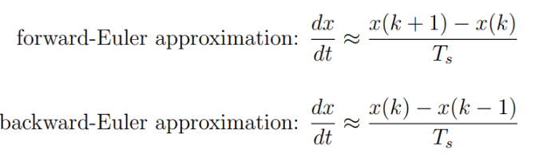
Ref: Experimental Implementation of Model
Predictive Control for Permanent Magnet Synchronous Motor

Slide 2
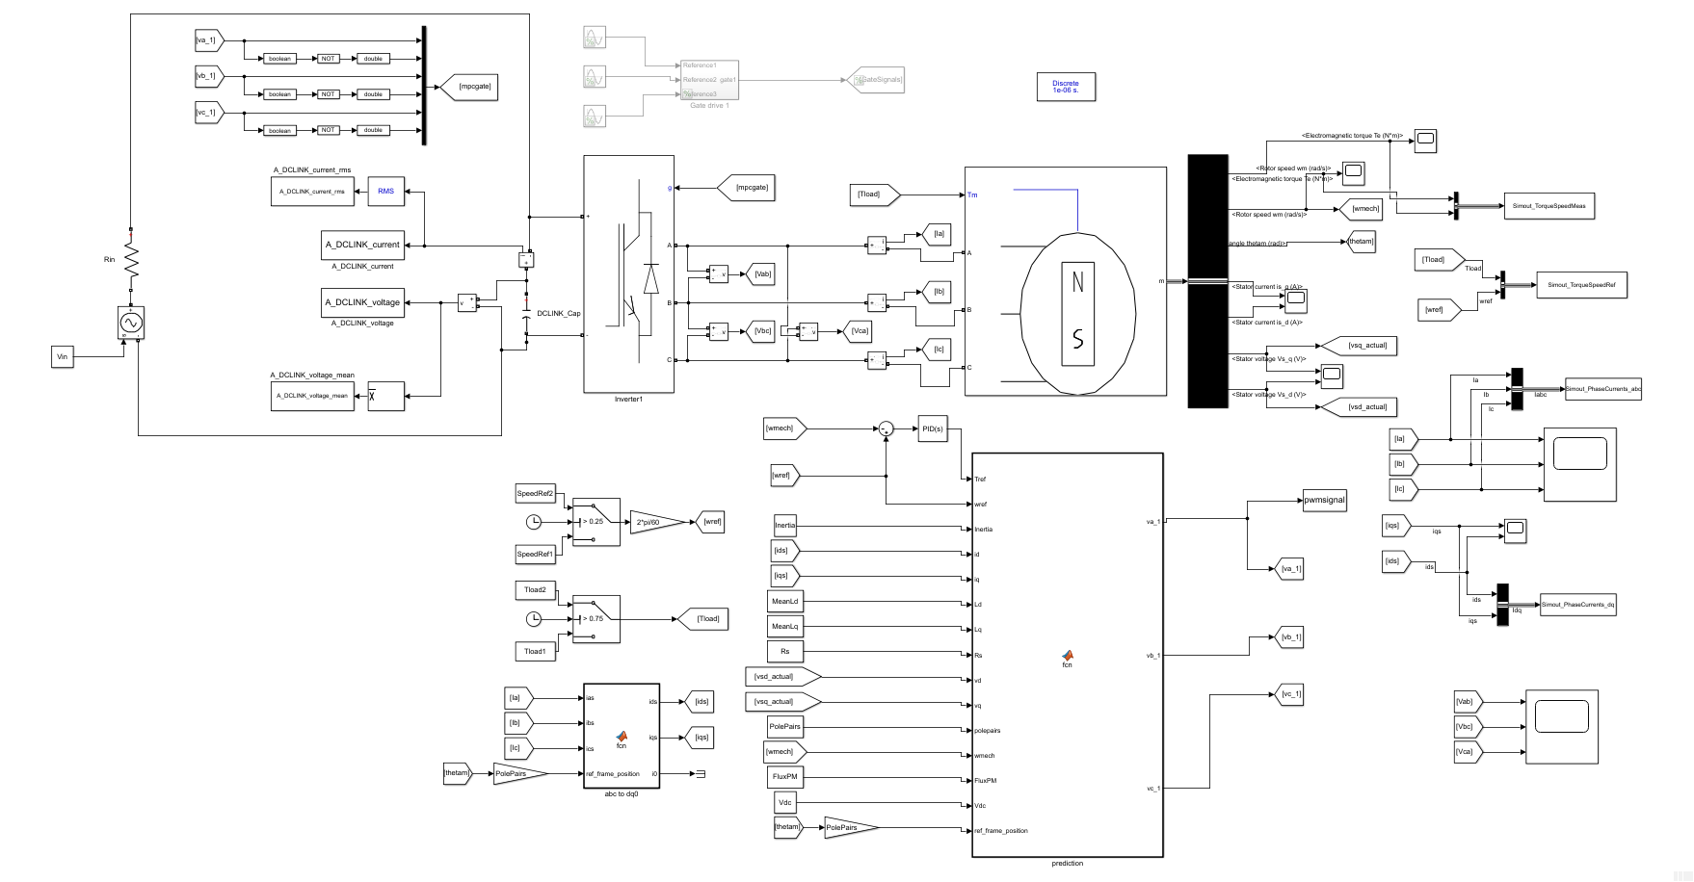

Slide 3
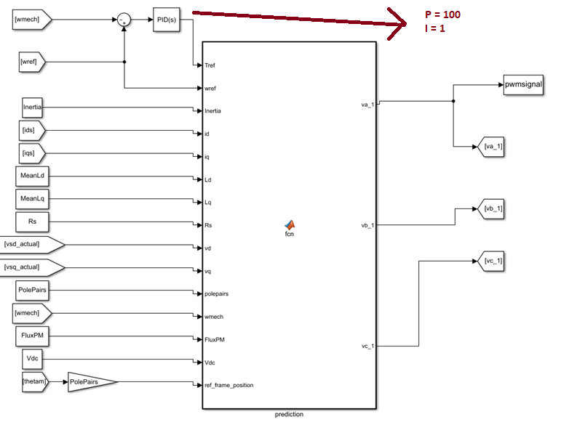

Slide 4
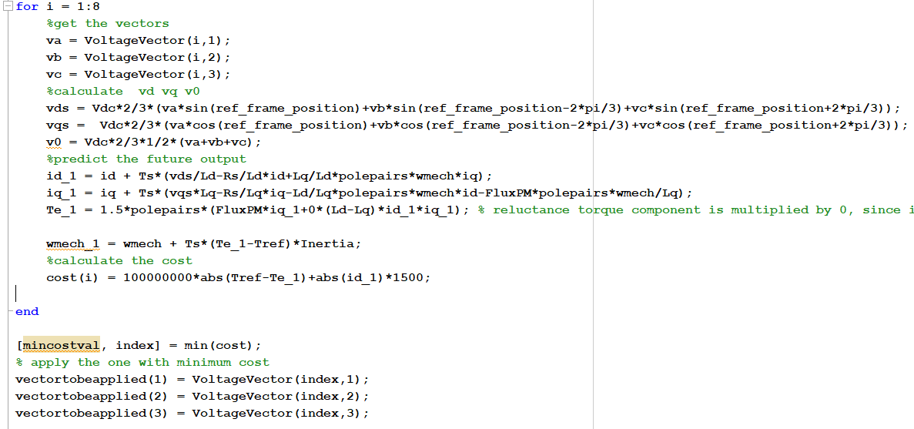

Slide 5
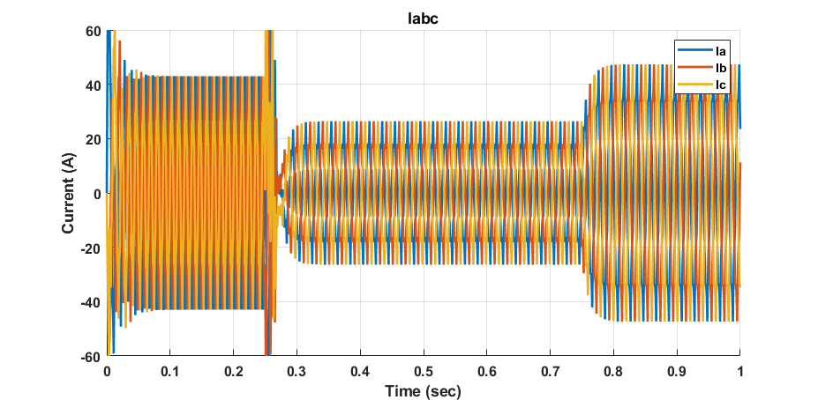
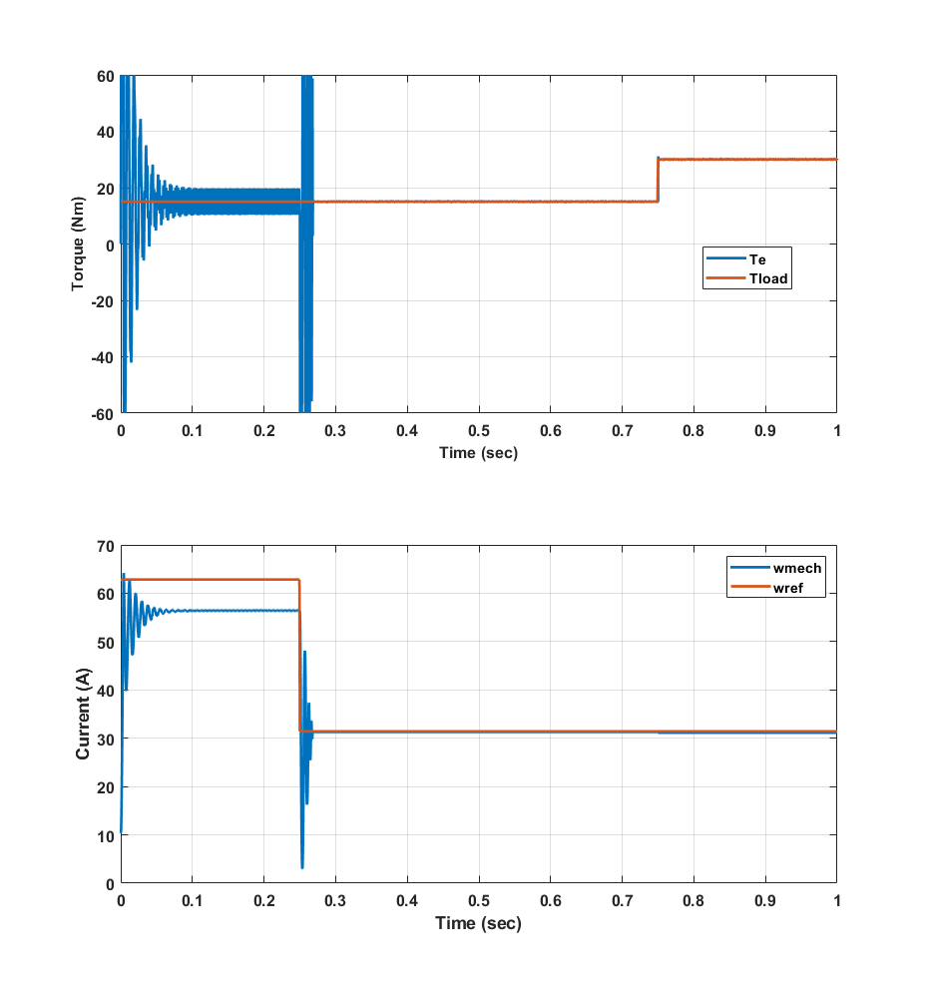
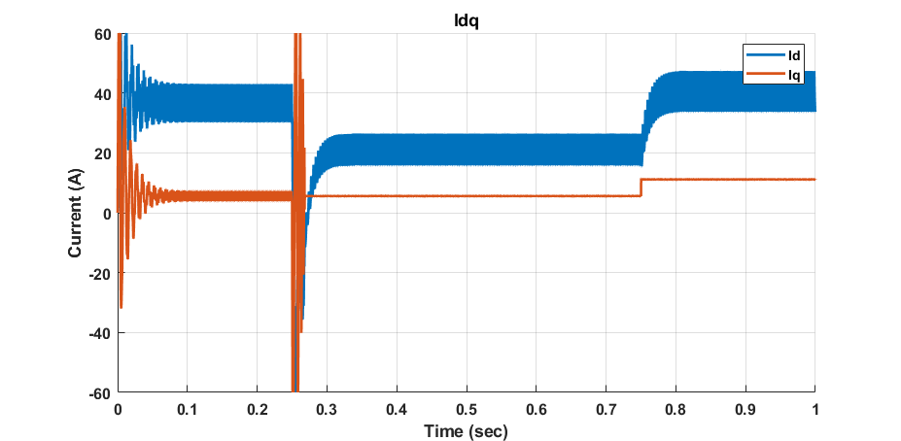
No limit & NO Id penalty & 1MHz
300RPM
15Nm
300RPM
30Nm
600RPM
15Nm

Slide 6
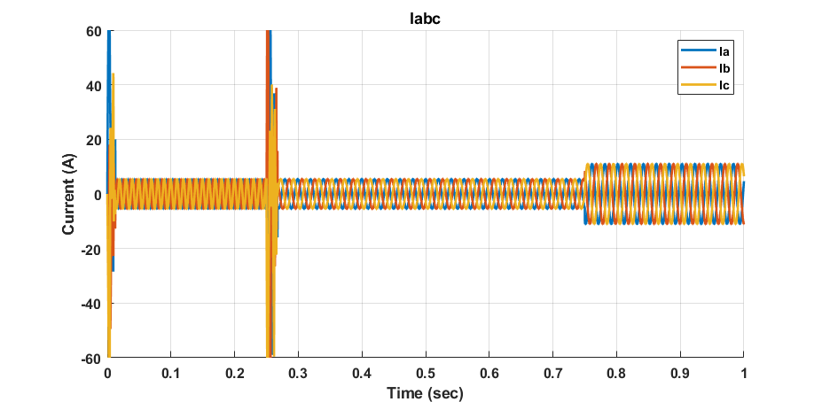
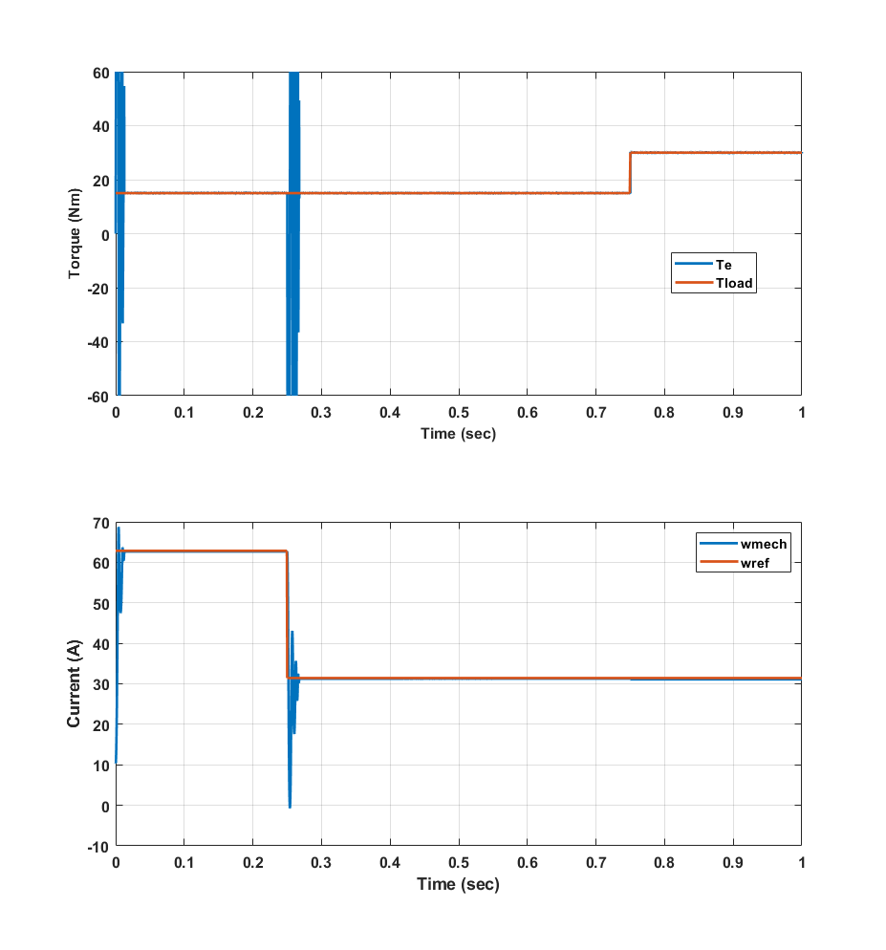
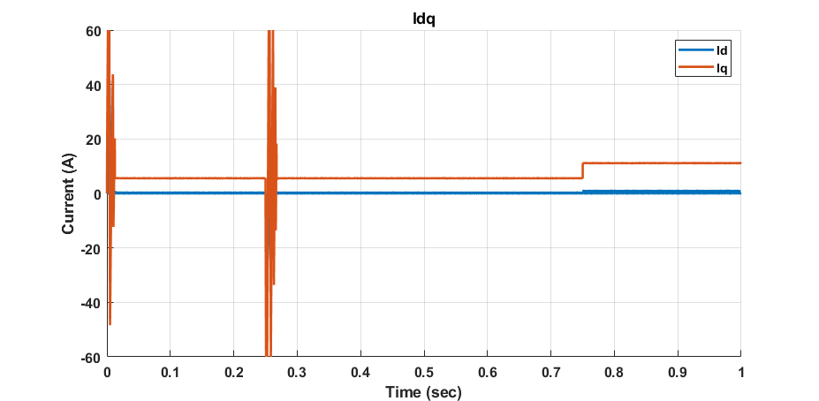
No limit & WITH Id penalty & 1MHz
600RPM
15Nm
300RPM
15Nm
300RPM
30Nm

Slide 7
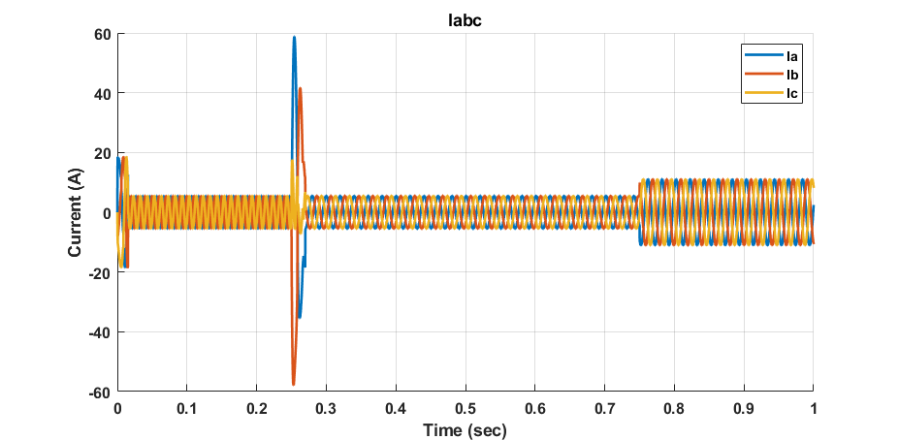
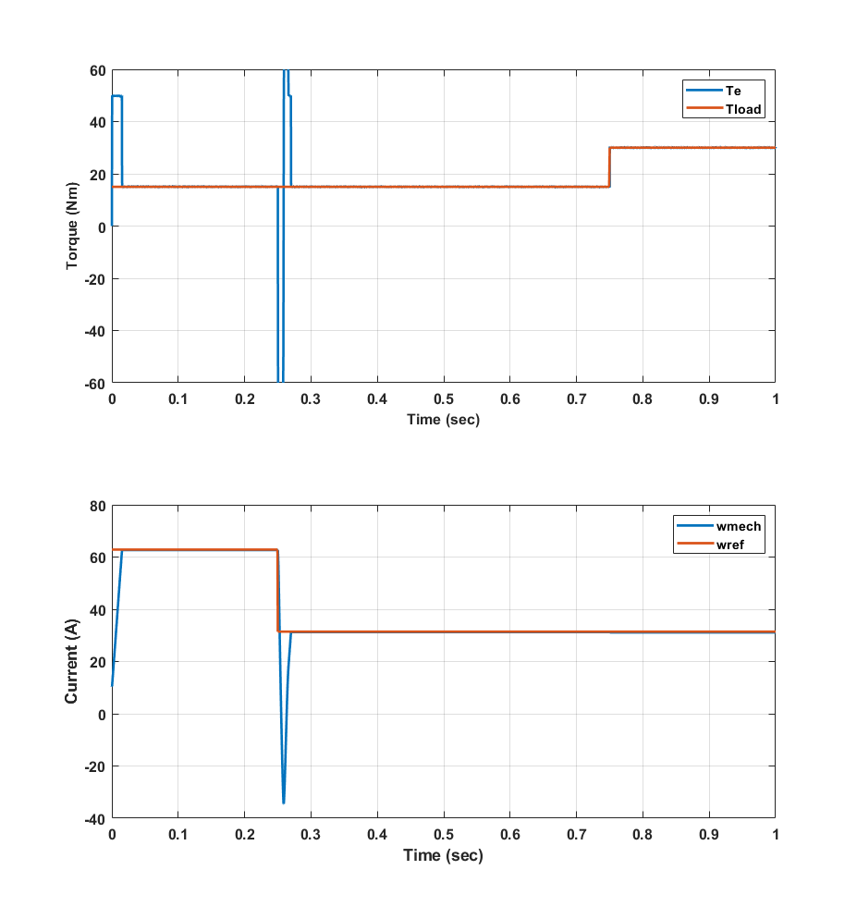
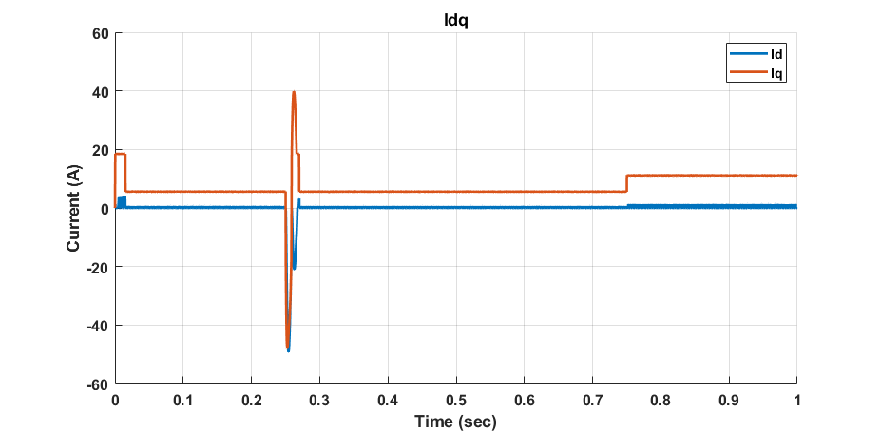
Iq Limit: 30A, Te Limit: 50, WITH Id penalty & 1MHz
600RPM
15Nm
300RPM
15Nm
300RPM
30Nm

Slide 8
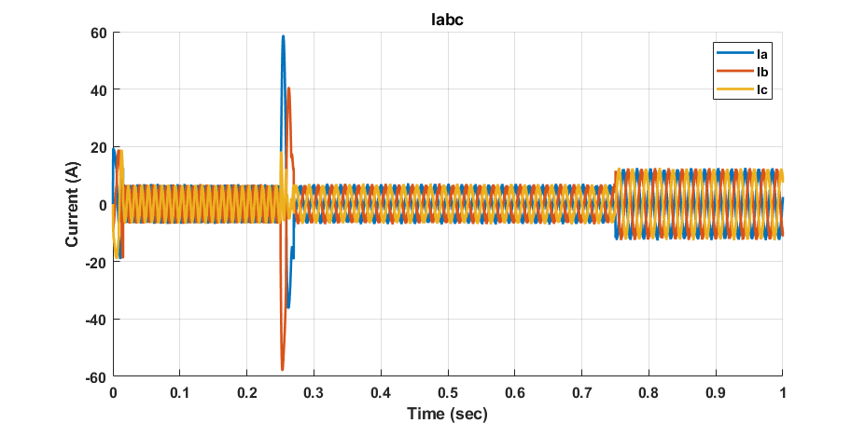
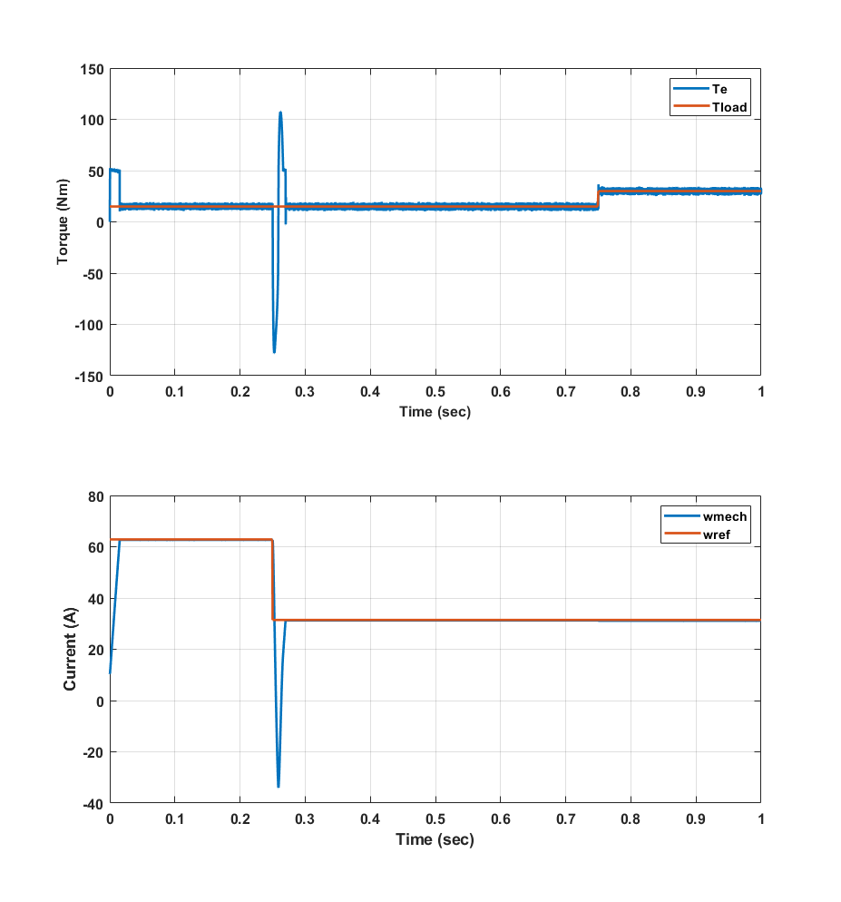
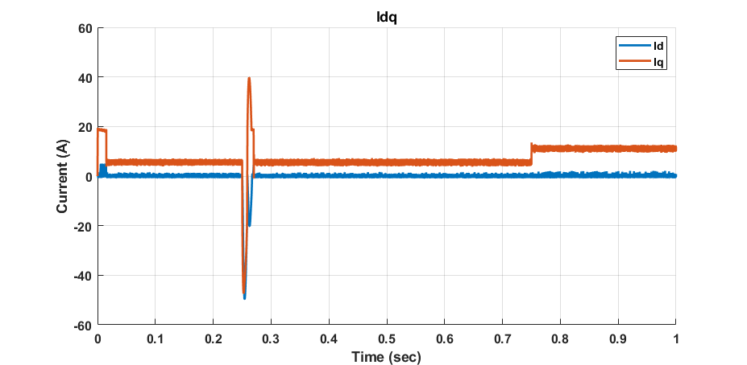
Iq Limit: 30A, Te Limit: 50, WITH Id penalty & 40khz
600RPM
15Nm
300RPM
15Nm
300RPM
30Nm

Slide 9
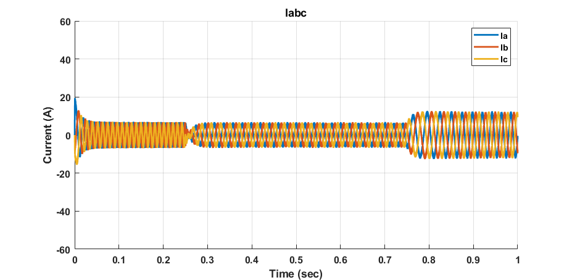
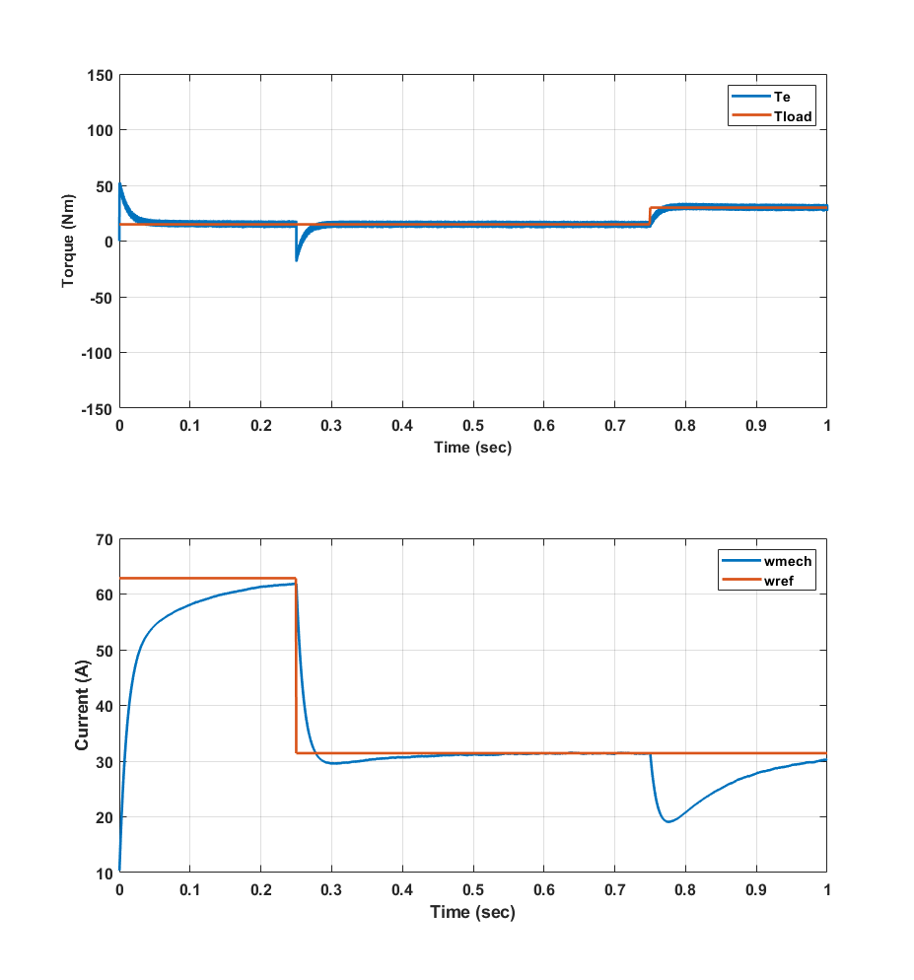
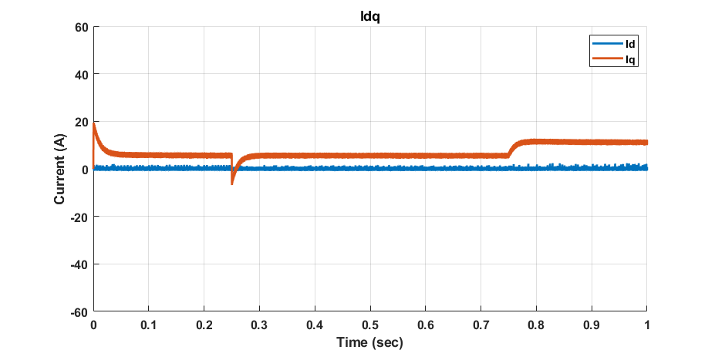
Iq Limit: 30A, Te Limit: 50, WITH Id penalty & 40khz P: 1 , I: 10
600RPM
15Nm
300RPM
15Nm
300RPM
30Nm

Slide 10
Issues & future work
1
Overshoots
Two module implementation and fault analysis
Cost function weight selection
Other costs (switching number , torque ripple)

