Slide 1
LeadAI Trust Framework
Automated AI Governance & Compliance Platform
From Regulations to Trust Scores

Slide 2
Executive Summary
The Challenge
Multiple Regulations
Complex Requirements
Evidence Management
Continuous Monitoring
The Solution
Automated Governance
Evidence-Centric
Continuous Control
Intelligent Reporting

Slide 3
Process Overview - The Big Picture
Entity Assessment
EU AI Act, ISO 42001, NIST AI RMF → Regulatory Input Funnel
Policy & Guardrail Engine → Policies, Guardrails, KPIs, Controls
Evidence Collection → Manual uploads + Automatic integrations (Jira, DB Tables, Asana, etc.)
Evidence Vault → Centralized storage with integrity verification
Control & Audit Process → Human review + AI assistance
Artifact & Scoring Engine → Trust scores
Monitoring & Reporting → Dashboards + Executive reports
Continuous Improvement

Slide 4
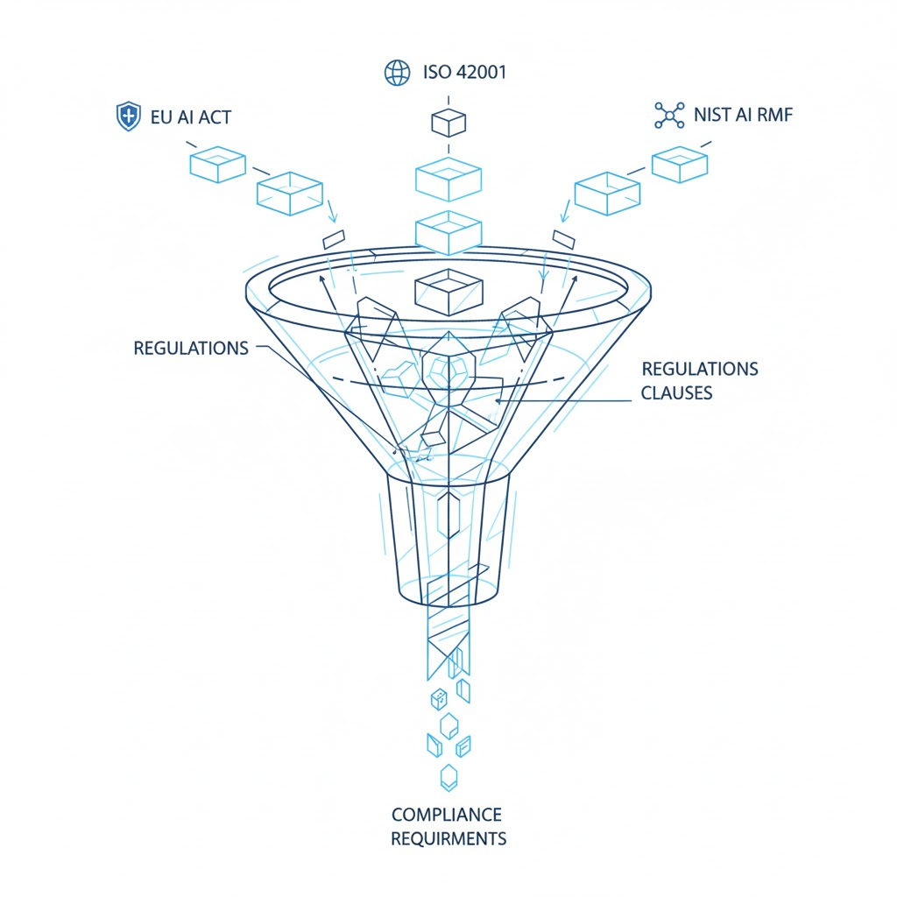
Step 1: Entity Regulatory Needs

Slide 5
Step 2: Validate Compliance req.
EU AI Act:
High-Risk AI Systems (Annex III)
Transparency Requirements (Article 50)
Data Governance (Article 10)
ISO/IEC 42001:
Organizational Context (Clause 4)
Planning & Operation (Clauses 6-8)
Performance Evaluation (Clause 9)
NIST AI RMF:
Govern, Map, Measure, Manage

Slide 6
Step 3: Metric, Action & Policy
Entity Setup (The Organizational Context)
AI Scope (The Boundary)
AI Projects (The Pipeline)
AI Systems (The Inventory)
KPI definition (The Metric)
Control values (The Action)
Policy generation (The Mandate)
Evidence capture (The Proof)
Automatic mapping: Compliance Requirements → Policies
Policy templates and customization
Automatic Guardrail rule definitions
Hard gates (non-negotiable)
Soft gates (warnings)

Slide 7
Step 4: Evidence Collection Layer
Manual Collection:
Direct file uploads
Metadata entry
Control linking
Status tracking
Automatic Integration:
Jira sync (requirements, risks, tests)
REST API endpoints
Scheduled syncs
Webhook support

Slide 8
Step 5: Evidence Vault
Storage:
Centralized repository (S3-compatible)
Version control
Retention policies
Integrity Verification:
SHA-256 hashing
Hash verification
Digital signatures
Metadata Management:
Rich metadata (project, control, status)
Search & discovery
Relationship linking

Slide 9
Step 6: Control & Audit Process
AI-Assisted Review:
Automated analysis
Compliance checking
Anomaly detection
Recommendations
Human Decision:
Evidence verification
Challenge process
Approval workflow
Rejection handling

Slide 10
Step 7: Artifact & Trust Engine
Accepted Evidence → Artifact
Regulation → KPI → Control → Policy → Evidence → Artifact → Score
Trust Scoring:
3 Trust Axes: Safety, Compliance, Provenance
Provenance Levels (Origin trust):
P0 (Fail) to P3 (Excellent)

Slide 11
Full Lifecycle Monitoring & Reporting
Real-Time Dashboard:
Entity-level view
Project-level view
Portfolio-level view
Trust scorecards
KPI trends
Alert summary
Executive Reporting:
Template-based reports
AI-generated summaries
Delivery schedules
Multiple formats (PDF, Excel, PPT)

Slide 12
Recursive Process - Continuous Improvement
The process is recursive and continuous:
1. Regulatory Updates → New/updated requirements
2. Policy Refresh → Update policies and guardrails
3. Evidence Re-collection → Gather new evidence
4. Re-audit & Re-scoring → Verify and recalculate
5. Monitoring & Alerts → Track changes and anomalies
6. Reporting & Feedback → Generate insights
Frequency:
Daily: Evidence collection, score updates
Weekly: Evidence audit, compliance checks
Monthly: Policy review, KPI assessment
Quarterly: Regulatory updates
Annually: Comprehensive audit

Slide 13
Key Benefits & Value Proposition
For Compliance Teams:
Automated mapping: Regulations → Policies → Metrics → Actions
Evidence management: Centralized, verified
Audit trail: Complete traceability
For Risk Management:
Risk visibility: Comprehensive risk register
Risk scoring: Quantified risk levels
Trend analysis: Risk evolution tracking
For Executives:
Executive dashboards: High-level visibility
Automated reporting: AI-powered insights
Trust and alerts: Simple, actionable metrics

Slide 14
Conclusion
LeadAI Trust Framework Delivers:
✅ Automated Governance: From regulations to policies to KPIs
✅ Evidence Management: Centralized, verified, traceable
✅ Continuous Scoring: Real-time trust and compliance scores
✅ Intelligent Reporting: AI-powered executive insights
✅ Recursive Process: Continuous improvement and monitoring
Key Differentiators:
• Regulatory-Agnostic: Supports multiple frameworks
• Evidence-Centric: Built around evidence verification
• Human + AI: Combines AI assistance with human judgment
• Recursive: Self-improving, continuous process

Slide 15
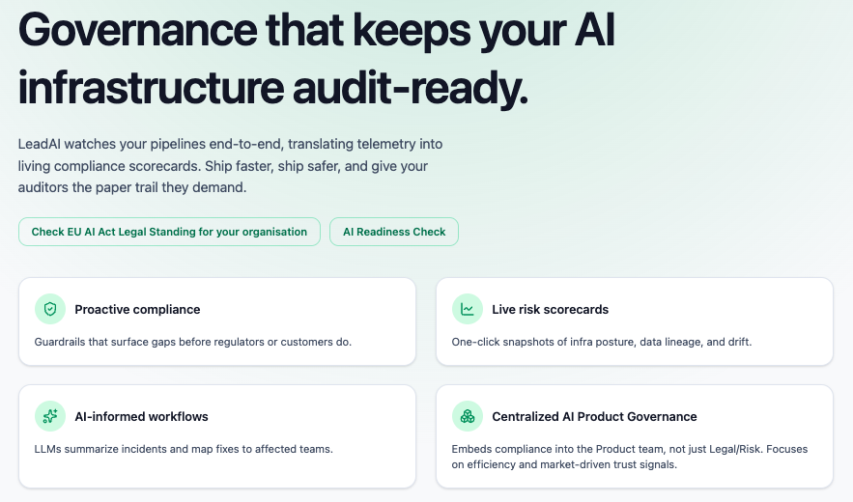

Slide 16
Detailed Process Overview
AI Readiness check
Entity Legal status check (EU AI Act, ISO 42001, NIST AI RMF → Regulatory Input Funnel )
Onboard Entity => Entity created, obligations found
AIMS (AI Management System) scope set
Currently used AI Systems registered
AI related projects registered
AI projects’ KPIs set
Controls set and responsibilities addressed (evidence; which, where, who, when)
Policies set → Policies and Guardrails for the Entity
Evidence Collection → Manual uploads + Automatic integrations (Jira, DB Tables, Asana, etc.)
Evidence Vault → Centralized storage with integrity verification
Control & Audit Process → Human review + AI assistance
Artifact & Scoring Engine → Trust scores
Monitoring & Reporting → Dashboards + Executive reports
Continuous Improvement

