Slide 1
50 EJB 3 Best Practices in 50 Minutes
Michael Remijan – Fusion Technology Solutions
Ryan Cuprak – Dassault Systemès

Slide 2
About Us
Michael
  @mjremijan
  mjremijan@yahoo.com
  http://mjremijan.blogspot.com
  http://linkedin.com/in/mjremijan
Ryan
  @ctjava
  rcuprak@gmail.com
  http://www.cuprak.info

Slide 3

EJB 3 In Action 2nd Edition
Updated For
EE 7
EJB 3.2

Slide 4
#1 Where to use EJBs
Full EE server not needed
Web profiles
  @since 2009
  Introduced in EE 6
  JSF 2.2, CDI 1.1, EJB 3.2 Lite, JPA 2.1, JTA 1.2, bean validation.
TomEE
Resin
GlassFish
WebLogic
WildFly
JBoss App Server
Michael Remijan | Ryan Cuprak | https://github.com/mjremijan/JavaOne

Slide 5
@Singleton
Michael Remijan | Ryan Cuprak | https://github.com/mjremijan/JavaOne

Slide 6
#2 Concurrency
Singleton beans are unique per deployment.
Default concurrency on singleton beans is WRITE.
Default type is CONTAINER
@ConcurrencyManagement
  ConcurrencyManagementType.CONTAINER
    Use @Lock(LockType.READ) – on non-mutable methods
    Use @AccessTimeout() – to reduce the chances of a deadlock.
      value = -1 – Wait indefinitely
      value = 0 – Timeout immediately if locked
      value = 1+ - Wait this many time units (default millis)
      unit = java.util. concurrent.TimeUnit
ConcurrencyManagementType.BEAN
  Program for multiple threads – use sparingly.
Don’t mix approaches!
Michael Remijan | Ryan Cuprak | https://github.com/mjremijan/JavaOne

Slide 7
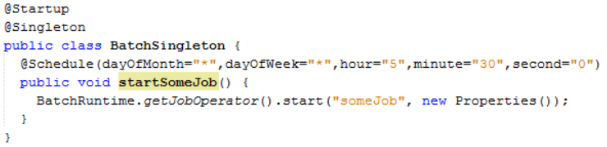
#3 Batch
Use Singletons to schedule batch jobs
Java Batch API (JSR 352)
@Startup – Container starts automatically
@Schedule – CRON scheduler
Michael Remijan | Ryan Cuprak | https://github.com/mjremijan/JavaOne

Slide 8
#4 Batch Server
Common question
  Does the batch API handle clustering?
  No.
How do you handle deployment to a cluster?
  Each cluster will run the job
  Synchronization strategies
    Database lock
    @Resource environment entry
    File system file/directory check
Avoid it all together
  Dedicated server just for batch operations
    Typically need special resources anyway
  Separate from application server stack
Michael Remijan | Ryan Cuprak | https://github.com/mjremijan/JavaOne

Slide 9
@Stateful
Michael Remijan | Ryan Cuprak | https://github.com/mjremijan/JavaOne

Slide 10
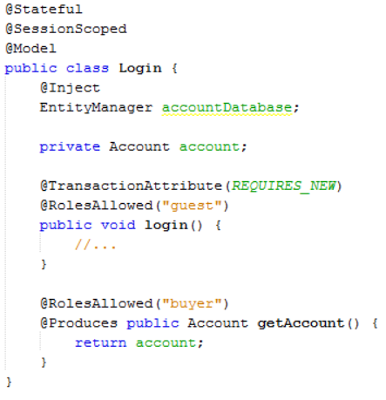
#5 JSF Bean
Stateful bean can store session state
Used directly by JSF
  Target of JSF actions
  Produce bean JSF pages want.
Use CDI instead
  @SessionScoped
  @ConversationScoped
Michael Remijan | Ryan Cuprak | https://github.com/mjremijan/JavaOne

Slide 11
@Stateless
Michael Remijan | Ryan Cuprak | https://github.com/mjremijan/JavaOne

Slide 12
#6 Injection
Am I a POJO?
  @Inject
Am I an EJB?
  @EJB
Answer is YES!
Both are valid
Prefer @Inject for
  @Local, @LocalBean, no-interface EJB
  Running in web profile
Must use @EJB for:
  @Remote EJB
  Running in full EE server
  Remote XA Transactions
Michael Remijan | Ryan Cuprak | https://github.com/mjremijan/JavaOne

Slide 13
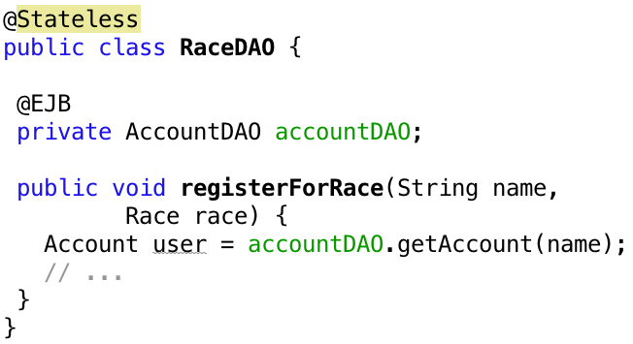
#7 DAO Pattern
Do not implement DAOs as EJBs!
EJB chaining is bad for performance
  Wait for pooled instance?
Pooled!
Michael Remijan | Ryan Cuprak | https://github.com/mjremijan/JavaOne

Slide 14
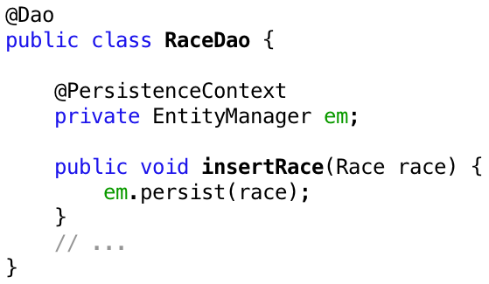
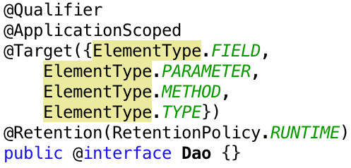
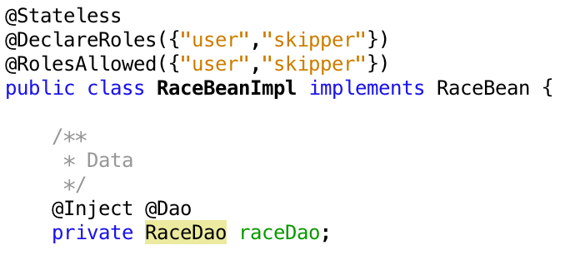
#8 Inject DAO
Michael Remijan | Ryan Cuprak | https://github.com/mjremijan/JavaOne

Slide 15
#9 DTO Pattern
15 years ago
  EJBs are mysterious things
  All EJB calls remote
  Container managed Entity beans
    SQL select for getter methods
Data Transfer Object (DTO) pattern created
  Get massive object with one call
  All data, even unrelated
Now
  EJBs are POJOs
  EJBs are local
  EJBs are injectable
  Avoid the DTO pattern
    Multiple injects to get different data
Michael Remijan | Ryan Cuprak | https://github.com/mjremijan/JavaOne

Slide 16
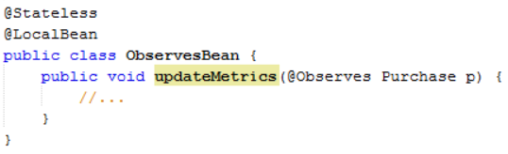
#10 @Observes
EJBs can observe CDI events
Method must be
  Static
  || method on @Local interface
  || public method on @LocalBean
  || public method on no-interace bean
Michael Remijan | Ryan Cuprak | https://github.com/mjremijan/JavaOne

Slide 17
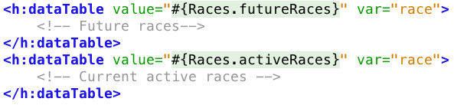
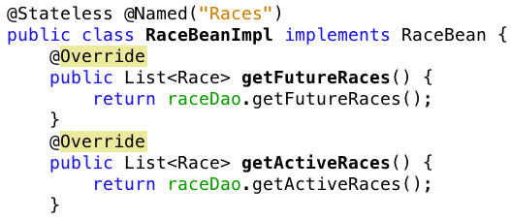
#11 @Named
Beware!
  @Named on EJBs is convenient but dangerous.
  Code below results in 2 transactions in rendering
2 Transactions
Michael Remijan | Ryan Cuprak | https://github.com/mjremijan/JavaOne

Slide 18
#12 Threading
Never been a good idea to do your own threading.
Even worse idea now
  More communication between client and server
    JAX-WS
    JAX-RS
    WebSockets
  All fighting for threads
Threads must be managed
  Use ManagedExecutorService
Michael Remijan | Ryan Cuprak | https://github.com/mjremijan/JavaOne

Slide 19
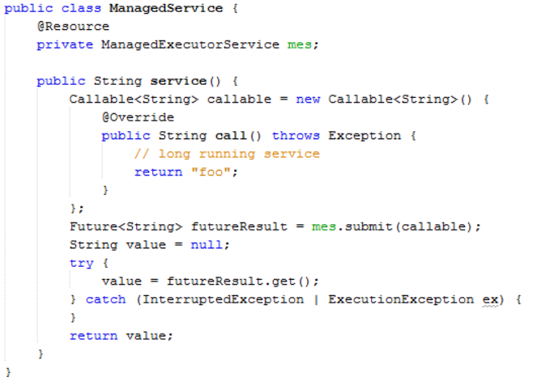
Michael Remijan | Ryan Cuprak | https://github.com/mjremijan/JavaOne

Slide 20
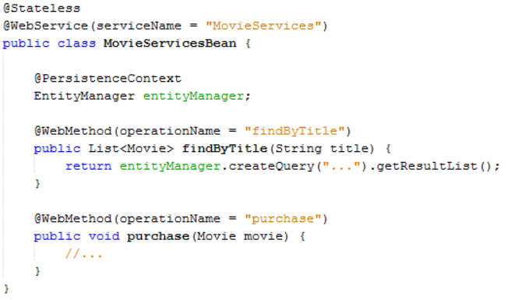
#13 SOAP Web Service
Expose EJB directly as a Web Service
Basically RMI
Michael Remijan | Ryan Cuprak | https://github.com/mjremijan/JavaOne

Slide 21
#14 REST Web Service
Do not expose EJB methods directly as RESTful services.
  Aggregate operations into a single message.
  Service should be a façade over EJBs.
RESTful services are stateless – no Stateful Session Beans.
Stay true to RESTful services design principles:
  PUT/POST/GET/DELETE
Don’t let transport specific code creep into EJBs:
  JsonGenerator, JsonGeneratorFactory, etc.
Michael Remijan | Ryan Cuprak | https://github.com/mjremijan/JavaOne

Slide 22
#15 @Remote Beans
Full EE Server
  EJBs are accessible remotely
  Not available in web profile
Why?
  Heavy CPU or data processing
  Clients need to be transactional
@Remote
  Must be on an interface. . .AccountService
Implementation Bean
  Must implement interface. . .AccountServiceBean
  No-interface bean not allowed
Michael Remijan | Ryan Cuprak | https://github.com/mjremijan/JavaOne

Slide 23
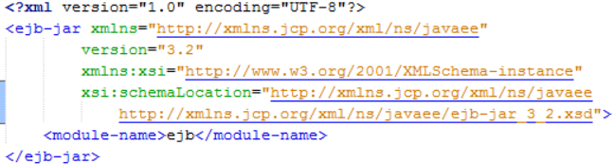
#16 @Remote ejb-xml
ejb-jar.xml
  Use <module-name> to control portable JNDI name
Michael Remijan | Ryan Cuprak | https://github.com/mjremijan/JavaOne

Slide 24

#17 @Remote web.xml
web.xml
  Make funny application-level lookups
  Helps ensure you are getting the right bean
Michael Remijan | Ryan Cuprak | https://github.com/mjremijan/JavaOne

Slide 25
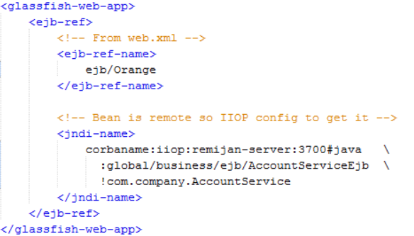
#18 @Remote glassfish-web.xml
Application server specific mapping
  Link funny name to real location in JNDI
  Use EE standard global JNDI name
    Avoid using proprietary names. . .they may change
<module-name>
Michael Remijan | Ryan Cuprak | https://github.com/mjremijan/JavaOne

Slide 26

#19 @Remote Inject as EJB
@Inject cannot be used
  Proxied remote resource
Use @EJB with lookup
  “module” is preferred over “comp”
Michael Remijan | Ryan Cuprak | https://github.com/mjremijan/JavaOne

Slide 27
Security &
Transactions
Michael Remijan | Ryan Cuprak | https://github.com/mjremijan/JavaOne

Slide 28
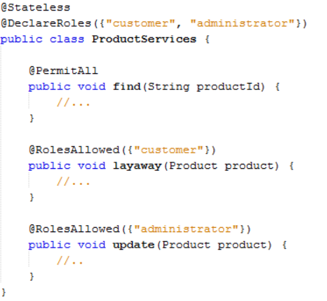
#20 Security in beans
Define @DeclaredRoles
Protect with @RolesAllowed
Michael Remijan | Ryan Cuprak | https://github.com/mjremijan/JavaOne

Slide 29
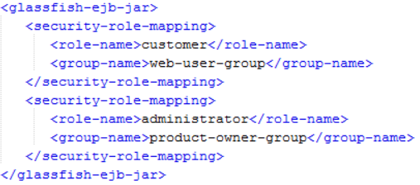
#21 Security mapping
Roles in code
Roles in your enterprise
  Database, LDAP
Not necessarily the same
  Develop code to meet security requirements
  Map code roles to enterprise roles
    Application server specific
    glassfish-ejb-jar.xml
Michael Remijan | Ryan Cuprak | https://github.com/mjremijan/JavaOne

Slide 30

#22 Transactions
This is the default
Let the container handle it
Avoid Bean Managed Transaction!
Michael Remijan | Ryan Cuprak | https://github.com/mjremijan/JavaOne

Slide 31
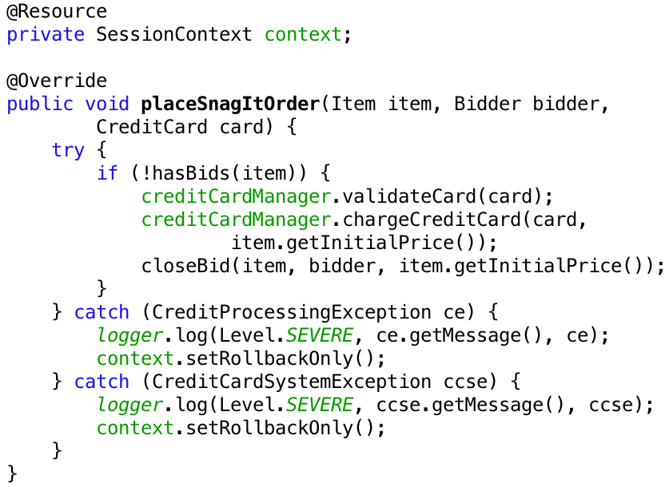
#23 Transaction Rollback
Avoid programmatic rollback!
Error prone
Going to miss a rollback somewhere
Michael Remijan | Ryan Cuprak | https://github.com/mjremijan/JavaOne

Slide 32

#24 Transactions and Exceptions
Don’t assume automatic rollback on Exceptions!
System Exceptions
  Container managed
    Rolled back
  Bean managed
    Marked for rollback
  RemoteException, RuntimeException, EJBException, etc.
Application Exceptions
  No automatic rollback of transaction
  Use @ApplicationException
Michael Remijan | Ryan Cuprak | https://github.com/mjremijan/JavaOne

Slide 33
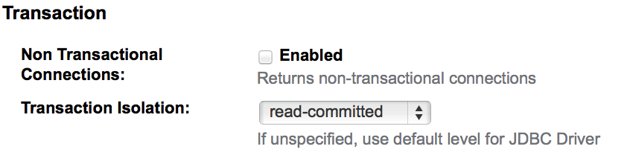
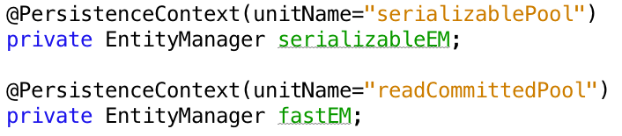
#25 Isolation Levels
Configure your isolation levels on your JDBC pools
Glassfish
Use multiple Persistence Units and different pools to access different isolation levels.
Michael Remijan | Ryan Cuprak | https://github.com/mjremijan/JavaOne

Slide 34
Transaction Isolation Level | Description
read-uncommitted | Dirty reads, non-repeatable reads, and phantom reads can occur.
read-committed | Dirty reads are prevented; non-repeatable reads and phantom reads can occur.
repeatable-read | Dirty reads and non-repeatable reads are prevented; phantom reads can occur.
serializable | Dirty reads, non-repeatable reads and phantom reads are prevented.
Dirty Reads: Technically speaking a dirty read happens when a transaction reads some data that is being changed by another transaction which is not committed yet.
Non-Repeatable Reads: A Non-Repeatable Read happens when a transaction reads some records that another transaction is modifying. If the reader transaction tries the same query within the same transaction again, the result will be different compared to the first time.
Phantom Reads: Occur when we are reading a set of records with a specific WHERE clause and another operation inserts new records matching our WHERE clause. Our transaction has read the records without including the record being inserted.
Michael Remijan | Ryan Cuprak | https://github.com/mjremijan/JavaOne

Slide 35
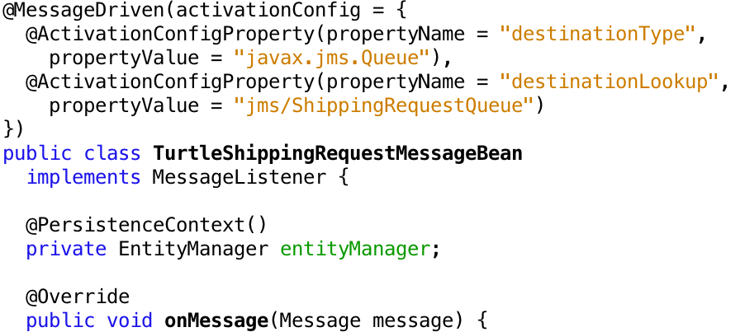
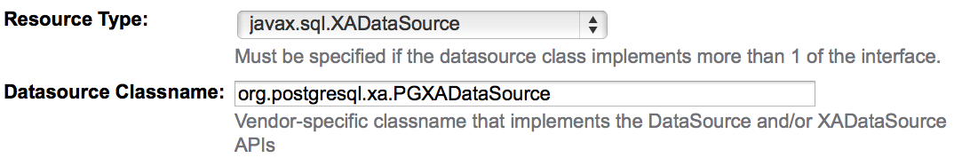
#26 XADataSource
Mixing JMS and Database?
Make sure you configure an XADataSource
GlassFish
Michael Remijan | Ryan Cuprak | https://github.com/mjremijan/JavaOne

Slide 36
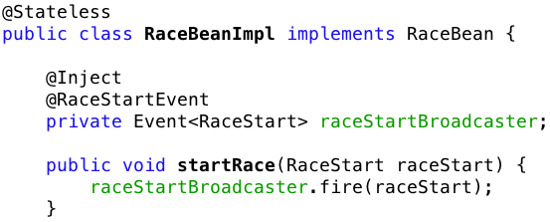
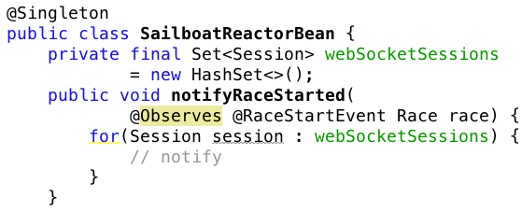
#27 EJB Decoupling
Avoid unnecessary coupling
Use CDI Events
Michael Remijan | Ryan Cuprak | https://github.com/mjremijan/JavaOne

Slide 37
#28 WebSockets
Exposing an EJB as a WebSocket endpoint?
  Not well defined in the Java EE 7 specification
  Implementation specific at this point
Invoking an EJB from a WebSocket endpoint
  Use @Inject or @EJB
  Inject into a WebSocket
Similar to JAX-RS
Stateful and SingleBeans are the best match.
Michael Remijan | Ryan Cuprak | https://github.com/mjremijan/JavaOne

Slide 38
Messaging
Michael Remijan | Ryan Cuprak | https://github.com/mjremijan/JavaOne

Slide 39
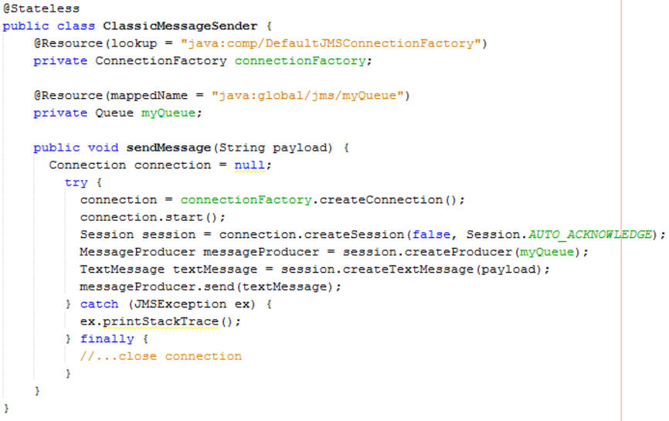
#29 Classic JMS
After 10 years, this classic code can go away! (Arun Gupta)
Michael Remijan | Ryan Cuprak | https://github.com/mjremijan/JavaOne
Notes:
[Michael]
Specify the locking policy on singleton beans. Singleton beans are are unique per JVM. By

Slide 40
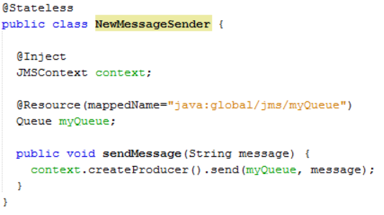
#30 JMSContext
Greatly simplied API (Arun Gupta)
Michael Remijan | Ryan Cuprak | https://github.com/mjremijan/JavaOne

Slide 41
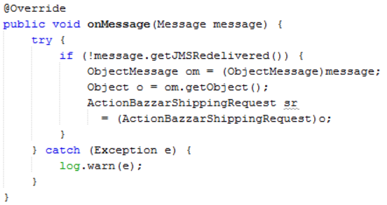
#31 Poison JMS - Redelivery
Message that keeps getting re-delivered!
Use getJMSRedelivered()
Surround with try-catch
Wrong type!
Michael Remijan | Ryan Cuprak | https://github.com/mjremijan/JavaOne

Slide 42
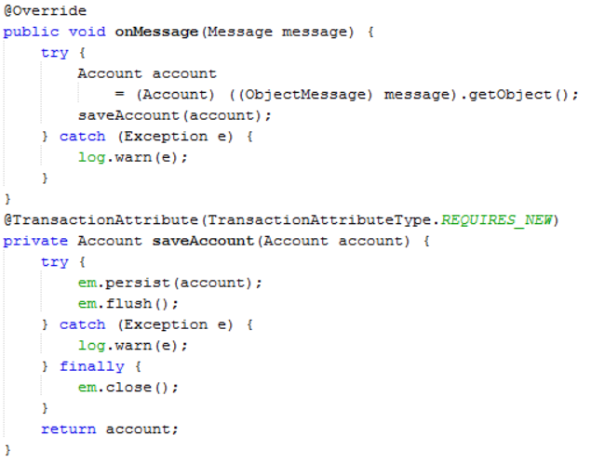
#32 Poison JMS - Transaction
A JPA rollback will cause a JMS rollback
Use helper method with REQUIRES_NEW
Michael Remijan | Ryan Cuprak | https://github.com/mjremijan/JavaOne

Slide 43
Interceptors
Michael Remijan | Ryan Cuprak | https://github.com/mjremijan/JavaOne

Slide 44
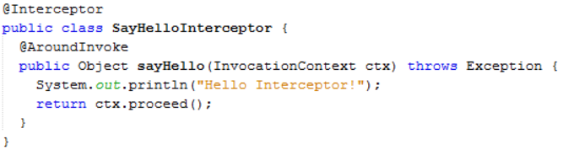
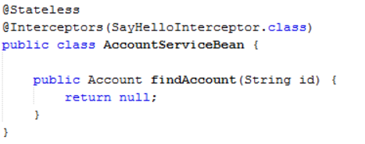
#33 Class Interceptors
Simplified AOP interceptors for around-invoke
Invoked before any of the EJB’s methods are invoked
  Not called again for internal method calls
Michael Remijan | Ryan Cuprak | https://github.com/mjremijan/JavaOne

Slide 45
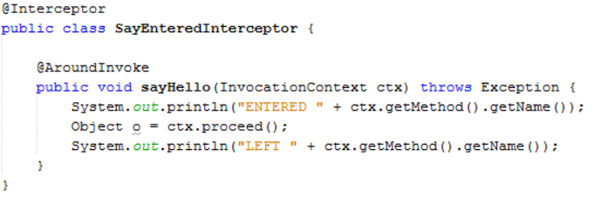
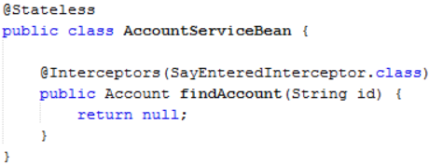
#34 Method Interceptors
Simplified AOP interceptors for around-invoke
Invoked before the specific EJB’s method is invoked
Michael Remijan | Ryan Cuprak | https://github.com/mjremijan/JavaOne

Slide 46
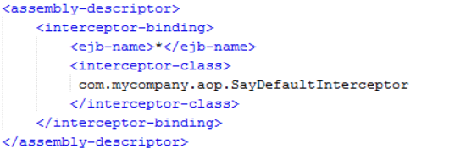
#35 Default Interceptor
The ejb-jar.xml must be used for a default interceptor
Attaches to all methods of every bean
Michael Remijan | Ryan Cuprak | https://github.com/mjremijan/JavaOne

Slide 47
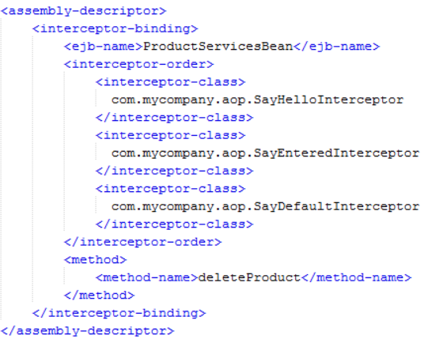
#36 Interceptor Ordering
Called from most general to most specific
  Default -> Class -> Method
Called in the order they appear in XML or annotations
Use ejb-jar.xml to change ordering
Michael Remijan | Ryan Cuprak | https://github.com/mjremijan/JavaOne

Slide 48
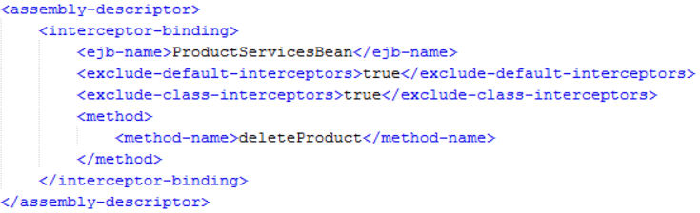
#37 Interceptor Exclusion
All interceptors are applied
Exclusion by annotation
  @ExcludeDefaultInterceptors
  @ExcludeClassInterceptors
Exclusion by ejb-jar.xml
Michael Remijan | Ryan Cuprak | https://github.com/mjremijan/JavaOne

Slide 49
Testing
Michael Remijan | Ryan Cuprak | https://github.com/mjremijan/JavaOne

Slide 50
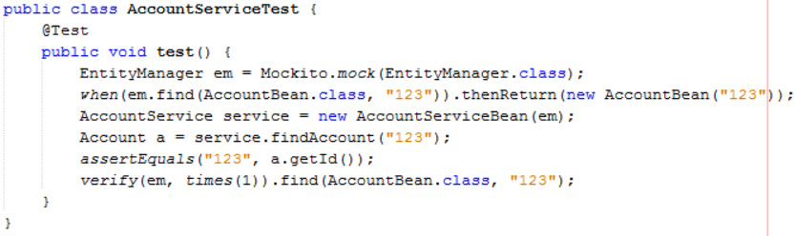
#38 Unit Testing
EJB classes are POJOs!
Unit test one class at a time
Mock external resources
JUnit, Mockito
maven-surefire-plugin
  *Test.java
Michael Remijan | Ryan Cuprak | https://github.com/mjremijan/JavaOne

Slide 51
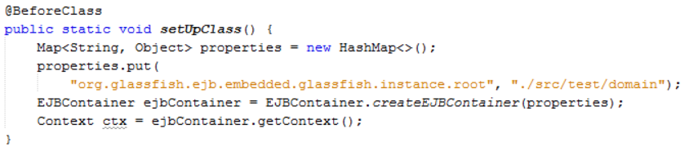
#39 Integration Testing Embedded
Embedded container API
  EJBContainer
Mimic (In-memory) resources
JUnit
maven-failsafe-plugin
  *IT.java
Michael Remijan | Ryan Cuprak | https://github.com/mjremijan/JavaOne

Slide 52

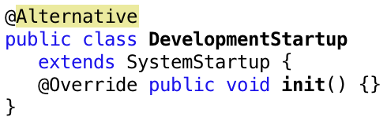
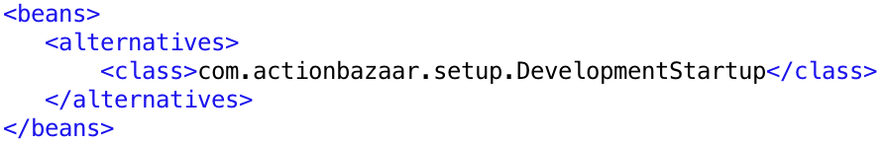
#40 Integration Testing Alternative
Alternatives are additional implementations of a Bean
Ignored by CDI when looking for an injection match
Enabled by beans.xml
Michael Remijan | Ryan Cuprak | https://github.com/mjremijan/JavaOne

Slide 53
Packaging
Michael Remijan | Ryan Cuprak | https://github.com/mjremijan/JavaOne

Slide 54

#41 EAR
Recall global JNDI lookup names for EJBs
Default value for [app-name] is EAR file name.
  ejbrace-business-ear-1.0.0.0-SNAPSHOT.ear
Use application.xml
  <application-name>
  <display-name>
java:<namespace>/[app-name]/<module-name>
/<bean-name>[!fully-qualified-interface-name]
Michael Remijan | Ryan Cuprak | https://github.com/mjremijan/JavaOne

Slide 55

#42 EJB-JAR
Recall global JNDI lookup names for EJBs
Default value for <module-name> is EJB-JAR file name.
  ejbrace-ejb-1.0.0.0-SNAPSHOT.jar
Use ejb-jar.xml
  <module-name>
java:<namespace>/[app-name]/<module-name>
/<bean-name>[!fully-qualified-interface-name]
Michael Remijan | Ryan Cuprak | https://github.com/mjremijan/JavaOne

Slide 56
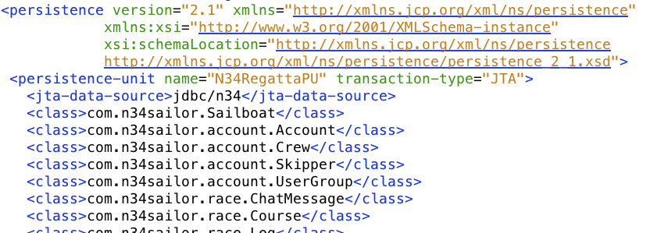
#43 JPA
Auto-scanning for entities not in the JAR with persistence.xml
Core (Entites)
Server
(EJBs)
JavaFX
(Client)
Michael Remijan | Ryan Cuprak | https://github.com/mjremijan/JavaOne

Slide 57
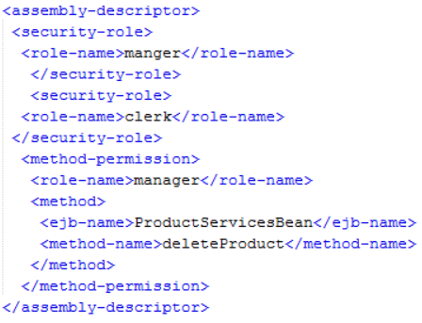
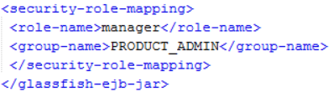
#44 Override Annotations
The ejb-jar.xml can override certain annotations
Method permission
  Annotations allow all roles for testing
  Production adds role security
ebj-jar.xml
glassfish-ejb-jar.xml
Michael Remijan | Ryan Cuprak | https://github.com/mjremijan/JavaOne

Slide 58
#45 Alternatives Per Environment
The bean.xml can specify alternate beans
Have Maven builds for different environments
  Alternatives provide environment specific implementations
Michael Remijan | Ryan Cuprak | https://github.com/mjremijan/JavaOne

Slide 59
#46 Batching EAR
Don’t have batch jobs on you application stack
  Avoid hacks to only get one instance to run
Dedicated batch server
Separate EJB-JAR project
  Job XML documents
  Readers
  Processors
  Writers
EAR project
  Combines Batch EJB-JAR and application EJB-JAR
Michael Remijan | Ryan Cuprak | https://github.com/mjremijan/JavaOne

Slide 60
Miscellaneous
Michael Remijan | Ryan Cuprak | https://github.com/mjremijan/JavaOne

Slide 61
#47 Which Remote Technology?
Remote EJB, JAX-RS, JAX-WS, Servlets
Speed?
Michael Remijan | Ryan Cuprak | https://github.com/mjremijan/JavaOne

Slide 62
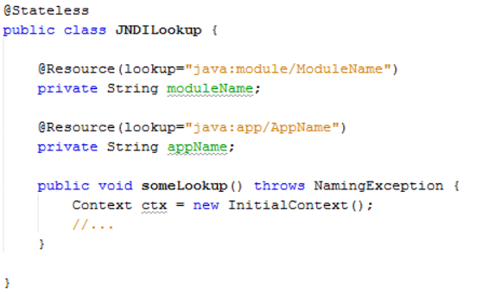
#48 JNDI Lookup
Injection is great
JNDI lookups still needed?
  Changing environment properties
  Non-container managed classes – new SomeBean()
  Multiple resources determined by user input
Michael Remijan | Ryan Cuprak | https://github.com/mjremijan/JavaOne

Slide 63
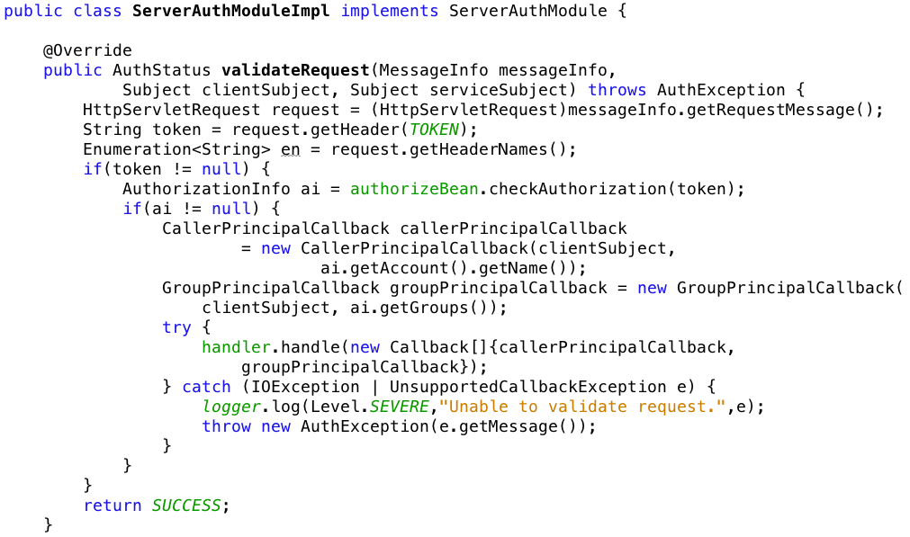
#49 Securing RESTful Services
Use tokens with RESTful Web Services (OWASP).
Leverage JASPIC to setup JAAS environment.

Slide 64

#50 Timers
Use programmatic or declarative timers?
  Programmatic - defined at runtime
  Declarative – annotated methods on an EJB
Considerations:
  Clustering
  Persistence

Slide 65
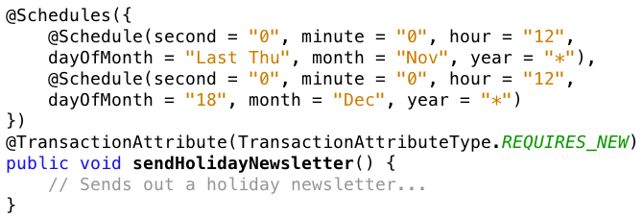
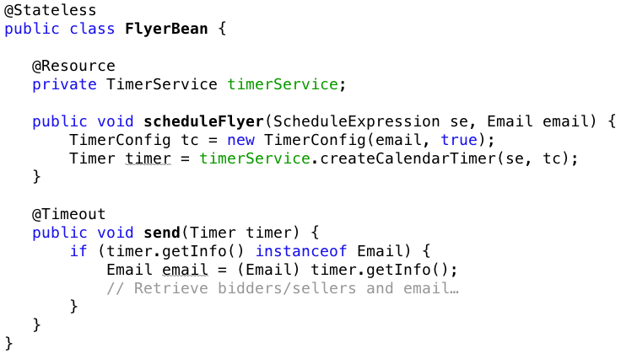
#50 Timers

Slide 66
Final Thoughts
Michael Remijan | Ryan Cuprak | https://github.com/mjremijan/JavaOne

Slide 67

Don’t Panic
Michael Remijan | Ryan Cuprak | https://github.com/mjremijan/JavaOne

Slide 68
Buy the Book
Michael Remijan | Ryan Cuprak | https://github.com/mjremijan/JavaOne

Slide 69

Evangelize
EJB is a super technology
Michael Remijan | Ryan Cuprak | https://github.com/mjremijan/JavaOne

