Slide 1
DUYARLIOL.COM

Slide 2
What is the economic crisis ?
A situation in which the economy of country experiences a sudden downturn brought on by a financial crisis

Slide 3
Reasons of Economic Crisses
Increases of Interest Rates
Increases In Uncertainty
Problems in the Banking Sector

Slide 4
Effects of Economic Crisses
Inflatıon
Increase ın Unemployement
Family and Social Problems
Business Life Problems
Decrease in Housing Prices
Decline the Growth Rate

Slide 5
In The Past
Some Economic Crisses In The World
Great Crises(1929)
The World Economic Crisis is a global crisis that began in the United States and showed its impact all over the world
Black Monday (1987)
The world's stock markets have come to the fore as a result of great depreciation in a short period of time
Global Economic Crisis(2008-2012)
With the collapse of the US mortgage system and the sudden cash shortage in the markets, big monetary companies started to sink and this has happened with a chain effect

Slide 6
How About In Turkey
What is the reason for Economic crisis ?
Big increase in unemployment
Unexpected Increation in Inflatıon
Decrease in Economic Growth
Liquidity problem
Irregular expenditure

Slide 7
What is the effects of economic crisis on Turkey ?
Psychological problems
Unemployment
Family and Social Problems
Reduction in production speed etc..

Slide 8
So ,How About in the Future ?
Individual Economic Crisis is expected instead of Global Economic Crisis by economist.
So , what is the Individual Economic Crisis ?
It ıs a financial crisis in which individuals who is living in that country, are unbalanced spending and overtaking extremly borrowing

Slide 9
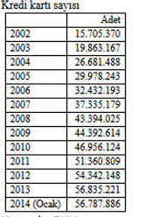
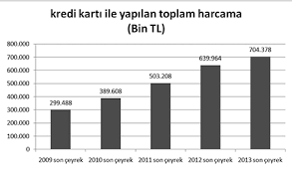
Think about unbalanced spending and overtaking barrowing
Number of Credit Card
Spending Amount

Slide 10
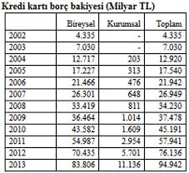
Individual borrowing
As a result of credit card usage, The increase in the debts of individuals. In this case it is a problem of liquidity.
What do we suggest to prevent this situation?

Slide 11
DUYARLIOL
So, what does it means ?
Motion tracking system
Put the user to the test
Give the advice that need or not need
Make a second thought

Slide 12
Why we choose ?
Too many online shopping
Incentive instead of prevent
The financial situation of the people
Change spending habits
Control expenditures

Slide 13
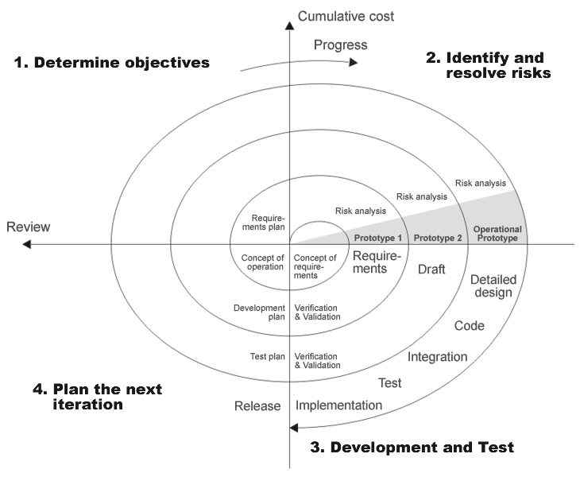
So, How will we follow a path?
As you see on the picture , we will use spiral model for our project.
Risk analysis and planning
Analysis design and coding
Prototyping after each design
Risk analysis and planning again for existing prototype
We have 4 stages
Planning
Risk analysis
Engineering
Evaluation

Slide 14
What do we know about 4 stages?
Planning :determining the requirements and alternative approaches
Risk analysis :Alternative solution is examined,identfy the whole risk and produce a prototype
Engineering : make a test and produce software
Evaluation :Before entering the next spiral loop, Previous project is evaluated

Slide 15
Determining the requirements
Functional Requirements
Unfunctional Requirements
Facebook and Gmail login
Register personal information
Survey
Give an advice
Use chrome extensions
Performance
Scalability
Security
Maintainability
Usability
Availability

Slide 16
Why do we need requirement analysis ?
Determine software and system limitations
Solve the requirements
Determine of the quality of the system
Increase the requirements for quality
Classify requirements
So , how do we plan the development process?

Slide 17
Development Process
Design Website
Design Database and Use Azure Platform
Creating a Web Service
Creating Chrome Extensions
Which development tools do we will use ?

Slide 18
Development tools
ASP.NET
CSS
JAVA SCRİPT
HTML
AZURE
MYSQL
POLYMER

Slide 19
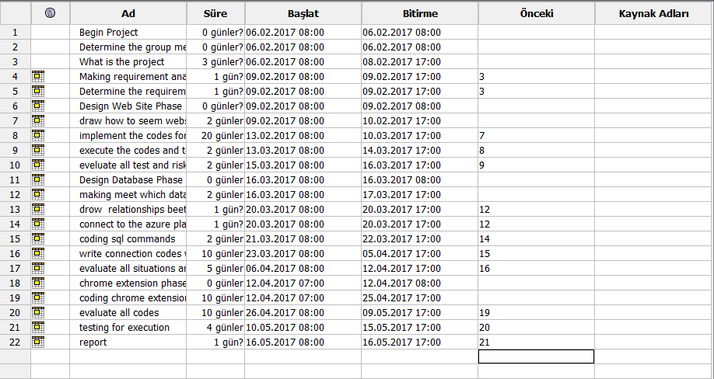
When ?

Slide 20
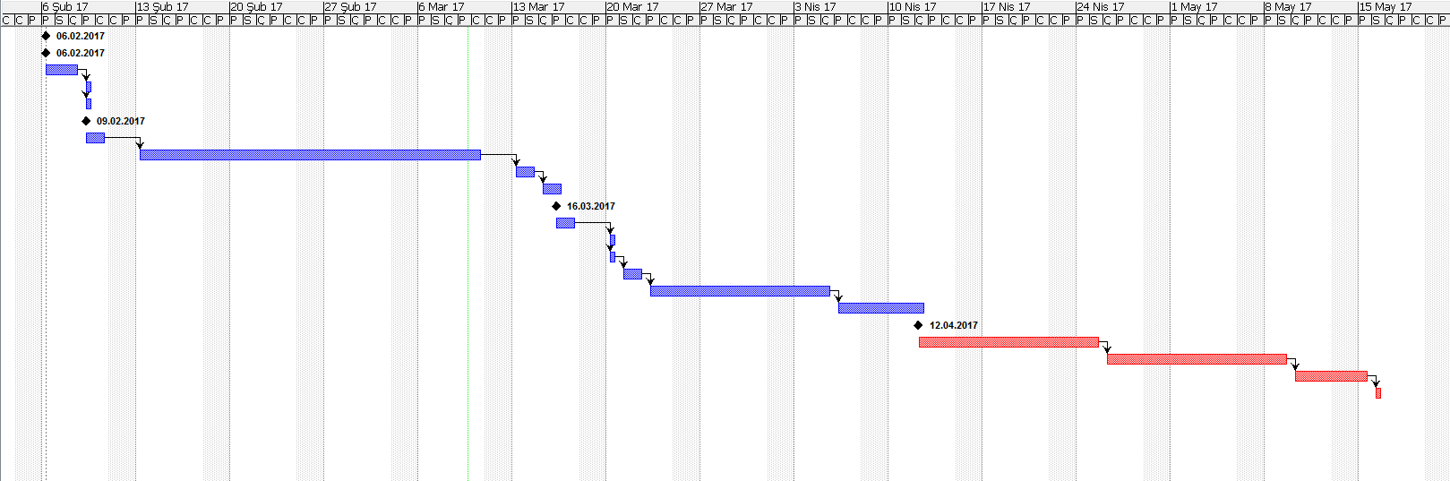

Slide 21
THANK YOU

