Slide 1
DUYARLI.OL
Duyarlı.Ol

Slide 2
What is the economic crisis?
A situation in which the economy of country experiences a sudden downturn brought on by a financial crisis

Slide 3
Reasons of Economic Crisses
Reasons of Economic Crisis
Increases of Interest Rates
Increases of Uncertainty
Effects of the asset market on the balance sheet
Problem in the banking sector

Slide 4
Effects of Economic Crisses
Effects of Economic Crisis
Inflation
Increase in Unemployement
Decline the Growth Rate
Business Life Problems
Family and Social Problems

Slide 5
In The Past
In the Past
Some Economic Crisses In The World
Great Crises(1929)
The World Economic Crisis is a global crisis that began in the United States and showed its impact all over the world
Black Monday (1987)
The world's stock markets have come to the fore as a result of great depreciation in a short period of time
Global Economic Crisis(2008-2012)
With the collapse of the US mortgage system and the sudden cash shortage in the markets, big monetary companies started to sink and this has happened with a chain effect
Some Economic Crisses In The World
Great Crises(1929)
The World Economic Crisis is a global crisis that begain in the US and showedits impact all over the World.
Black Monday(1987)
The World‘s stock markets have come to the fore as a result of great depreciation in a short period of time.
Global Economic Crisis(2008-2012)
With the collapse of the US mortgage system and the sudden cash shortage in the markets, big monetary companies started to sink and this has happened with a chain effect.

Slide 6
How About In Turkey
How about in Turkey?
What is the reason for Economic Crisis?
Big increases in Unemployement
Unexpected Increation in Inflation
Decrease in Economic Growth
Liquidity Problem
Irregular Expenditure

Slide 7
So ,How About in the Future ?
So, How about the future?
Individual Economic Crisis is expected instead of Global Economic Crisis by economists.
It is a financial crisis in which individuals who is living in that country, are unbalanced spending and overtaking extremly borrowing

Slide 8
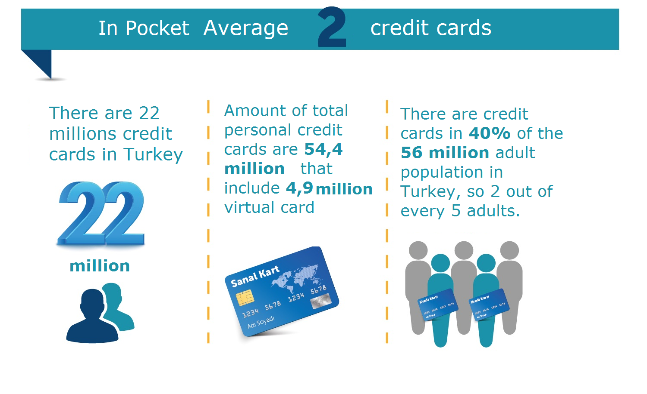
Think about Unbalanced Spending and Overtaking Barrowing
Year | # of Credit Cards
2002 | 15.705.370
2004 | 26.863.167
2006 | 29.978.243
2008 | 43.394.025
2010 | 46.956.124
2012 | 54.342.148
2014 | 56.787.886
2016 | 58.795.476

Slide 9
BKM 2016 Card-based payment transactions from the Internet
2016 YILI
Session | İşlem Adedi |  |  |  |  |  | İşlem Tutarı (Milyon TL)
 | Domestic and International Use of Local Cards |  |  | Domestic Use of Domestic and Foreign Cards |  |  | Domestic and International Use of Local Cards |  |  | Domestic Use of Domestic and Foreign Cards
 | Domestic | Abroad | Total | Local Card | Foreign Card | Total | Domestic | Abroad | Total | Local Card | Foreign Card | Total
OCAK | 21.585.017 | 3.981.356 | 25.566.373 | 21.585.017 | 674.890 | 22.259.907 | 5.066,46 | 480,12 | 5.546,58 | 5.066,46 | 382,14 | 5.448,60
ŞUBAT | 20.436.710 | 3.934.457 | 24.371.167 | 20.436.710 | 464.809 | 20.901.519 | 4.590,60 | 422,84 | 5.013,44 | 4.590,60 | 348,3 | 4.938,91
MART | 22.375.845 | 4.287.095 | 26.662.940 | 22.375.845 | 541.047 | 22.916.892 | 4.981,53 | 463,42 | 5.444,95 | 4.981,53 | 396,16 | 5.377,70
1. DÖNEM | 64.397.572 | 12.202.908 | 76.600.480 | 64.397.572 | 1.680.746 | 66.078.318 | 14.638,60 | 1.366,38 | 16.004,98 | 14.638,60 | 1.126,61 | 15.765,21
NISAN | 20.823.540 | 4.050.812 | 24.874.352 | 20.823.540 | 702.434 | 21.525.974 | 4.554,47 | 460,09 | 5.014,56 | 4.554,47 | 461,16 | 5.015,63
MAYIS | 21.825.960 | 4.353.750 | 26.179.710 | 21.825.960 | 700.759 | 22.526.719 | 5.368,02 | 490,26 | 5.858,29 | 5.368,02 | 454,86 | 5.822,89
HAZIRAN | 20.917.714 | 4.176.207 | 25.093.921 | 20.917.714 | 710.851 | 21.628.565 | 5.447,17 | 469,4 | 5.916,57 | 5.447,17 | 465,6 | 5.912,77
2. DÖNEM | 63.567.214 | 12.580.769 | 76.147.983 | 63.567.214 | 2.114.044 | 65.681.258 | 15.369,66 | 1.419,75 | 16.789,41 | 15.369,66 | 1.381,63 | 16.751,29
TEMMUZ | 19.346.080 | 3.790.408 | 23.136.488 | 19.346.080 | 688.591 | 20.034.671 | 5.270,10 | 385,15 | 5.655,25 | 5.270,10 | 448,54 | 5.718,65
AĞUSTOS | 22.364.239 | 4.088.895 | 26.453.134 | 22.364.239 | 773.097 | 23.137.336 | 6.157,22 | 449,3 | 6.606,52 | 6.157,22 | 499,32 | 6.656,54
EYLÜL | 19.450.096 | 4.113.612 | 23.563.708 | 19.450.096 | 694.093 | 20.144.189 | 5.050,72 | 423,01 | 5.473,73 | 5.050,72 | 402,69 | 5.453,40
3. DÖNEM | 61.160.415 | 11.992.915 | 73.153.330 | 61.160.415 | 2.155.781 | 63.316.196 | 16.478,04 | 1.257,47 | 17.735,51 | 16.478,04 | 1.350,55 | 17.828,59
EKIM | 21.588.654 | 4.543.561 | 26.132.215 | 21.588.654 | 593.477 | 22.182.131 | 5.112,98 | 457,5 | 5.570,48 | 5.112,98 | 355,41 | 5.468,39
KASIM | 23.122.472 | 4.645.148 | 27.767.620 | 23.122.472 | 497.166 | 23.619.638 | 6.131,43 | 463,36 | 6.594,79 | 6.131,43 | 345,67 | 6.477,10
ARALIK | 22.616.595 | 4.433.236 | 27.049.831 | 22.616.595 | 475.835 | 23.092.430 | 5.748,17 | 440,16 | 6.188,33 | 5.748,17 | 329,76 | 6.077,93
4. DÖNEM | 67.327.721 | 13.621.945 | 80.949.666 | 67.327.721 | 1.566.478 | 68.894.199 | 16.992,58 | 1.361,02 | 18.353,60 | 16.992,58 | 1.030,85 | 18.023,43
2016 YILI | 256.452.922 | 50.398.537 | 306.851.459 | 256.452.922 | 7.517.049 | 263.969.971 | 63.478,88 | 5.404,61 | 68.883,49 | 63.478,88 | 4.889,64 | 68.368,52

Slide 10
Individual borrowing
Individual Borrowing
Credit Card Debt Balance (Billion TL)
As a result of credit card usage,
The increase in the debts of individuals. In this case it is a problem of liquidity.
What do we suggest to prevent this situation?
 | Bireysel | Kurumsal | Toplam
2002 | 4.335 | - | 4.335
2003 | 7.030 | - | 7.030
2004 | 12.717 | 203 | 12.920
2005 | 12.227 | 313 | 17.540
2006 | 21.466 | 476 | 21.942
2007 | 26.301 | 648 | 26.949
2008 | 33.419 | 811 | 34.230
2009 | 36.464 | 1.014 | 37.478
2010 | 43.582 | 1.609 | 45.191
2011 | 54.987 | 2.954 | 57.941
2012 | 70.435 | 5.701 | 76.136
2013 | 83.806 | 11.136 | 94.942

Slide 11
DUYARLIOL
Duyarli.Ol
Motion tracking system
Put the user to the test
Give the advice that need or not need
Make a second thought

Slide 12
Why we choose ?
Why We Choose?
Too many online shopping
Incentive instead of prevent
The financial situation of the people
Change spending habits
Control expenditures

Slide 13
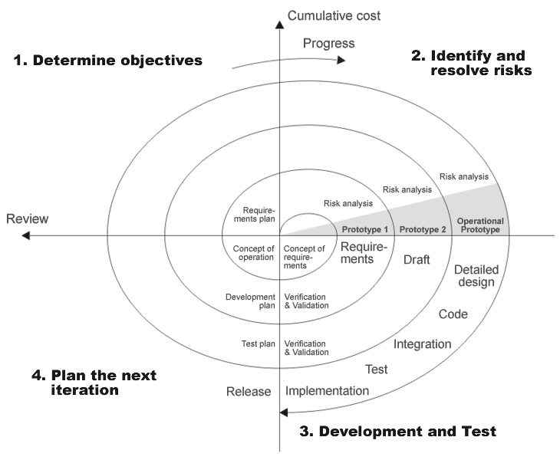
So, How will we follow a path?
As you see on the picture,
we will use spiral model for our project.
Risk analysis and planning
Analysis design and coding
Prototyping after each design
Risk analysis and planning again for existing prototype
We have 4 stages
Planning
Risk analysis
Engineering
Evaluation

Slide 14
What do we know about 4 stages?
Planning :determining the requirements and alternative approaches
Risk analysis :Alternative solution is examined,identfy the whole risk and produce a prototype
Engineering : make a test and produce software
Evaluation :Before entering the next spiral loop, Previous project is evaluated

Slide 15
Determining the requirements
Determining Requirements
Functional Requirements Unfunctional Requirements
Facebook and Gmail login
Fill the User Income, Outcome and Credit Card Details
Monitor and organize User Information
Use Chrome extension
Following user interaction in e-commercial website.
Test
Give an advice
Performance
Scalability
Security
Maintainability
Usability
Availability

Slide 16
Development Process
Development Process
Design Database and Use Azure Platform
Design Website
Creating a Web Service
Creating Chrome Extension
Which development tools do we will use ?

Slide 17
Development tools
Development Tools
ASP.NET
CSS
Javascript
HTML
AZURE
MSSQL
POLYMER (Web Components)

Slide 18
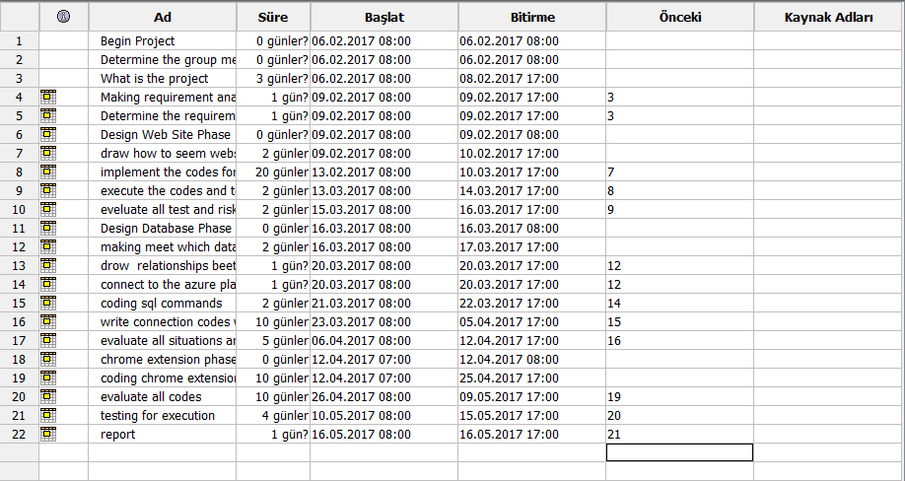
When ?
When?

Slide 19
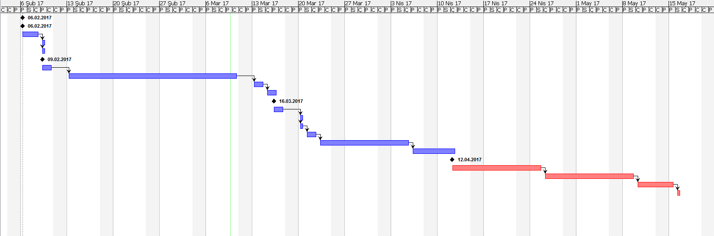
When? (Continue)

Slide 20
THANK YOU FOR LISTENING
Duyarli.Ol is a susceptibility campaign!
Hakan YILDIZ – Okan OZTABAN

