Slide 1
DUYARLIOL.COM

Slide 2
What is the economic crisis ?
A situation in which the economy of country experiences a sudden downturn brought on by a financial crisis

Slide 3
Reasons of Economic Crisses
Increases of Interest Rates
Increases In Uncertainty
Problems in the Banking Sector

Slide 4
Effects of Economic Crisses
Inflatıon
Increase ın Unemployement
Family and Social Problems
Business Life Problems
Decrease in Housing Prices
Decline the Growth Rate

Slide 5
In The Past
Some Economic Crisses In The World
Great Crises(1929)
The World Economic Crisis is a global crisis that began in the United States and showed its impact all over the world
Black Monday (1987)
The world's stock markets have come to the fore as a result of great depreciation in a short period of time
Global Economic Crisis(2008-2012)
With the collapse of the US mortgage system and the sudden cash shortage in the markets, big monetary companies started to sink and this has happened with a chain effect

Slide 6
How About In Turkey
What is the reason for Economic crisis ?
Big increase in unemployment
Unexpected Increation in Inflatıon
Decrease in Economic Growth
Liquidity problem
Irregular expenditure

Slide 7
What is the effects of economic crisis on Turkey ?
Psychological problems
Unemployment
Family and Social Problems
Reduction in production speed etc..

Slide 8
So ,How About in the Future ?
Individual Economic Crisis is expected instead of Global Economic Crisis by economist.
So , what is the Individual Economic Crisis ?
It ıs a financial crisis in which individuals who is living in that country, are unbalanced spending and overtaking extremly borrowing

Slide 9
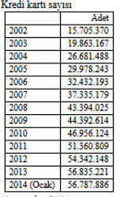
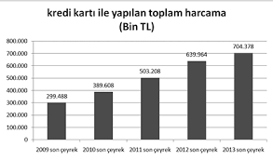
Think about unbalanced spending and overtaking barrowing
Number of Credit Card
Spending Amount

Slide 10
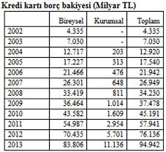
Individual borrowing
As a result of credit card usage, The increase in the debts of individuals. In this case it is a problem of liquidity.
What do we suggest to prevent this situation?

Slide 11
DUYARLIOL
So, what does it means ?
Motion tracking system
Put the user to the test
Give the advice that need or not need
Make a second thought

Slide 12
Why we choose ?
Too many online shopping
Incentive instead of prevent
The financial situation of the people

