Slide 1

JAVA Basic

Slide 2

Java first thought
Java is case sensitive ( hello vs Hello) different
Object – states and behavior
Class – template or blueprint
Methods : action behavior
Instance Variables – unique set of instance variables.
Class Names : name should start first letter Upper case. Ex : MyFirstClass
Method names : should start first letter lower case : ex : myMethodName()
Source code file extension : .java , compile , .class

Slide 3
Variable
Every variable must have a data type.
Two types of data type
Primitive
Reference
Scope
Private
None specifier - default
Protected
Public
Naming Rule - identifier
Begin with letter (A to Z or a to z), currency character ($) or an underscore (_)
Variable name is case sensitive
Keyword can not be used as identifier
Legal naming : age, $salary , _post
Illegal naming : 123age, -salary

Slide 4
Final Variables
Declare in any scope
The value can not be changed
It is used to declare the “Constant”
public static final int JAVA_LESSON = 1;
public static void main(String[] args) {
JAVA_LESSON = 2; //Error
}

Slide 5
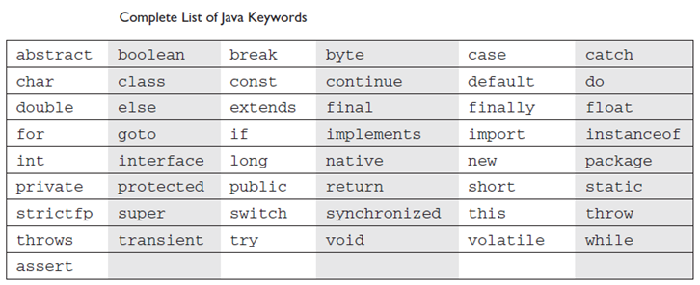
Keywords

Slide 6
Comments
// This is a comment
/* This is a comment too */
/* This is a
multiline
comment */

Slide 7
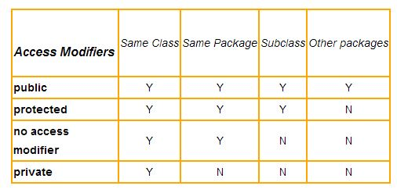
Scope

Slide 8
Data Type
Type | Explanation
int | A 32-bit (4-byte) integer value
short | A 16-bit (2-byte) integer value
long | A 64-bit (8-byte) integer value
byte | An 8-bit (1-byte) integer value
float | A 32-bit (4-byte) floating-point value
double | A 64-bit (8-byte) floating-point value
char | A 16-bit character using the Unicode encoding scheme
boolean | A true or false value
Primitive type
Reference Type
Integer
Short
Long …

Slide 9
Reference Type
Based on a class
Difference from primitive type is memory location
Primitive Type -> actual value
Reference Type -> address (pointer)

Slide 10
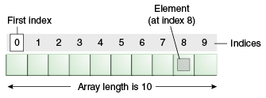
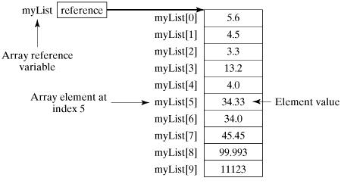
Array
Syntax
dataType[] arrayRefVar; // preferred way.
or
dataType arrayRefVar[];// works but not preferred way.
int[] arrayValue; or
Int arrayValue[];
double[] doubleAarray;
Accessing array
Create Arrays
type[] var = new type[size];
Int[] value = new int[10];
type[] var = {val1,val2,…};
Int[] value = {1,3,4,5};

Slide 11
Basic Operators
Arithmetic Operators
Relational Operators
Bitwise Operators
Logical Operators
Assignment Operators
Misc Operators

Slide 12
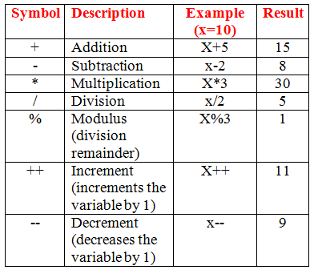
Arithmetic Operators
+ (addition) : ex 20+30
- (subtraction) ex : 20-12
* (multiple)
/ (division)
% (Modulus) – 3%2 = 1
++ (increment) : incrase by 1 a=3 ; a++
- - ( decrement) : decrase by 1 b=4; b--;

Slide 13
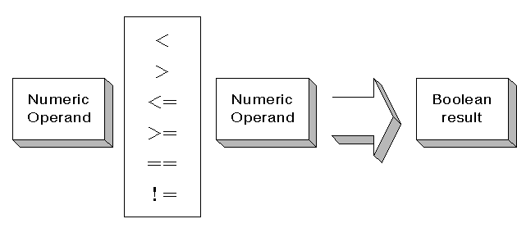
Relational Operators
Check 2 operands true or not
== (equal to) - a == b
!= (not equal to) a != b
> (greater than) a > b
< (less than) a < b
>= (greater than or equal to) – a >= b
<= (less than or equal to) - a <=b

Slide 14
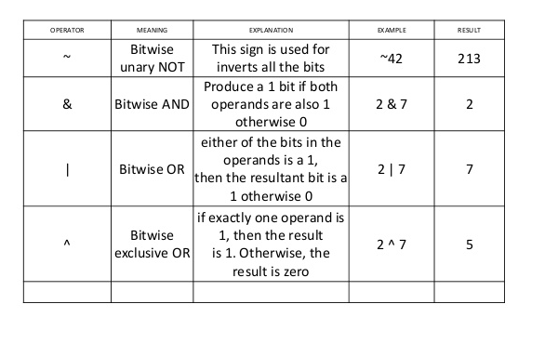
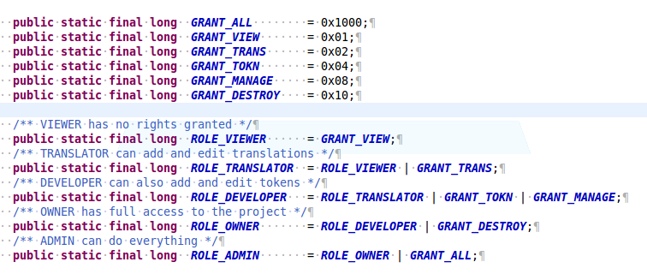
Bitwise Operators
applied to the integer types, long, int, short, char, and byte.
& (bitwise and)
|(bitwise or)
^ (bitwise XOR)
~ (bitwise compliment)
<< (left shift)
>> (right shift)

Slide 15
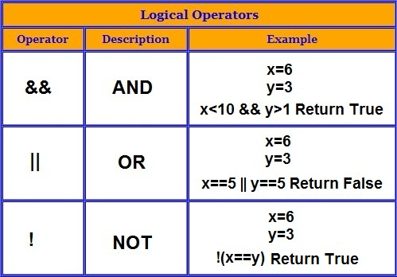
Logical Operators
Can be used to test or adjust the value of a boolean type
&& (and) , || ( or) ! (logical not)
ex :
boolean a = true
boolean b = false;
a && b ===> false
a || b ===> true
! (a && b) → true

Slide 16
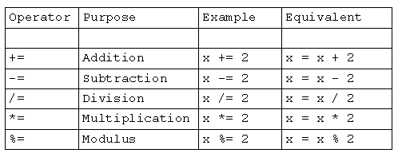
Assignment Operators

Slide 17
Miscellaneous Operators
Conditional Operator ( ? : ) also known as ternary operator.
Ex : variable x = (expression) ? value if true : value if false
Int state =1;
boolean result = state >= 2 ? true : false;
instanceof Operator : refer to object reference instance type – return true | false
Ex : (object_reference_variable ) instanceof (class/interface type)
String x = “value”;
If (x instanceof String) {
//statements
}

Slide 18
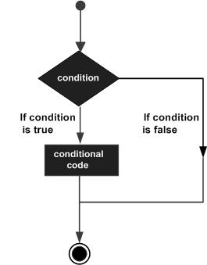
Conditions
If else elseif
switch
The ? : operator (conditional operator)

Slide 19
If statement
if(Boolean_expression) {
// Statements will execute if the Boolean expression is true
}
Ex : int x = 20;
If ( x < 20) {
System.out.print(“if statement runs”);
}

Slide 20
If else statement
if(Boolean_expression) {
// Statements will execute if the Boolean expression is true
} else {
// Statements will execute if the Boolean expression is flsae
}
Ex : int x = 20;
If ( x < 20) {
System.out.print(“if statement true”);
} else {
System.out.print(“if statement false”);
}

Slide 21
elseif statement
if(Boolean_expression) {
// Statements will execute if the Boolean
} elseif(expression) {
// Statements will execute if the Boolean
}
Ex : int x = 21;
If ( x < 20) {
System.out.print(“if statement true”);
} elseif (x ==20) {
System.out.print(“elseif statement ”);
}

Slide 22
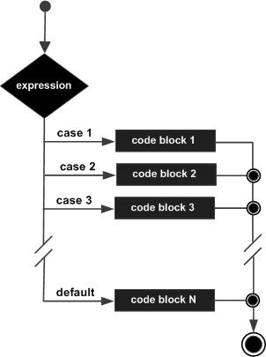
switch statement
Switch(expression) {
Case value1 : statement(s); break;
Case value2 : statement(s); break;
…
default (optional) : statement(s); break;
}

Slide 23
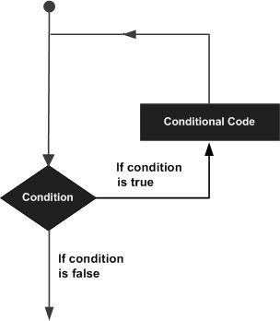
Loop control
For loop / while / do while
Break statement
Continue statement

Slide 24
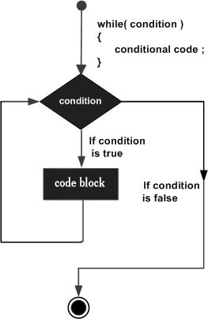
while statement
while(expression) {
statements;
}
Ex : int x<10;
while (x<20) {
Sytem.out.print(x);
x++;
}

Slide 25
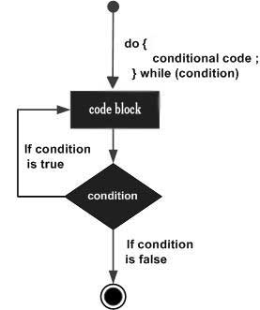
Do while statement
do {
statements;
}(expression);
Ex : int x<10;
do {
Sytem.out.print(x);
x++;
}while (x<20);

Slide 26
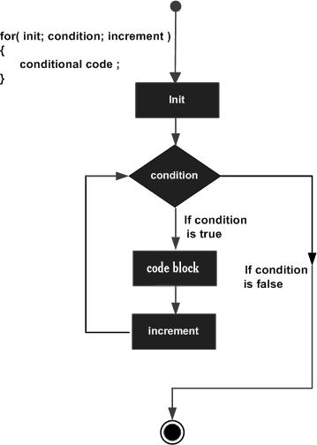
For loop statement
for(initial;expression;update) {
//statements
}
Ex :
for(int i=0; i<=10;i++){
System.out.println(i);
}

Slide 27
For loop statement cont.
for(declaration;expression) {
//statements
}
Ex : int [] numbers={10, 20, 30, 40, 50};
for(int number; numbers){
System.out.println(number);
}
String [] names = {"James", "Larry", "Tom", "Lacy"};
for( String name : names ) {
System.out.print( name );
System.out.print(",");
}

Slide 28
Exception Handling
Check Exception – compile time
Uncheck Exception – runtime
try {
statement(s)
} catch (exception type name) {
statement(s)
} finally {
statement(s)
}

Slide 29
Check Exception
Try catch block / Throws keyword
public void storeDataFromUrl(String url){
try {
String data = readDataFromUrl(url);
} catch (BadUrlException e) {
e.printStackTrace();
}
}
public String readDataFromUrl(String url) throws BadUrlException{
if(isUrlBad(url)){
throw new BadUrlException("Bad URL: " + url);
}
String data = null;
//read lots of data over HTTP and return
//it as a String instance.
return data;
}
private boolean isUrlBad(String url)
{
return false;
}
public class BadUrlException extends Exception {
public BadUrlException(String message)
{
super (message);
}
}

Slide 30
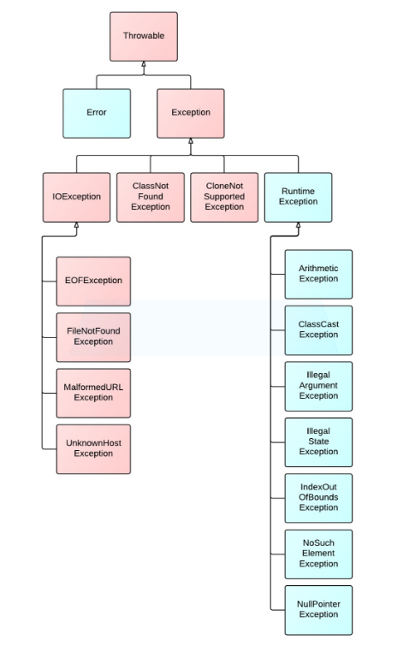
Check Exception
Unchecked exceptions
checked exceptions

Slide 31
Classes and Object
Class – A class can be defined as blueprint / template. Class contains of field properties and methods
Object - State or behaviors
A class is a blueprint from which individual objects are created. Creating new object , use new keyword to create object from class
public class Person {
private String name;
public int age;
public Person() {} // constructor
public void goToWork() { }
public void eating() {}
public void setName(String name) { this.name= name;}
public void setAge(int age) { this.age = age; }
}
//creating object with new keyword
Person person = new Person();
person.setName(“Sophea”);
person.age=33;
person.goToWork();

Slide 32
Creating and Cleaning up Objects
Create new object by :
new operator and constructor
Return the reference
Garbage collector
Happen automatically during the life time of java program
De-allocate
Heap in java
OutOfMemoryError …

Slide 33
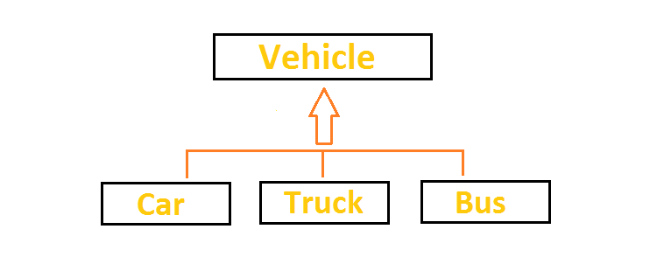
Inheritance
A class inherits from another class to share accessing properties
known as Base class or parent class
extends is the keyword used to inherit
public class BaseClass {
…
}
public class Subclass extends BaseClass {
…..
}

Slide 34
Inheritance
public class JBaseObject {
private long id;
private String createdBy;
public long getId() {
return id;
}
public void setId(long id) {
this.id = id;
}
public String getCreatedBy() {
return createdBy;
}
public void setCreatedBy(String createdBy) {
this.createdBy = createdBy;
}
}
public class JBanner extends JBaseObject {
private String label;
private String imageUrl;
public String getLabel() {
return label;
}
public void setLabel(String label) {
this.label = label;
}
public String getImageUrl() {
return imageUrl;
}
public void setImageUrl(String imageUrl) {
this.imageUrl = imageUrl;
}
}

Slide 35
Writing Final Classes and Methods
Final class - Can not be sub classed
Final method - Can not override
public class ClassB extends ClassA {
private void printValue()
{
System.out.println("Value 1 - [" + super.getValue() +"]");
System.out.println("Value 2 - [" + getValue() + "]");
}
public int getValue()
{
return 20;
}
}
public class ClassA {
protected final int getValue()
{
return 10;
}
}

Slide 36
Abstract Classes and Methods
Should have at least one abstract method
Can not initiate object
Must be extends from other class
Every abstract method must be implemented
Can contain non-abstract method

Slide 37
Abstract Classes and Methods
public abstract class AbstractA {
abstract public int getAValue();
public void printValue()
{
System.out.println("This is the non abstract method");
}
}
public class NormalClassA extends AbstractA {
}
public class NormalClassA extends AbstractA {
private void displayValue()
{
System.out.println(getAValue());
printValue();
}
@Override
public int getAValue() {
return 20;
}
public static void main(String[] args)
{
NormalClassA n = new NormalClassA();
n.displayValue();
}
}
AbstractA a = new AbstractA() {
@Override
public int getAValue() {
return 25;
}
};
System.out.println(a.getAValue());

Slide 38
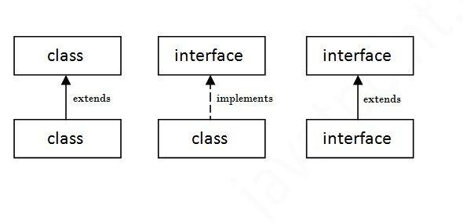
Interface
Use to declare the abstract method & constant
All methods in Interface are abstract
By default methods are abstract & public
No need to write public abstract
No body
Can implement multiple interface

Slide 39
Interface
public interface Working
{
public void work();
}
public class WorkingMan extends Man implements Working
{
public void work()
{
//Your implement work here
}
}
public class WorkingMan extends Man implements Working, Behavior

Slide 40
String
Common use in java programming
Looks similar to primative type BUT it is not the case – it treated as Object
Create new String object just do : String varName = “String_value”
Compare two string by equals() instead ==
Use StringBuilder for String concatenations instead of + operator
Call .equals on known string constants rather than unknown variable
Use String.valueOf() instead of toString()
Use String.format() to format the the strings
Use org.apache.commons.lang3.StringUtils Utility class for various String related operations

Slide 41
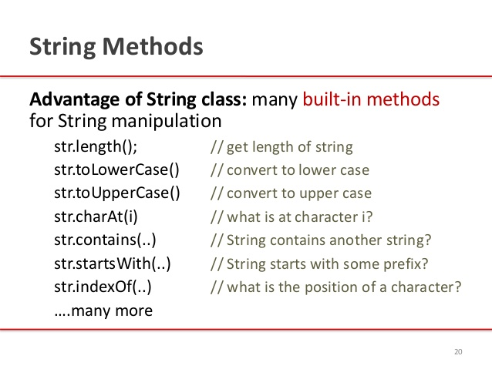
String built-in methods

Slide 42
(String) Compare two string by equals() instead ==
public class Test {
public static void main(String[] args) {
String s1 = "string";
String s2 = "string";
String s3 = new String("string");
String s4 = s3;
String s5 = "str"+"ing";
System.out.println("s1==s2 :"+(s1==s2));
System.out.println("s1==s3 :"+(s1==s3));
System.out.println("s1.equals(s3) :"+s1.equals(s3));
System.out.println("s3==s4 :"+(s3==s4));
System.out.println("s3.equals(s4) :"+s3.equals(s4));
System.out.println("s1==s5 :"+(s1==s5));
System.out.println("s1.equals(s5) :"+s1.equals(s5));
}
}
and here is the comparison output
s1==s2 :true
s1==s3 :false
s1.equals(s3) :true
s3==s4 :true
s3.equals(s4) :true
s1==s5 :true
s1.equals(s5) :true

Slide 43
(String) Use StringBuilder for String concatenations instead of + operator
String finalString = "";
long startTime = System.nanoTime();
for(int i=0;i<10;i++) {
finalString = finalString + i;
}
long endTime = System.nanoTime();
System.out.println(String.format("String opetation with + operator took [%d] nano seconds",(endTime-startTime)));
StringBuilder builder = new StringBuilder();
startTime = System.nanoTime();
for(int i=0;i<10;i++) {
builder.append(i);
}
endTime = System.nanoTime();
System.out.println(String.format("String opetation with StringBuilder took [%d] nano seconds",(endTime-startTime)));
}
Result :
String opetation with + operator took [308289] nano seconds
String opetation with StringBuilder took [15902] nano seconds

Slide 44
(String) Call .equals on known string constants rather than unknown variable
Public class Test {
public static final String CONSTANT = "someConstant";
public static void main(String[] args) {
String string = new Test().getString();
// always compare like this, this will never throw NPE
System.out.println("CONSTANT.equals(string):"+ CONSTANT.equals(string));
System.out.println("Comparision like string.equals(CONSTANT) may throw NullPointerException");
// next statement will throw NPE
System.out.println("string.equals(CONSTANT):" + string.equals(CONSTANT));
}
private String getString() {
return null;
}
}
--------------------------------------
CONSTANT.equals(string):false
Comparision like string.equals(CONSTANT) may throw NullPointerException
Exception in thread "main" java.lang.NullPointerException
at Test.main(Test.java:10)

Slide 45
(String) Use String.valueOf() instead of toString()
obj.toString() and String.valueOf(obj) will be same but String.valueOf() is null safe, means it will never throw NullPointerException.
Test test = null;
// Below statement will not throw NPE
System.out.println(String.valueOf(test));
// Next statement will throw NPE
System.out.println(test.toString())

Slide 46
(String) Use String.format() to format the the strings
String.format() has very good feature if we want to have a single formatted string with multiple values. for example
public class Test {
public static void main(String[] args) {
int obtainedMarks = 86;
int maxMarks = 120;
double percent = obtainedMarks*100.0/ maxMarks;
System.out.println(String.format("I secured [%d] marks out of [%d] which is %.2f%%",obtainedMarks,maxMarks,percent));
}
}
will print: I secured [86] marks out of [120] which is 71.67%

Slide 47
Date Time
Java provides the Date class available in java.util package, this class encapsulates the current date and time.
//create new Date Object
Date date = new Date();
Date date = new Date(long millisecond); // since midnight, January 1, 1970
Methods :
boolean after(Date date)
boolean before(Date date)
int compareTo(Date date)
long getTime( )
void setTime(long time)
…..
Date Formatter
Calendar Object - see example

Slide 48
Exercise
- Read more details about Java Basic (book / Internet)
Create class / inheritance / interface
Play around with loop-control / condition / operators
Learn more on-line resources such as String, Number, File, Array
https://docs.oracle.com/javase/tutorial/java/nutsandbolts/index.html
https://www.tutorialspoint.com

