Slide 1

OOP Concept

Slide 2
OOP (Object-Oriented Programming )
What is OOP ?
Why OOP ?
Benefits of software reuse
abstraction / Inheritance
Polymorphism
Encapsulation

Slide 3
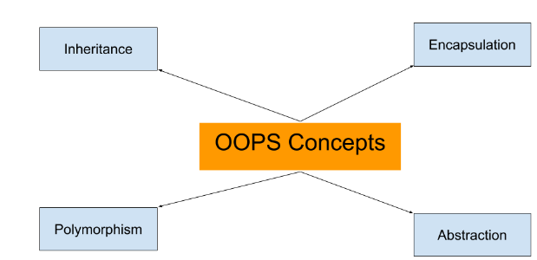
What is OOP ?
Object-oriented programming is a method of programming based on a hierarchy of classes, and well-defined and cooperating objects.

Slide 4
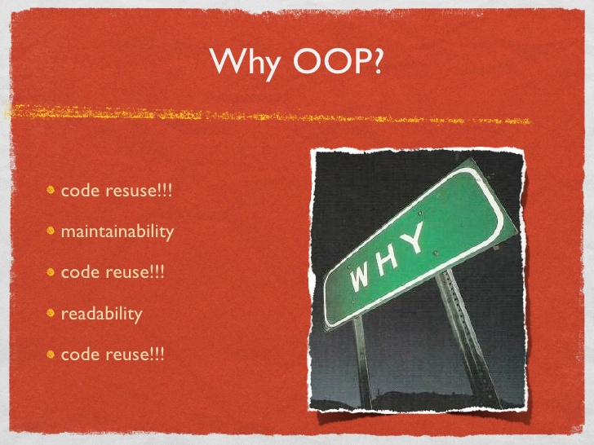
Why OOP ?
The goal: software reuse
Programs tend to be "stick built" from the ground up
develop manageable, understandable, reusable software components that can be employed in a wide variety of applications, so that "new" code is specific to the problem at hand.
Reuse is not the same as "cut and paste"

Slide 5
Why OOP ?
Benefits of software reuse
Reduces coding/testing, thereby reducing delivery time and cost
Many re-users means many testers: well-tested code!
Bugs found in reusable module can be reported to source: fix is made, new module is distributed

Slide 6
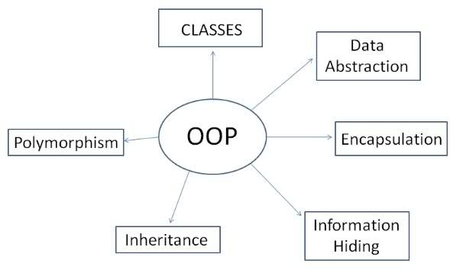
Object Oriented
Encapsulation/Data Hiding
Inheritance
Polymorphism
Abstraction
All predefined types are objects
All operations are performed by sending messages to objects
All user defined types are objects.

Slide 7
THE OO UNIVERSE
Objects
Classes
Instance variables / methods
Constructors

Slide 8
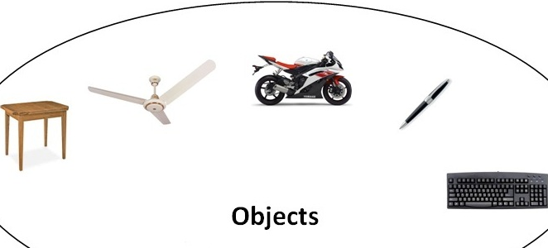
Objects
Instances of classes
Object for a Person
Object for a Car
Lastname: Smith
Firstname: Jean
Age: 35
Weight: 120
Car:
Make: Ford
Model: Escort
License: THX-1138
Color: white
Miles: 64000

Slide 9
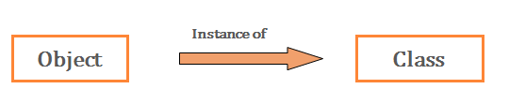
Classes and instances
A class is a blueprint for creating many similar objects.
The created object is an instance of that class.
Objects created from the same class will have the same basic structure and functionality.

Slide 10
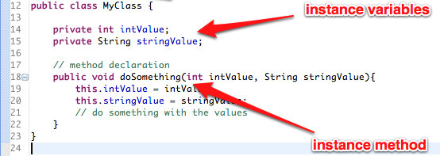
Instance variables & methods

Slide 11
Constructors
constructors are special functions (usually class or instance methods) used to initialize or return a new object.
Depending on the OO environment, a class might have many constructors, each of which builds an object a different way.
They do not have return types, not even void and therefore they cannot return values.

Slide 12
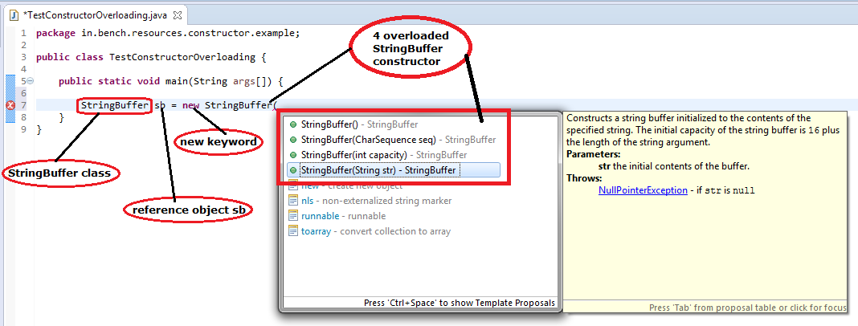
Constructors

Slide 13
Constructors
public class Person {
private int id;
private String name;
private int age;
//Constructor
public Person(){
}
public Person(int id) {
this.id=id;
}
//Constructor
public Person(int id, String name, int age) {
this.id = id;
this.name = name;
this.age = age;
}
}
Person (id, name, age)
Person p1 = new Person();
Person p2 = new Person(1);
Person p3 = new Person(100, ”Sophea”, 33);

Slide 14
OO Practice (Please see picture and convert to code)
Toyota Japan (Factory)
Toyota Camary 2010
Steering Wheel, Seat, Tires ...
drive

Slide 15
Principle concepts of OOPS
Abstraction
Encapsulation
Polymorphism
Inheritance

Slide 16
Abstraction
Abstraction refers to the act of representing essential features without including the background details or explanations.
Focuses on the outside view of an object (i.e. the interface)
Solves the problem in the design side

Slide 17
Abstraction
public abstract class Gragphic {
abstract void draw();
}
Create new class Line , Box , Rectangle which inherit Gragphic

Slide 18
Encapsulation
Information hiding
prevents clients from seeing it’s inside view, where the behavior of the abstraction is implemented.
Encapsulation: Hiding boundary (properties, methods) we have to think the word
setter refers to change or mutator.
getter refers to accessor

Slide 19
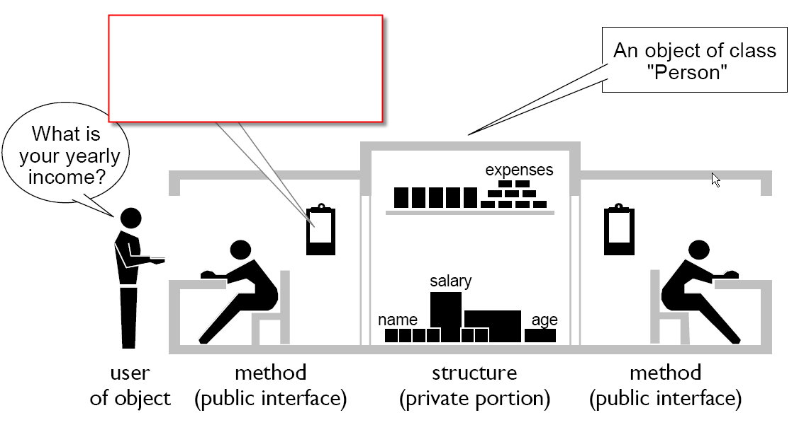
Encapsulation

Slide 20
Inheritance
Inheritance is the process by which objects of one class acquire the properties of objects of another class.
A class that is inherited is called a superclass.
The class that does the inheriting is called a subclass.
Using the keyword extends.
Reduce and easily the code

Slide 21
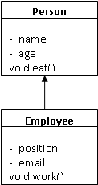
Inheritance
public class Employee extends Person
private String position = null;
private String email = null;
public void work () {
…
}
public void main () {
private Employee emp = new Employee();
String empName = emp.name;
emp.work();
}
}
Should use emp.getName()

Slide 22
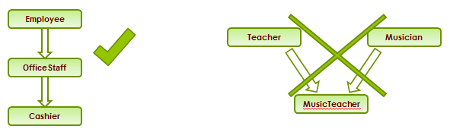
Inheritance
Multi-level inheritance is allowed in Java but not multiple inheritance

Slide 23
Advantages/disadvantages
Code sharing.
Software reusability without disturbing working code.
Overloading helps develop
standard class interfaces.
Requires an OO
programming environment.
Too many subclasses
makes debugging difficult.
Performance may be degraded.

Slide 24
Inheritance (Tips)
In Java does not allow multiple inheritances. (sub class can not have many super classes )
We say to Inheritance we should think the words: super class and sub class
super class: The original class to be inherited by other classes
sub class : The classes inherits from original class.

Slide 25
Polymorphism
A generic term meaning having many forms.
One interface, many implementations.
You can use the same name for several different things and the compiler automatically figures out which version you wanted.
There are several types of polymorphism supported in Java :
Overriding
Overloading
Dynamic method bidding (Or Late-binding)

Slide 26
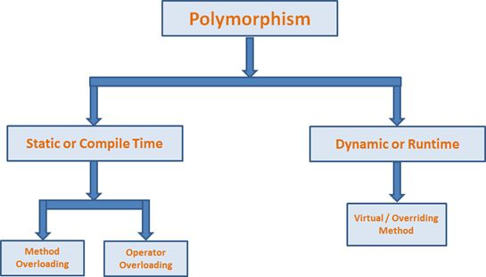
Polymorphism
Compile time polymorphism
Runtime time polymorphism
Dynamic Binding (Late Binding)
Dynamic binding (also known as late binding) means that the code associated with a given procedure call is not known until the time of the call at run-time.

Slide 27
Compile time Polymorhism method overloading
public class X {
public void methodA(int num) {
System.out.println ("methodA:" + num);
}
public void methodA(int num1, int num2) {
System.out.println ("methodA:" + num1 + "," + num2);
}
public double methodA(double num) {
System.out.println("methodA:" + num);
return num;
}
}
public class Y {
public static void main (String args []) {
X Obj = new X();
double result;
Obj.methodA(20);
Obj.methodA(20, 30);
result = Obj.methodA(5.5);
System.out.println("Answer is:" + result);
}
}

Slide 28
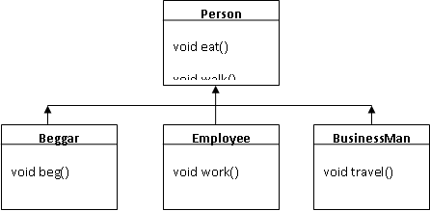
Late binding or Dynamic binding

Slide 29
Polymorphism
public class Person {
public void eat () {
System.out.println(“Eating like a person”);
}
public class Beggar extends Person {
public void eat () {
System.out.println(“Eating in the street”);
}
public class Business Man Person {
public void eat () {
System.out.println(“Eating in a nice restaurant”);
}
public class Employee extends Person {
public void eat () {
System.out.println(“Eating at home”);
}
Person p = null;
p = (Beggar) new Beggar();
p.eat(); // will print “Eating in the street”
p = (Employee) new Employee();
p.eat(); // will print “Eating at home”
p = (BusinesMan) new BusinessMan();
p.eat(); // will print “Eating in a nice restaurant”

Slide 30
Polymorphism feature:
Overloading
Has the same name method but the parameter list is different
Overriding
super class and sub class has the same name method, parameter list , and return type

Slide 31
Polymorphism
Method overloading
Overloaded methods MUST change the argument list
Overloaded methods CAN change the return type
Overloaded methods CAN change the access modifier
Overloaded methods CAN declare new or broader checked exceptions
A method can be overloaded in the same class or in a subclass

Slide 32
Polymorphism
Method overriding
You cannot override a method marked final
You cannot override a method marked static

Slide 33
Polymorphism (Tips)
Overloading 'min' to compare different types:
Please give other samples for :
Overriding
Overloading
Dynamic method binding
firstInDictionary = min("astro", "zodiac");
lowerNumber = min(42, 99);
closerToOrigin = min(complex1, complex2);

Slide 34
Excercise
Create a Class "DCommon" with the following properties : id, createdDate, updatedDate, createdBy, updatedBy, state, version
Create a Class “Person” extending class "Dcommon" with the following properties: birthDate, lastName, firstName
Create a Class “Employee” with the following properties: salary, holiday, years (years spent in the company) and lastName, birthDate, firstName.
Create Interface “View” with method getDataView() return as String.
Implements the interface View with the Employee class to display all the data of an employee.
Create a class “Developer” extends employee with properties: comment.
Add a constructor so we can create a Developer from an Employee Object.
Implement the Interface View to display: fullName + comment + salary
Create a class “TeamLeader” with properties : projectNum.
Implements the interface View to display: fullName: UPPERCASE_NAME + number of projects
(use StringBuffer to manipulate string, the fullName should be in UPPERCASE)
Create an employee, a developer and a teamleader object. Put them in an arrayList of Employee.
Loop on the array and display the information using the getDataView Method.
Display the information by accessing directly to the object.
for example: Developer dev = new Developer();
dev.getDataView();

Slide 35
Refs
http://beginnersbook.com/2013/04/oops-concepts/
http://www.javatpoint.com/java-oops-concepts
http://www.oracle.com/technetwork/java/oo-140949.html

