Slide 1

Maven

Slide 2
What is Maven?
One of build Tool for Java Project
Project Management & Comprehension Tool.
Generating documentation from the source code.
Compiling source code.
Packaging compiled code into JAR or ZIP (war / ear) files.
Installing the packaged code on a server, in a repository or somewhere else.
Maven is written with xml tag syntax
More other purpose...

Slide 3
Download And Installation
Install JAVA JDK ( version 1.7 to later)
Download maven 3 and follow instruction
Set the M2_HOME environment variable to point to the directory you unzipped Maven to.
Set the M2_HOME environment variable to point to M2_HOME/bin
Window : %M2_HOME%\bin
Unix : $M2_HOME/bin
Mac-OS : $M2_HOME/bin
appending Path environment
Window : %M2_HOME%\bin
Unix / Mac-OS : $M2_HOME/bin
Open a command prompt and type 'mvn' (without quotes) and press enter.

Slide 4
Download And Installation
Window installation : https://www.mkyong.com/maven/how-to-install-maven-in-windows/
Linux / Mac-OS example : maven directory at /opt/apache-maven-3.2.2
open file ~/.bash_rc add the following line at the bottom
M2_HOME=/opt/apache-maven-3.2.2
export M2_HOME
M2=$M2_HOME/bin
export M2
PATH=$PATH:$JAVA_HOME
PATH=$PATH:$M2
export PATH

Slide 5
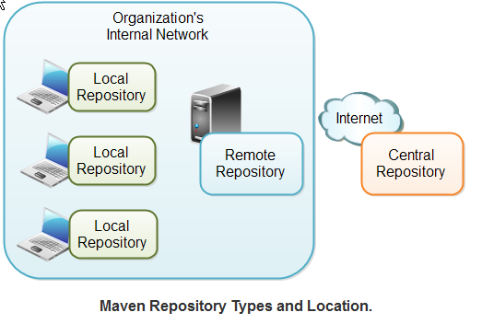
Maven settings.xml repository
${m2_home}/conf/settings.xml - global projects
${user_home}/.m2/settings.xml - per user
${user_home}/.m2/repository ( all dependencies jar files download from server or remote)
There are three types
local
central
remote

Slide 6
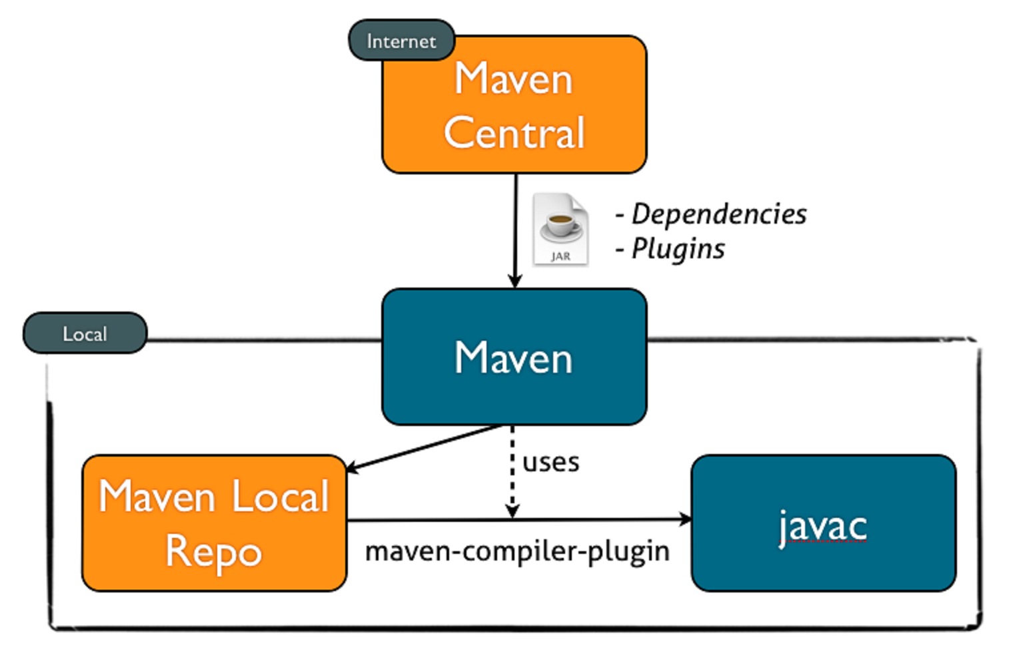
Maven Repo

Slide 7
Local repository
It points to directory in your local machine. It means that it will store all dependencies jar files into your local machine with specific directory. See the settings.xml configuration below
<settings xmlns="http://maven.apache.org/SETTINGS/1.0.0" xmlns:xsi="http://www.w3.org/2001/XMLSchema-instance" xsi:schemaLocation="http://maven.apache.org/SETTINGS/1.0.0 http://maven.apache.org/xsd/settings-1.0.0.xsd"> <localRepository>C:/MyLocalRepository</localRepository> </settings>

Slide 8
Central repository
Public access vai internet access. This repo is managed by maven community. It is not required to configured at all.

Slide 9
Remote repository
Specific Server (ex specific Nexus server)
custom specific libraries which not found in central
<repositories> <repository> <id>gekko</id> <url>https://nexus.goldengekko.com/nexus/content/groups/public</url> </repository> <repository> <id>bintray-sopheamak-maven_repo</id>
<name>bintray</name>
<url>http://dl.bintray.com/sopheamak/maven_repo</url>
</repository> </repositories>

Slide 10
Remote repository - pom.xml
<?xml version="1.0" encoding="UTF-8"?>
<project xmlns="http://maven.apache.org/POM/4.0.0" xmlns:xsi="http://www.w3.org/2001/XMLSchema-instance"
xsi:schemaLocation="http://maven.apache.org/POM/4.0.0 http://maven.apache.org/maven-v4_0_0.xsd">
<modelVersion>4.0.0</modelVersion>
<groupId>com.goldengekko.integraton</groupId>
<artifactId>user-security</artifactId>
<packaging>jar</packaging>
<version>1.0-SNAPSHOT</version>
<name>user security</name>
<repositories>
<repository>
<id>gekko</id>
<url>https://nexus.goldengekko.com/nexus/content/groups/public</url>
</repository>
<repository>
<id>bintray-sopheamak-maven_repo</id>
<name>bintray</name>
<url>http://dl.bintray.com/sopheamak/maven_repo</url>
</repository>
</repositories>
// see detail : https://github.com/sophea/basic-maven/blob/master/remote_pom.xml
<dependencies>
<dependency>
<groupId>junit</groupId>
<artifactId>junit</artifactId>
<version>3.8.1</version>
<scope>test</scope>
</dependency>
</dependencies>
</project>

Slide 11
Remote repo : Sample settings.xml
</repositories>
<pluginRepositories>
<pluginRepository>
<id>ppRepo</id>
<!--<url>http://192.168.1.97:8001/nexus/content/groups/public</url>-->
<url>https://nexus.dminc-gtc.com/nexus/content/groups/public</url>
<releases><enabled>true</enabled></releases>
<snapshots><enabled>true</enabled></snapshots>
</pluginRepository>
</pluginRepositories>
<!-- machine-specific properties goes here: -->
</profile>
</profiles>
<activeProfiles>
<!--make the profile active all the time -->
<activeProfile>nexus</activeProfile>
</activeProfiles>
</settings>
<settings>
<mirrors>
<!-- Inhouse Nexus from extern -->
<mirror>
<id>ppRepo</id>
<mirrorOf>*</mirrorOf>
<name>Inhouse Nexus</name>
<!-- nexus.dimin-gtc.com -->
<url>https://nexus.dminc-gtc.com/nexus/content/groups/public</url>
</mirror>
</mirrors>
<profiles>
<profile>
<id>nexus</id>
<!--Enable snapshots for the built in central repo to direct -->
<!--all requests to nexus via the mirror -->
<repositories>
<repository>
<id>ppRepo</id>
<url>https://nexus.dminc-gtc.com/nexus/content/groups/public</url>
<releases><enabled>true</enabled></releases>
<snapshots><enabled>true</enabled></snapshots>
</repository>
See more : https://docs.google.com/document/d/1VYSNfJOABhZ1Yf5QRostUYSBYX9NoRN_hLRTzPC9FGo/edit

Slide 12
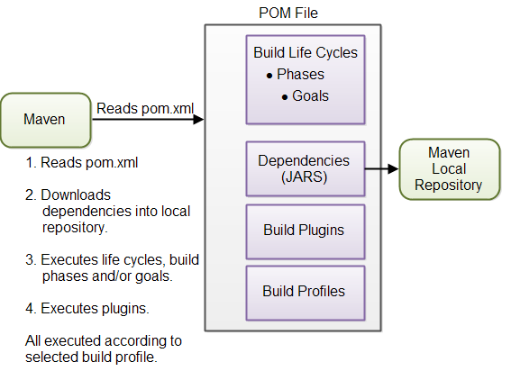
Maven Overview

Slide 13
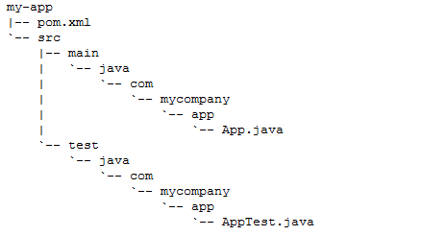
POM file (pom.xml)
Stands for Project Object Model
Content written as xml format
Located in the root of project

Slide 14
POM file (pom.xml) cont.
<?xml version="1.0" encoding="UTF-8"?>
<project xmlns="http://maven.apache.org/POM/4.0.0" xmlns:xsi="http://www.w3.org/2001/XMLSchema-instance"
xsi:schemaLocation="http://maven.apache.org/POM/4.0.0 http://maven.apache.org/maven-v4_0_0.xsd">
<modelVersion>4.0.0</modelVersion>
<groupId>com.sample.repo</groupId>
<artifactId>sample</artifactId>
<packaging>war</packaging>
<version>1.0-SNAPSHOT</version>
Version 4.0.0 matches Maven version 2 and 3.
<groupId>This is an Id of project's group. This is generally unique amongst an organization or a project. For example, a banking group com.company.bank has all bank related projects.
This is the version of the project.Along with the groupId, It is used within an artifact's repository to separate versions from each other. For example:
com.company.bank:banking:1.0
com.company.bank:banking:1.1.
<artifactId>This is an Id of the project.This is generally name of the project. For example, consumer-banking. Along with the groupId, the artifactId defines the artifact's location within the repository.

Slide 15
pom.xml elements
<properties>....</properties>
<repositories>...</repositories>
<dependencies>...</dependencies>
<build>...</build>
<plugins>...</pulgins>
<profiles>...</profiles>
<developers>...</developers>
<goals>...</goals>
….
See : https://github.com/sophea/basic-maven/blob/master/general_pom.xml

Slide 16
pom.xml elements : example
<?xml version="1.0" encoding="UTF-8"?>
<project xmlns="http://maven.apache.org/POM/4.0.0" xmlns:xsi="http://www.w3.org/2001/XMLSchema-instance"
xsi:schemaLocation="http://maven.apache.org/POM/4.0.0 http://maven.apache.org/maven-v4_0_0.xsd">
<modelVersion>4.0.0</modelVersion>
<groupId>com.sample.repo</groupId>
<artifactId>sample</artifactId>
<packaging>war</packaging>
<version>1.0-SNAPSHOT</version>
<properties>
<spring.version>4.3.4.RELEASE</spring.version>
<logging.level>ALL</logging.level>
<hibernate.version>5.2.4.Final</hibernate.version>
</properties>
<dependencies>
<dependency>
<groupId>org.hibernate</groupId>
<artifactId>hibernate-core</artifactId>
<version>${hibernate.version}</version>
</dependency>
…..
</dependencies>
<build>
<!-- final name -->
<finalName>sample</finalName>
<resources>
<!-- base set of resources -->
<resource>
<directory>${project.basedir}/src/main/resources</directory>
</resource>
<!-- filter some files -->
<resource>
<directory>${project.basedir}/src/main/resources</directory>
<filtering>true</filtering>
</resource>
</resources>
<plugins>
<plugin>
<artifactId>maven-compiler-plugin</artifactId>
<version>2.3.2</version>
</plugin>
</plugins>
</build>
…..
</project>
xx

Slide 17
Dependency
<?xml version="1.0" encoding="UTF-8"?>
<project xmlns="http://maven.apache.org/POM/4.0.0" xmlns:xsi="http://www.w3.org/2001/XMLSchema-instance"
xsi:schemaLocation="http://maven.apache.org/POM/4.0.0 http://maven.apache.org/maven-v4_0_0.xsd">
<modelVersion>4.0.0</modelVersion>
<groupId>com.sample.repo</groupId>
<artifactId>sample</artifactId>
<packaging>war</packaging>
<version>1.0-SNAPSHOT</version>
<properties>....</properties>
<dependencies>
<dependency>
<groupId>org.hibernate</groupId>
<artifactId>hibernate-core</artifactId>
<version>${hibernate.version}</version>
</dependency>
…..
</dependencies>

Slide 18
External Dependency
JAR files that are not in local/remote/central repository.
You might have them by copy from somewhere or your local computer somewhere else
Create lib directory from root project and copy those JAR files in this directory
Your maven external dependency configuration look likes
<dependency>
<groupId>mydependency</groupId>
<artifactId>mydependency</artifactId>
<scope>system</scope>
<version>1.0</version>
<systemPath>${basedir}\lib\mydependency.jar</systemPath>
</dependency>

Slide 19
plugins
Maven Plugins are generally used to :
create jar file
create war file
compile code files
unit testing of code
create project documentation
create project reports
mvn [plugin-name]:[goal-name]
Ex: mvn compile:complie
There are 2 type
Build plugins :
They execute during the build and should be configured in the <build/> element of pom.xml
Reporting plugins
They execute during the site generation and they should be configured in the <reporting/> element of the pom.xml

Slide 20
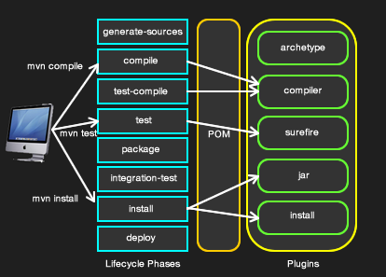
Maven Build lifecycle

Slide 21
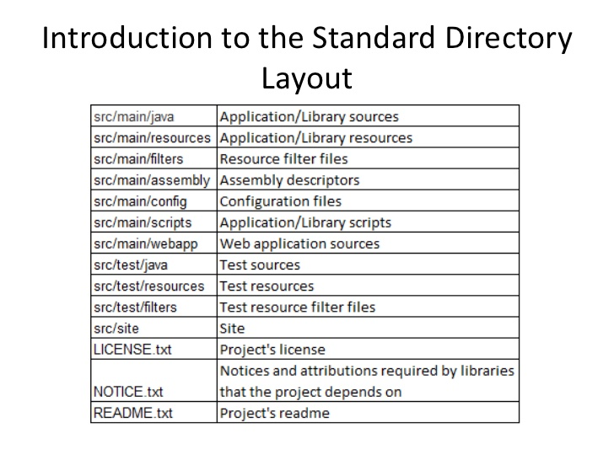
Maven Standard structure

Slide 22
Maven basic command
mvn clean
mvn test
mvn compile
mvn package
mvn install
mvn deploy
mvn eclipse:eclipse
mvn dependency:tree
mvn site
….
mvn --help

Slide 23
Maven java compiler plugin
<!-- it is the most important maven plugin -->
<plugins>
<plugin>
<!-- java compile 1.7 -->
<artifactId>maven-compiler-plugin</artifactId>
<version>2.3.2</version>
<configuration>
<source>1.7</source>
<target>1.7</target>
</configuration>
</plugin>
…
</plugins>

Slide 24
Lab : Create new project - jar type
Run this command :
>> mvn archetype:generate -DgroupId=com.rupp.app -DartifactId=myFirstMavenApp -DarchetypeArtifactId=maven-archetype-quickstart -DinteractiveMode=false
Execute class with mvn : mvn exec:java -Dexec.mainClass="com.example.Main" [-Dexec.args="argument1"]
Ex :
mvn package exec:java -Dexec.mainClass="com.rupp.app.App"
See this : https://github.com/sophea/basic-maven

Slide 25
Lab : Create new project - war type
Run this command :
mvn archetype:generate -DgroupId=com.rupp.sample -DartifactId=samplewebapp -DarchetypeArtifactId=maven-archetype-webapp -DinteractiveMode=false >> cd samplewebapp //project structure >> tree ─ pom.xml └── src └── main ├── resources └── webapp ├── index.jsp └── WEB-INF └── web.xm
See this : https://github.com/sophea/basic-maven/tree/master/simple-webapp

Slide 26
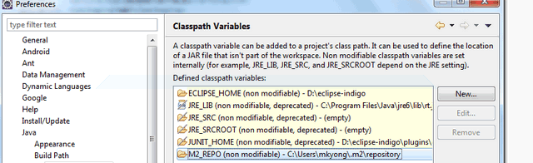
M2_Repo with IDE eclipse/STS
Define and add M2_REPO classpath variable manually into Eclipse IDE. Follow below steps :
Eclipse IDE, menu bar
Select Window > Preferences
Select Java > Build Path > Classpath Variables
Click on the new button > defined a new M2_REPO variable and point it to your local Maven repository ~/.m2/repository
Done.

Slide 27
Maven with resource properties filter
https://github.com/sophea/basic-maven/properties_pom.xml
file src/main/resources/application.properties
driverClassName=${database.driver} url=${database.url} username=${database.username} password=${database.password}
<build> <resources> <resource> <directory>src/main/resources</directory> <filtering>true</filtering> </resource> </resources> </build> <properties> <database.driver>com.mysql.jdbc.Driver</database.driver> <database.url>jdbc:mysql://localhost:3306/database?autoReconnect=true</database.url> <database.username>myusername</database.username> <database.password>mypassword</database.password> </properties>

Slide 28
Maven with Profile environment (Test/Stage/Prod)
<profiles>
<profile>
<id>test</id>
<properties>
<database.driver>com.mysql.jdbc.Driver</database.driver>
<database.url>jdbc:mysql://test-qadb01:3306/database?autoReconnect=true</database.url>
<database.username>test-user</database.username>
<database.password>testpassword</database.password>
</properties>
</profile>
<profile>
<id>production</id>
<properties>
<database.driver>com.mysql.jdbc.Driver</database.driver>
<database.url>jdbc:mysql://prod-db01:3306/database?autoReconnect=true</database.url>
<database.username>produser</database.username>
<database.password>prodpassword</database.password>
</properties>
</profile>
</profiles>

Slide 29
Maven with Profile environment
Test | stage | production
https://github.com/sophea/basic-maven/tree/master/mvnProfile
>>mvn install -P{profileId}
>>mvn clean install -Ptest|production

Slide 30
Ref Maven example
https://github.com/foomango/mavenex/tree/master/mvnref-book-examples-1.0-SNAPSHOT

Slide 31
Exercise
See https://docs.google.com/document/d/1yaFZkB9oEBENAgIXWqnA2PFNhtcHR_kR34YYrBUCYYk/edit

Slide 32
Exercise
1 - create a new maven project with the following
- groupId : edu.rupp.repo
- artifact : mite-2016-oop
- version : 1.0-SNAPSHOT
- type : jar
Move and update classes from exercise collection : CountriesList.java with 2 methods under package edu.rupp.repo
+ getCountries() && getCountriesByFirstLetter()
2 - create new project with using jar dependency from exercise 1 and create new class 2 methods using class from jar above:
+ finding firstLetter which has the largest number of countries and display it
+ finding firstLetter which has the least number of countries and display it
3 - create maven project with different profile (TEST | STAGE | PROD). The project has feature to connect with database with different environment. create pom.xml to manage these properties using profile tag. see this https://github.com/sophea/basic-maven/tree/master/mvnProfile
## application properties
application.version =${app.version}
logging.level=${logging.level}
jdbc.hostAndPort=${jdbc.hostAndPort}
jdbc.databasename=${jdbc.database.name}
jdbc.username=${jdbc.database.username}
jdbc.password=${jdbc.database.password}
4 - Convert Java Object to JSON and Vice Versa try it out and follow below :
https://www.tuturself.com/posts/view?menuId=91&postId=911

