Slide 1

GIT

Slide 2

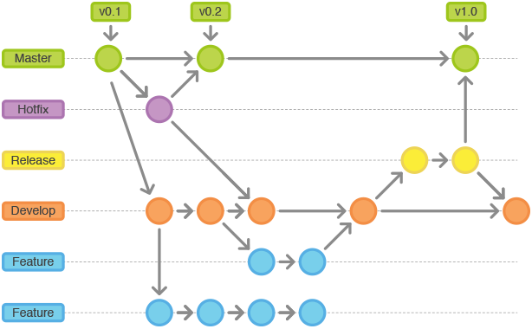
In general, Git is one of a version control system that is used for software development and other version control tasks

Slide 3
Why GIT ?
Open Source - free
Small and fast operation
Security encrypted SHA1
Easy for branching
No need of powerful hardware
Implicit backup - The chances of losing data are very rare when there are multiple copies of it. Data present on any client side mirrors the repository, hence it can be used in the event of a crash or disk corruption.

Slide 4
Git setup
Download git for OSX
Download git for Windows
Download git for Linux

Slide 5
Installation
Guide line Git for Window
https://vladmihalcea.com/tutorials/git/windows-git-ssh-authentication-to-github

Slide 6
Configure your Git username and email
$ git config --global user.name "Sophea Mak" $ git config --global user.email "sopheamak@gmail.com"
//alias command
//git config --global alias.<alias-name> <git-command>
$ git config --global alias.st status
//list configuration
$ git config --list

Slide 7
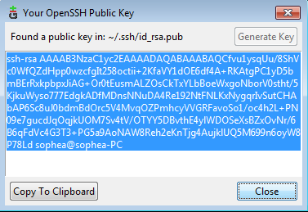
SSH key
Step 2 : add this key to your git server /
github/bitbucket ssh key setting

Slide 8
Let’s start with the simple guide.

Slide 9
Experiment with Git hub repo :
Git hub : https://github.com
Let’s create an account in github
Online tools: https://try.github.io/levels/1/challenges/1

Slide 10
Basic commands and flow
git init
git clone
git add
git commit
git push
git log | status
git pull
git merge
git reset
git checkout

Slide 11
git init

Slide 12
Create a new repository : git init
create a new directory, open it and perform a
git init
> cd my_git_repo
> ls
README pom.xml ,...
> git init
Initialized empty Git repository in /opt/my_git_repo/.git/

Slide 13
git remote

Slide 14
Add remote repository : git remote
git remote add origin ${serverUrl}
> git remote add origin https://github.com/sophea/basic-maven.git
Or ssh
>> git remote add origin git@github.com:sophea/basic-maven.git
Update remote server url
>> git remote set-url origin git@github.com:sophea/basic-maven.git

Slide 15
git clone

Slide 16
remote
git clone
master
local
master
origin/master

Slide 17
Checkout a repository : git clone
local repository by running the command
git clone /path/to/repository
Remote server repository by running the command
git clone username@host:/path/to/repository
Ex (ssh) : git clone git@github.com:sophea/basic-maven.git
Ex (https) : git clone https://github.com/sophea/basic-maven.git

Slide 18
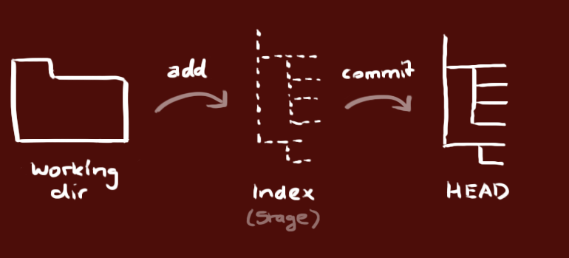
workflow
Working Directory
Index
HEAD

Slide 19
git add

Slide 20
git add
You can propose changes(add it to the index stage). This is the first step in the basic git workflow
$ git add <filename>
Or
$ git add *.java
$ git add .

Slide 21
git commit

Slide 22
commit
To commit these changes use
$ git commit -m “commit message”
Now the file is committed to the HEAD, but not in your remote repository yet.

Slide 23
git push

Slide 24
git push changes
Your changes are now in the HEAD of your local working copy. To send those changes to your remote repository, execute
git push origin master
Or
git push origin master:master

Slide 25

git push to remote server
local branch name
git push origin master:master
remote branch name

Slide 26
git pull

Slide 27
git update
To update your local repo with the new commit, execute
git pull
git pull --rebase
git pull = git fetch + git merge
git pull --rebase = git fetch + git rebase (recommended)

Slide 28
Lab
// create new git project : test-git
git clone
git add
git commit
git push
git log | status
git pull

Slide 29
branching

Slide 30
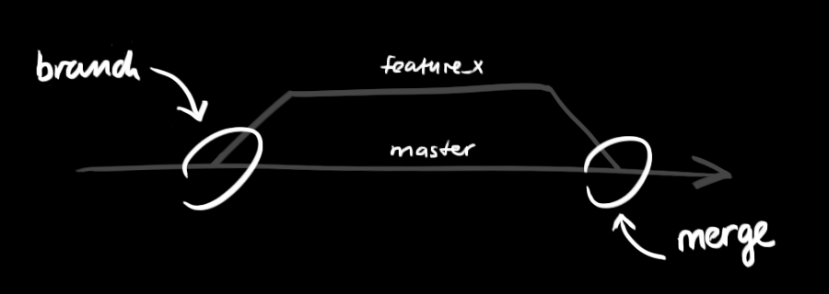
Branching

Slide 31
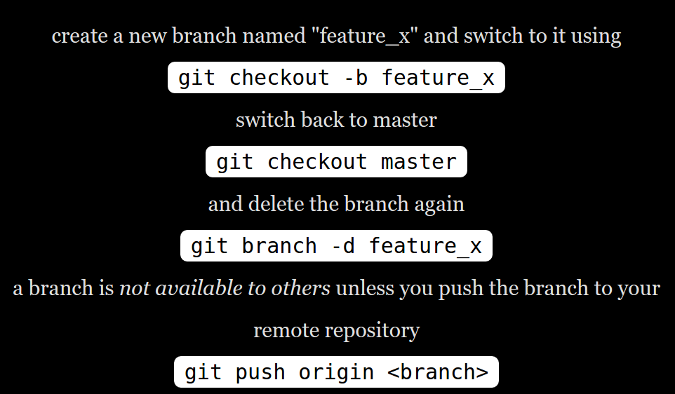
Branching

Slide 32
git update and merge
To update your local repo with the new commit, execute
$ git pull --rebase
To merged another branch into your active branch (master), use
$ git merge <branch>
both cases git tries to auto-merge changes.you might get conflicts. You are responsible to merge those conflicts manually by editing the files shown by git. After changing, you need to mark them as merged with : git add filename

Slide 33
git update and merge
After changing, you need to mark them as merged with
$ git add <filename>
before merging changes, you can also preview them by using
$ git diff <source_branch> <target_branch>

Slide 34
tag

Slide 35
git tag
it's recommended to create tags for software releases. this is a known concept, which also exists in SVN. You can create a new tag named 1.0.0
$ git tag 1.0.0 <1b2e1d63ff>
the <1b2e1d63ff> stands for the first 10 characters of the commit id you want to reference with your tag. You can push your tag to remote server by using command :
$ git push --tags

Slide 36
git amend

Slide 37
git amend
Commit files again and again with the last commit-id.
//add new file test.txt
>> git add .
>> git commit -m “message”
//update file test.txt
>> git add .
>> git commit --amend
// git add . or git --amend
>> git push original master
>> git log

Slide 38
git status

Slide 39
git log

Slide 40
git log
git log
// find only commits with certain author:
git log --author={name}
Ex : git log --author=sophea
//display one line each commit
git log --pretty=oneline

Slide 41
Common
problems

Slide 42
Git common problems (conflict)
// when your local repo and remote is not the same version
// push from local repo to remote you will get conflicted. How to resolve :
// resolve file conflicted first
// git add
// git rebase --continue
// git push original master

Slide 43

Git common problems
I screwed up!!
how do I fix it?

Slide 44
merging?
git merge --abort

Slide 45
rebasing?
git rebase --abort

Slide 46
Reset?
git fetch origin
git reset --hard origin/master

Slide 47
built-in git GUI :
gitk
Use colorful git output :
git config color.ui true
show log on just one line per commit
git config format.pretty oneline

Slide 48
.gitignore file
Files / folder excluded to be committed:
>>cat .gitignore
*.class
# Package Files #
*.jar
*.war
*.ear
target/
.project
.classpath

Slide 49
Reference resources :
http://learngitbranching.js.org/
https://www.alexkras.com/19-git-tips-for-everyday-use/
https://github.com/git-tips/tips
https://www.atlassian.com/git/tutorials/learn-git-with-bitbucket-cloud/copy-and-add-files
https://git-scm.com/book/en/v2/Git-Basics-Git-Aliases
http://gitref.org/remotes/
Online tool
https://try.github.io/levels/1

Slide 50
exercise :
Move homework source code into github server.
java-collection repo
java-oop repo
maven-basic repo

Slide 51
Question?

