Slide 1

AuthentiFeel
Sentiment Analysis & Authenticity Detection System
Atreyo Das & Atyab Hakeem

Slide 2
Introduction
Analysis of the sentiment of product reviews is invaluable for the customers to be fully informed before making a purchase.
In addition, it is also vital for businesses to understand the performance of their products in the market.
Furthermore, with the generative AI boom, determining the authenticity of these reviews becomes crucial to make sound decisions by customers and businesses.
To solve this, we built a sentiment analysis system that determines the sentiment of the review and its authenticity to see how likely the review is computer generated.

Slide 3
Project Workflow
Data Collection, Exploration and Preprocessing
Collected, parsed, explored and preprocessed the data for the downstream tasks.
Model Selection and Hyperparameter Tuning
Selected the models that performed the best and tuned hyperparameters to get the best configuration that maximized the performance.
Model Testing
Employed different algorithms and evaluating their performance.
Applying model to Real World Data
Scraped reviews from e-commerce platforms and used the final model to derive insights about the product.

Slide 4
Data & Preprocessing
Dataset for Sentiment Analysis
The Amazon product reviews dataset was obtained from ‘Biographies, Bollywood, Boomboxes and Blenders: Domain Adaptation for Sentiment Classification.’
The data consists of 8000 amazon product reviews with their labels and corresponding metadata.
These are the attributes:
Unique ID, ASIN, Product Name, Product Type, Helpful Votes, Rating, Review Title, Review Date, Reviewer, Reviewer Location, Review Text, Sentiment (Positive or Not).
Dataset for Fake Review Detection
The Fake product reviews dataset was obtained from ‘Creating and detecting fake reviews of online products.’
The data consists of about 40,000 human generated amazon product reviews and computer generated reviews through GPT2 with their corresponding labels.

Slide 5
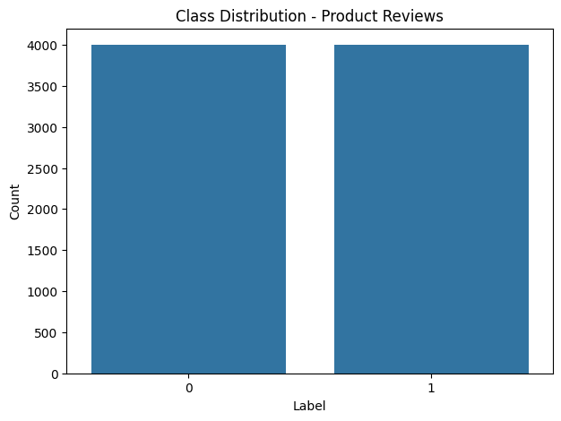
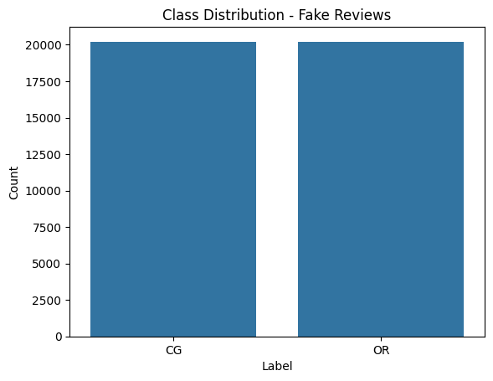
Exploratory Data Analysis

Slide 6
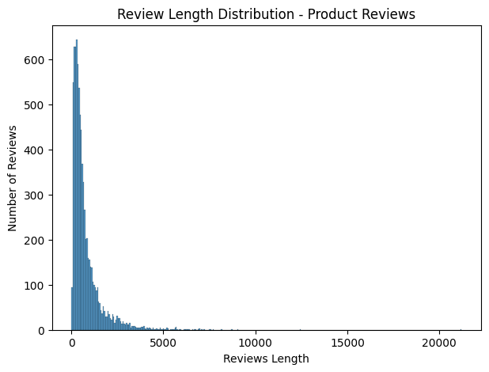
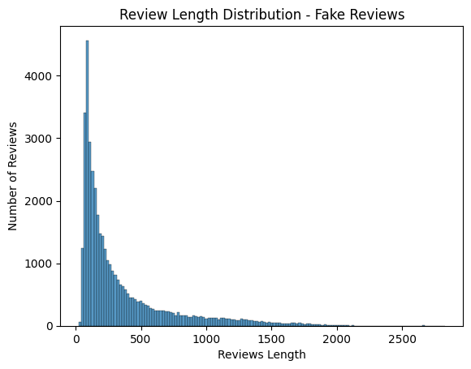
Exploratory Data Analysis

Slide 7
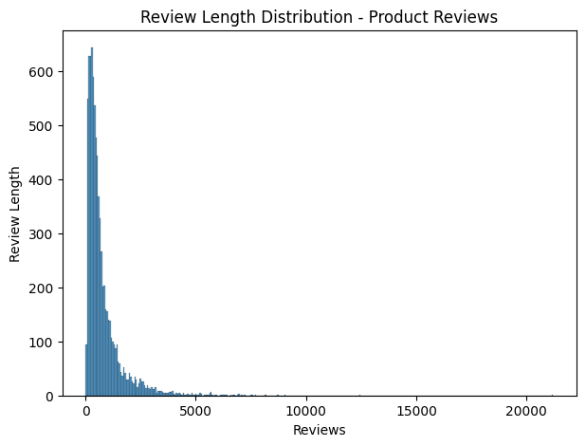
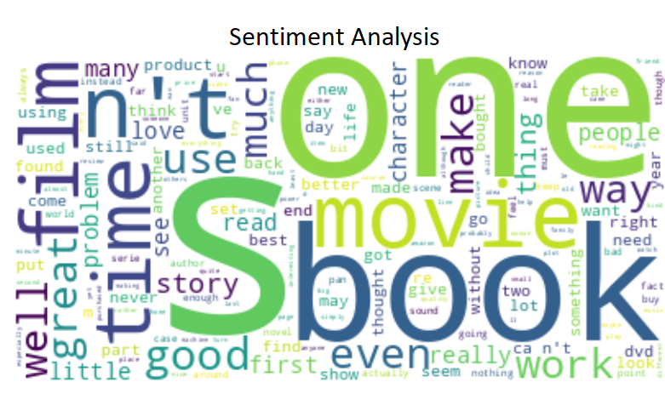
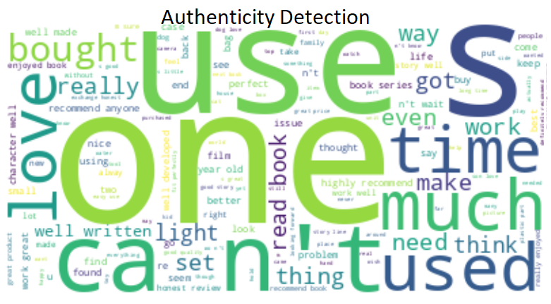

Exploratory Data Analysis

Slide 8
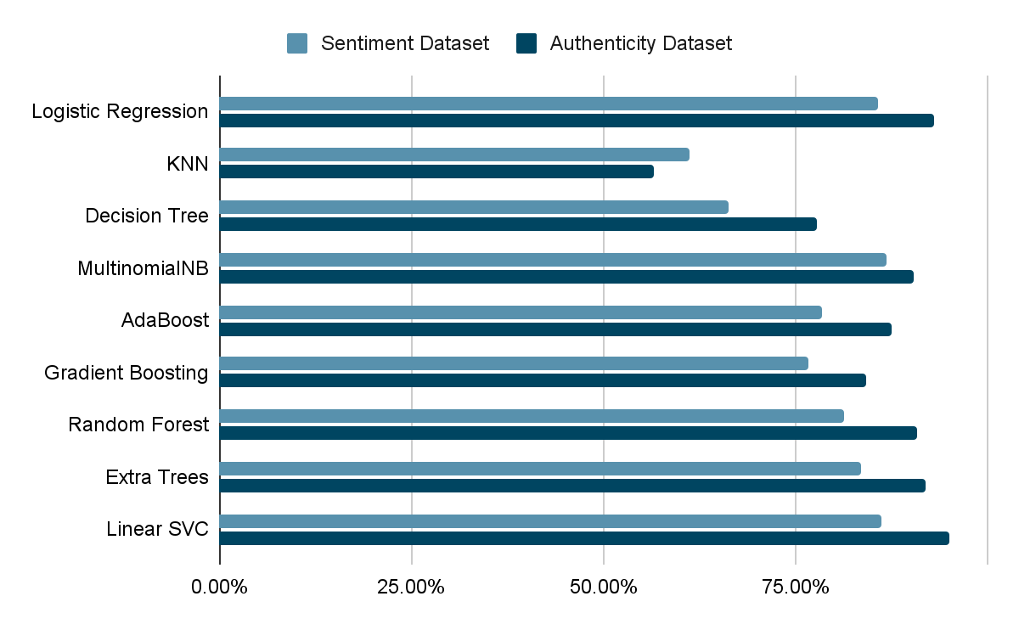
Comparative Analysis of Models

Slide 9
Final Models
Sentiment Analysis
The algorithm that worked best was an ensemble of Logistic Regression, MultinomialNB and LinearSVC.
It gave an accuracy of about 87%
Authenticity Detection
The best performing algorithm was LinearSVC.
It resulted in an accuracy of 95.18% and a precision of 95.59%

Slide 10
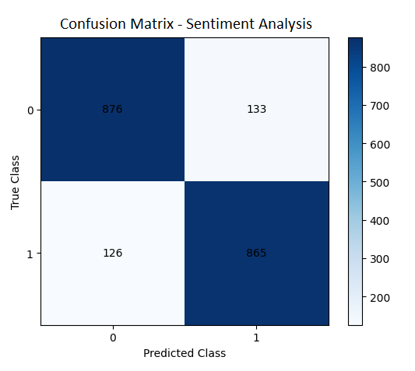
Final Model Results - Evaluation Metrics
 | Precision | Recall | F1-Score | Support
Negative | 0.87 | 0.87 | 0.87 | 1009
Positive | 0.87 | 0.87 | 0.87 | 991
Accuracy | - | - | 0.87 | 2000
Macro Average | 0.87 | 0.87 | 0.87 | 2000
Weighted Average | 0.87 | 0.87 | 0.87 | 2000

Slide 11
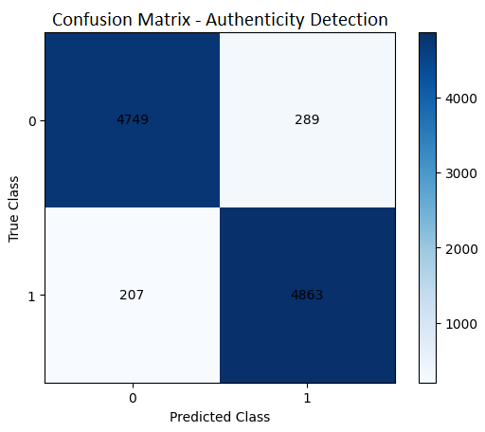
Final Model Results - Evaluation Metrics
 | Precision | Recall | F1-Score | Support
Negative | 0.96 | 0.94 | 0.95 | 5038
Positive | 0.94 | 0.96 | 0.95 | 5070
Accuracy | - | - | 0.95 | 10108
Macro Average | 0.95 | 0.95 | 0.95 | 10108
Weighted Average | 0.95 | 0.95 | 0.95 | 10108

Slide 12
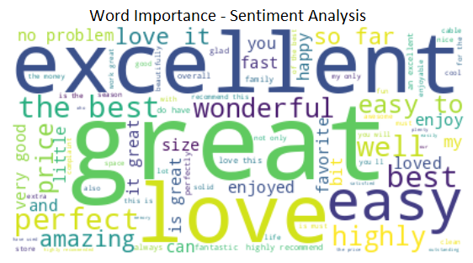
Final Model Results - Word Importance

Slide 13
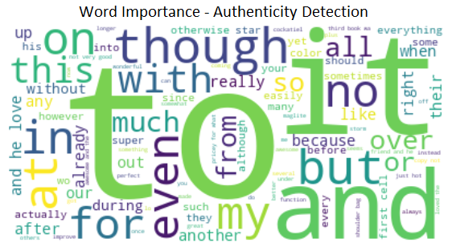
Final Model Results - Word Importance

Slide 14

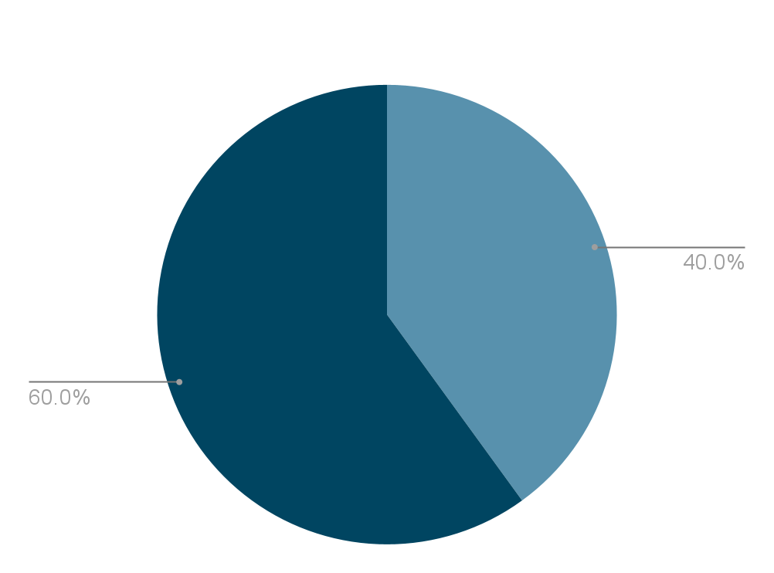
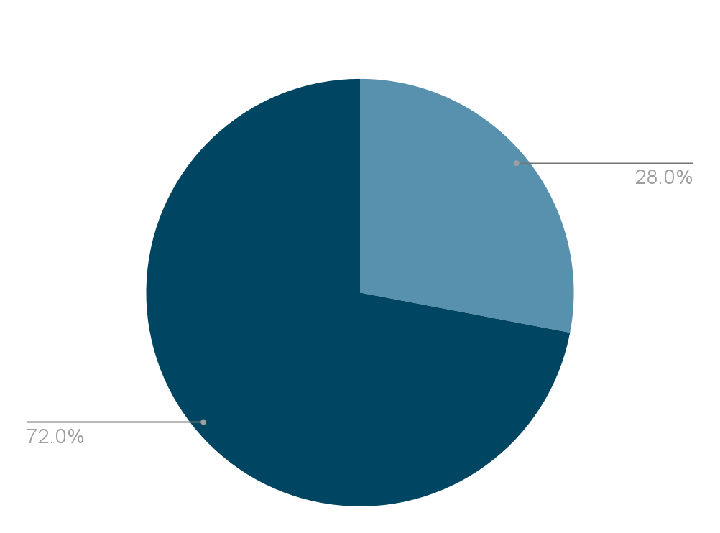
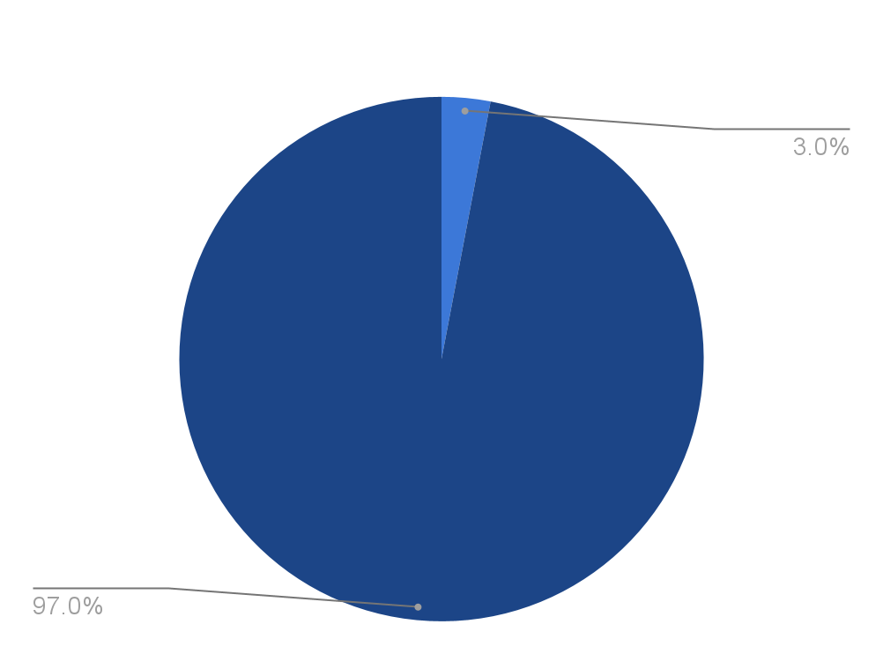
Use Case - S22 Ultra Review Analysis

Slide 15
Key Takeaways
The type of vectorization and the tuning of the parameters of the vectorization provided greater boost in the performance than the hyperparameter tuning of the individual algorithms.
Retaining of stopwords lead to increased performance compared to when it was removed.
Simple models like logistic regression provided better results and were faster to train than the complicated ones like Kernel SVC in many cases.
The coefficients of the trained logistic regression model were highly interpretable.
The model could be further improved by employing word embeddings, like word2vec, and deep learning algorithm for increased performance and a more holistic model.

Slide 16
Thanks!
Any questions?

