Slide 1
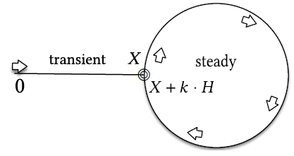
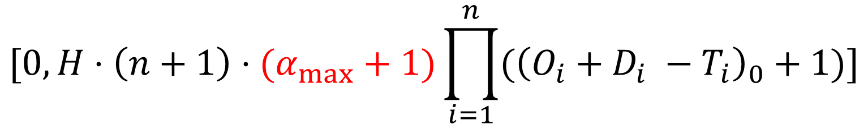
On the simulation intervals for single core real-time schedulers with preemption delays
$$[0, H⋅\left(n+1\right)⋅(α_{max}+1)\prod_{i=1}^{n}{({\left(O_{i}+D_{i} −T_{i}\right)}_{0}+1)}]$$

Slide 2

Assumptions
Time is discrete
Tasks are independent, periodic and asynchronous
Deadlines are constrained
Single core platform
Deterministic and memoryless (FTP or FJP) scheduler with preemption delays
$$[0; H⋅\left(n+1\right)⋅(α_{max}+1)\prod_{i=1}^{n}{({\left(O_{i}+D_{i} −T_{i}\right)}_{0}+1)}]$$

Slide 3
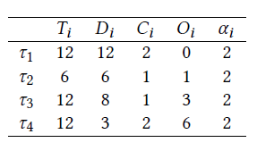




Each job can be preempted only by other jobs with release and deadline falling in its execution window
The first release time (offset) of every task is relative to that of the previously released ones
$$τ_{1}$$
$$τ_{2}$$
$$τ_{3}$$
$$τ_{4}$$
0
2
4
6
8
10
12
14
16
18
20
22
24
26
28
30
32

Slide 4
Each job can be preempted only by other jobs with release and deadline falling in its execution window
$$τ_{1}$$
$$τ_{2}$$
$$τ_{3}$$
$$τ_{4}$$
0
2
4
6
8
10
12
14
16
18
20
22
24
26
28
30
32

Slide 5









Each job can be preempted only by other jobs with release and deadline falling in its execution window
$$τ_{3}$$
$$τ_{3}$$
3
3
$$τ_{2}$$
$$τ_{2}$$
$$τ_{4}$$
0
$$τ_{4}$$
6
6
0
$$τ_{1}$$
$$τ_{1}$$
9
9

Slide 6
Each job can be preempted only by other jobs with release and deadline falling in its execution window
8
5
$$τ_{1}$$
$$τ_{2}$$
$$τ_{3}$$
$$τ_{4}$$
0
2
4
6
8
10
12
14
16
18
20
22
24
26
28
30
32

Slide 7
Each job can be preempted only by other jobs with release and deadline falling in its execution window
8
5
$$τ_{1}$$
$$τ_{2}$$
$$τ_{3}$$
$$τ_{4}$$
0
2
4
6
8
10
12
14
16
18
20
22
24
26
28
30
32

Slide 8

















Each job can be preempted only by other jobs with release and deadline falling in its execution window
8
5
$$τ_{4}$$
$$τ_{4}$$
$$τ_{2}$$
6
6
$$τ_{3}$$
$$τ_{3}$$
$$τ_{3}$$
$$τ_{2}$$
$$τ_{2}$$
$$τ_{1}$$
0
$$τ_{1}$$
0
12
$$τ_{1}$$
12
$$τ_{1}$$
$$τ_{2}$$
$$τ_{2}$$
18
18
$$τ_{4}$$
$${τ_{2}, τ}_{3}$$
$$τ_{4}$$
${, τ}_{3}$

Slide 9
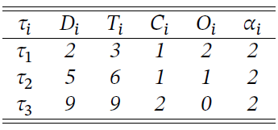



Each job can be preempted only by other jobs with release and deadline falling in its execution window
$$τ_{1}$$
$$τ_{2}$$
$$τ_{3}$$
0
2
4
6
8
10
12
14
16
18
20
22
24
26
28
30
32

Slide 10






Each job can be preempted only by other jobs with release and deadline falling in its execution window
6
3
$$τ_{1}$$
6
3
$$τ_{1}$$
$$τ_{2}$$
$$τ_{2}$$
0
$$τ_{3}$$
9
0
$$τ_{3}$$
9
12
15
12
15

