Slide 1
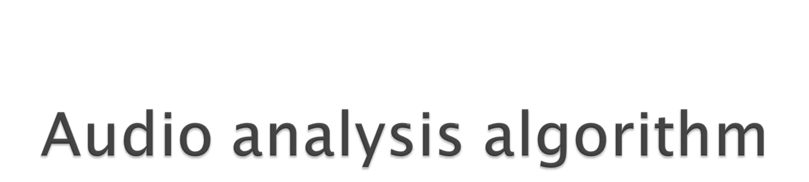
Author Haley Guo

Slide 2
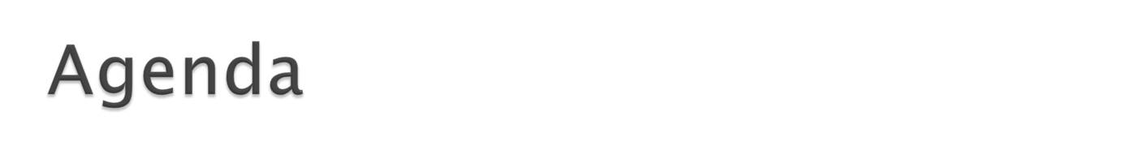
Overview
  Features
  Plan to add features
Why we need it
How it work
  Detect broken frame
  Recognize audio
Test result

Slide 3
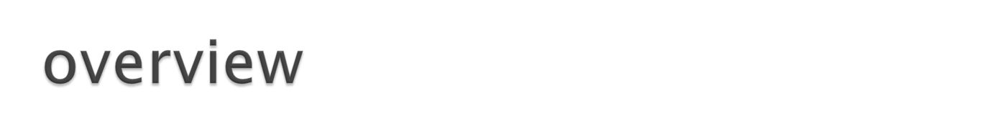
Audio analysis algorithm is designed for automatic analysis the audio from the playing-device weather it achieve our expectation or some standards.
The features as bellowing:
Detect broken frame: (achieve)
people can pick out the minimum broken frame is 0.02ms, and this algorithm can pick out smaller.
Recognize the audio and give it`s information:
it can recognize the audio, such as file names, etc.(achieve)

Slide 4
Detect the average volume value(achieve).
Plan Features:
Detect the sound error caused by device clock frequency:
sometimes the device clock configuration is not suitable, it will result in that voice sound fast or slow.
How to detect the noise value in audio, it is still a challenge.
Improve it and reach real time analysis.

Slide 5
Plan:
Except add new features, There are many place need to improve it.I will test the algorithm. Now it can analysis a length 15seconds audio and will take 20seconds. Algorithm is not fast enough. How to improve the speed is important.
Make it more stable and reliable.
I will try to use it to analysis sai demo in RC3.

Slide 6
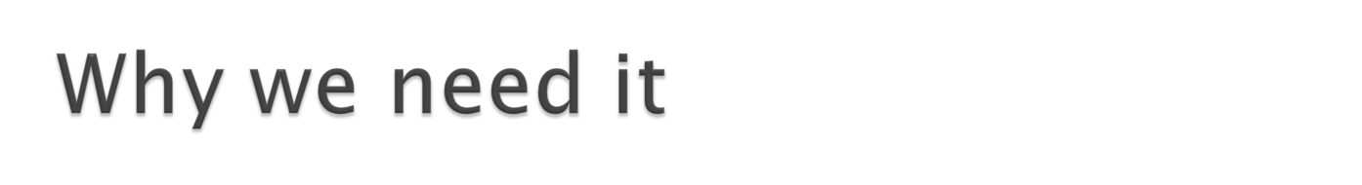
Synchronous Audio Interface is a module which is integrated into some kinetis chips. In tradition test way, it need someone mannually and constantly press button and listen the voice from the headphone. It will consume the a lot of time. And in my experience it is low efficient. With the number of platform and KSDK project developing, the work become more and more hard to complete.
Now we have the Dapeng automation environment. So weather we can improve the way of test and make a system to automatic judge the result of the voice from our platform.
Based on above consideration, we real need it.

Slide 7
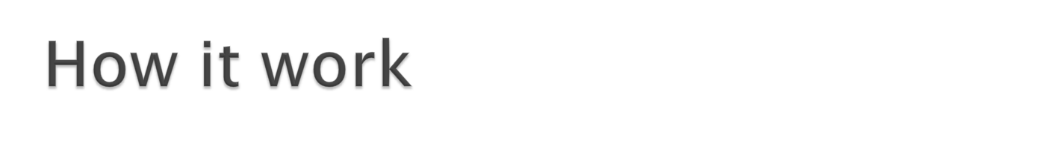
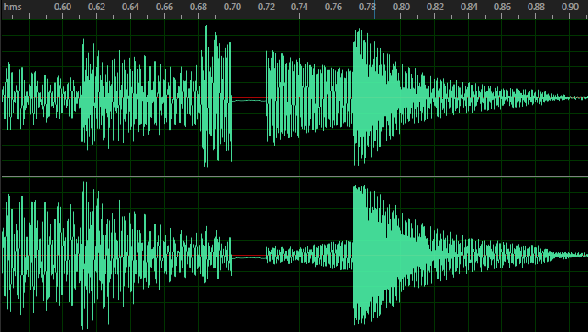
The audio analysis algorithm now have two basic functions.
Detect broken frame:
  This is a waveform of a music. From the picture we can clearly see that there is a broken frame in:0.70(s), the silence section is 0.02(s)
waveform

Slide 8
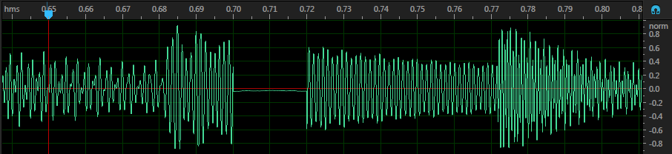

The variance shows measures of central tendency in a set of data. In broken frame section the variance is very low, but in another section where is the normal waveform is big. Based on this, we use two section variance to detect the broken frame.
Use a window to calculate the variance0 in this part , and move a width to next location, and also get the variance.
If variance0 – variance > threshold, we can get a falling edge.
Based on detecting a falling edge, variance- variance0 > threshold, we can get a rising edge.
Above of all , we can detect a broken frame.

Slide 9
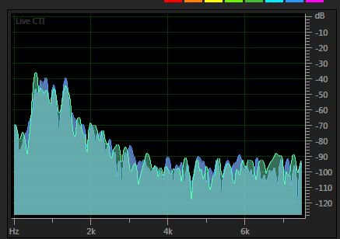
2) Recognize function:
If people know the sound before, they will recognize it when hear next. However for machine? We need the computer also know the audio is which one it heard from the input.
Music is a special signal, we can`t compare the sample voice and source by waveform, because even though the waveform is not same, but probably they are a same music. So it need to analysis in frequency domain.
The algorithm of the mainstream in the world is based on audio-fingerprint. (For detail please see: A Highly Robust Audio Fingerprinting System author: Jaap Haitsma and Ton Kalker)
The frequency include many features about the signal.
For sound, human can hear 200Hz~2000Hz. Extract the useful information of this part as audio fingerprint.
A audio frequency domain figure

Slide 10
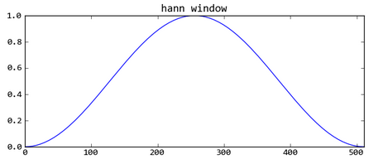
Step one:
The audio signal is segmented into frames, and frame overlap 15/16. This will keep the change of sub-fingerprint is continuous.
Step two:
Frames is transformed into frequency domain from time domain by FFT. In order to decrease the influence by FFT, the
signal should be smoothed by Hann window.
smoothedFrame = Hann * oneframe

Slide 11
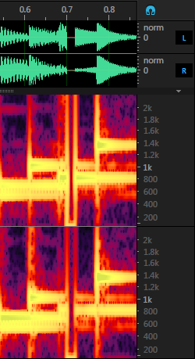
Step three:
Calculate frame`s sub-fingerprint. If we segment the frequency to 32 bands, and each bans is one bit. We denote the energy of band m of frame n by f(n,m) and the m-th bi of the sub-fingerprint of frame n by F(n,m), the bits of the sub-fingerprint are formally defined as bellow:
F(n, m) = 1 if f[n][m] – f[n][m+1] – (f[n-1][m]-f[n-1][m+1])>0
F(n, m) = 0 if f[n][m] – f[n][m+1] – (f[n-1][m]-f[n-1][m+1])<0
One frame
Waveform and frequency

Slide 12
Each sub-fingerprint is a 32bit number: just like [01001…..0000]
Before recognize we must save the source audio fingerprints into a .pkl file.
Get the audio fingerprint process is just find a way to compress the data, and also get it`s features, by this method we can decrease the data size and improve the recognize efficiency.

Slide 13
Step four:
Get the fingerprints, and then how we use it to recognize file is very important. We use the smooth-window to compare the sub-fingerprint block between the two file. The following picture shows the process.
Window1
move n
L
Source file
move L
Window2
L
L
L
……
Target file

Slide 14
Calculate the block distance and when it less than a threshold, we can get a matched-time point.
Block distant = window1 ^ window2
If window1 is same with window2, the amount of “1” should be less than a threshold. So the block distant can through calculate the number of “1”.
In order to improve the speed of the search. There are two special treatment.
1) use Hamming weight to decrease the time complexity
2) if the section we have compared that will be ignored in next search cycle.

Slide 15
After walk a cycle, we can get a series matched-time point data, because the window size is certain, so the matched-time point is a Arithmetic sequence. The tolerance is decided by window size. For example, the window size is 10, the sample rates is 44100, the fft size is 8192, the overlap is 15/16:
tolerance = 10 *(8192/44100) * (1/16) = 0.116s
So at the last we just need to judge the sequence weather is arithmetic sequence. If it is, that is to say they are a same audio.

Slide 16
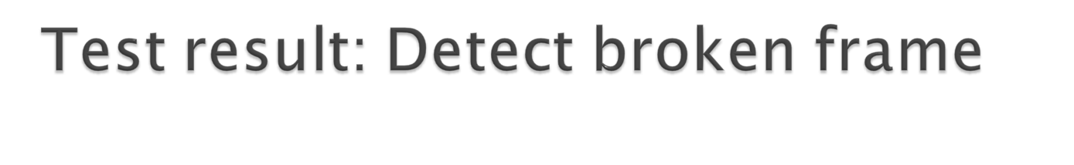
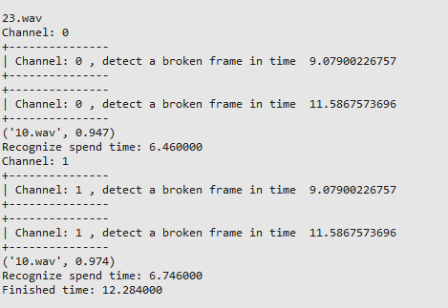
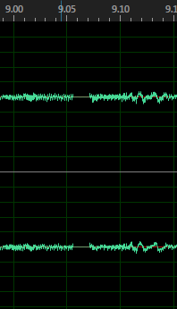
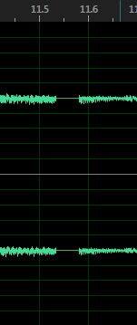
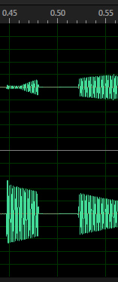
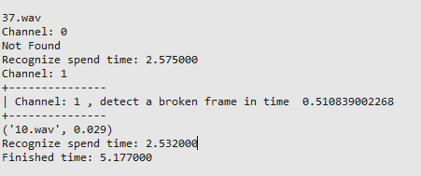

Slide 17
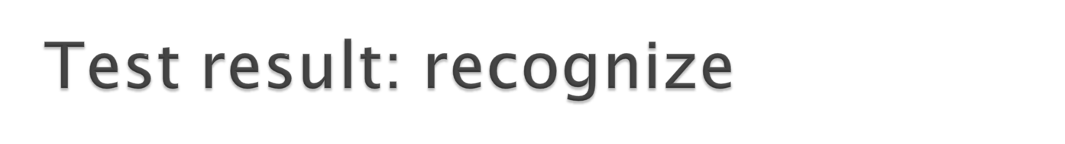
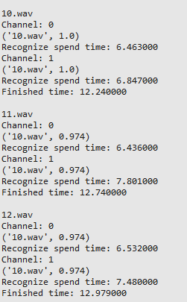
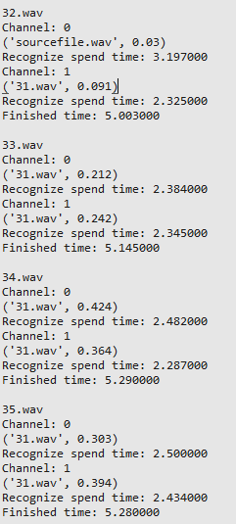
(’10.wav’, 0.97)
’10.wav’ means file name,
0.97 means the confidence of the result
For 15 seconds music, there is a
satisfactory result.
However, the result is poor performance for short file. On the hand because the number of fingerprints is rarely, on another hand the file frequency have been changed by playing or recording. And also the algorithm have defectiveness.

