Slide 1
do...while loop

Slide 2
The do and while keyword is used to create a do...while loop. It is similar to a while loop, however there is a major difference between them.
In while loop, the condition is checked before the body is executed. It is the exact opposite in do...while loop, i.e. condition is checked after the body is executed.

Slide 3
The syntax for do...while loop is:
Do
{
// body of do while loop
} while (test-expression);

Slide 4
How do...while loop works?
The body of do...while loop is executed at first.
Then the test-expression is evaluated.
If the test-expression is true, the body of loop is executed.
When the test-expression is false, do...while loop terminates.

Slide 5
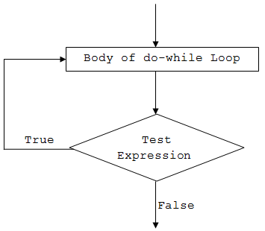
do...while loop Flowchart

Slide 6
THANK YOU
Assigment: Bashar Ahmad “Khalidi”
ID: 21RB200-184

