Slide 1
GIT basic tutorial

Slide 2
1.1、What Git
Git is a free and open source distributed version control system designed to handle everything from small to very large projects with speed and efficiency.
Git is easy to learn and has a tiny footprint with lightning fast performance. It outclasses SCM tools like Subversion, CVS, Perforce, and ClearCase with features like cheap local branching, convenient staging areas, and multiple workflows.

Slide 3
1.2、Install Git
Before you start using Git, you need to install it on your computer. Even if it is already installed, it is best to upgrade it to the latest version. You can install it through a package or other installer, or download the source compilation installation.
Installing on Linux
If you want to install Git with a binary installer on Linux, you can install it using the underlying package management tools included in the release. If you take Fedora as an example, you can use yum:
$ sudo yum install git
If you're on a Debian based distribution, try using apt-get:
$ sudo apt-get install git
Installing on Windows
There are several installation methods for installing Git on Windows. The official version can be downloaded from the Git official website. Open http://gitscm.com/download/win and the download will start automatically.

Slide 4
1.3、Git initialization
Git initialization
View git version
$ git –version
Before we start using Git, we first need to set the git configuration variable with the git config command. The main steps are as follows：
（1）Configuring User Information，this will be used when submitting
$ git config --global user.name “yangli”
$ git config --global user.email “li.yang@ncsi.com.cn”
（2）Set alias，to use a more concise subcommand
$ git config --global alias.ci commit
（3）Turn on color display
$ git config --global color.ui true

Slide 5
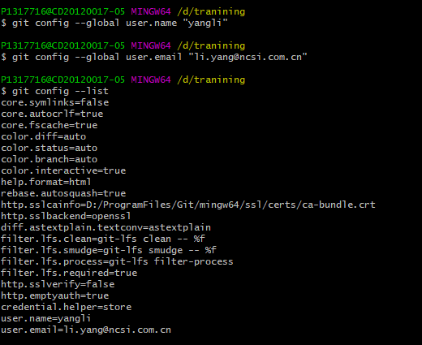
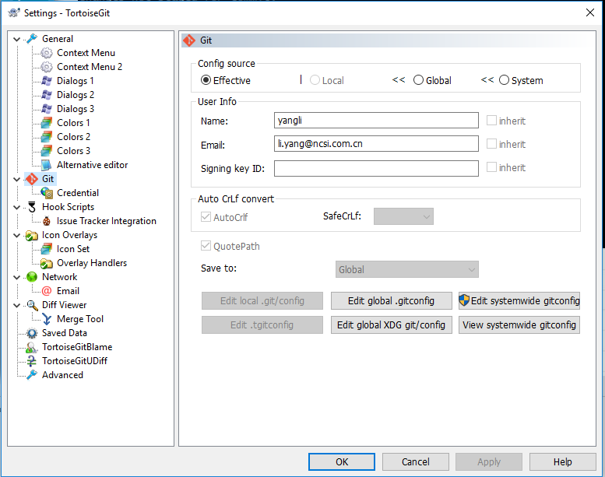

Slide 6
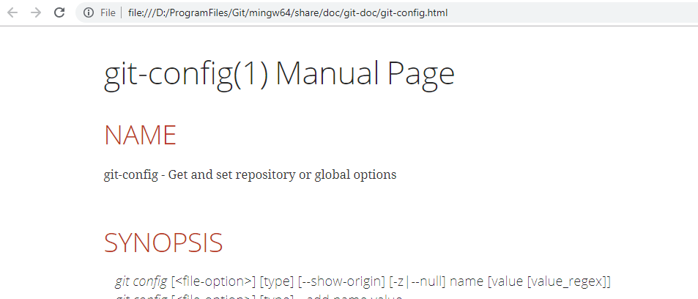
1.4、Get help
If you need help using Git, there are three ways to find the user manual for the Git command:
git help <verb>
git <verb> --help
man git-<verb>
For example, to obtain a manual for the Config command, perform the
$ git help config

Slide 7
2.1、Get git warehouse
You typically obtain a Git repository three ways:
Create a new repository
Existing folder
Existing Git repository

Slide 8
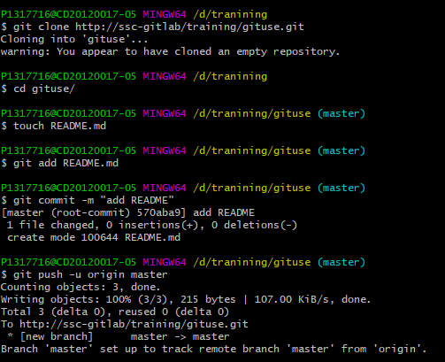
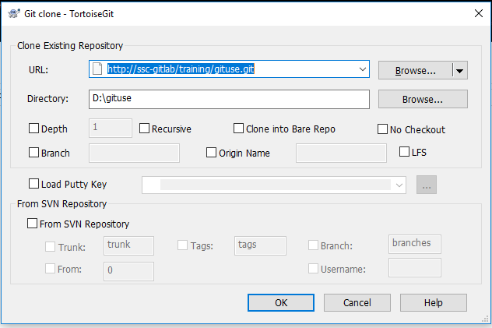
Create a new repository
git clone http://ssc-gitlab/training/gituse.git
cd gituse
touch README.md
git add README.md
git commit -m "add README"
git push -u origin master

Slide 9
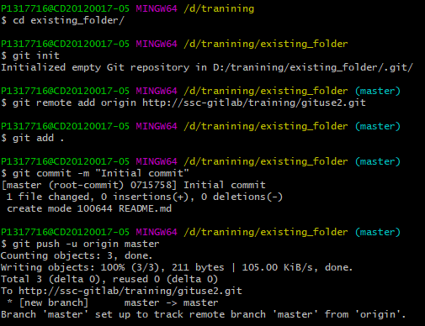
Existing folder
cd existing_folder
git init
git remote add origin http://ssc-gitlab/training/gituse2.git
git add .
git commit -m "Initial commit"
git push -u origin master

Slide 10
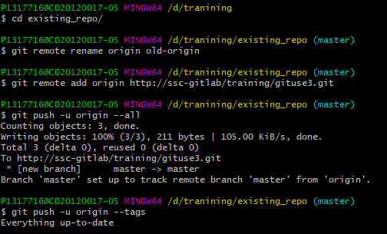
Existing Git repository
cd existing_repo
git remote rename origin old-origin
git remote add origin http://ssc-gitlab/training/gituse3.git
git push -u origin --all
git push -u origin --tags

Slide 11
2.2、Recording Changes to the Repository
Keep in mind that every file in your working directory is nothing more than two states: tracked or not tracked. Tracked files are those that are included in versioning and have their records in the last snapshot, and after a period of work, their status may be unmodified, modified, or placed in staging area. All files in the working directory except the tracked files belong to the unread files, which do not exist in the records of the last snapshot and are not placed in staging area. When a warehouse is first cloned, all files in the working directory belong to the tracked file and are in an unmodified state.
After you have edited some files, Git marks them as modified because you have modified them since the last commit. We gradually put these modified files into the staging area, and then submitted all the pending changes, so repeatedly. So when you use Git, the life cycle of the file is as follows:

Slide 12
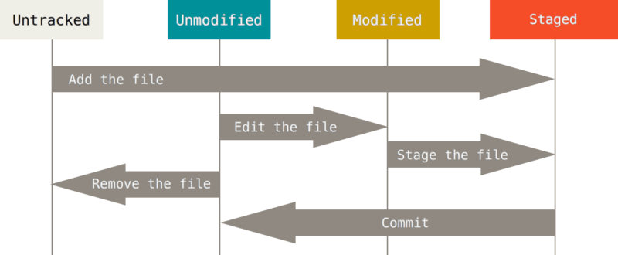

Slide 13
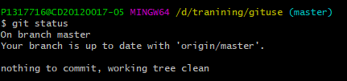
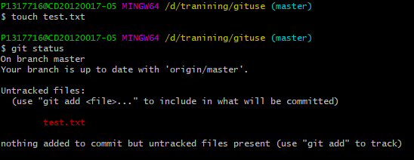
Check the current file status
git-status - Show the working tree status:
create new file and Show the working tree status:

Slide 14
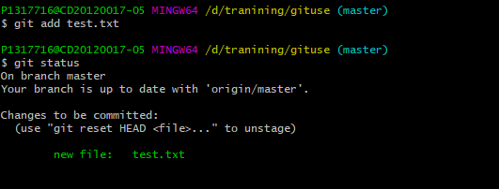
Tracking New Files
In order to begin tracking a new file, you use the command git add. To begin tracking the README file, you can run this:
$ git add text.txt
If you run your status command again, you can see that your test.txt file is now tracked and staged to be committed.

Slide 15
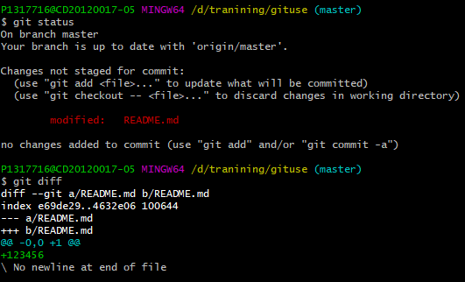
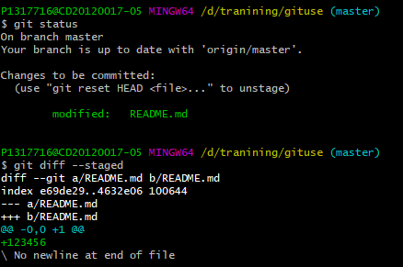
Viewing your Staged and Unstaged Changes
To see what you've changed but not yet staged, type git diff with no other arguments
If you want to see what you’ve staged that will go into your next commit, you can use git diff --staged.

Slide 16
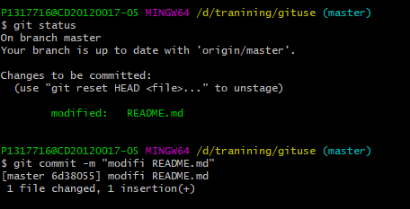
Committing Your Changes
Now that your staging area is set up the way you want it, you can commit your changes. Remember that anything that is still unstaged — any files you have created or modified that you haven’t run git add on since you edited them — won’t go into this commit. They will stay as modified files on your disk. In this case, let’s say that the last time you ran git status, you saw that everything was staged, so you’re ready to commit your changes. The simplest way to commit is to type git commit:
$ git commit –m <submit a note>

Slide 17
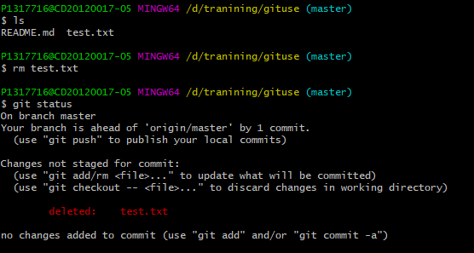
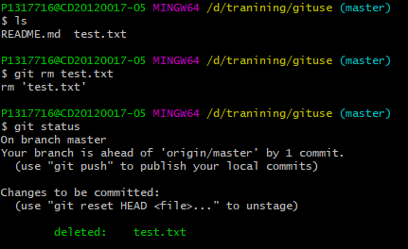
Removing a file
To remove a file from Git, you have to remove it from your tracked files (more accurately, remove it from your staging area) and then commit. The git rm command does that, and also removes the file from your working directory so you don’t see it as an untracked file the next time around.If you simply remove the file from your working directory, it shows up under the “Changes not staged for commit” (that is, unstaged) area of your git status output:
Then, if you run git rm, it stages the file’s removal:

Slide 18
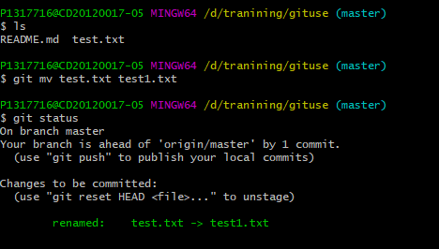
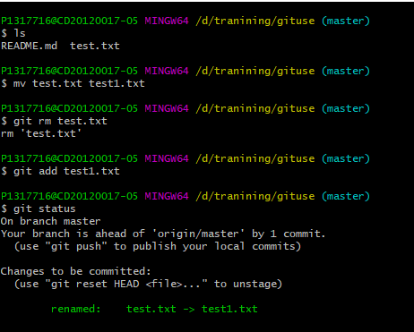
Move files
git mv file_from file_to
In fact, running the git MV is equivalent to running the following three commands:
$ mv README.md READM
$ git rm README.md
$ git add README

Slide 19
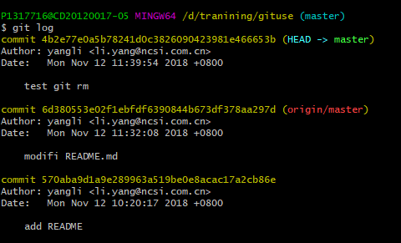
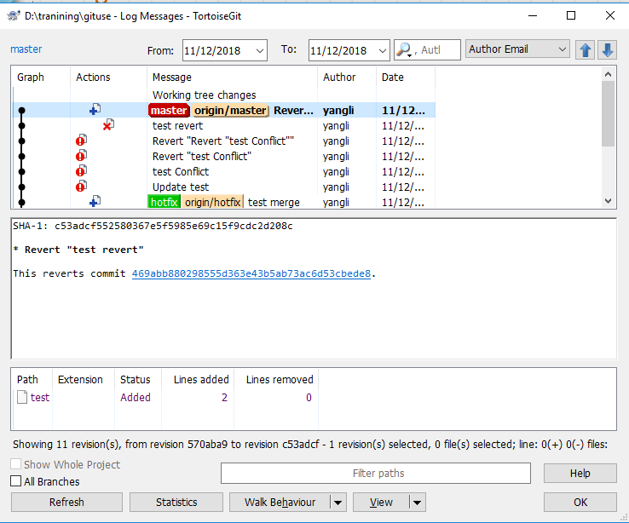
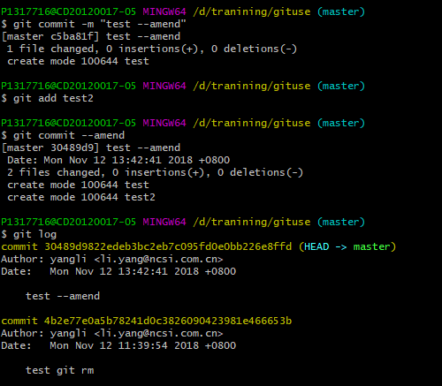
Viewing the Commit History
$ git log
Undoing Things
$ git commit –m “test --amend”
$ git add test2
$ git commit --amend
You end up with a single commit — the second commit replaces the results of the first.

Slide 20
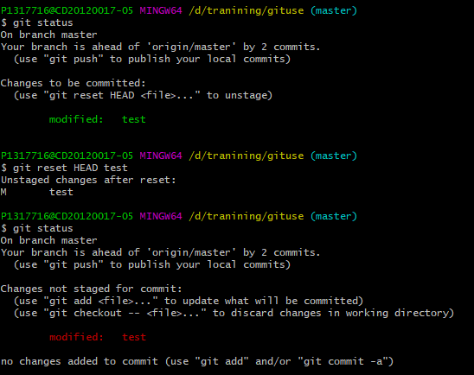
Unstaging a Staged File
Use git reset HEAD <file>... to unstage

Slide 21
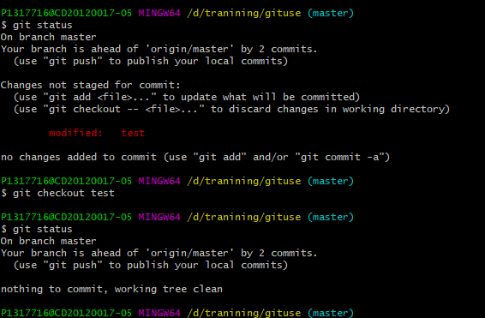
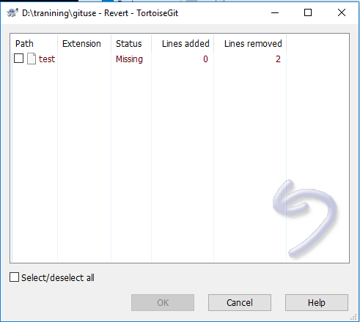
Unmodifying a Modified File
user git checkout --<file>... to Unmodifying

Slide 22
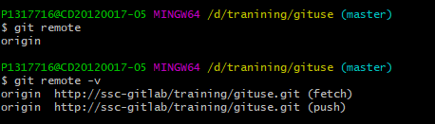
2.3 Working with Remotes
Showing Your Remotes
To see which remote servers you have configured, you can run the git remote command. It lists the shortnames of each remote handle you’ve specified. If you’ve cloned your repository, you should at least see origin — that is the default name Git gives to the server you cloned from:

Slide 23
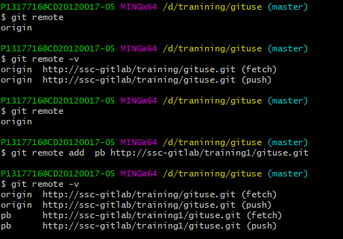
Adding Remote Repositories
run git remote add <shortname> <url>:

Slide 24

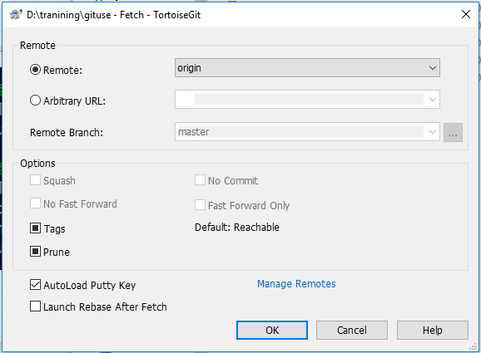
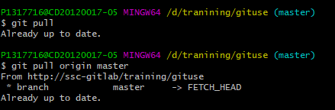
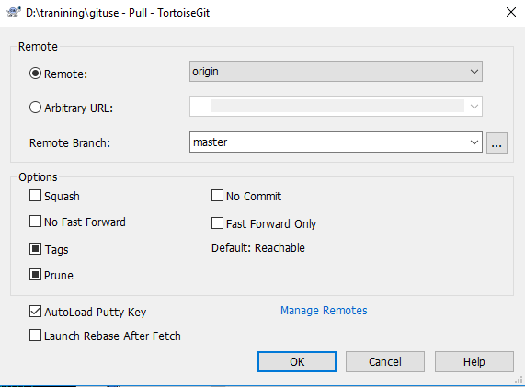
Fetching and Pulling from Your Remotes
$ git fetch <remote>
It’s important to note that the git fetch command only downloads the data to your local repository — it doesn’t automatically merge it with any of your work or modify what you’re currently working on. You have to merge it manually into your work when you’re ready.
$ git pull or git pull <remote>
If your current branch is set up to track a remote branch, you can use the git
pull command to automatically fetch and then merge that remote branch into your current branch. Running git pull generally fetches data from the server you originally cloned from and automatically tries to merge it into the code you’re currently working on

Slide 25
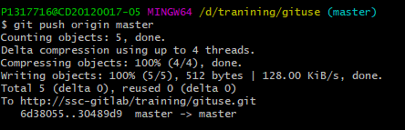
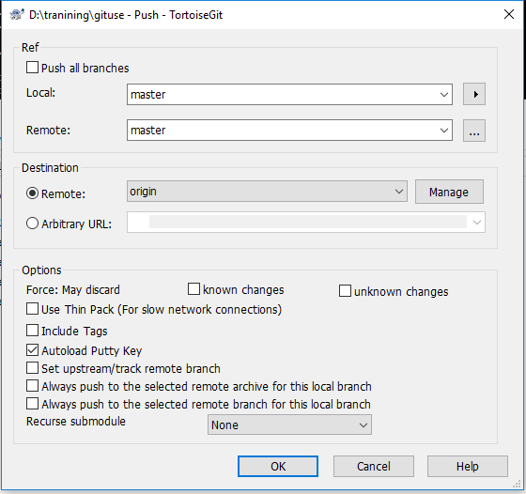
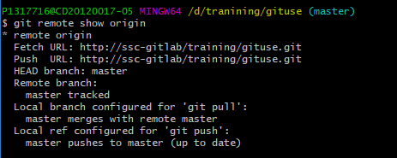
Pushing to Your Remotes
The command for this is simple: git push <remote> <branch>.
Inspecting a Remote
If you want to see more information about a particular remote, you can use the git remote show <remote> command.
$ git remote show origin

Slide 26
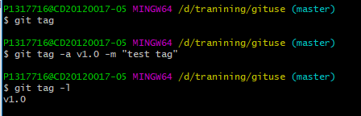
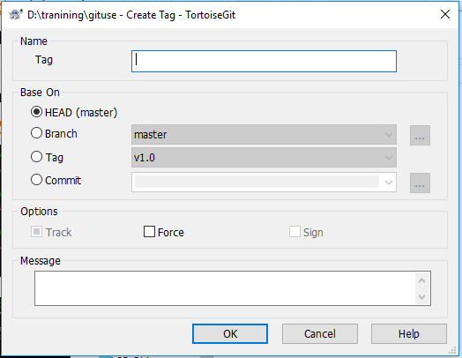
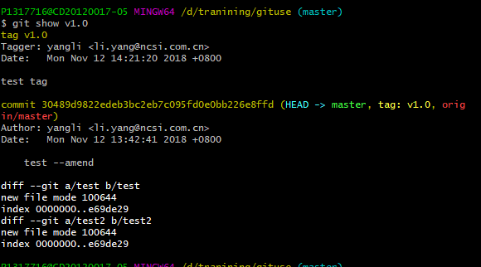
2.4 Git Basics - Tagging
Listing Your Tags
Listing the available tags in Git is straightforward. Just type git tag (with optional -l or --list):
$ git tag -l
Annotated Tags
Creating an annotated tag in Git is simple. The easiest way is to specify -a when you run the tag command:
$ git tag -a v1.0 -m "test tag"

Slide 27
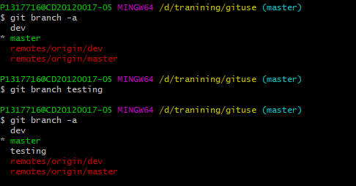
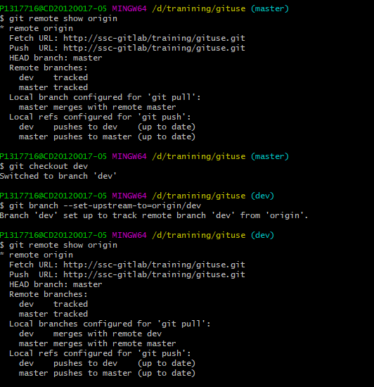
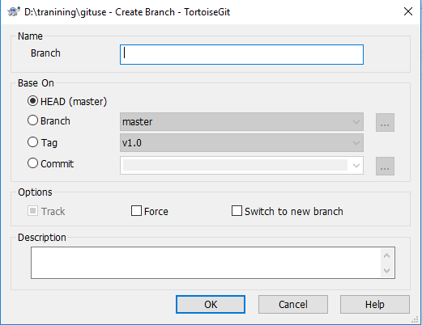
3.1 Git Branch-Introduction to Branches
Creating a New Branch
Command: git branch <branchName> --create new branch
Command: git branch --View Local Branches
Command: git branch –a –list all branch(remote and local)
Command: git branch --set-upstream-to=origin/dev --Branch association

Slide 28
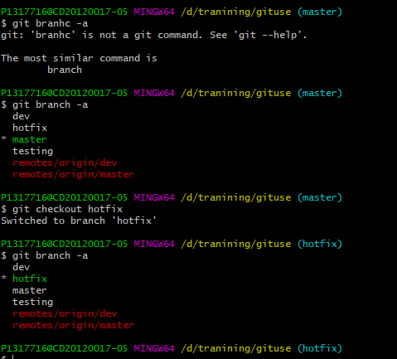
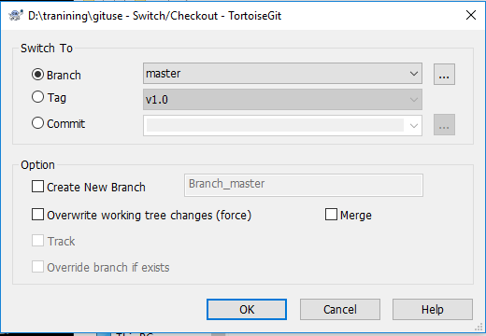
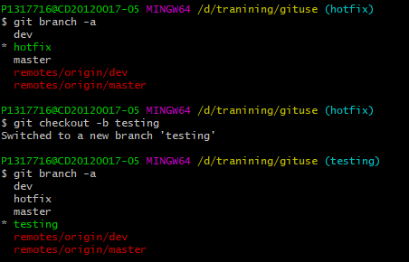
Switching Branches
Command: git checkout <branchName>
Command: git checkout –b <branchName>
Equal to:
$ git branch <branchName>
$ git checkout <branchName>

Slide 29
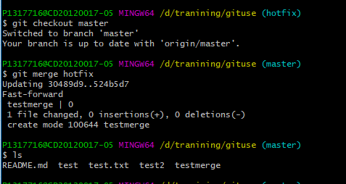
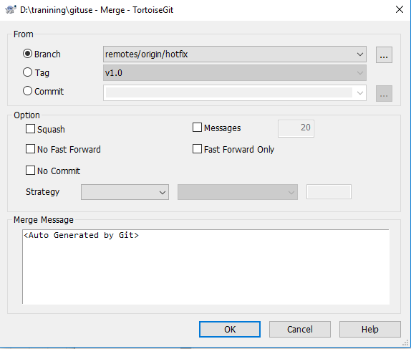
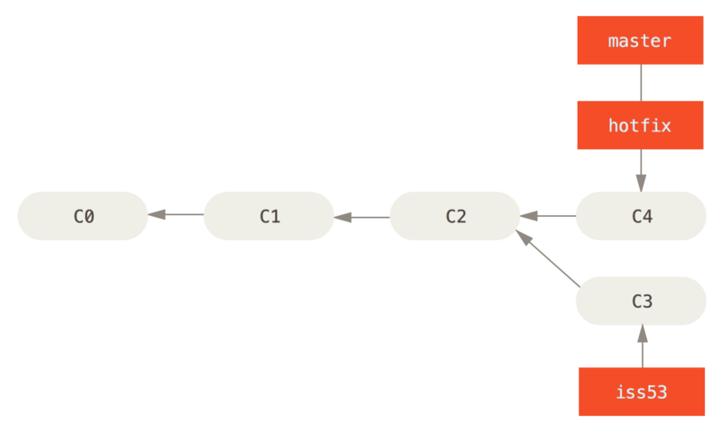
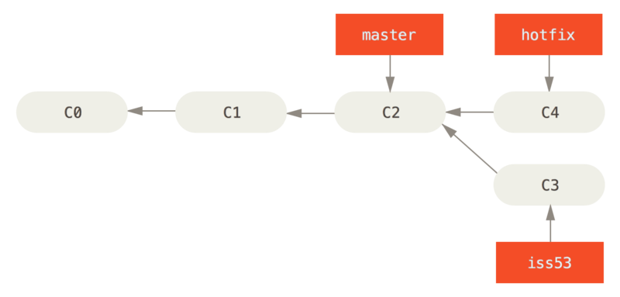
Basic Branching and Merging
command: git merge <branchName>

Slide 30
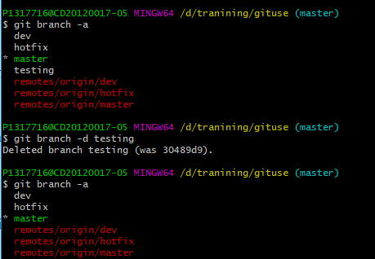
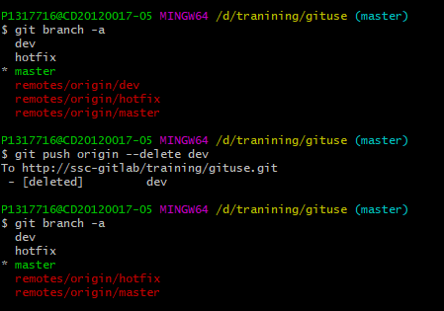
Delete branch
Command: git branch -d <branchName>
Command: git push origin –delete <branchName> -- delete remote branch

Slide 31
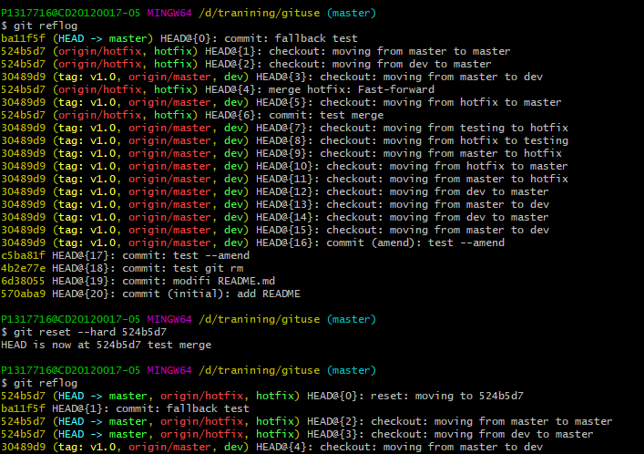
Version fallback
Local branch version fallback
find fallback version commit id: git reflog
fallback: git reset --hard /--soft /--mixed <commit id>
Command: git reset --soft <commit id>

Slide 32
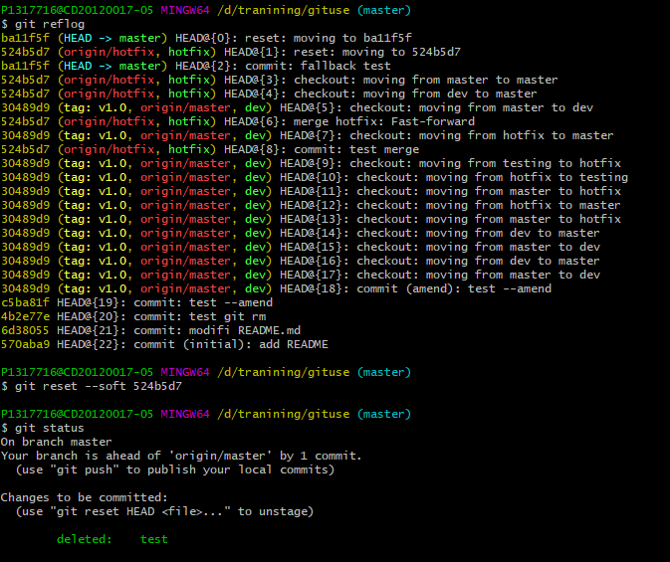
Command: git reset --soft <commit id>

Slide 33
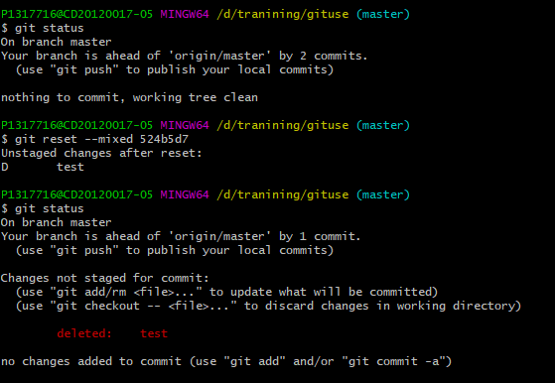
Command: git reset --mixed <commit id>

Slide 34


Remote branch version fallback
git reflog
git reset --hard <commit id>
git push –f
Note: After the local branch is rolled back, the version will lag behind the remote branch, and the remote branch must be overwritten with forced push, otherwise it cannot be pushed to the remote branch.

Slide 35

Public remote branch version fallback
git revert HEAD //Undo the last commit
git revert HEAD~1
git revert 0ffaacc //Revoke 0ffaacc this submission

Slide 36

Conflict management
When executing git pull conflicts, you cannot pull the latest code, you can use git-stash command to save you local changes.
git stash list --List the stash entries that you currently have
git stash pop -- Remove a single stashed state from the stash list and apply it on top of the current working tree state.
git-stash - Stash the changes in a dirty working directory away

Slide 37
Thanks

