Slide 1


SCIKIT-LEARN
Machine Learning Library
Presented By :-
Aadarsh Yadav
Aditya Pratap Singh
Devesh Soni

Slide 2
What is Scikit-Learn (Sklearn)
Scikit-learn (Sklearn) is one of the most useful library for machine learning in Python. It provides a selection of efficient tools for machine learning and statistical modeling including classification, regression, clustering and dimensionality reduction via a consistence interface in Python. This library, which is largely written in Python is built upon NumPy, SciPy and Matplotlib

Slide 3
Origin of Scikit Learn
It was originally called scikits.learn and was initially developed by David Cournapeau as a Google summer of code project in 2007. Later, in 2010, Fabian Pedregosa, Gael Varoquaux, Alexandre Gramfort, and Vincent Michel, from FIRCA (French Institute for Research in Computer Science and Automation), took this project at another level and made the first public release (v0.1 beta) on 1st Feb. 2010.

Slide 4
Installation
Using pip
Following command can be used to install scikit-learn via pip
pip install -U scikit-learn
Using conda
Following command can be used to install scikit-learn via conda
conda install scikit-learn

Slide 5
Features
Rather than focusing on loading, manipulating and summarizing data, Scikit-learn library is focused on modeling the data. Some of the most popular groups of models provided by Sklearn are up next.

Slide 6
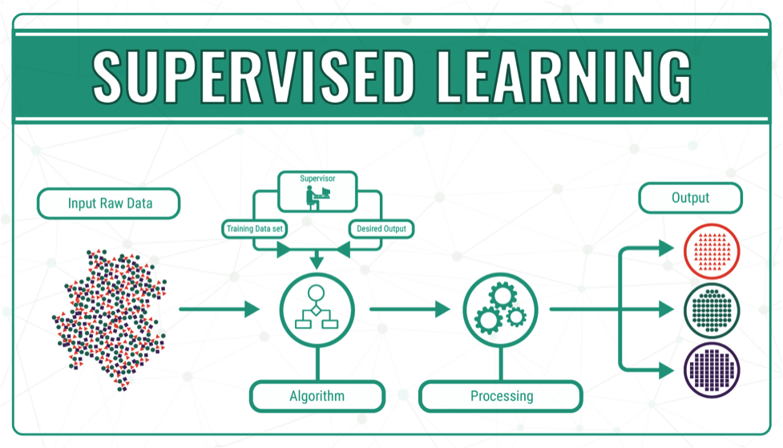
Supervised Learning algorithms
Almost all the popular supervised learning algorithms, like Linear Regression, Support Vector Machine (SVM), Decision Tree etc., are the part of scikit-learn.

Slide 7
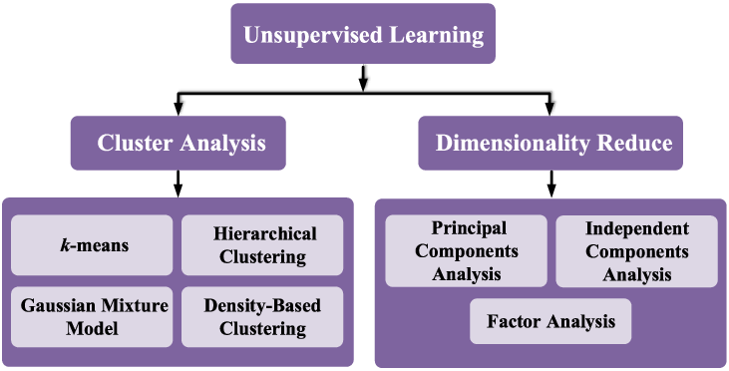
Unsupervised Learning algorithms
On the other hand, it also has all the popular unsupervised learning algorithms from clustering, factor analysis, PCA (Principal Component Analysis) to unsupervised neural networks.

Slide 8
CRoss Validation
It is used to check the accuracy of supervised models on unseen data.
DIMENSIONALITY REDUCTION
It is used for reducing the number of attributes in data which can be further used for summarization, visualization and feature selection.
Ensemble methods
As name suggest, it is used for combining the predictions of multiple supervised models.

Slide 9
Feature extraction
It is used to extract the features from data to define the attributes in image and text data.
Feature selection
It is used to identify useful attributes to create supervised models.
Open Source
It is open source library and also commercially usable under BSD license.

Slide 10
scikit Learn - Modelling Process

Slide 11
Dataset Loading
A collection of data is called dataset. It is having the following two components −
Features − The variables of data are called its features. They are also known as predictors, inputs or attributes.
Response − It is the output variable that basically depends upon the feature variables. They are also known as target, label or output.

Slide 12
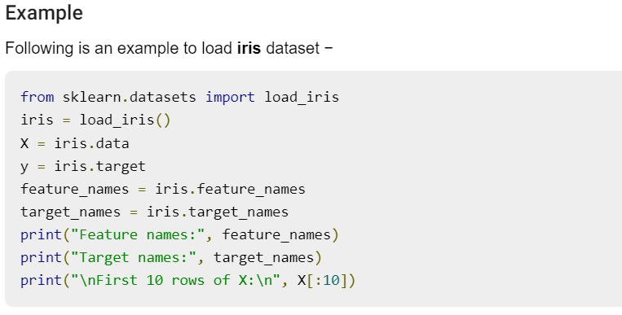

Slide 13
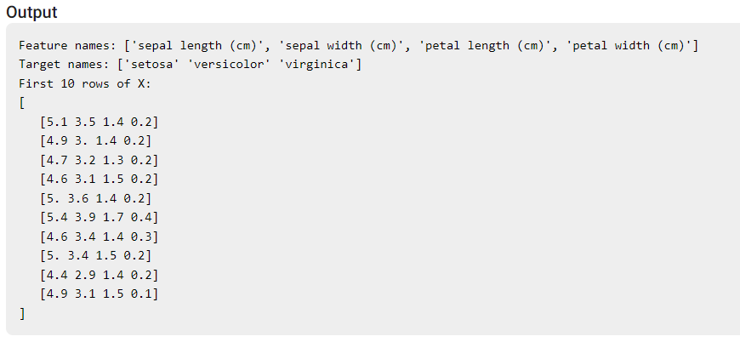

Slide 14
2. splitting the dataset
To check the accuracy of our model, we can split the dataset into two pieces - a training set and a testing set. Use the training set to train the model and testing set to test the model. After that, we can evaluate how well our model did.

Slide 15
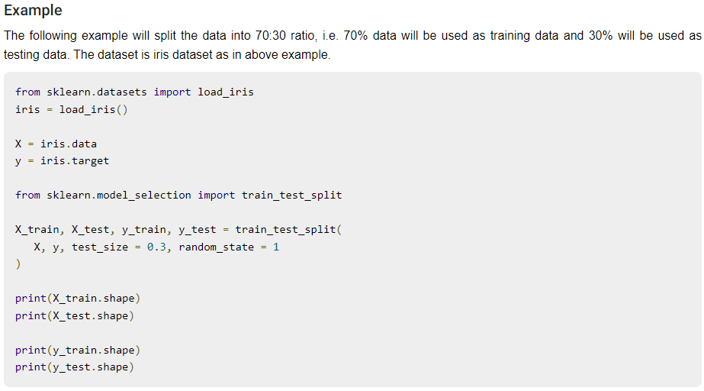
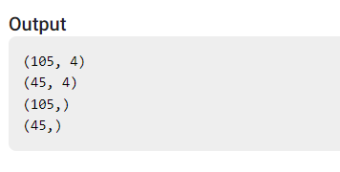

Slide 16
3. Train the Model
Next, we can use our dataset to train some prediction-model. As discussed, scikit-learn has wide range of Machine Learning (ML) algorithms which have a consistent interface for fitting, predicting accuracy, recall etc.

Slide 17
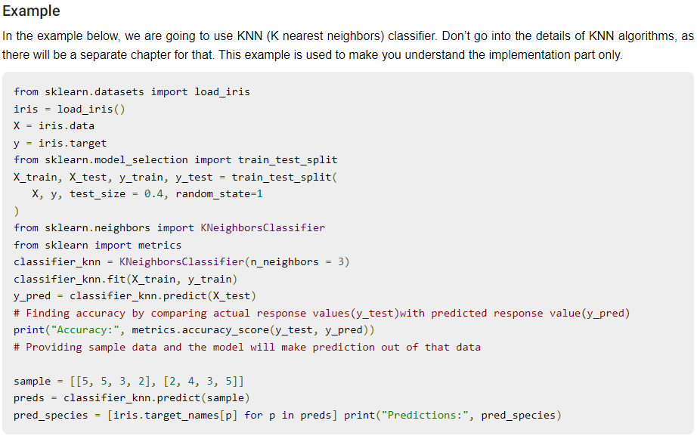
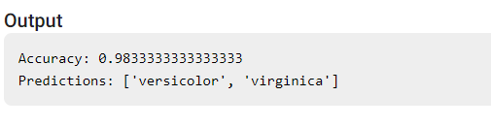

Slide 18
4. Preprocessing the Data
As we are dealing with lots of data and that data is in raw form, before inputting that data to machine learning algorithms, we need to convert it into meaningful data. This process is called preprocessing the data. Scikit-learn has package named preprocessing for this purpose.
The preprocessing package has the following techniques −
Binarization
Mean Removal
Scaling
Normalization

Slide 19
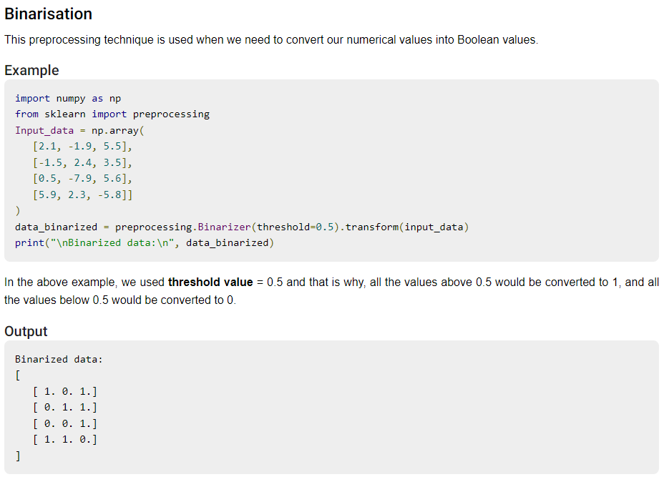

Slide 20
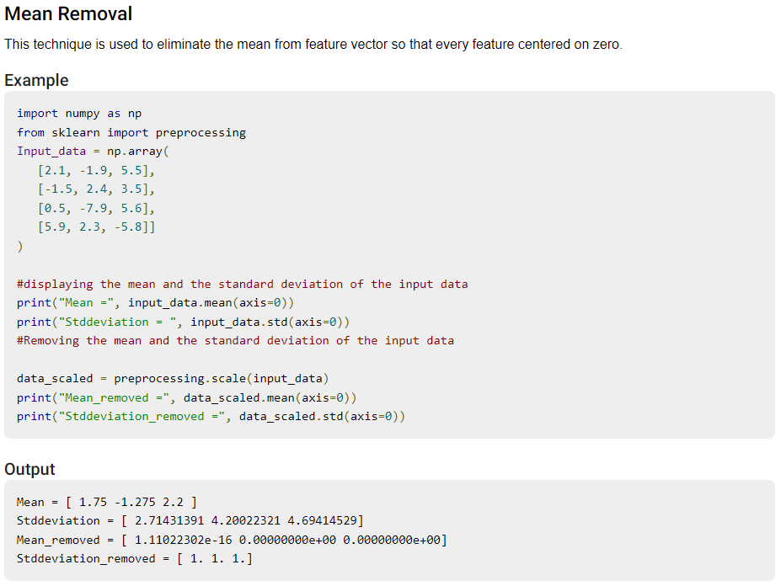

Slide 21
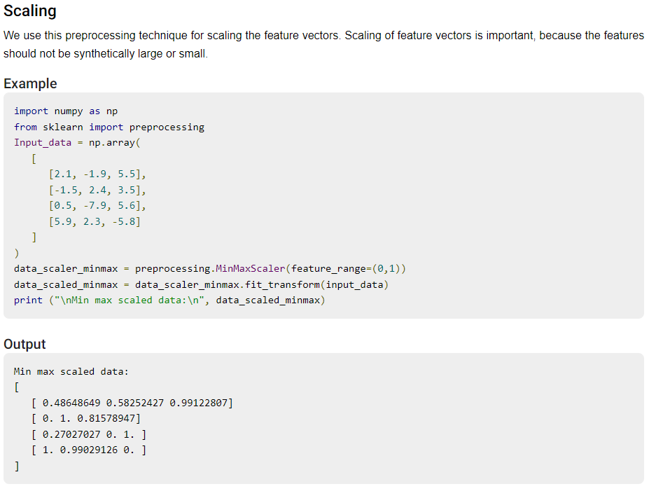

Slide 22
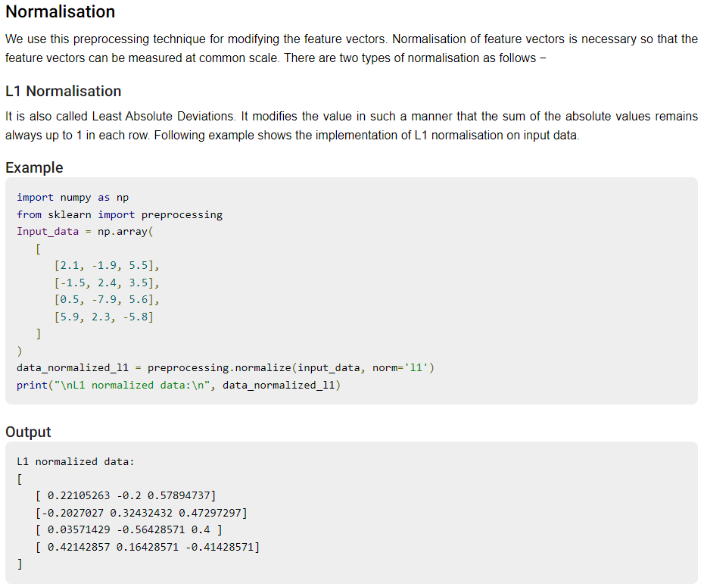

Slide 23
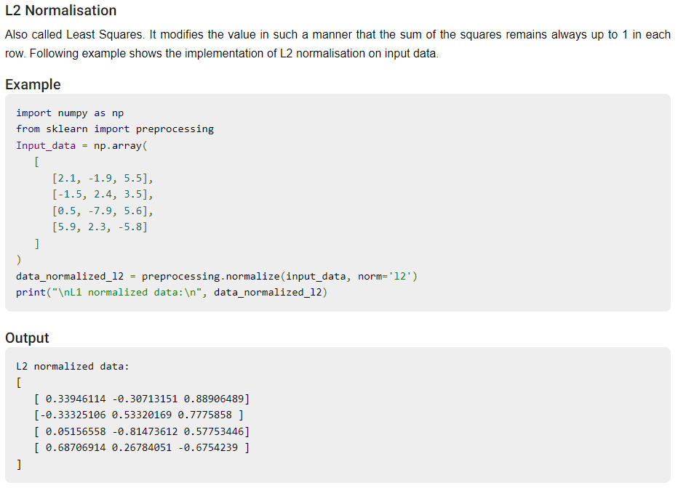

Slide 24
Scikit Learn - Data Representation

Slide 25
Data as table
The best way to represent data in Scikit-learn is in the form of tables. A table represents a 2-D grid of data where rows represent the individual elements of the dataset and the columns represents the quantities related to those individual elements.

Slide 26
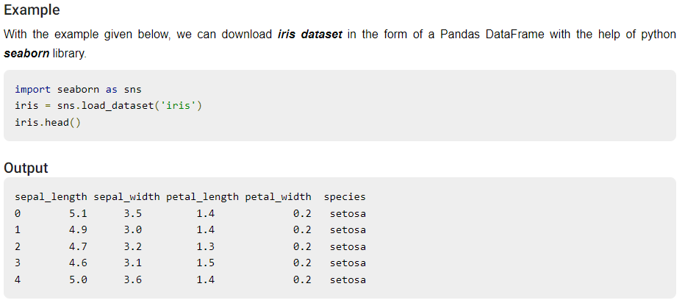

Slide 27
2. Data as Feature Matrix
Features matrix may be defined as the table layout where information can be thought of as a 2-D matrix. It is stored in a variable named X and assumed to be two dimensional with shape [n_samples, n_features]. Mostly, it is contained in a NumPy array or a Pandas DataFrame. As told earlier, the samples always represent the individual objects described by the dataset and the features represents the distinct observations that describe each sample in a quantitative manner.

Slide 28
3. Data as Target array
Along with Features matrix, denoted by X, we also have target array. It is also called label. It is denoted by y. The label or target array is usually one-dimensional having length n_samples. It is generally contained in NumPy array or Pandas Series. Target array may have both the values, continuous numerical values and discrete values.

Slide 29
