Slide 1
Scalable Sharded Blockchain Network
Author: Abdoul-Nourou Yigo, Haki Dehari
Presented by: Abdoul-Nourou Yigo, Haki Dehari

Slide 2
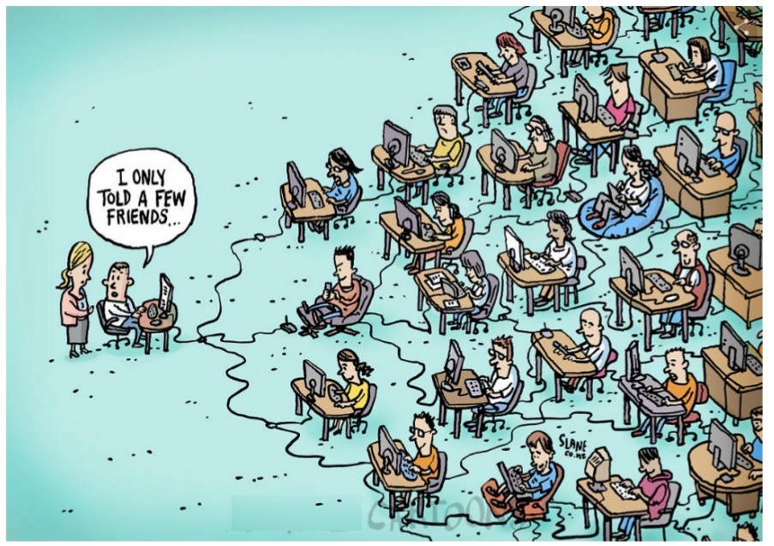
What is a Blockchain?
A Blockchain platform enables a decentralization of ressources
Peer to Peer Approach
Bitcion
Decentralized ledger
Smart Contracts
Immutable
Encrypted data
Time stamped
Cannot be chamged

Slide 3
Blockchain Usability
The phenomenon of Blockchain Technology could open a new era of digital communication
Sharpen users privacy in the Digital environment
Enabling transactions between organization without the need
Third party organizations
Businesses can interact with each other wihout worrying about trrust
Blockchain Consensual rules enable high trust
Could be used to improve some domain like
Supply chain Management

Slide 4
Why The need of efficient Blockchain Ecosystem?
The need of efficient Blockchain Ecosystem is essential to improve its effectiveness
The Bitcion network can only valid
3 to 7 transaction per second
Etherum network can only valid
7 to 15 validations per second
Visa and Mastercard perform than 5000 transactions
Per second
Why is that?
Proof of Work and Proof of Stake Algorithms
Require Significant amount of energy
Reduice effectivness of the Blockchain Platform

Slide 5
Different Concepts of a Blockchain Structures
Because of this scalability isssue scalable blockchain network need to designed by maintaining Blockchain properties ( Security and Decentralization )
The most Scalable Concept Researchers have been trying to implement is sharing
The Concept of “RapidChain”
In this architecture aims
Sharding of
Computation
Communication and Storage
Using PBFT

Slide 6
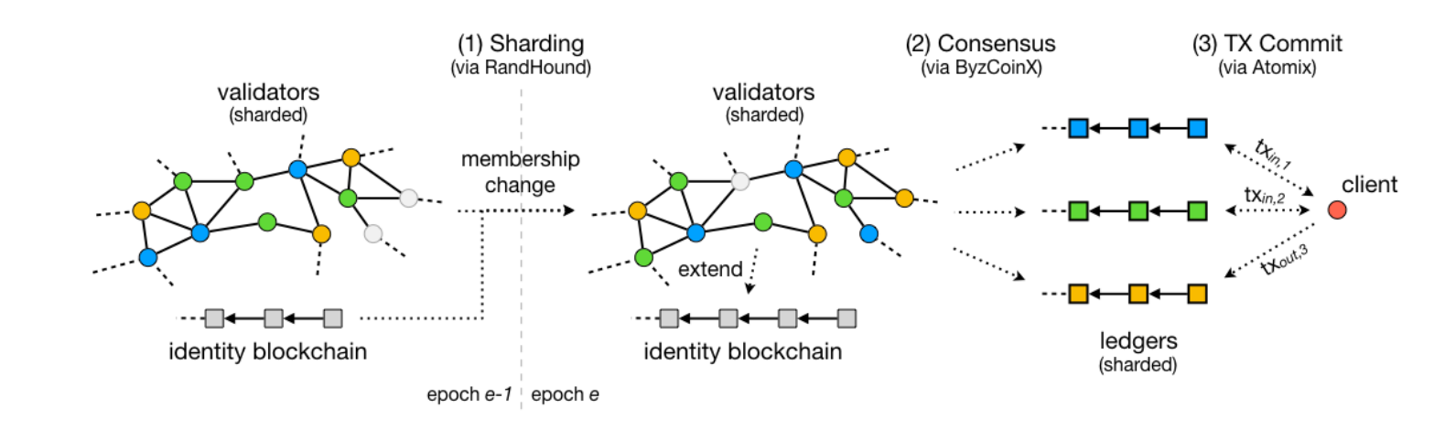
Different Concepts of a Blockchain Structures: OmniLedger

Slide 7
Conceptual Network Modelling
With the implementation of sharding described there is still a gap for improvement
The previous sharding concept suffers from
Deterioration of
decentralization
The effectiveness of the fault tolerance
They come out with another concept
Spontaneous Sharding
The logic behing Spontaneous Sharding
Nodes in the network would try to PROVE that their transactions
Is not double-spent
To minimize to transaction cost

Slide 8
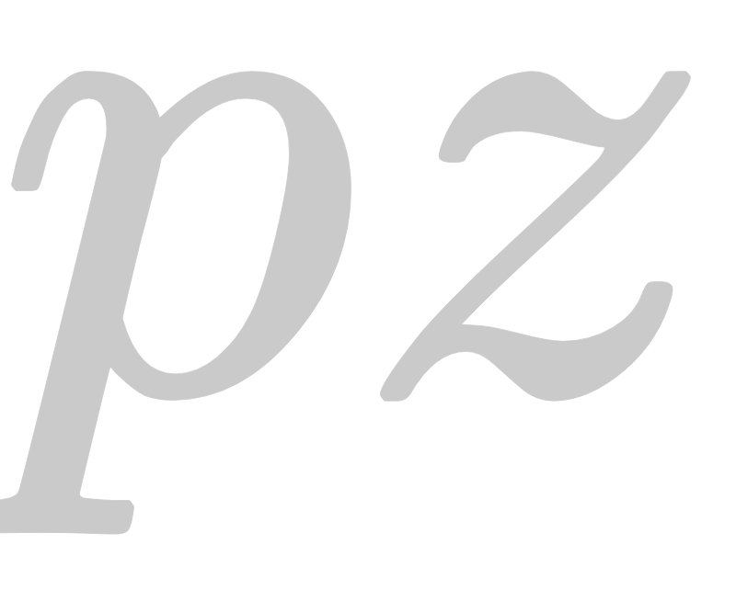
Conceptual Network Modelling
From the concept of proof at each node we have modelled with the following characteristics
We have modelled a directed Blockchain network
N nodes and M edges to stimulate CCPT within a shard
A shard would a collection of nodes
The nodes in the network would have proof sizes
Since we it is permissioned Blockchain Network
The nodes are supposed to be honest
There would be demand node and a supply node
The other nodes in the network would play as validators ( Transshipment Nodes )
The arc in the network would have the same transaction cost
Proof sizes would be randomly assigned to avoid baised properties
The Transaction trajectory would try to use
Transshipment nodes with small proof sizes

Slide 9
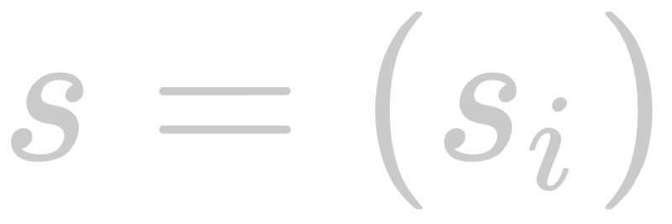

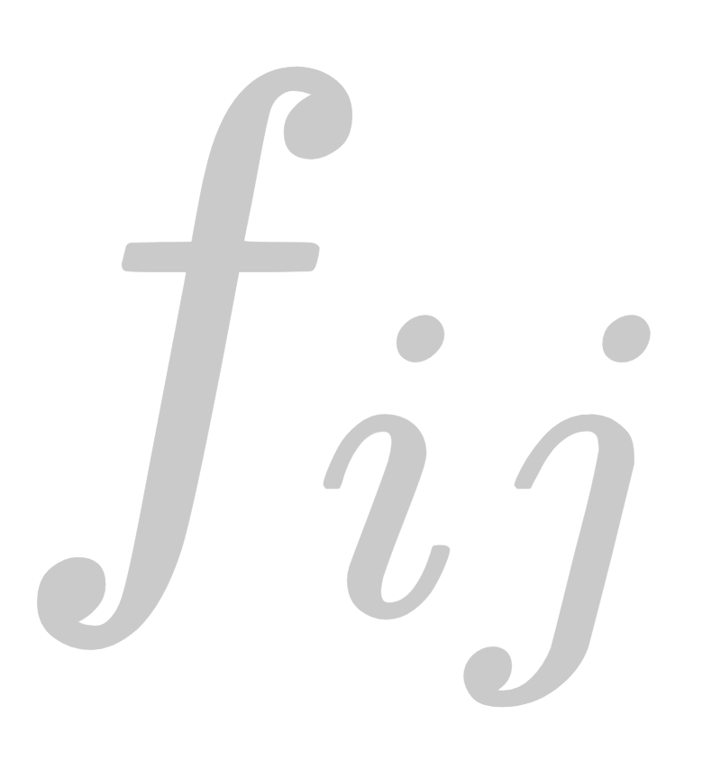

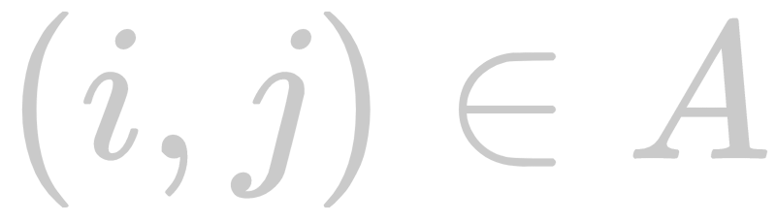
Network Flow Problem Formulation
With our conceptual approach we came out with an implementation model
Let V be a set of vertices and A be a set of arcs in the network
G( V, A ) is directed graph
A supply vector for
A fixed cost and proof size for
The desirable outcome for the model is to find a set
Of node with small proof size
To minimize CCPT
With the shortest path
The transshipment nodes would be represented by 1
And the other by 0
So MIP

Slide 10
What is Sharding?
Sharding is the concept of splitting the Blockchain network into different groups or “shards”
Sharding challenges
How can security be maintained within a shard?
How can decentralization be maintained within a shard?
How can fairness be maintained over the whole Blockchain if each shard is doing their own thing?
How can scalability and accuracy be assured?
Ethereum network

Slide 11
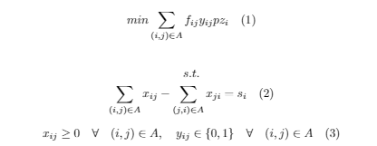
Network Model

Slide 12
Implementation
Network of 150 nodes randomly generated by a Python script we wrote
Random connections generated by the Python script between the nodes
The script made sure each node had maximum of 7 connections to other nodes
Incomplete graph
Proof size is taken into account when traversing the network
This is so the true lowest cost and shortest path possible is found

Slide 13
Implementation Continued
2 constraints as mentioned before
First ran the model on 15 different supply and demand nodes to test the model over the whole network
Implemented sharding
Network was randomly split up into 3 groups or “shards”
Ran the model on each shard

Slide 14
Challenges of Evaluation
Randomly splitting up the network in GAMS was hard
Had to ensure that there was a valid path to every node in each shard
Used the magic number 7
Connectivity on the nodes was maintained
Made sure connections only within the nodes of the shard were used for the tests
No modifications to the connections were made other than excluding the connections that did not exist within a specific shard

Slide 15
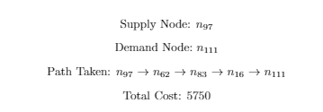
Evaluation
Ran 15 different test runs using the whole network

Slide 16




Evaluation Continued
Split the network up into the shards and ran the model on each shard

Slide 17
DEMO AND MODEL WALKTHROUGH

