Slide 1
Repliclade: A Simulator of sequence evolution in gene families
Presented by haki dehari

Slide 2

Introduction
DNA sequence evolution simulation is an ever-evolving field filled with different algorithms and programs which tackle the problem from a variety of different angles using various methods
There is a vital need for a program which consolidates various evolutionary principles and models to produce better results based on the specific user’s preferences
There are many different evolutionary models developed by experts over the years to incorporate elements of DNA sequence evolution
Whilst some are more accurate than others, it is important to allow the user to choose based on their preferences, since different types of genomes tend to evolve differently than others under various evolutionary forces

Slide 3
Introduction continued
Although direct observation is still the preferred method of sequence parameter extraction, there are also various ways to extract sequence characteristics via probabilistic and computational methods
By looking at orthologous or homologous genes which are related to the original sequence, one can extract various parameters such as mutation rate and effective population size using the aforementioned methods
There are not many tools or programs which currently do this, and one must dig through stacks of literature to isolate the best methods for sequence parameter extraction

Slide 4
purpose
Repliclade’s main purpose is to consolidate these evolutionary models and statistical methods of sequence parameter extraction while providing the user with the ability to simulate an ancestral sequence based on their choices for methods and evolutionary models
It hopes to provide a more accurate representation of DNA sequence evolution through the flexibility of user-controlled choices to better fit the original DNA sequence provided by the user
Also provides a tool for ancestral sequence inference based on Coalescence Theory using the existing BLAST algorithm

Slide 5
methods
Evolutionary models

Slide 6
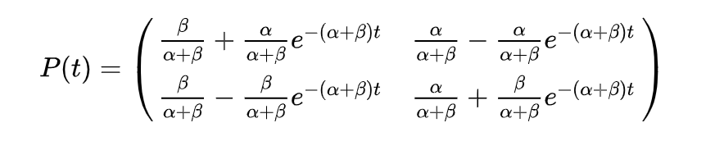
What is an evolutionary model
,
An evolutionary model is a probabilistic model used to derive probabilities of DNA sequence evolution
Most evolutionary models use a mathematical principle called Continuous Time Markov Chains or better known as Markov Models
Most evolutionary models use matrices as the physical representation of the probabilities of DNA sequence nucleotide mutation and these derived probabilities change as time progresses
Most evolutionary models compute the probability of a nucleotide base staying the same before computing the probability of a mutation
2 parameters to note:
t – unit of time
μ – mutation rate (sometimes denoted as α or ß)
Fig 1: An example of a physical representation of a Markov Chain where t is the changing parameter

Slide 7

Jukes and cantor 1969 (JC69)
Considered the simplest substitution model
Assumes equal base frequencies $π_{A}=π_{G}=π_{T}=π_{C}= .25$
Also assumes equal mutation rates µ
$P_{ii}=\frac{1}{4}+\frac{3}{4}e^{−tµ}$ (probability of non-mutation)
$P_{ij}=\frac{1}{4}−\frac{1}{4}e^{−tµ}$ (probability of mutation)
As we can see, there is a higher probability that a nucleotide base pair will stay the same

Slide 8


Kimura 2p model (k2p)
Very similar to JC69, but has different mutation rate values for transitions and transversions
What is a transition and transversion?
Purines (A, G)
Pyrimidines (C, T)
Transition is a mutation from Purine to Purine or Pyrimidine to Pyrimidine
Transversion is a mutation from Purine to Pyrimidine or vice versa
α is the mutation rate for transitions
ß is the mutation rate for transversions, usually anywhere from 3-4 times lower than α
Transversions are known to be less common than transitions
Figure 2: Probability of Transition in K2P model
Figure 3: Probability of Transversion in K2P model

Slide 9
Felsenstein 1981 model (f81)
To be continued

Slide 10
Repliclade

Slide 11

Introduction to repliclade
Written completely using the Python programming language
Incorporates the Biopython library as well as the numpy library for dealing with DNA sequences and the mathematics behind the evolutionary models, respectively
Utilizes the BLAST algorithm against GenBank to retrieve like sequences to the input sequence
After extracting sequence parameters via user input or probabilistic methods, simulates the ancestral sequence generated via Coalescence Theory
Terminates simulation upon sequence extinction or time exhaustion

Slide 12
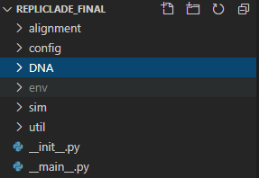
File system
Firstly, prompts the user whether they would like to use an input FASTA file which contains a sequence
This FASTA file must go in the “DNA” folder under the root program directory
The “DNA” folder is where the results from BLAST are also returned in XML format
In the config folder there is a config.py file
This file is where the user’s Genbank API credentials will go (to utilize the BLAST algorithm against Genbank)
Under the alignment folder are where the alignment output files are located, which is used to display the tree representation of the alignment
The sim folder houses the simulator.py file which completely controls the whole simulation portion of repliclade
The util folder is comprised of multiple utility Python files which perform the various tasks having to do with DNA sequences and evolutionary models
__main__.py is what kicks off Repliclade

Slide 13
Repliclade – Setting up the simulator
After kicking off the program, Repliclade will ask if you would like to use an input FASTA file
If selected Yes, it will then prompt you for the file name
After the input file is selected, Repliclade will run the input sequence against BLAST and Genbank to retrieve a list of similar sequences to the input sequence
Once the similar sequences are returned in XML format via BLAST on Genbank, Repliclade performs an alignment
The alignment is then displayed as an unrooted Phylogenetic tree

Slide 14
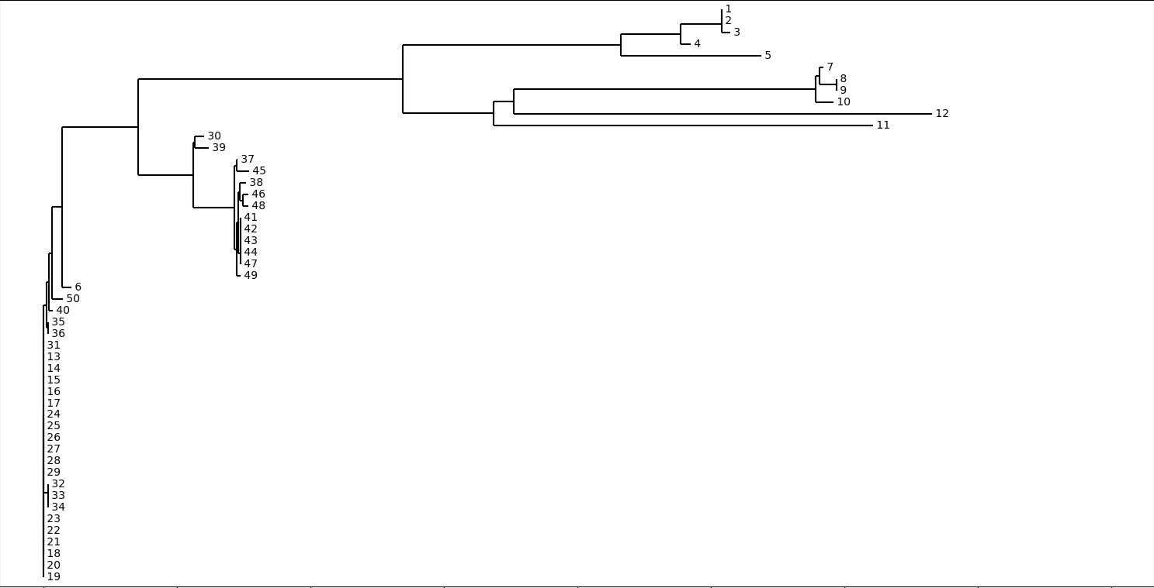
Figure 4: An example of an alignment output in Repliclade on 50 input sequences returned from Genbank via the BLAST algorithm

Slide 15

Repliclade – Sequence parameter extraction
Once the initial sequence setup is complete, Repliclade provides the user with a series of prompts to extract various DNA sequence parameters
This is a crucial process in Repliclade, as it provides the users with a series of values which will be useful during the simulation
The thought process behind these extractions will be discussed in the upcoming slides

Slide 16

Importance of aligned sequences
The alignment performed in Repliclade has a very important function. Not only does it provide a phylogenetic tree to visualize relationships between various sequences, but it also provides us with a list of “aligned” sequences
These aligned sequences help us utilize a top-down approach when dealing with sequences and are useful when trying to extract various parameters
They are incredibly important when trying to infer an ancestral sequence via a process called “The Coalescent”

Slide 17

The coalescent
Often referred to as a “backwards simulation”, the Coalescent is used to infer an ancestral sequence from a group of related sequences
One of the main assumptions of the Coalescent is that the sample size used to perform the backwards simulation is much smaller than the effective population size (more on this in a later slide)
This enables us to make educated inferences about population processes

Slide 18
Repliclade – implementation of coalescent
Repliclade implements a variant of the Coalescent to infer an ancestral sequence which will be used for the simulation
The process used in Repliclade is as follows:
Start with i = n lineages/sequences
Choose two sequences at random to coalesce
Merge the two sequences selected and set i = i – 1
If i > 1, keep performing the above steps until an ancestral sequence is derived

Slide 19


Repliclade – Estimating effective population size
Another crucial parameter for Repliclade is the effective population size
The effective population size can be defined as the number of individuals in a population who contribute offspring to the next generation
We will denote the effective population size by $N_{e}$ from here on out
It is considered to be one of the most crucial parameters in Population Genetics and Conservation Biology
To estimate population size, we must be able to satisfy the equation $θ=4N_{e}μ$
µ is the mutation rate as described in earlier slides and theta is considered a measure of genetic diversity

Slide 20


Estimating θ – watterson method
Repliclade currently uses a process called the Watterson Method which is used to estimate $θ$
The Watterson Method equation is set up as follows:
$θ_{w}=\frac{K}{α_{n}}$
K is the number of segregating sites
A segregating site is a site in the DNA sequence where the nucleotide base pair differs from one sequence to another or between multiple sequences
$α_{n}$ is the n-1th harmonic number or $\sum_{k=1}^{n−1}{\frac{1}{k}}$ where n is the number of sequences
Repliclade determines whether a site is a segregating site using the aligned sequences
Requires a threshold of under 90% to be considered a segregating site across all aligned sequences

Slide 21


Back to effective population size
Once $θ$ is derived, we can go back to the original equation and figure out the effective population size
The user will get prompted to enter a value for µ or use a default value of 0.00001
Now that we have all the variables required, Repliclade can derive $N_{e}$ from:
$N_{e}=\frac{θ}{4μ}$
Repliclade is now able to use $N_{e}$ in its calculations

Slide 22


Estimation of coalescence time
Using $N_{e}$, Repliclade can estimate an age for the ancestral sequence derived
The assumption of the Coalescent is that with each sequence merge, time for another Coalescent event will get longer
Now that we have acquired a value for $N_{e}$, we can derive the ancestral sequence age by using these simple equations:
Estimate for time to a specific coalescent event $t=\frac{4N_{e}}{i(i−1)}$ where i is the current number of sequences left
Estimate for total time to ancestral sequence coalescence then becomes $T=\sum_{k=2}^{i}{\frac{4N_{e}}{k\left(k−1\right)}}$

Slide 23

Finding conserved regions (In Progress)
Repliclade will have the ability to identify conserved regions within the ancestral sequence
This will be derived from the original group of sequences
The simulation will prompt the user whether they would like to take the conserved regions into consideration when considering mutations
Will use a “sliding window” approach to determine regions of the DNA sequences which look to be conserved by comparing them to a threshold

Slide 24

The Simulation

Slide 25
Kicking off the simulation
Now that the parameters are extracted and the ancestral sequence has been derived, Repliclade will prompt the user for how many generations they would like to run the simulation for
Next, Repliclade will prompt the user to ask them which evolutionary model they would like to use when simulating mutations and the evolution of the ancestral sequence and will provide a list for the user to choose from
(In Progress) Repliclade will then prompt the user whether they would like to consider conserved regions when running the simulation
(In Progress) Finally, Repliclade will prompt the user for a duplication rate for the DNA sequence

Slide 26
Evolutionary models in the simulator
Evolutionary models are contained as classes in the util folder under the evolve.py file
Each model has its own class associated with it for easy separation
For every sequence, there is an evolutionary model object attached to it which keeps track of the time elapsed for that specific sequence as well as the current Markov Model associated with the sequence
This is important since Continuous Time Markov Chains are time dependent and due to that are varied in values depending on when the sequence was duplicated or created
After a sequence is done potentially mutating, the model increments the time variable and re-calculates the probability matrix

Slide 27
The simulation process
The simulation will run over the user-specified number of generations
Sequence number can change generation by generation due to sequence duplication or extinction
For each sequence in the current generation, a probability for duplication, extinction, and indel events will be calculated
An indel is an insertion or deletion in the genome or sequence
Happen far less often than SNP’s (Single-Nucleotide Polymporphisms or base pair substitution mutations on a single nucleotide)

Slide 28
Simulation Iteration process
For each generation, the previously described probabilities are calculated
Currently, only one operation per sequence is allowed per generation
If none of the probability rolls for duplication, extinction, and indel events are met, then the current sequence in the simulation is ran through the chosen evolutionary model where it will mutate (or not)
Each generation is saved to a Python dictionary
The plan is for the user to be able to access each sequence during whichever generation they choose post simulation to compare results during whatever step in the simulation they choose
They will also be provided the option of saving the Python dictionary to a file in JSON format which can be used to look at the results later

Slide 29
demo

