Slide 1
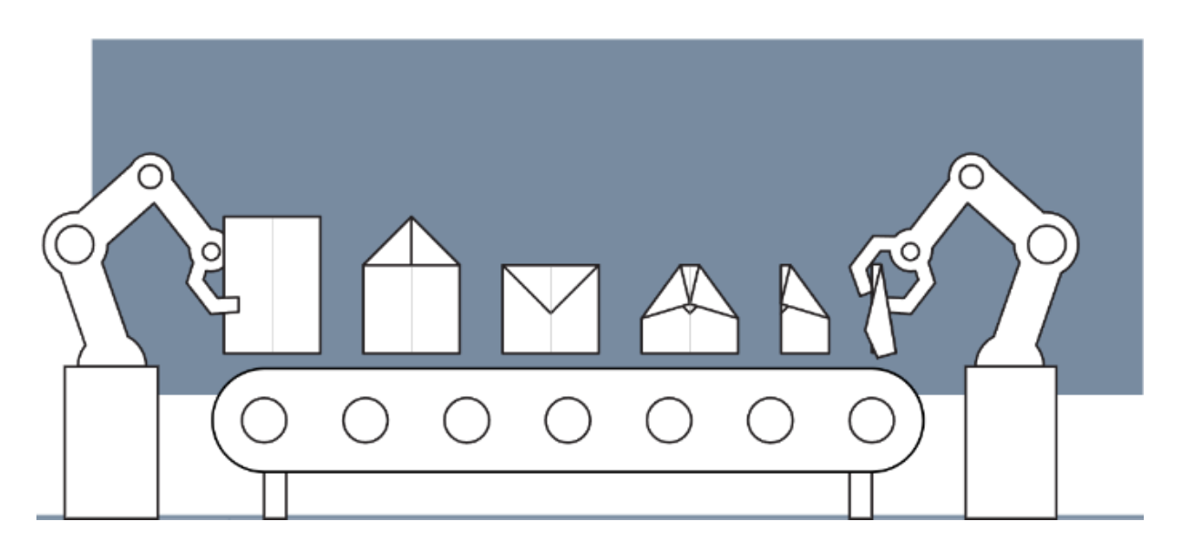
Design of Cyber-Physical Systems in Manufacturing
Development of a Digital Twin for a Robotic Paper Plane Production Line
Twente, 10.12.2024
Merve | Yating | Lukas | Shashang | Aly | Dogukan | Hakim

Slide 2
Agenda
What is a Digital Twin?
Definition and Concept
Discrete Model
Structure and Function
Current State
As Is State
Project Plan
Activity Diagram
MATLAB Simulation
Where Do We Want to Go?
Long-term Goals and Vision
Necessary Steps to Achieve the Goals

Slide 3
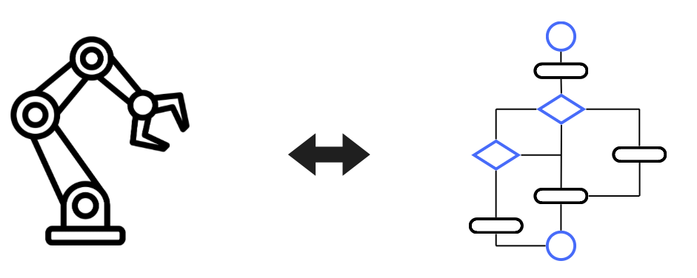
1. What is a Digital Twin?
Physical model
Simulation model
Conveyor belt motion
Trigger of sensors
Activity diagramm
Simulink simulation
Multibody Simscape

Slide 4
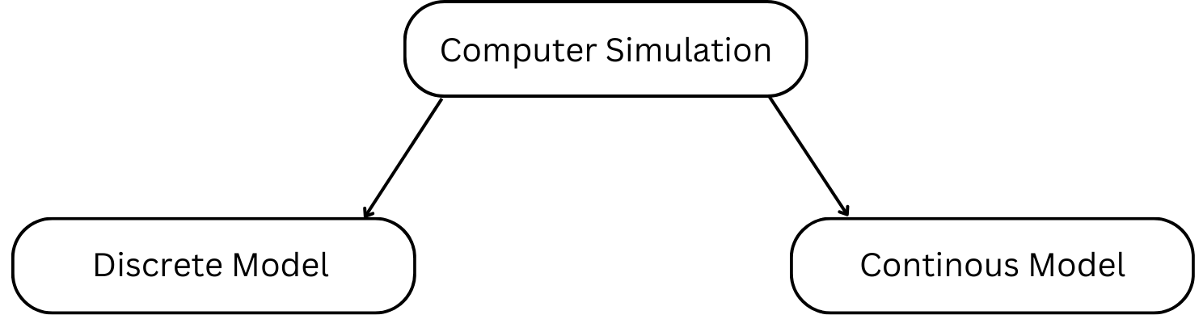
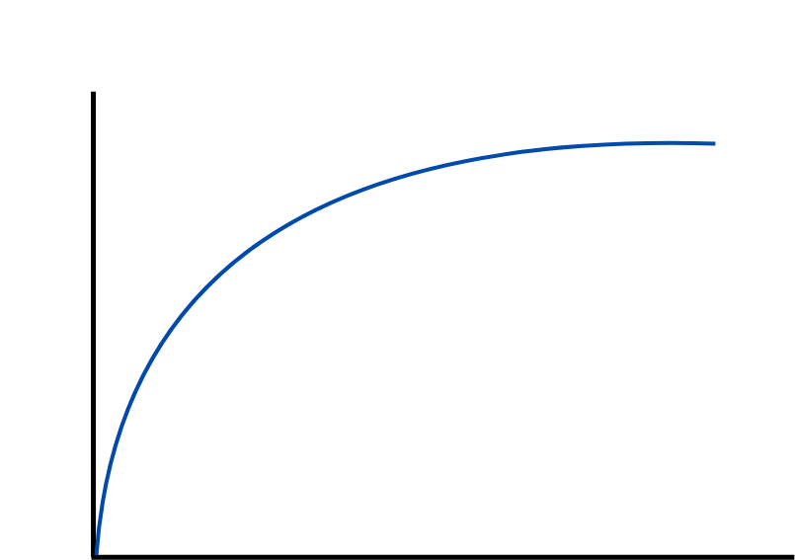
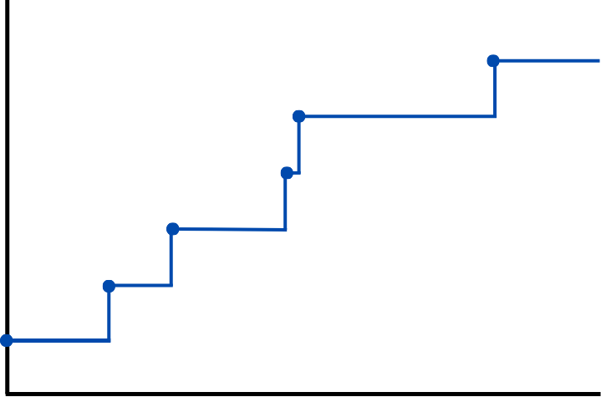
2. Discrete Event System

Slide 5
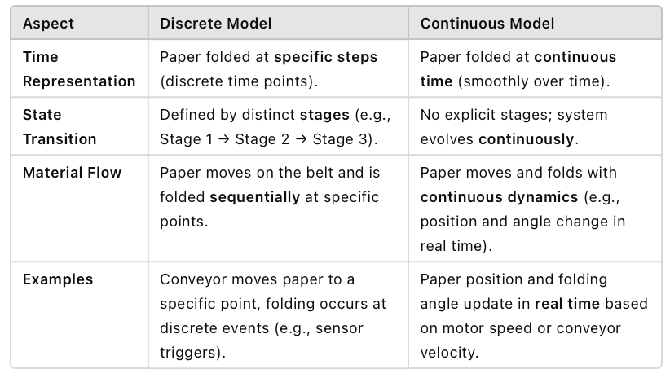
Discrete Event System vs. Continuous Model

Slide 6
3. As Is State: Project Plan

Slide 7
3. As Is State: Activity Diagram

Slide 8
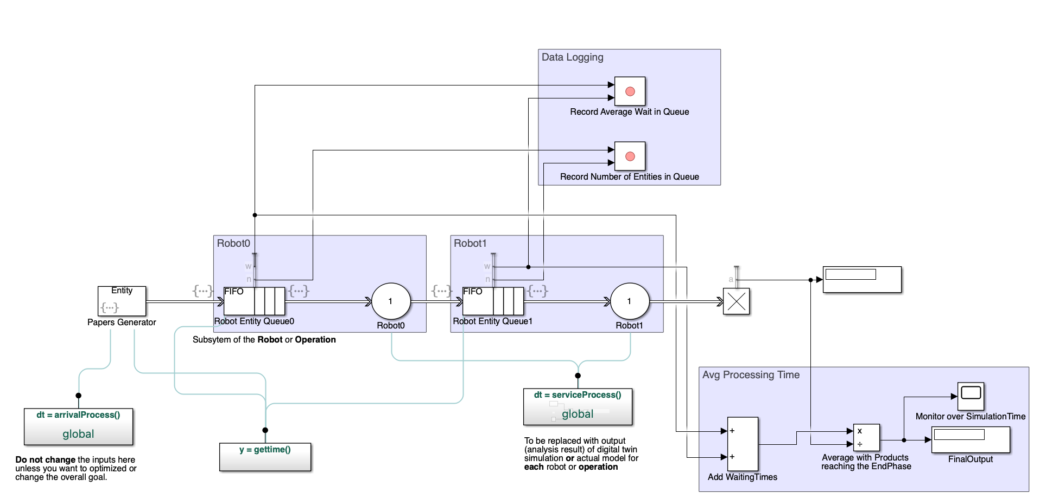
3. As Is State: MATLAB Simulation

Slide 9
Conclusion
Input on the sensors | 1.Position and Motion Sensors 2. Force and Pressure Sensors 3. Speed Sensors 4. Environmental Sensors 5. Error Detection Sensors
2. CAD Model

