Slide 1
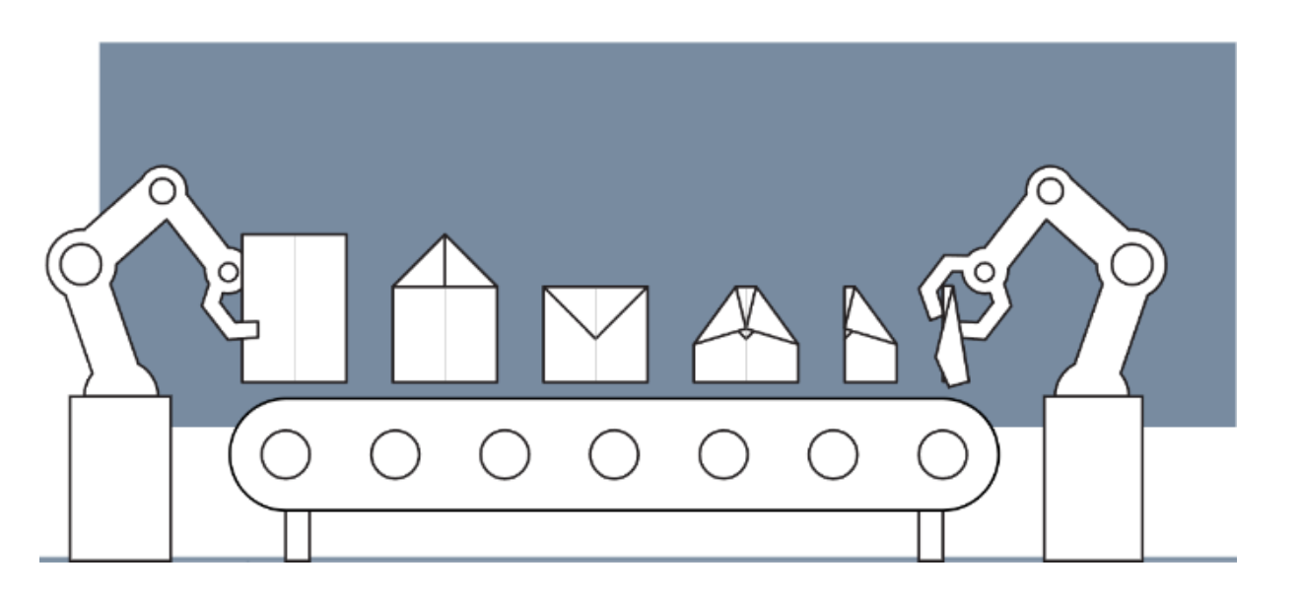
Design of Cyber-Physical Systems in Manufacturing
Development of a Digital Twin for a Robotic Paper Plane Production Line
Kaiserslautern, 29.12.2024
Lukas | Hakim

Slide 2
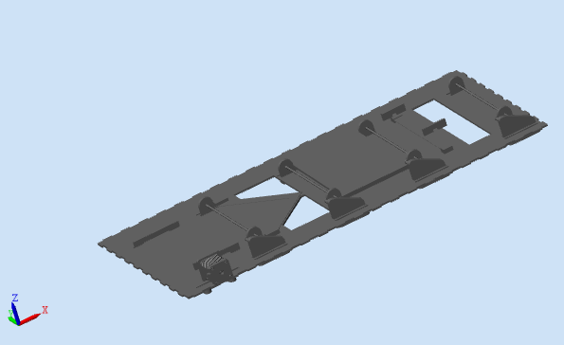
3D Model in Simscape : Baseplate

Slide 3
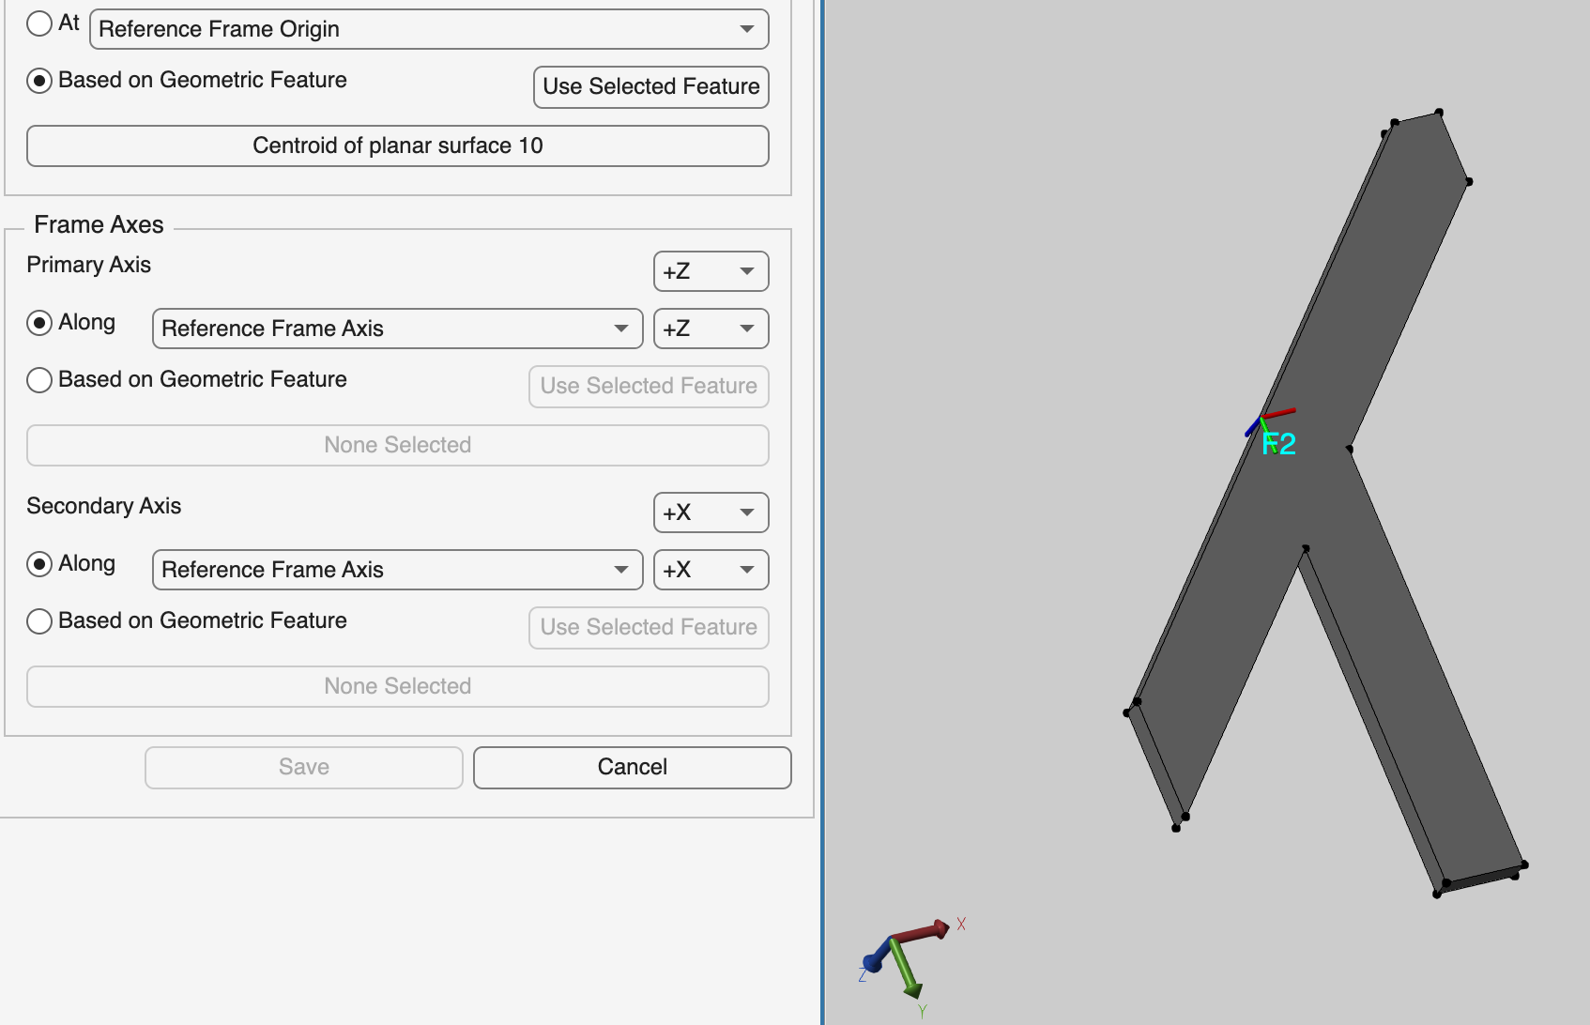
3D Model in Simscape : Moving Components
4 Rollers: Roller 1, Roller 2; Roller 3; Roller 4
2 Flippers: Flipper py; Flipper ny
Paper

Slide 4
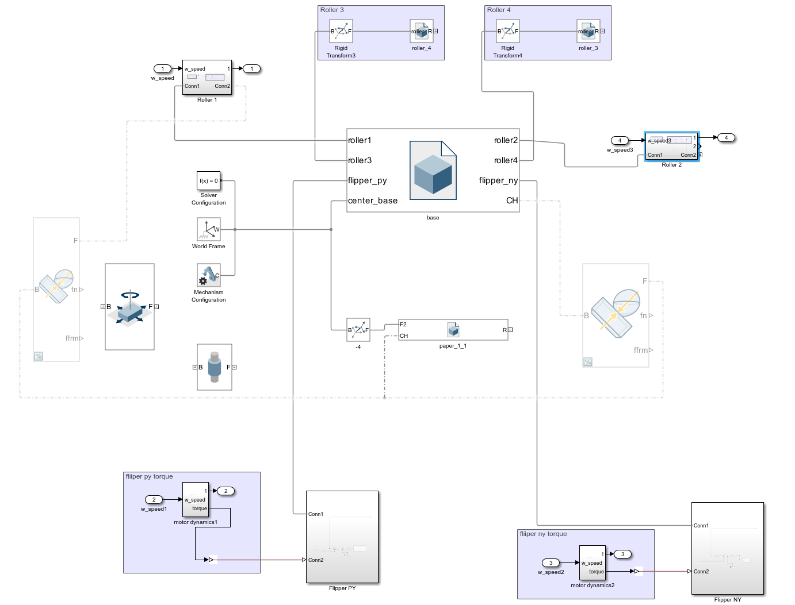
Overview Simulation: Folding Step 1

Slide 5
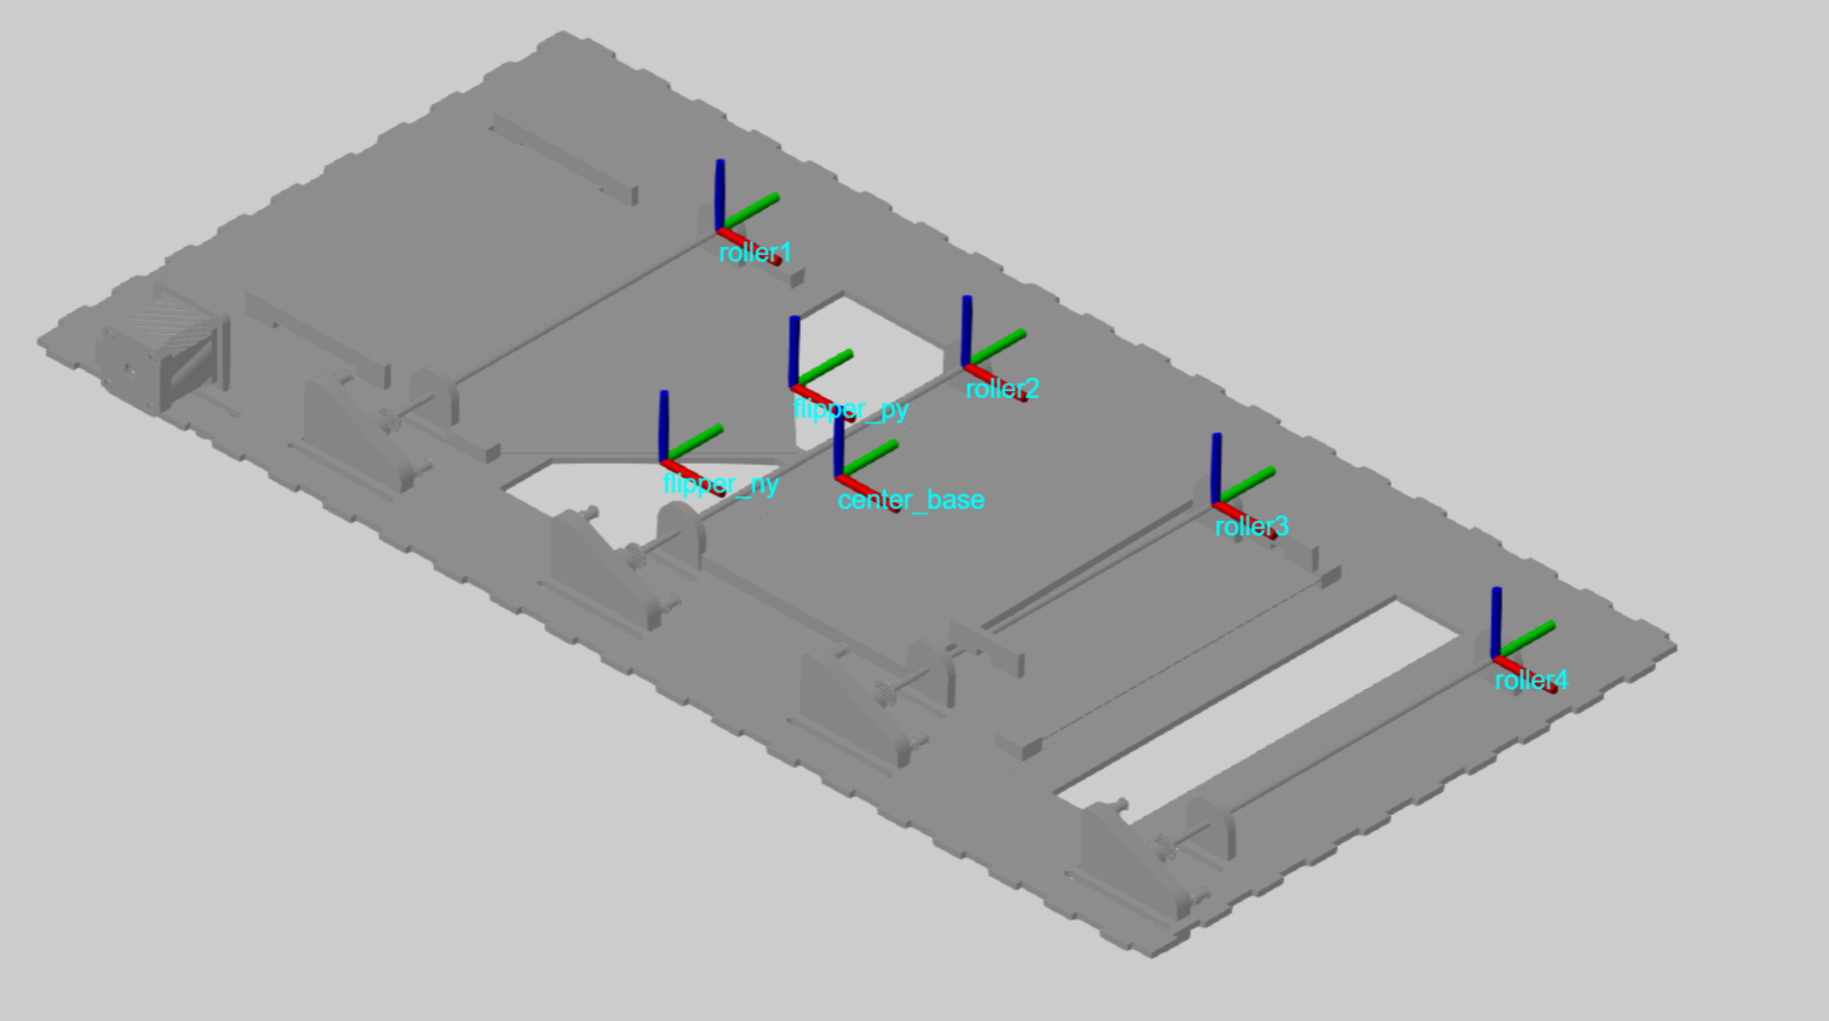
Overview Simulation: Base Plate with Coordinate Systems

Slide 6
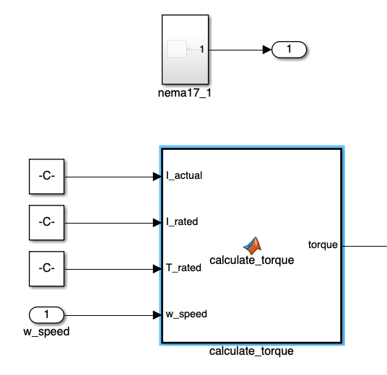
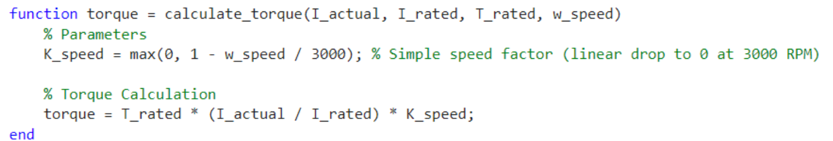
Motor Simulation: Folding Step 1
Matlab Function Block:
Parameters

Slide 7
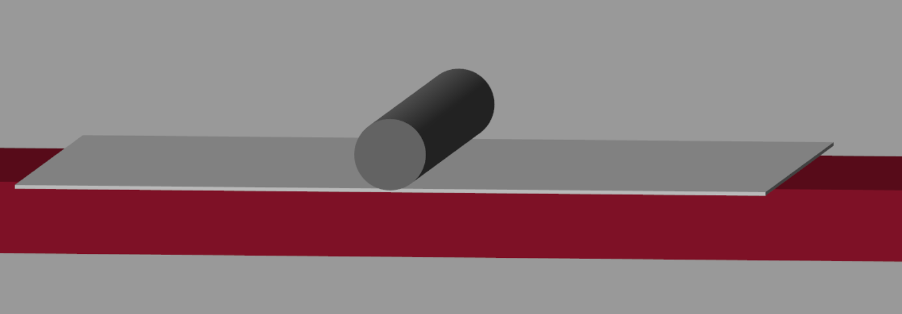
Simulation: Transportation of the Paper
Focus on important parts: Behaviour between rollers, paper and the base plate.
Simulate various scenarios (e.g. angled sheet of paper -> paper could get stuck)

Slide 8
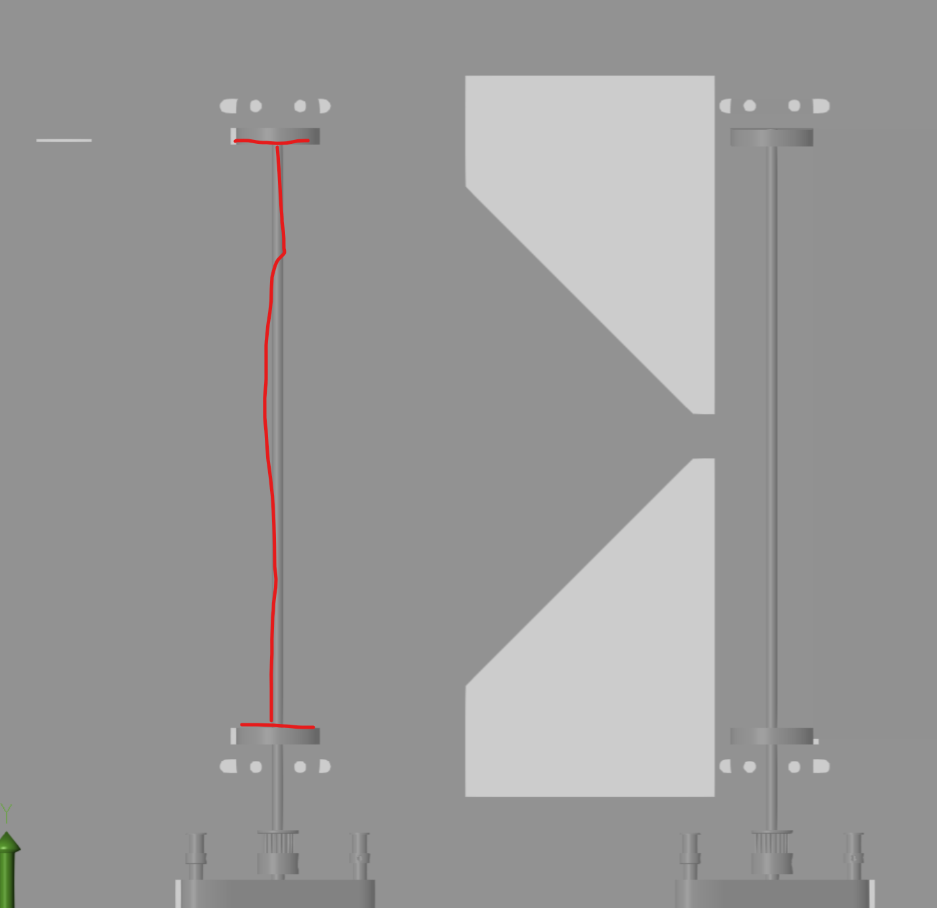
Simulation: Input needed
Roller design and parameters
weight of the roller
dimensions
width of space between the roller-holders (picture on the right)
also for the “bridge” of the robot if it is different
frictional coefficients paper-roller/ paper-base plate (static/dynamic)

Slide 9
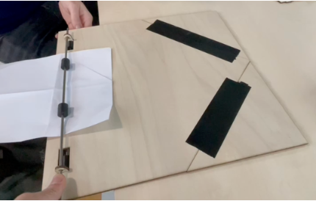
Friction Coefficient between paper and floor : µ_{PF}
Friction Coefficient between roller and paper : µ_{RP}

Slide 10
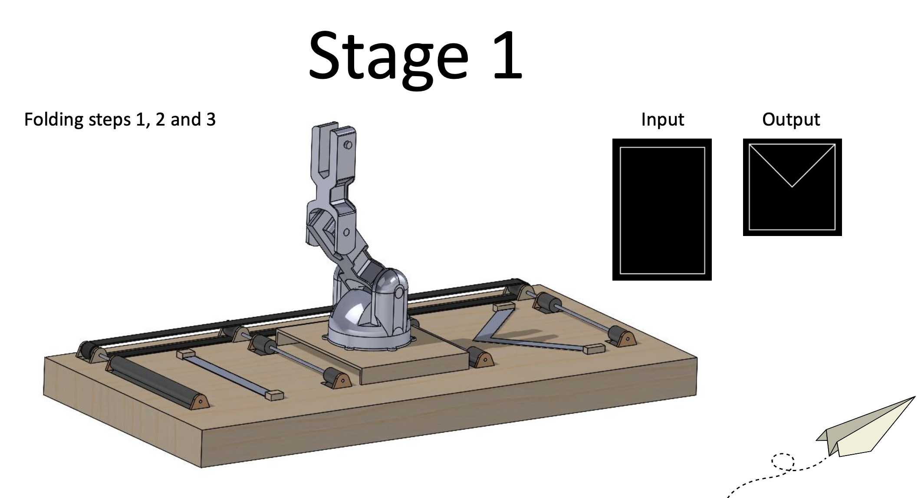
Parameters needed from UT: Folding Step 1
Physical Parameter Verification
Verify that the parameters used in the simulation accurately represent the physical system:
Motor Parameters: Measure or refer to the motor's datasheet for:
Torque constant kt
Back EMF constant ke​
Resistance R
Inductance L
Inertia Jm

