Slide 1
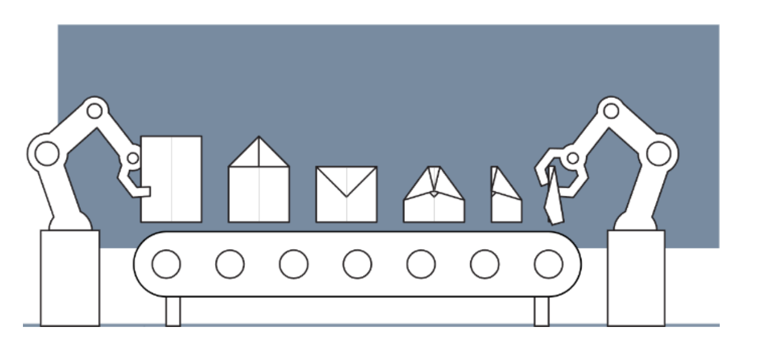
Design of Cyber-Physical Systems in Manufacturing
Development of a Digital Twin for a Robotic Paper Plane Production Line
Twente, 10.12.2024
Merve | Yating | Lukas | Shashang | Aly | Dogukan | Hakim

Slide 2
Agenda
What is a Digital Twin?
Definition and Concept
Discrete Model
Structure and Function
Current State
As Is State
Project Plan
Activity Diagram
MATLAB Simulation
Where Do We Want to Go?
Long-term Goals and Vision
Necessary Steps to Achieve the Goals

Slide 3
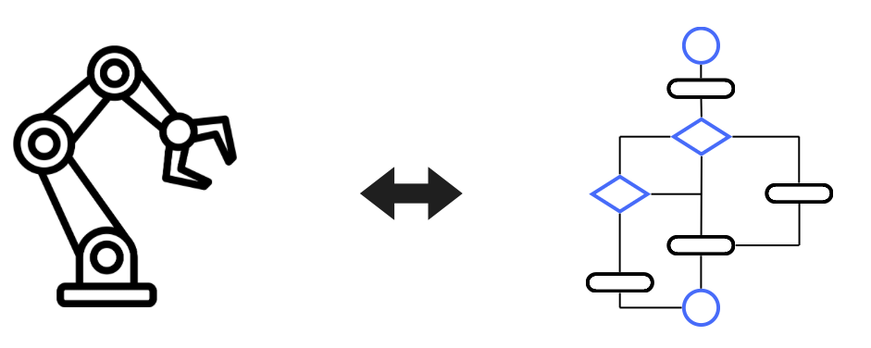
1. What is a Digital Twin?
Physical model
Simulation model
Conveyor belt motion
Trigger of sensors
Activity diagramm
Simulink simulation
Multibody Simscape

Slide 4
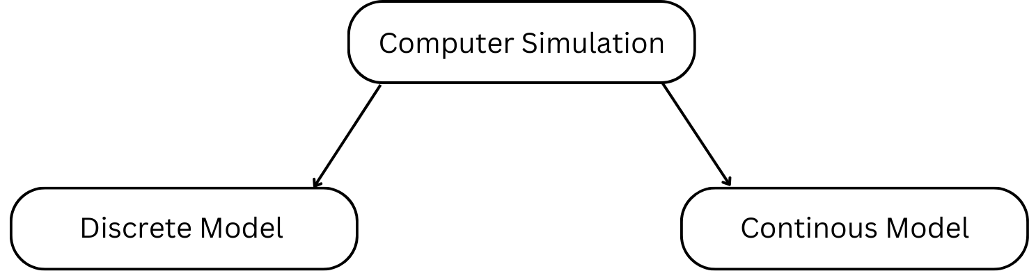
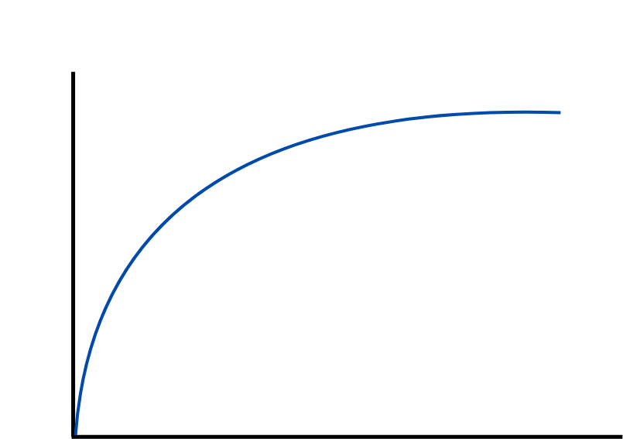
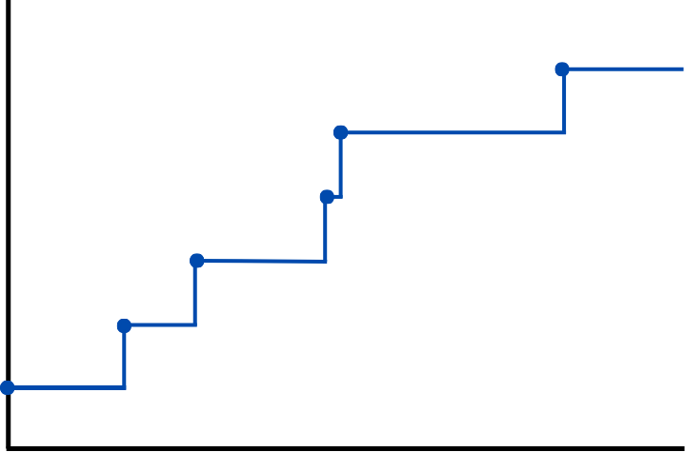
2. Discrete Event System

Slide 5
3. As Is State: Project Plan

Slide 6
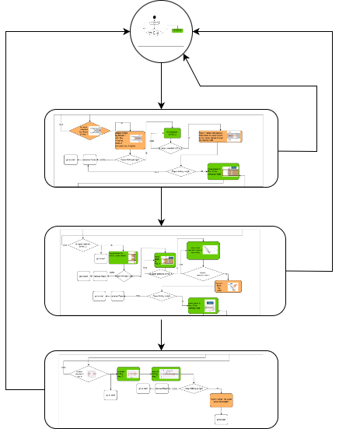
3. As Is State: Activity Diagram
Start
Github: DCS-RPTU-Twente/src/activity_flow_UT_concept.pdf at RPTU · hakim-code/DCS-RPTU-Twente
Stage 1
Stage 2
Stage 3

Slide 7
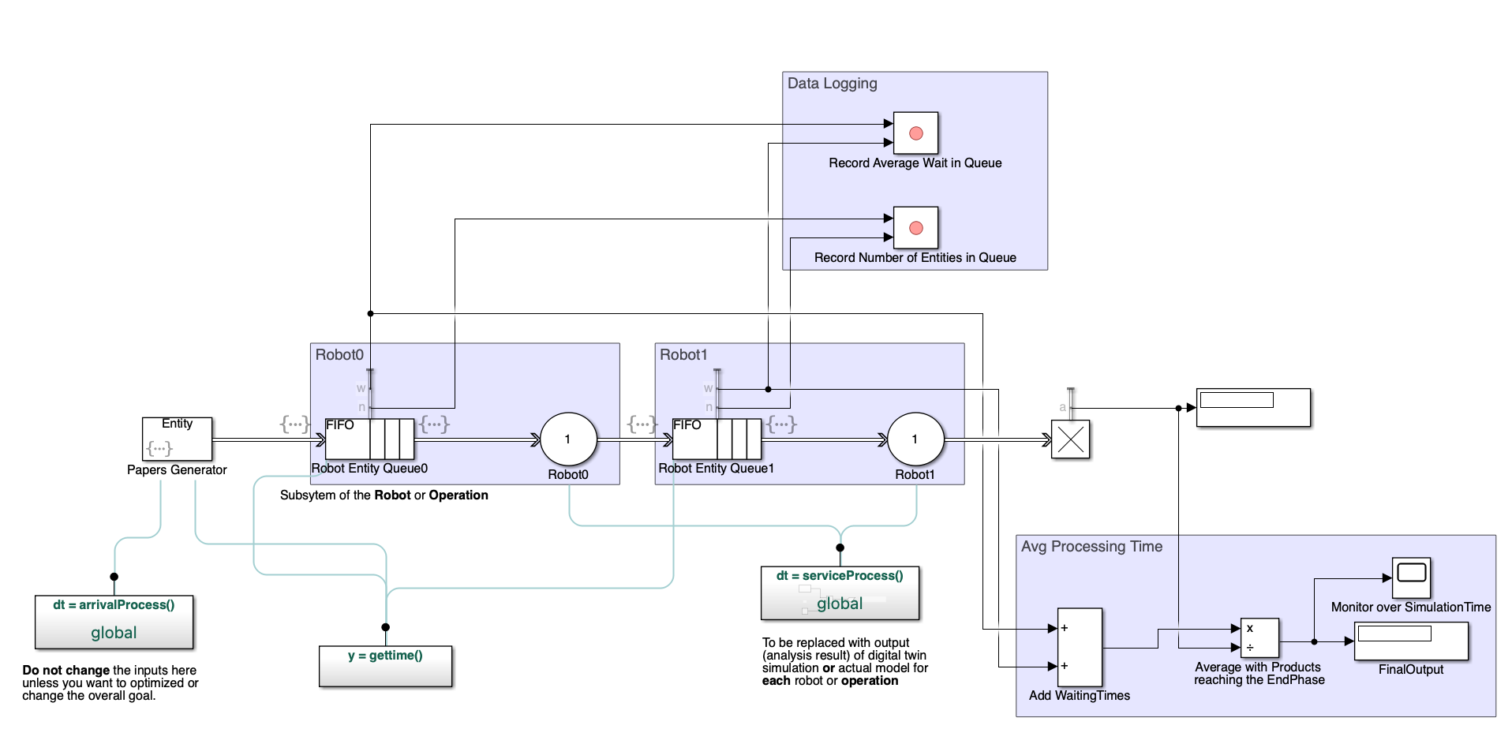
3. As Is State: MATLAB Simulation

Slide 8

3. As Is State: MATLAB Simulation
Time
 | ProcessingTimeArray0 | ProcessingTimeArray1 | waitTimeArray0 | waitTimeArray1
1 | 1.2292 | 1.0350 | 0 | 0
2 | 3.2987 | 0.3890 | 0.2292 | 0
⋮ | ⋮ | ⋮ | ⋮ | ⋮
84 | 0.2134 | 2.7117 | 6.7399 | 7.1484
85 | 0.7366 | - | 5.9533 | 9.1235
⋮ | ⋮ | - | ⋮ | -
89 | 1.1406 | - | 4.4385 | -
90 | 2.8739 | - | 4.5791 | -
91 | - | - | 6.4530 | -
Entity

Slide 9
3. As Is State: MATLAB Simulation
Needed input data from UT:
the action of each folding step
wie lange dauert jede folding steps(1-7)
-> klar definieren, welche Aktionen zu welchem Step gehören. (inwelchem Step wird gefaltet und in welchem Step wird paper transporniert)?
time of each action(transport/ folding/error action)
the solution of error action(our thought, also in activity flow: remove the paper), what is the thought of UT?
how to generate the paper(our thought, also in activity flow: human put it?)
define, when a new process begin, which parallel to another process
sensor-type: exact bezeichnung von sensor.
which sensor daten are really important for us?
conveyor belt? wie betreiben? wie erkannt zu stoppen, anzumachen?
Expected output from simulation:
die gesamte Bearbeitungszeit für eine große Menge Produktion schätzen.
vorhersehen, ob die Bearbeitung mehrere Papier parallel in jede Stage realisierbar ist.

Slide 10
Conclusion
1. Input on the sensors | 1.Position and Motion Sensors 2. Force and Pressure Sensors 3. Speed Sensors 4. Environmental Sensors 5. Error Detection Sensors
2. CAD Model

